Slide 1

Welcome to today’s class

Slide 2


Teacher’s Identity
Md. Azim Uddin
Latifpur Government Primary School.
Sitakund, Chattogram.
E-mail: azimsitakund2012@gmail.com.

Slide 3


Lesson identity
Subject: English
Class: Five
Unit: 13, Quality Time Together
Activity: 1.1
Page: 69 - 70

Slide 4

Learning outcomes
Student’s will be able to
4.2.1 Read aloud texts with proper stress, intonation.
5.1.1 Comprehend and express the meaning and uses of familiar words.
5.1.4 Get the general ideas from simple texts.

Slide 5
Review of the prior knowledge
Do your parents have mobile or laptop at your home?
When do you use it?
How long do you use it?
Does it disturb your sleep or keep you away from your friend?

Slide 6
Merits and demerits of using
mobile phone
Merits | Demerits
You can talk to anyone quickly. You can study online and learn many things. You can send messages and use the internet. You can take photos and videos | It wastes your precious time. It takes away your sleep and harms your eyes. It’s affected your school work and keeps you away from your friends. It distracts us from study.
We are going to read a story about the uses of a digital device.

Slide 7
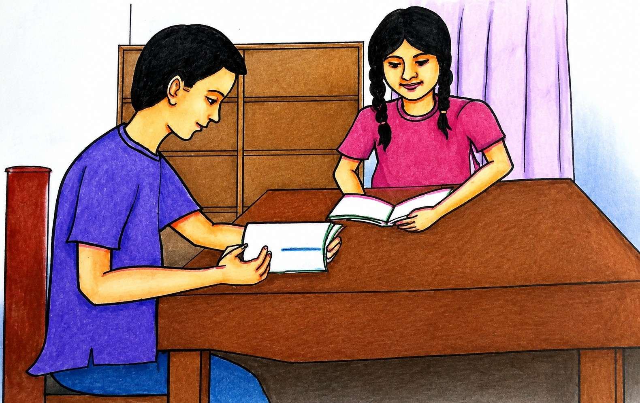
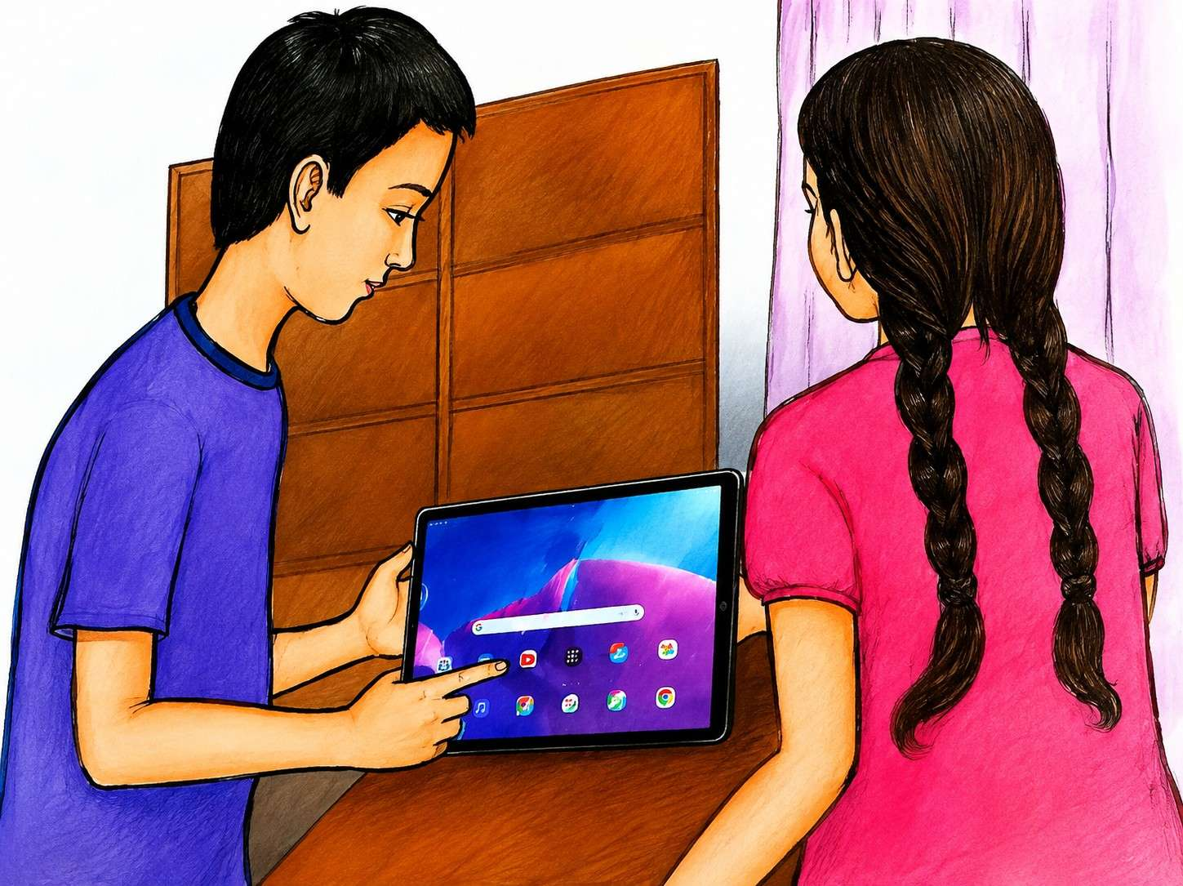
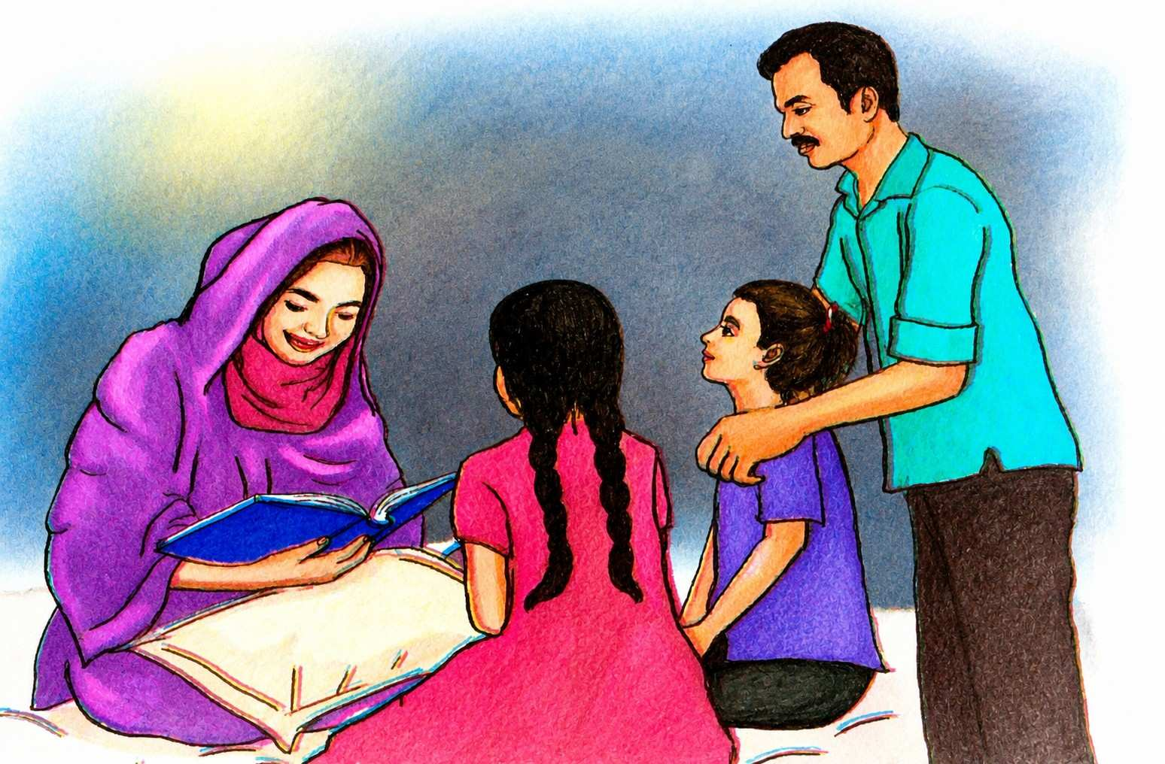
What do you see in the picture
Describe the pictures -
In the first picture I can see they are reading.
Second picture they use a device names tablet.
And third picture all family members sit together and enjoying funny stories.

Slide 8

Title of the lesson
We are going to read a text names
Quality Time Together

Slide 9

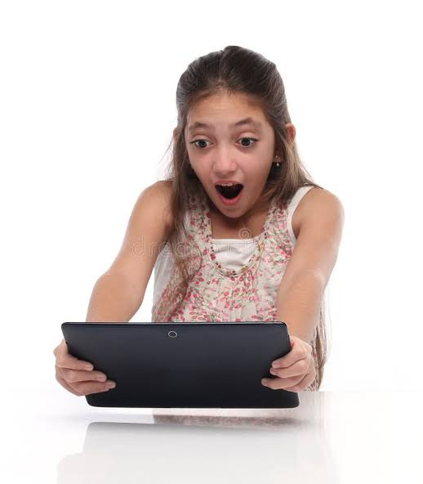
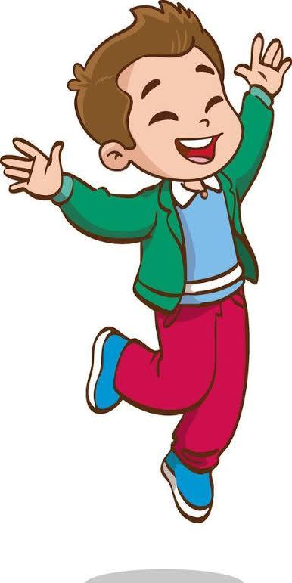
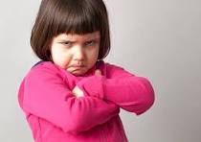
Free – teach the new words
Two children born at the same time to the same mother
Twins
Feeling astonished
Surprised
Something causing strong feelings of happiness
Exciting
Causing slight anger
Annoying

Slide 10
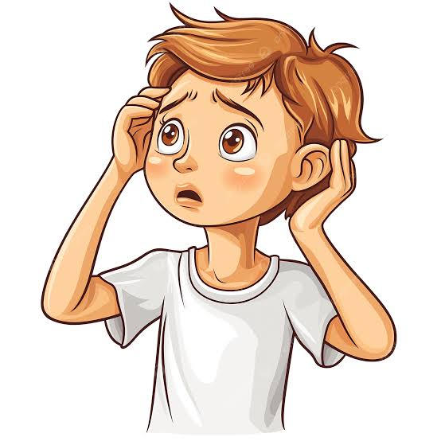
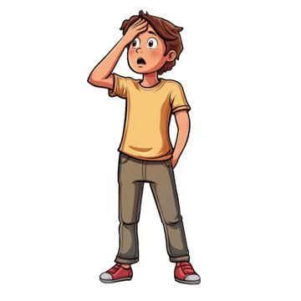
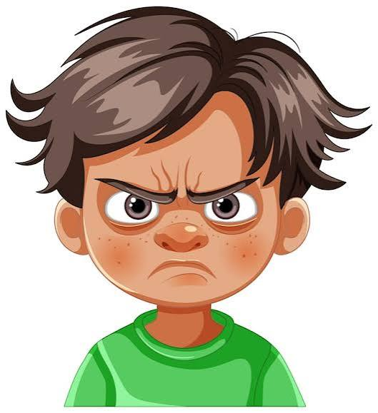
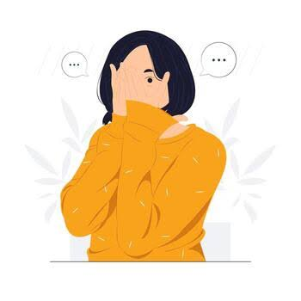
Free – teach the new words
worried
Feeling anxious
Realized
To become fully aware
Grumpy
Easily annoyed or unhappy
To feel bad or embarrassed about something
Ashamed

Slide 11
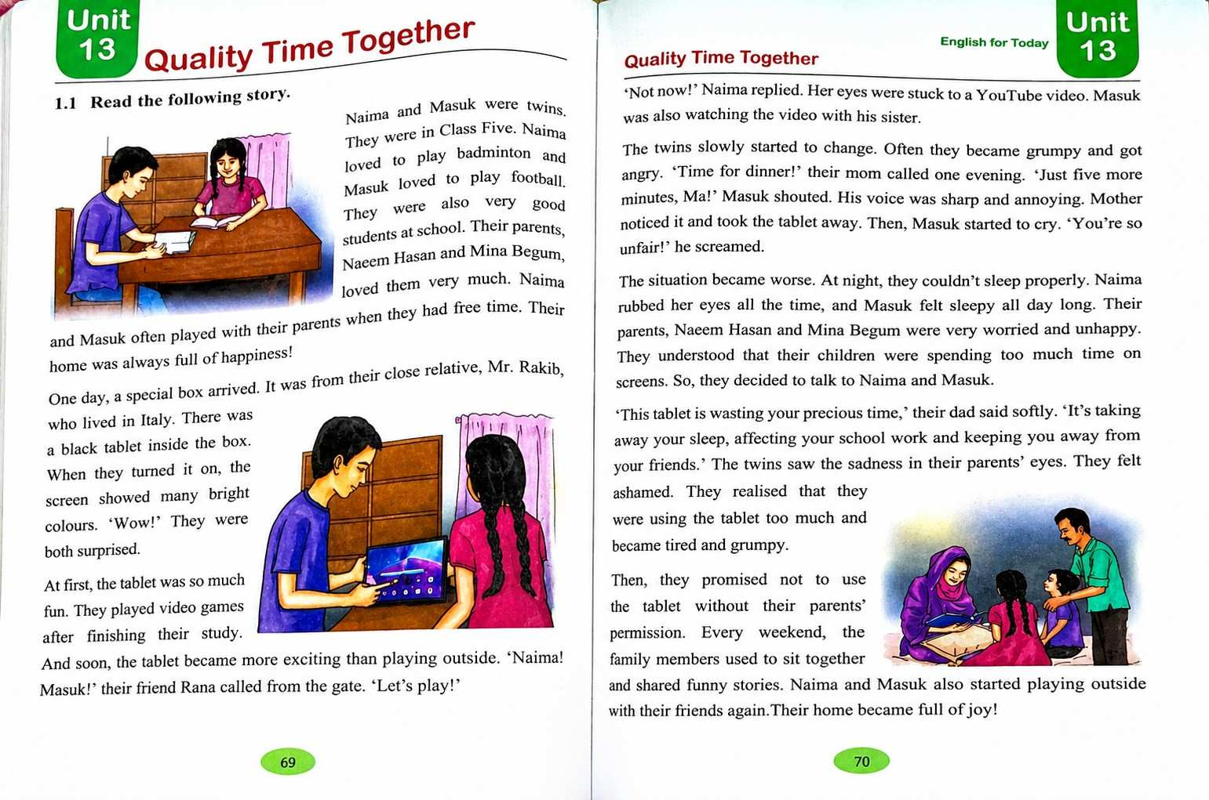

Teacher’s loud reading

Slide 12


Students will read one by one in the group

Slide 13
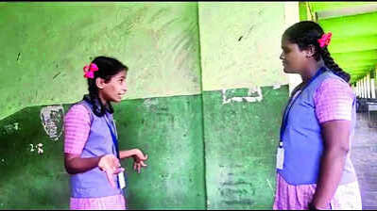
Practice activities
Look at the board
Think about the questions while reading the story.
1.What do Naima and Masuk do in their free time?
2.Where did Mr.Rakib live?
3. Why were Naima and Masuk surprised when they turned on the tablet?
4. What were the main problems faced by Naima and Masuk using thetablet too much?
Ask the questions to your partner and discuss

Slide 14
Assessing learning
What do Naima and Masuk do in their free time?
Where did Mr. Rakib live?
Why did the situation become worse?
What did they promise to their parents?
Ask the following questions randomly

Slide 15
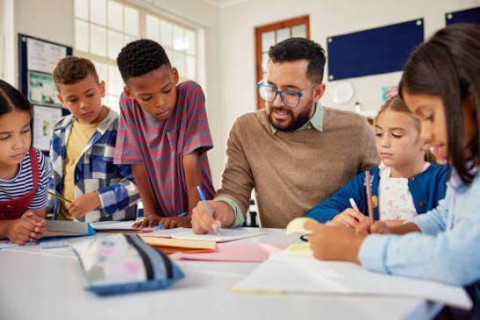
Feedback
I will support the students during the class who cannot re
I will support the students during the class who cannot read aloud the text properly.
d the conversation properly.

Slide 16
Summary of the session
What have you learnt today?
Ans: We have learnt the uses of digital devices.

Slide 17

