Slide 1


Slide 2
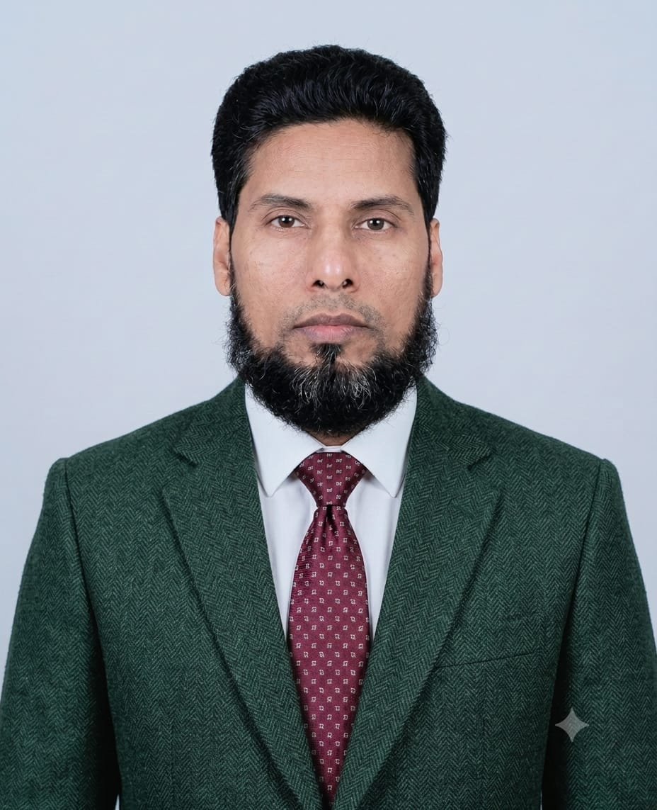
Teachers’ Identity
Mohhamad Abdul Kadir
Assistant Teacher
Mirshikari govt. Primary School.
Homna, Cumilla.

Slide 3
Lesson Introduction
Class :5
Unit :13
Title : Quality Time Together (1.1)
Page : 69,70

Slide 4
Learning Outcome:
4.2.1- Read aloud texts with proper stress, intonation
5.1.1- Comprehend and express the meaning and uses of familiar words.
5.1.4- Get the general ideas from simple texts.

Slide 5
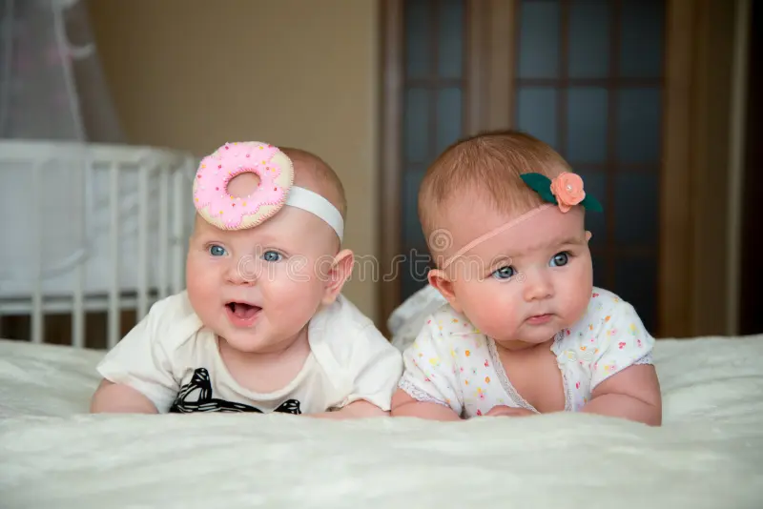
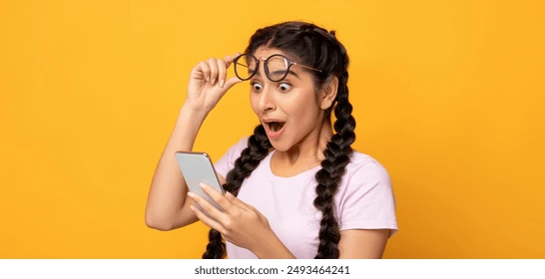
Twins –Two children born at the same time.
Exciting – causing great enthusiasm and eagerness.

Slide 6

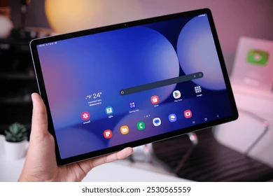
Happiness – The state of being happy.
Tablet – One type of computer.

Slide 7


Screen – A flat panel on an electronic device.
Stuck - inserted

Slide 8

Grumpy-bad tempered and irritable.

Slide 9

Quality Time Together

Slide 10
Naima and Masuk were twins. They were in Class Five. Naima loved to play badminton and Masuk loved to play football. They were also very good students at school. Their parents, Naeem Hasan and Mina Begum, loved them very much . Naima and Masuk often played with their parents when they had free time. Their home was always full of happiness!
One day, a special box arrived. It was from their close relative, Mr. Rakib, who lived in Italy. There was a black tablet inside the box. When they turned it on, the screen showed many bright colours . ‘Wow!’ They were both surprised.
At first, the tablet was so much fun. They played video games after finishing their study. And soon, the tablet became more exciting than playing outside. ‘Naima! Masuk !’ their friend Rana called from the gate. ‘Let’s play!’
‘Not now!’ Naima replied. Her eyes were stuck to a YOUTUBE video. Masuk was also watching the video with his sister.

Slide 11
slowly started to change. Often they became grumpy and got angry. ‘Time for dinner!’ their mom catwinslled one evening. ‘Just five more minutes, Ma!’ Masuk shouted. His voice was sharp and annoying. Mother noticed it and took the tablet away. Then, Masuk started to cry. ‘You’re so unfair! He screamed.
The situation became worse. At night, They couldn’t sleep properly. Naima rubbed her eyes all the time, and Masuk felt sleepy all day long. Their parents, Naeem Hasan and Mina Begum were very worried and unhappy. They understood that their children were spending too much time on screens. So, they decided to talk to Naima and Masuk.
‘This tablet is wasting your precious time,’ their dad said softly. ‘It’s taking away your sleep, affecting your school work and keeping you away from your friends.’ The twins saw the sadness in their parents’ eyes. They felt ashamed. That realized that they were using the tablet too much and became tired and grumpy.
Then, they promised not to use the tablet without their parents’ permission. Every weekend, The family members used to sit together and shared funny stories. Naima and Masuk also started playing outside with their friends again. Their home became full of joy!
The

Slide 12


