Slide 1

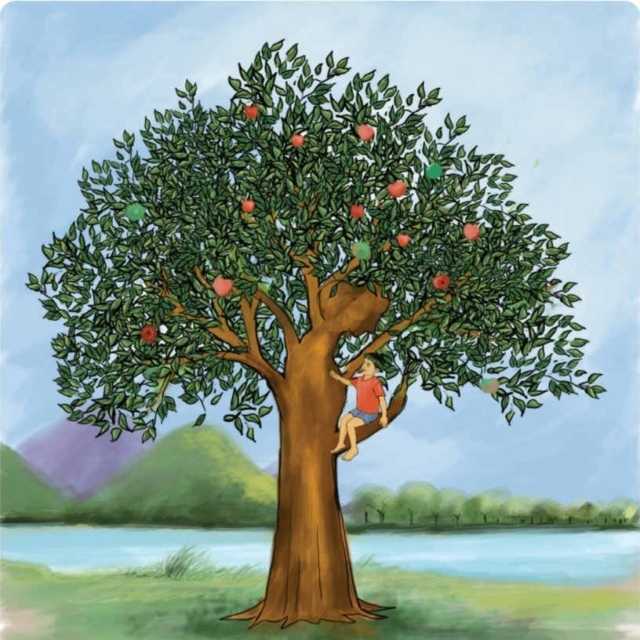
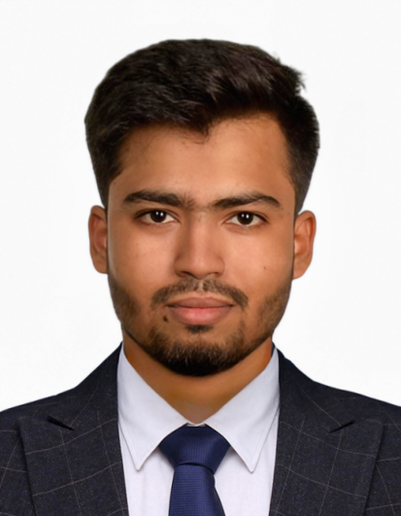
Class 5
UNIT 16 · SESSION 77
The Giving Tree
Teachers Information
Md. Al Amin
Assistant Teacher
Jamalpur Govt. Primary School
Ramganj, Lakshmipur.
English for Today · Activity 1.1, 1.2 · Textbook pp. 82–83
Notes:
INTRODUCTION (1 min). Greet the class with a smile: 'Good morning/Good afternoon.' Tell them: Today we will read a text about a tree. Session 77, Activity 1.1-1.2, textbook pages 82-83.

Slide 2



Today's lesson at a glance
3.4.2
Answer simple questions appropriately and confidently
4.2.1
Read aloud texts with proper stress and intonation
Materials: textbook, tree pictures, vocabulary flashcards, audio
English for Today · Unit 16 · Plan
Notes:
Share today's goals. Learning outcomes 3.4.2 (answer simple questions appropriately and confidently) and 4.2.1 (read aloud with proper stress and intonation). Sample timing for the 45-minute session is on the chart.

Slide 3
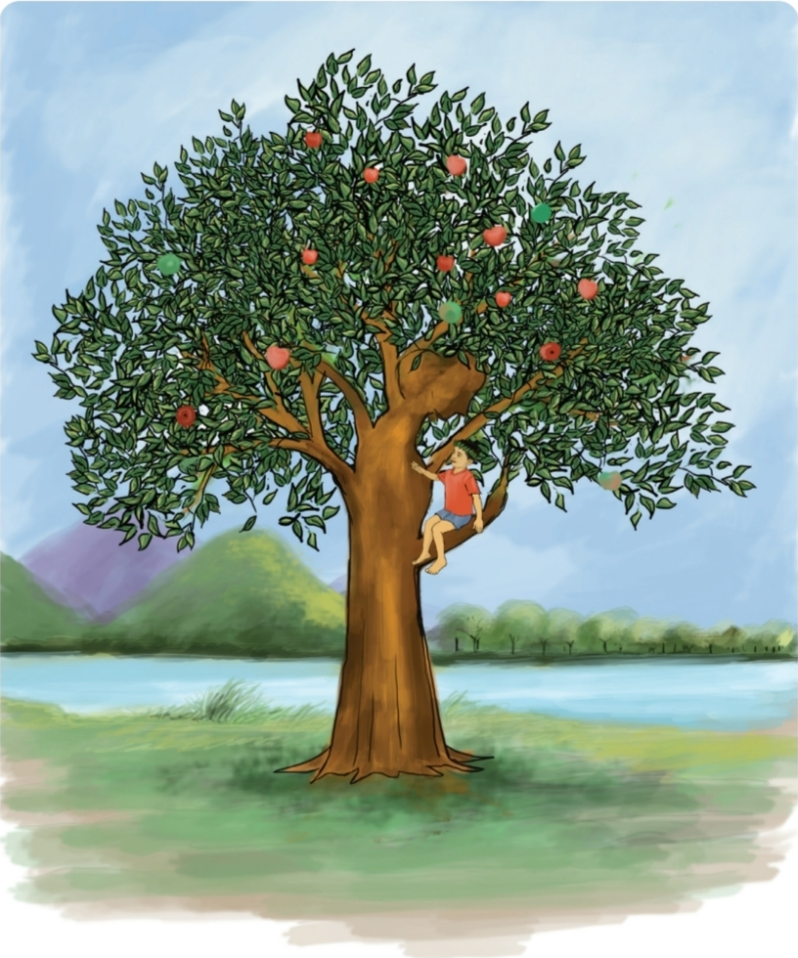

Warm-up: hello and look!
Teacher: Good morning! How are you today?
Students: Fine, thank you.
Activity 1.1
Let's answer this questions :
a) What is your favourite tree? Why do you like it?
b) How do trees help us?
Now Pair talk · Discuss with your partner about your favorite trees and explain their reasons like ( shade, fruits, beauty)
English for Today · Unit 16 · Warm-up
Notes:
REVIEW / PRIOR KNOWLEDGE (3 min). Greet: 'Good morning! How are you today?' Students reply 'Fine, thank you.' Show the picture of Activity 1.1 and let pairs ask and answer questions a and b. Elicit reasons: shade, fruits, beauty. Discuss how trees clean the air, give shade and shelter animals.

Slide 4






Meet the tree words
Today we will read a text about tree. Before reading lets learn some words.
trunk
branches
leaves
The main woody branch of a tree
Part of a tree that grow out of the trunk
Flat green parts that make food from sunlight
apples
shade
crown
Round red or green fruit that grows on trees
A cool, dark place under a tree
A circle worn on the head by a king
English for Today · Unit 16 · Vocabulary
Notes:
PRESENTATION - pre-teach vocabulary (part of 15 min). Show each flashcard, say the word, students repeat three times, then use it in a sentence. Words from the guide: trunk, branches, leaves, apples. Extra words: shade, crown.

Slide 5
The story, Parts 1 and 2
The tree loves the boy
Time goes by
1
2
Once there was a tree and she loved a little boy. Every day the boy would gather leaves and make them into crowns. He would play king of the forest wearing the crown. He would climb up her trunk and swing from her branches. When he was tired, he would sleep in her shade. The boy loved the tree very much. And the tree was happy.
But time went by. The boy grew older. He stopped playing with the tree. And the tree was often alone.
Pause and Answer: What did the boy do with the leaves?
Why did the boy stop playing with the tree?
English for Today · Unit 16 · Story
Notes:
PRESENTATION - read aloud Activity 1.2 (textbook p. 83), section by section. Read Part 1, pause and ask: 'What did the boy do with the leaves?' Explain the key meaning, then repeat the reading. Do the same for Part 2 and ask: 'Why did the boy stop playing with the tree?'

Slide 6
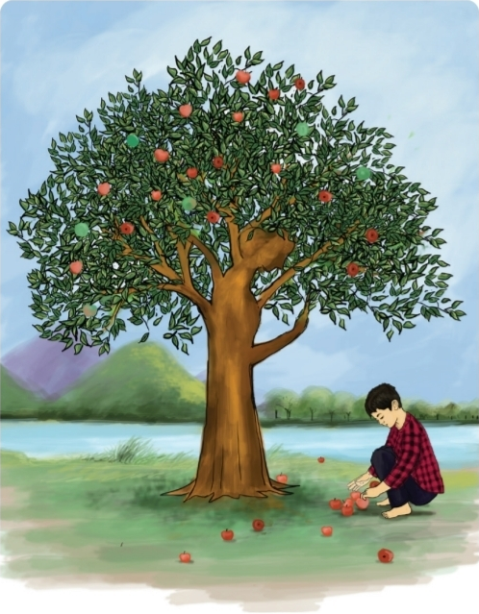
The story, Part 3
Then one day the boy came to the tree. The tree said, ‘Come, Boy, come and climb up my trunk. Swing from my branches and eat apples. Play in my shade and be happy.’
‘I am too big to climb and play,’ said the boy. ‘I want to buy things. I want some money. Can you give me some money?’
‘I'm sorry,’ said the tree. ‘I have no money. I have only leaves and apples. Take my apples, Boy, and sell them in the city’.
And so, the boy climbed up the tree and gathered her apples. And the tree was happy.
Key meaning: the tree has no money, so she gives what she has. Giving makes her happy.
English for Today · Unit 16 · Story
Notes:
PRESENTATION - Part 3 (textbook p. 83). Read aloud, then ask comprehension questions. Explain the key meaning: the tree has no money, but she gives what she has, and giving makes her happy. Repeat the reading.

Slide 7



Practice time: read in pairs
Stress
Intonation
Fluency
say the important words a bit louder
voice goes up for questions, down at the end
read smoothly, not word by word
Student A: the boy's actions
Student B: the tree's replies
Makes leaf crowns and swings
Grows older and stops playing
Asks for money
Picks the apples
Is happy to share her shade
Is often alone
Says sorry, she has no money
Gives her apples
English for Today · Unit 16 · Practice
Notes:
PRACTICE ACTIVITIES (15 min). Pairs take turns reading aloud. Encourage proper intonation, stress and fluency and help with pronunciation. Students may ask their own questions. Then each pair summarises parts of the story in their own words: one explains the boy's actions, the other the tree's responses.

Slide 8
Check and recap
Quick check
1. Who loved the little boy?
→ The tree
2. What did the boy make from leaves?
→ Crowns
3. What did the tree give for money?
→ Apples
4. How did the tree feel when she gave?
→ Happy
What have we learnt today?
We have read out a story and learnt some new words.
Think: how can we be kind and give like the tree? Plant a tree!
English for Today · Unit 16 · Feedback and Summary
Notes:
ASSESSING (6 min), FEEDBACK (2 min), SUMMARY (2 min), CONCLUSION (1 min). Observe reading and answers; support students who cannot yet read aloud properly. Ask: 'What have we learnt today?' Encourage: 'We have read out a story and learnt some new words.' Close: 'Have a great day. See you again in the next class. Take care.' Quiz answers: the tree; crowns; apples; happy.

Slide 9
Goodbye
Thank you Everybody.
Have a great day. See you again in the next class. Take care.
English for Today · Unit 16 · Concluding
Notes:
ASSESSING (6 min), FEEDBACK (2 min), SUMMARY (2 min), CONCLUSION (1 min). Observe reading and answers; support students who cannot yet read aloud properly. Ask: 'What have we learnt today?' Encourage: 'We have read out a story and learnt some new words.' Close: 'Have a great day. See you again in the next class. Take care.' Quiz answers: the tree; crowns; apples; happy.

