Slide 1
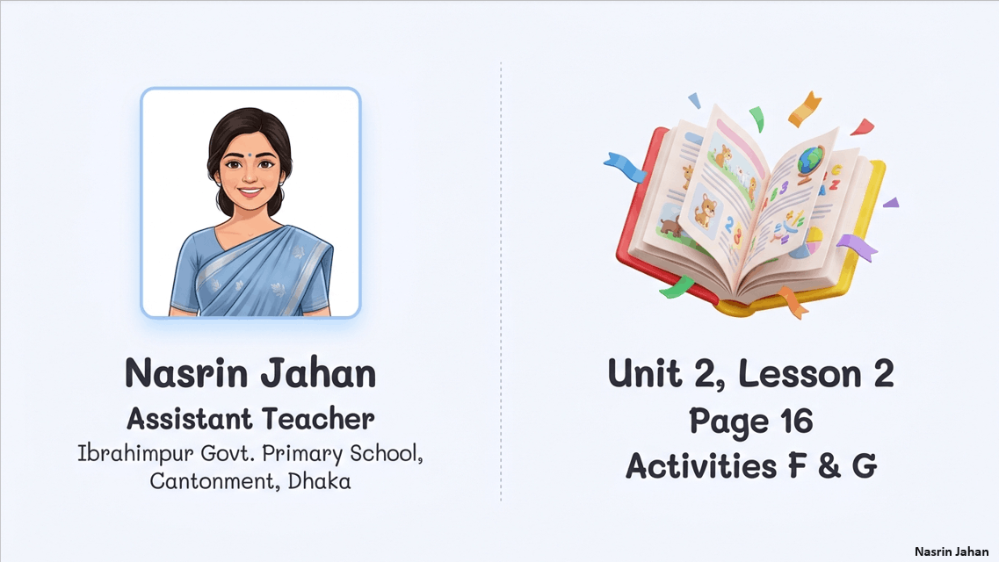

Slide 2


Slide 3


Slide 4
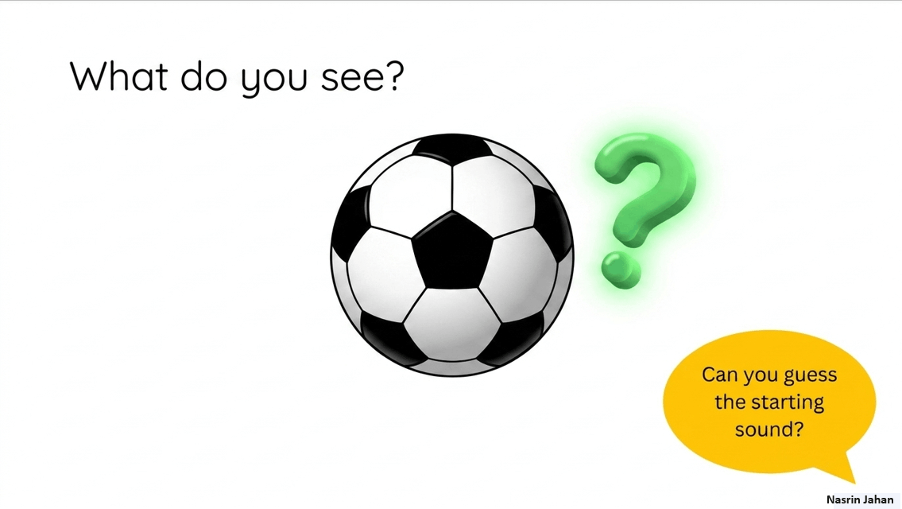

Slide 5
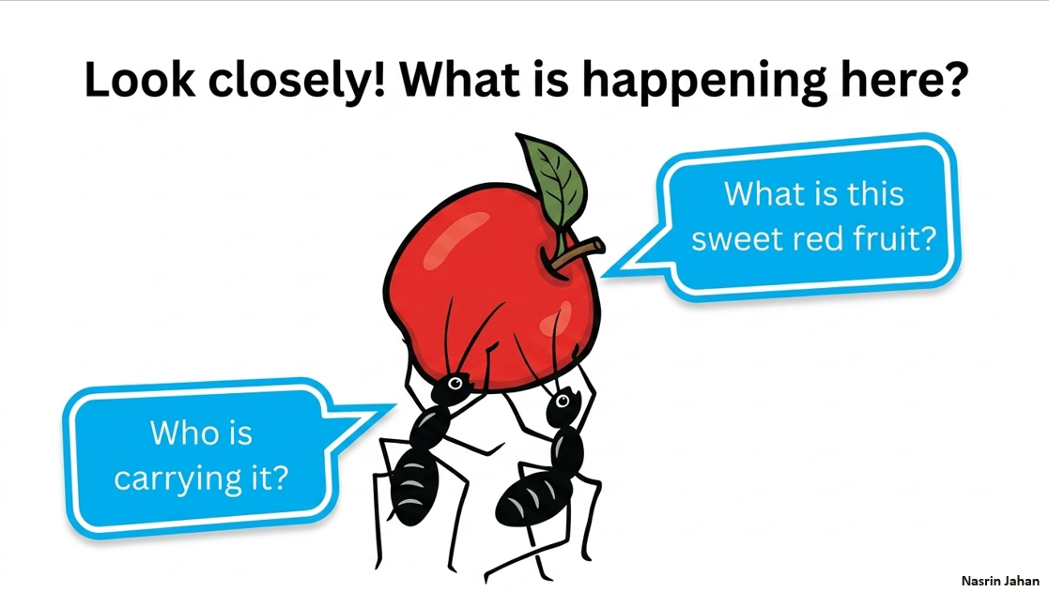

Slide 6
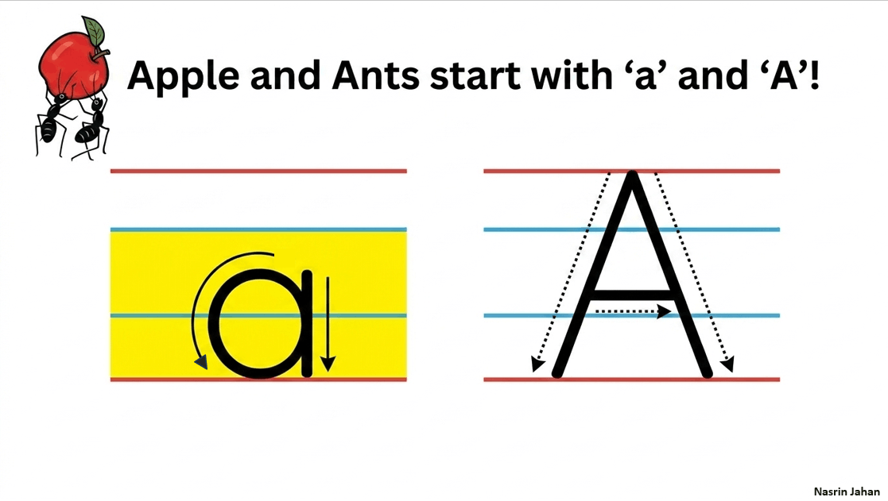

Slide 7
Fill in the blanks
………….pple
A
a
……..…nt
Mofakakkarul Alam
7

Slide 8
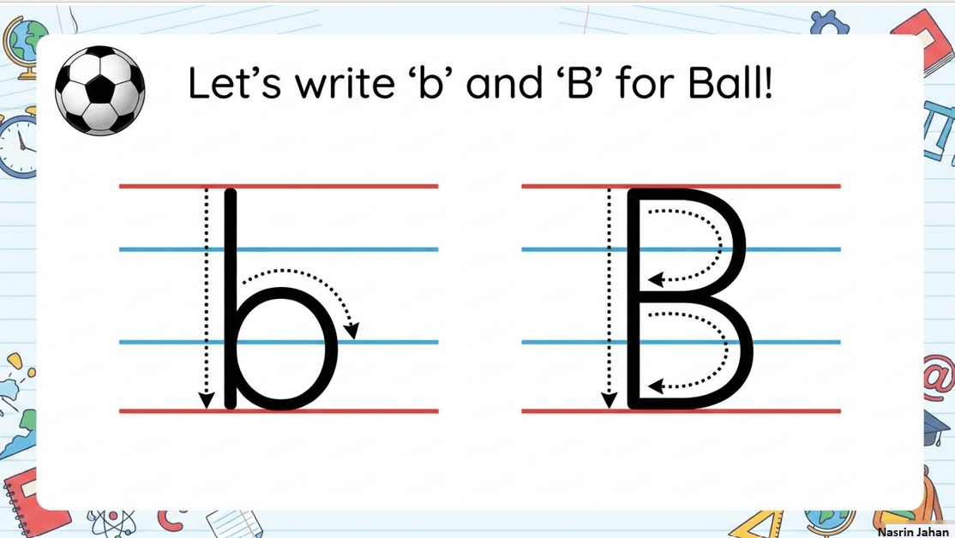

Slide 9
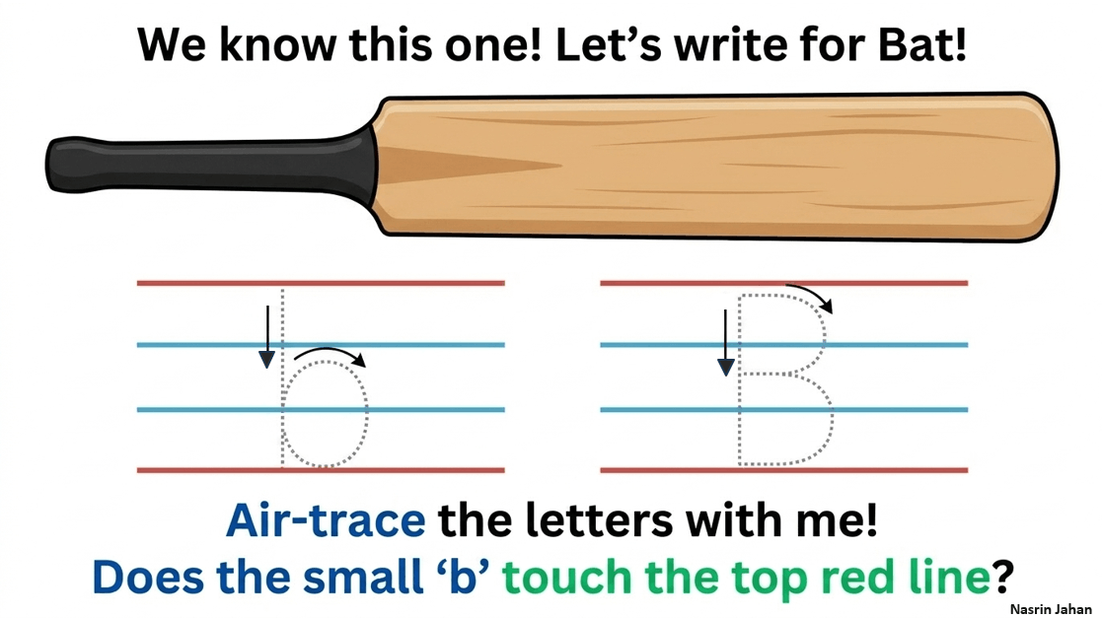

Slide 10


Slide 11


Slide 12


Slide 13


