Slide 1
Welcome to
our English Class

Slide 2
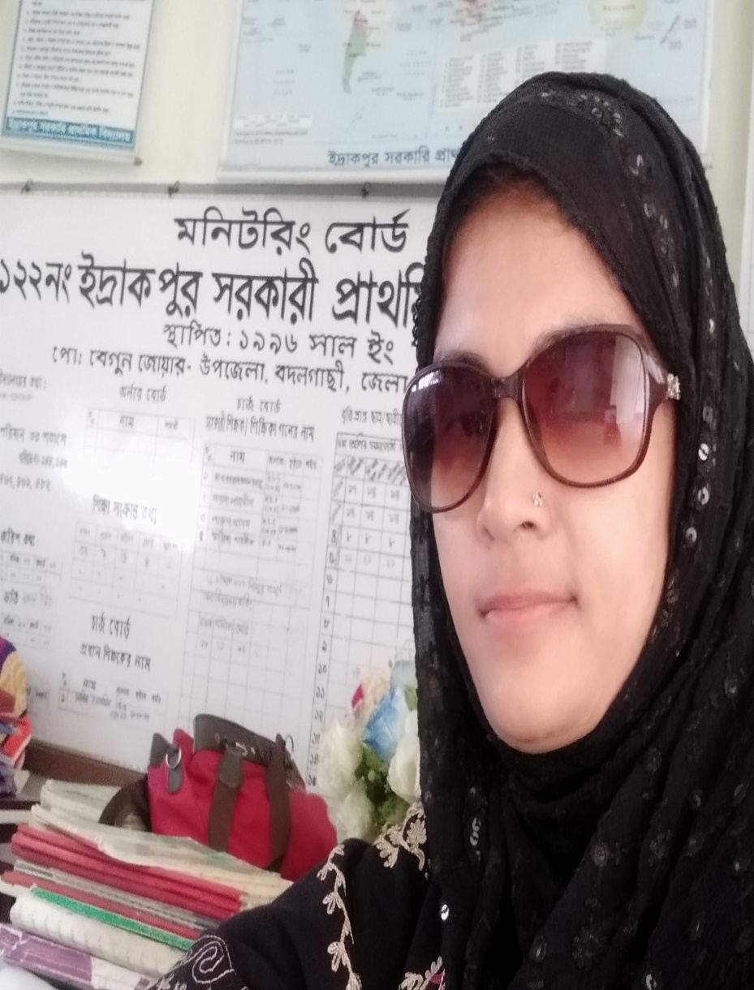

Teacher’s Identity
Mst. Mallika Parvin
Assistant teacher
Edrakpur Govt.Primary School
Badalgachi,Naogaon

Slide 3

Introducing Lesson
Unit: 02
Our School Garden
Page no : 7
Time: 50

Slide 4
Learning Outcome
Listening: 4.2.1 Understend and enjoy simple stories.
Speaking: 1.1.1 Say words, phrases and sentences with proper sounds and stress.
Reading: 1.7.1 Read paragraphs dialogues, stories, letters and other texts.
Writing: 10.1.1 To wtite a short piece of composition by answering questions.

Slide 5
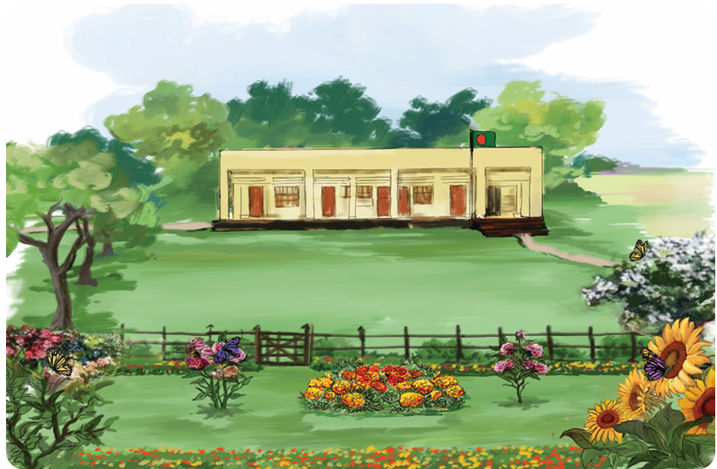
Today we are going to read a text about
“Our School Garden”

Slide 6

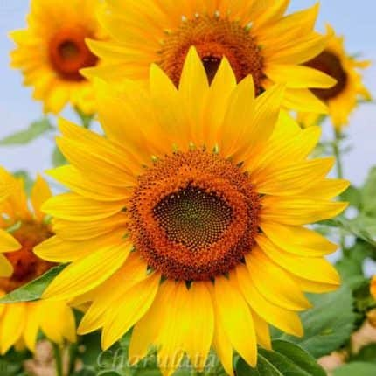
Look at the picture. What can you see?
Roses
Sunflowers

Slide 7
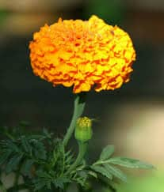
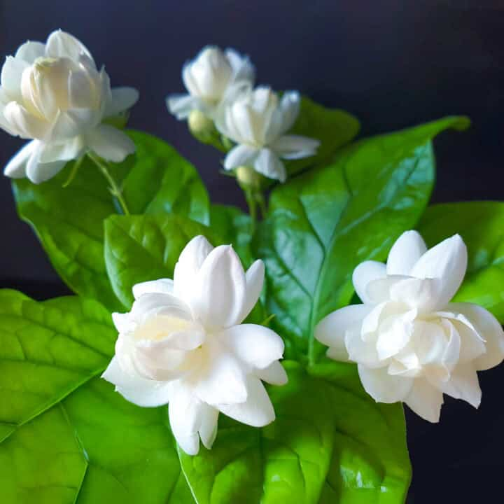
Jasmines
Marigolds

Slide 8
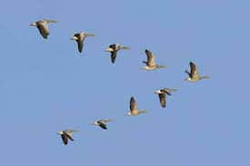
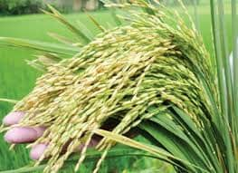
Aswarm of – এক ঝাঁক
A bunch of- এক গুচ্ছ

Slide 9
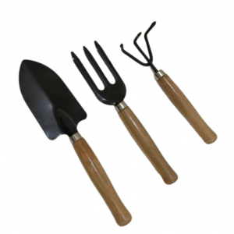
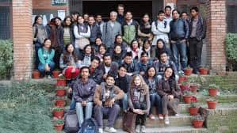
A set of –এক সেট
A group of- এক দল

Slide 10
Vocabulary
Playground (খেলার মাঠ ) There is a large playground in
front of our school.
Fence (বেড়া) There is a fence around our school.
Enclose (বেষ্টন করা) A fence incloses the garden.
Ditch (খাল/ নালা ) There is a ditch near our school.
Remove (দূর করা) We remove weeds from our flower garden.
Butterfly (প্রজাপতি) A butterfly is sitting on the flower.
Plant (গাছ/ চারা গাছ ) There are many plants in the garden.

Slide 11
Now I’m reading the text. Please be attentive and put your finger under the line. Listen to me carefully.
Our school has a lovely garden in front of the big playground. A fence encloses the garden. In the garden there are many beautiful flowers like roses, sunflowers. Jasmines and marigolds.

Slide 12
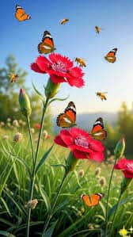
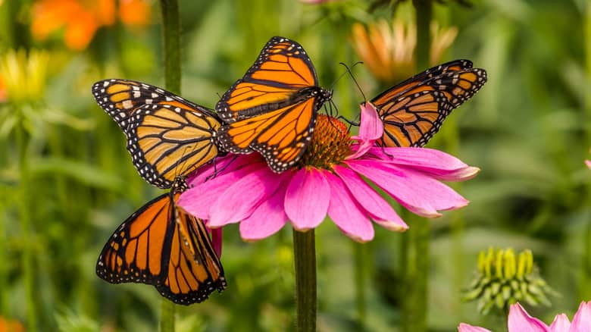
A swarm of butterflies dances on the flowers. It makes the garden look very beautiful.

Slide 13
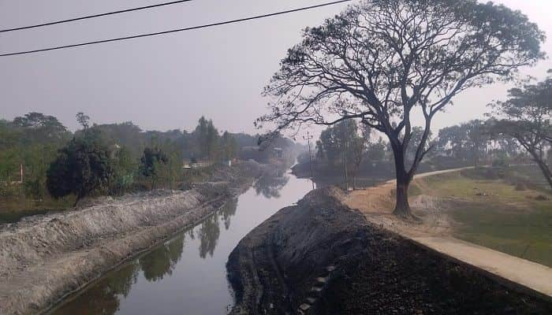
There is a ditch near the corner of the garden. A group of frogs live there.

Slide 14
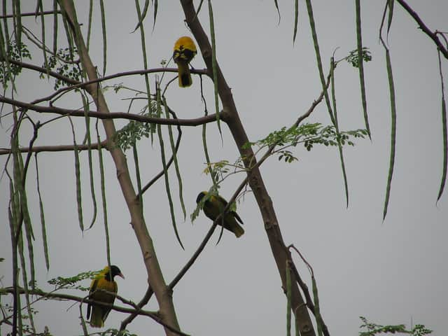
Sometimes, we see a flock of birds sitting on the nearby trees, singing sweet songs.

Slide 15
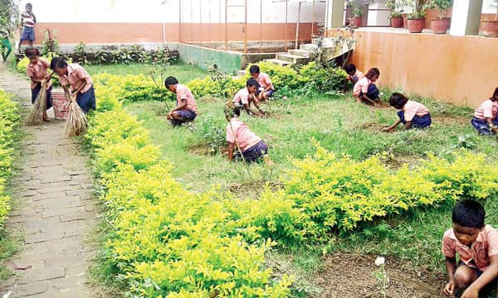
We take care of the garden regularly. On a selected day, students from each class work together to clean the garden.

Slide 16
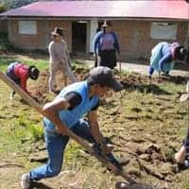
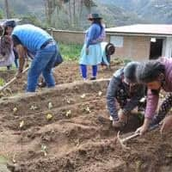
We use a set of gardening tools like spades ,rakes, and sickles.

Slide 17
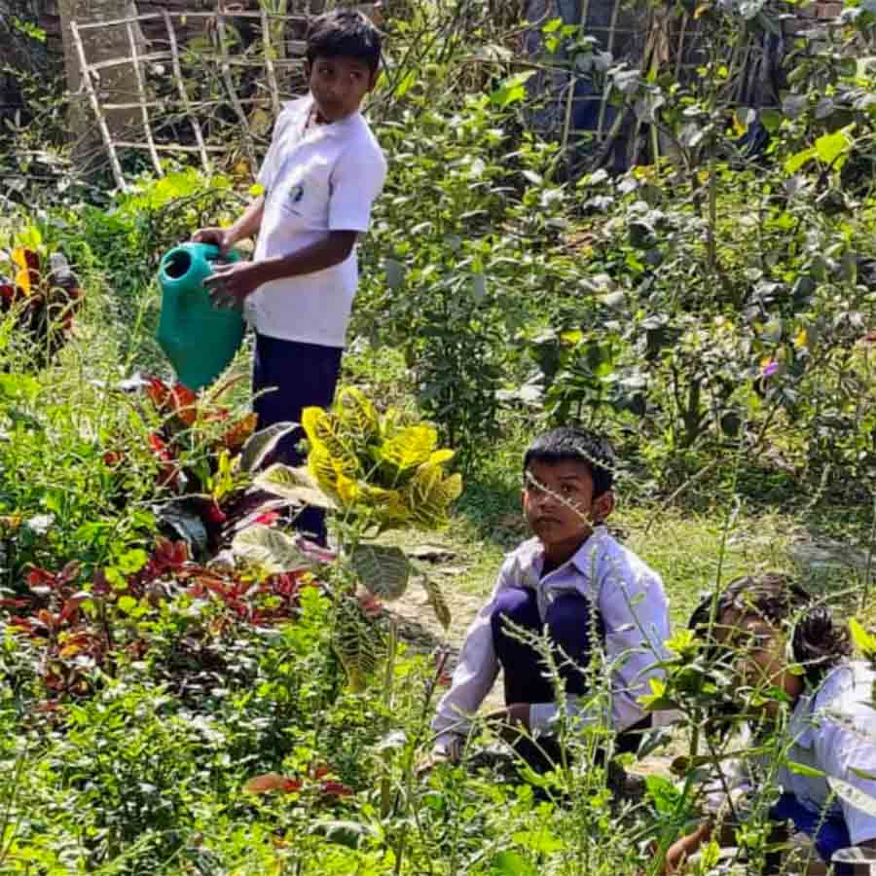
We water the plants and remove the weeds regularly.
We also add compost to the soil for making it fertile.

Slide 18
The garden is full of plants and flowers. They give us joy and happyness. We love working in our school garden.

Slide 19
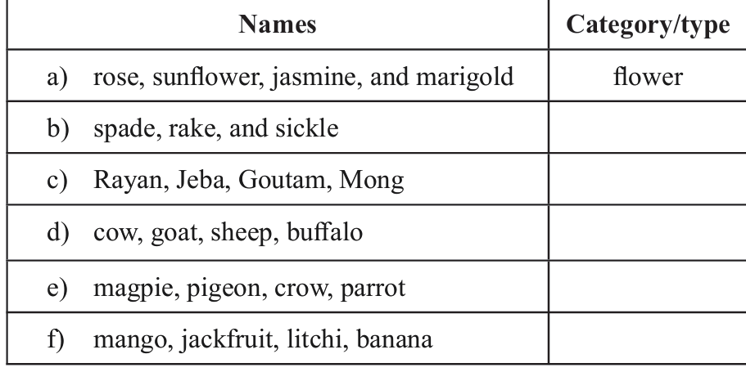
Groupwork
Open the book at page 8 and look at the table in activity 2.1
Write the names of the type/ category of the group of words in the table and present their group work in front of the class.

Slide 20
gardening tools
Person’s name
Domestic animals
birds
fruits

Slide 21
Read the text again and match each phrase with the correct words
Phrase | Words
a) A swarm of | i) birds
b) A group of | ii) flowers
c) A set of | iii) gardening tools
d) A flock of | iv) frogs
e) A bunch of | v) butterflies/bees

Slide 22
Evaluation
Answer the following questions.
1.Where is the school garden ?
2. Name two flowers mentioned in the passage.
3. Why is compost added to the soil ?
4. How does the garden make us feel ?

Slide 23
Soluation
1.Answer: The school garden is in front of the big
playground.
2.Answer: Roses and Jasmine.
3. Answer: Compost is added to make the soil fertile
4.Answer: The garden givse us joy and happiness.

Slide 24
WH Questions
1.A fence encloses the garden
2. It makes the garden look very beautiful
3.They give us joy and happiness
4.Our school has a lovely garden
5.The birds sings sweetly

Slide 25
Rearrange
1.is,raining,it,outside
2.the,sets,sun,behind,the mountains
3.In the night,twinkle,the stars, brightly
4. the,after,dinner,we,watch,TV
5.like,pictures,painting.I,Colourful

Slide 26
Home Task
You will write down
“Your School Garden” in your notebook,
at least 10 sentences.

Slide 27
Good
bye
students

