Slide 1
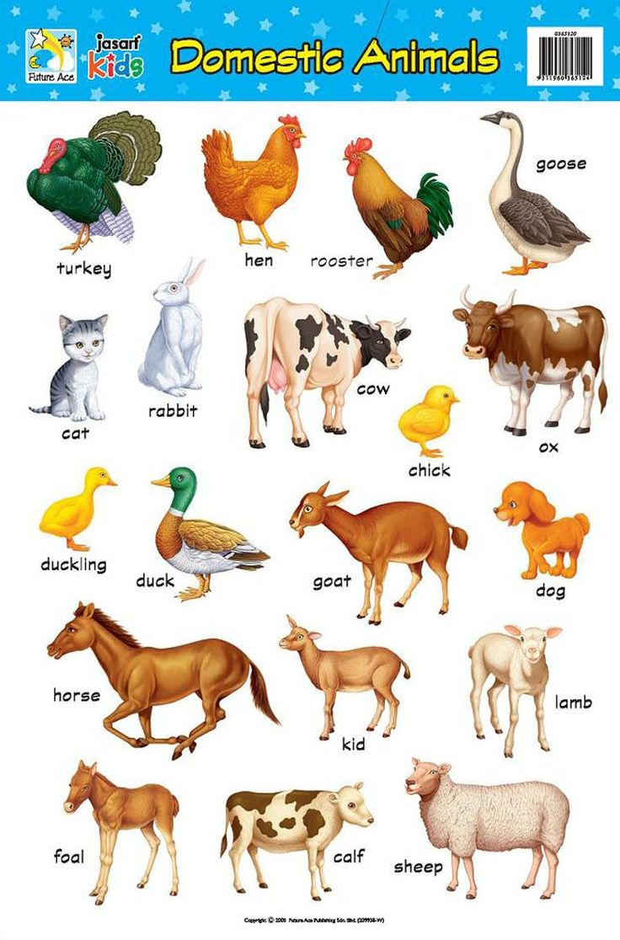

Dear learners good morning

Slide 2

Teachers Identity
Md. Nurul Karim Shobuz
Assistant Teachers
Salia GPS
Parshuram, Feni.
E-mail:nurulkarim1990@gmail.com

Slide 3

Class: Two
Subject: English
Unit: 9
Lesson: 3
Time: 40 minutes

Slide 4
Learning Outcomes: By the end of the lesson students will be better understand to:
4.2 Reading aloud simple sentences with proper punctuation.
5.1 Understanding familiar words and simple sentences for specific information.

Slide 5
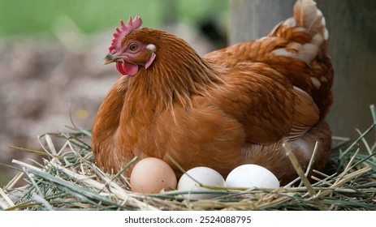
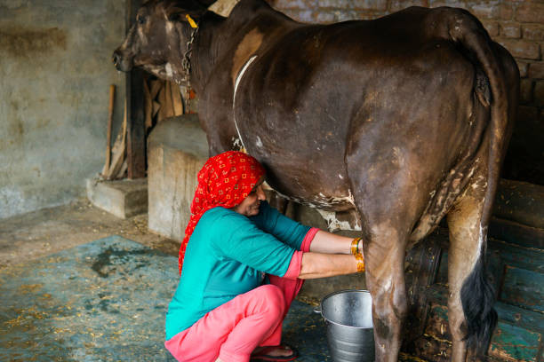
Think about the pictures.Share your thinking with your partner.What do you see in the picture?

Slide 6
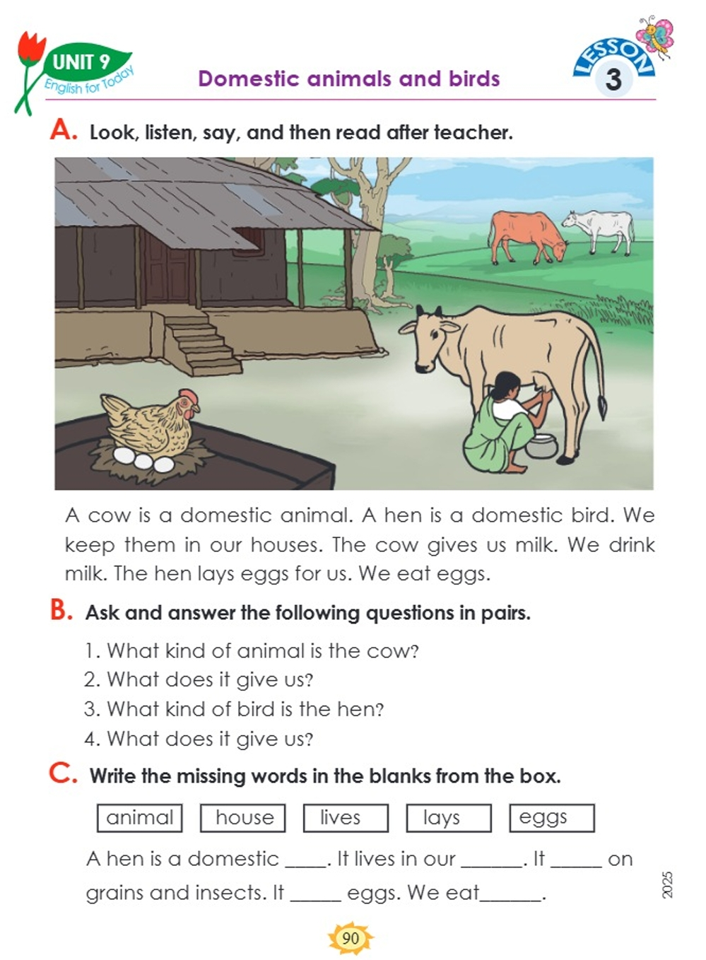
Lesson Title
Domestic animals and birds
Activity:A,B
Page:90

Slide 7
A cow is a domestic animal.A hen is a domestic bird.We keep them in our houses.The cow gives us milk.We drink milk.The hen lays eggs for us.We eat eggs.
Lets read the text

Slide 8
Lets see todays new words
Domestic=গৃহপালিত
Animal=প্রাণী
Bird=পাখি
Keep=রাখা
House=বাড়ি
Milk=দুধ
Drink=পান করা
Lays=পারা
Eat=খাওয়া
Egg=ডিম

Slide 9

Group work
Read the text in groups

Slide 10

Pair work
Read the text in pairs

Slide 11

Individual work
Read the text to come in front of the class

Slide 12
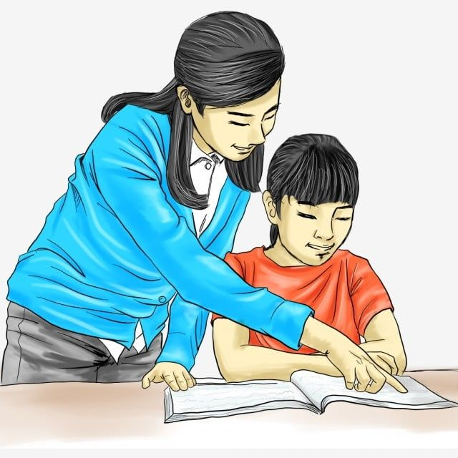
Feedback
Support those who can’t read and answer during the class.

Slide 13
Homework
Write the names of 5 domestic animals and birds .

Slide 14

Thank You
.

