Slide 1

Good
morning
Prepared by: Md. Saifuddin-Ass. Teacher , Afzal Nagar GPS. Satkania, Chattogram.

Slide 2
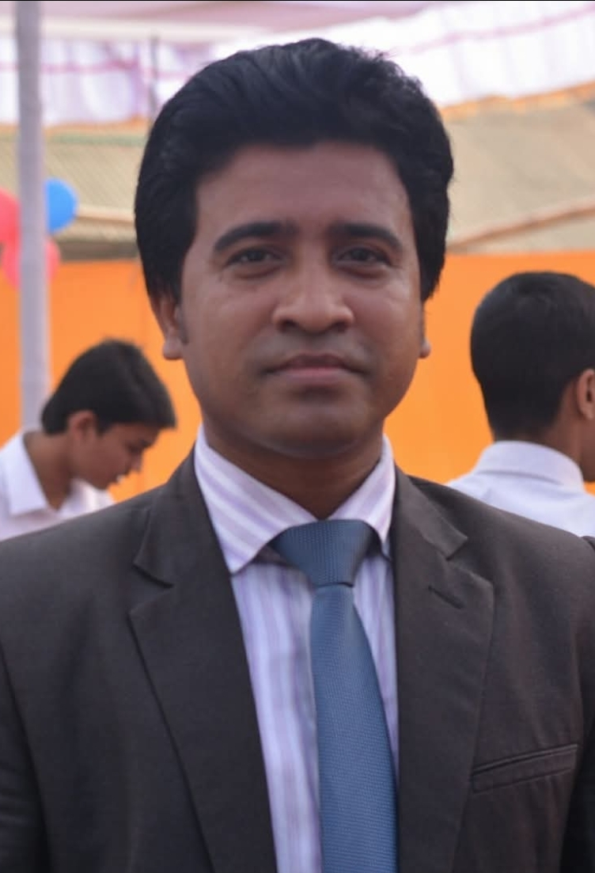
Teacher Profile
Md. Saifuddin
Ass. Teacher of Afzalnagar GPS.
Satkania, CTG.
Prepared by: Md. Saifuddin-Ass. Teacher , Afzal Nagar GPS. Satkania, Chattogram.

Slide 3

Let's see a picture!
Prepared by: Md. Saifuddin-Ass. Teacher , Afzal Nagar GPS. Satkania, Chattogram.

Slide 4
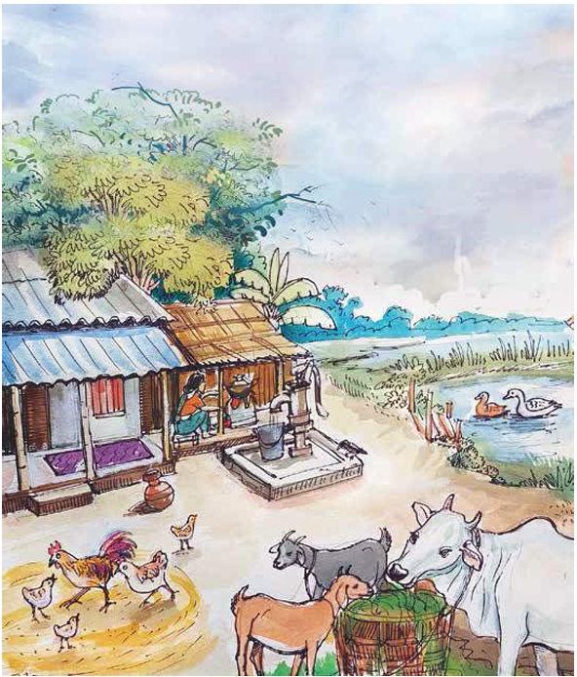

Prepared by: Md. Saifuddin-Ass. Teacher , Afzal Nagar GPS. Satkania, Chattogram.

Slide 5
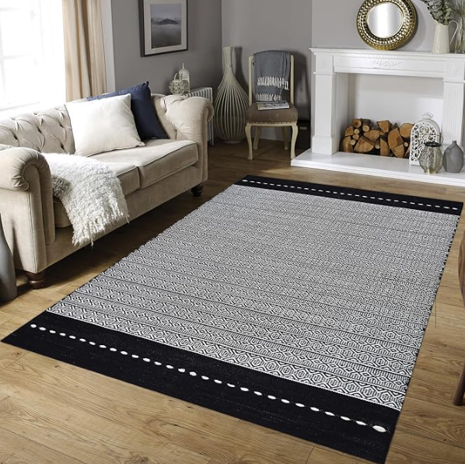


A mat
Prepared by: Md. Saifuddin-Ass. Teacher , Afzal Nagar GPS. Satkania, Chattogram.

Slide 6
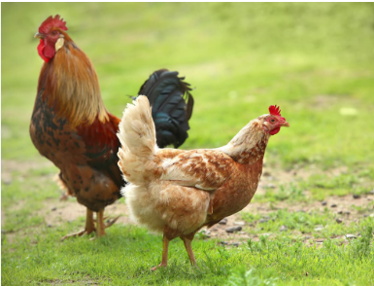
A hen
Prepared by: Md. Saifuddin-Ass. Teacher , Afzal Nagar GPS. Satkania, Chattogram.

Slide 7
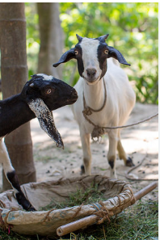
A goat
Prepared by: Md. Saifuddin-Ass. Teacher , Afzal Nagar GPS. Satkania, Chattogram.

Slide 8
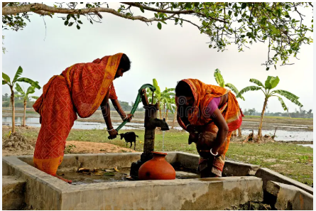
A tubewell
Prepared by: Md. Saifuddin-Ass. Teacher , Afzal Nagar GPS. Satkania, Chattogram.

Slide 9
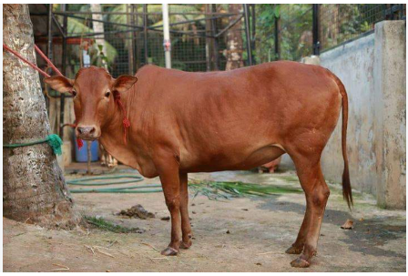
A cow
Prepared by: Md. Saifuddin-Ass. Teacher , Afzal Nagar GPS. Satkania, Chattogram.

Slide 10
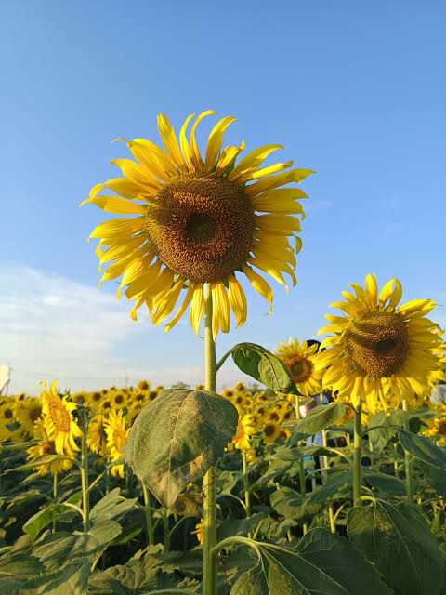
Thank you
for staying with me.
Prepared by: Md. Saifuddin-Ass. Teacher , Afzal Nagar GPS. Satkania, Chattogram.

