Slide 1


Slide 2



Introduction
Ayesha Siddiqua
Head Teacher
Rampur GPS
Laksam,Cumilla
Class : One
Sub : English
Unit : 4
Lesson : 4
Topics : At Village Home
Page (80-81)
Time : 30 minutes

Slide 3
LEARNING OUTCOMES
After finishing the lesson students will be able to-
3.3.2 Ask simple questions for getting information and respond accordingly

Slide 4

Let’s listen to a song (Number song)

Slide 5

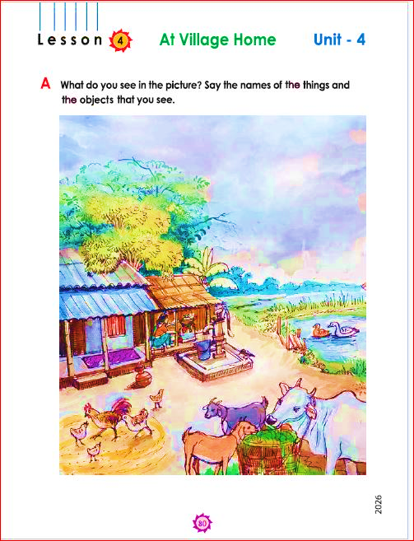
Look at the pictures with great attention:
Say the names that you find At Village Home

Slide 6
Today we are going to learn about our at village home.
The topic is “At Village Home” A, B & C

Slide 7
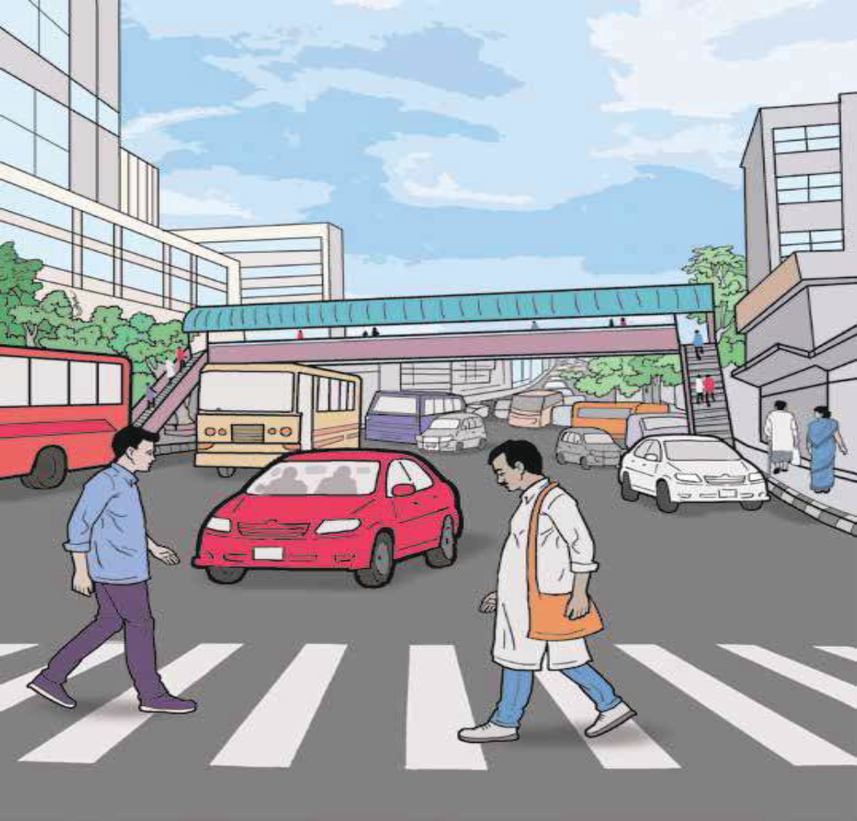






Say the names of the indicated objects
Review of the previous session:
Ask ss altogether, “What did we learn yesterday?”
[Showing the Picture] What’s this?
Ask a student randomly,
$$√$$
$$√$$
$$√$$
$$√$$
$$√$$
$$√$$

Slide 8
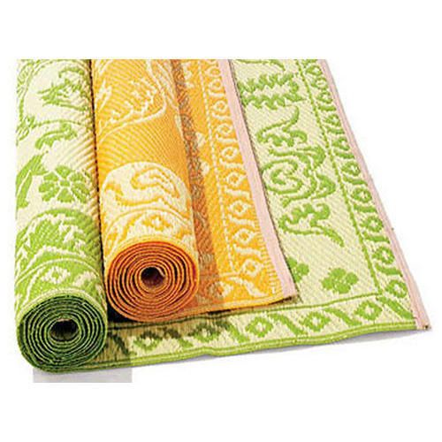
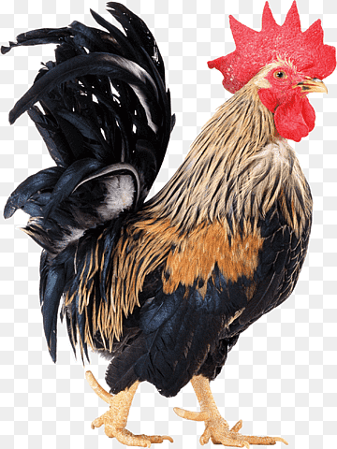
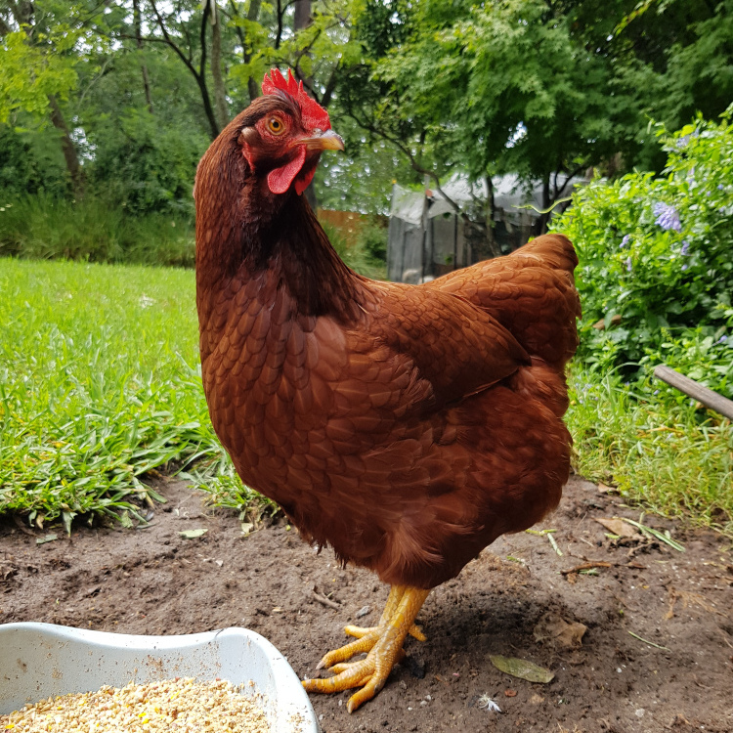
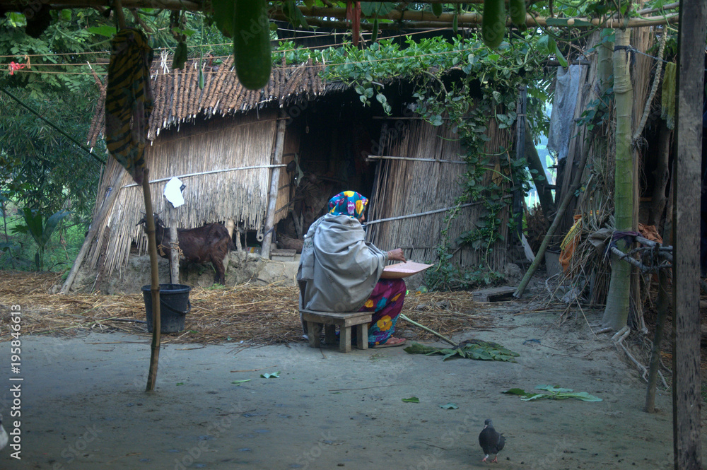
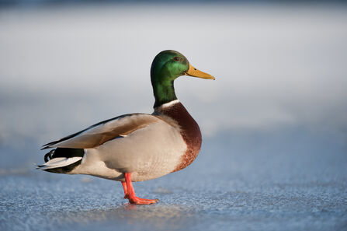
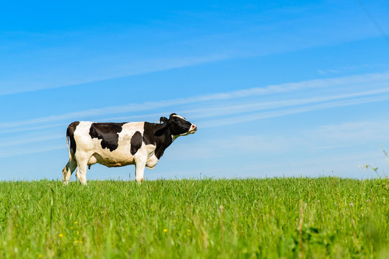
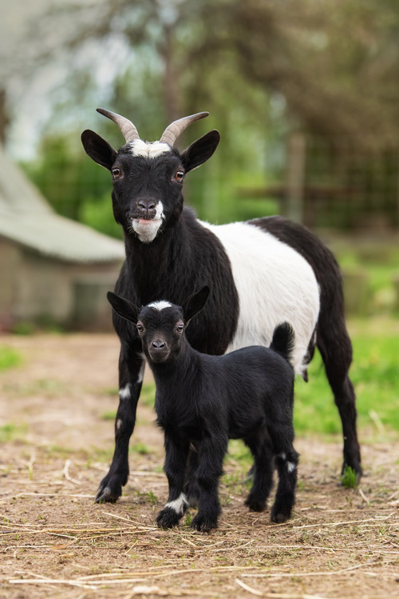
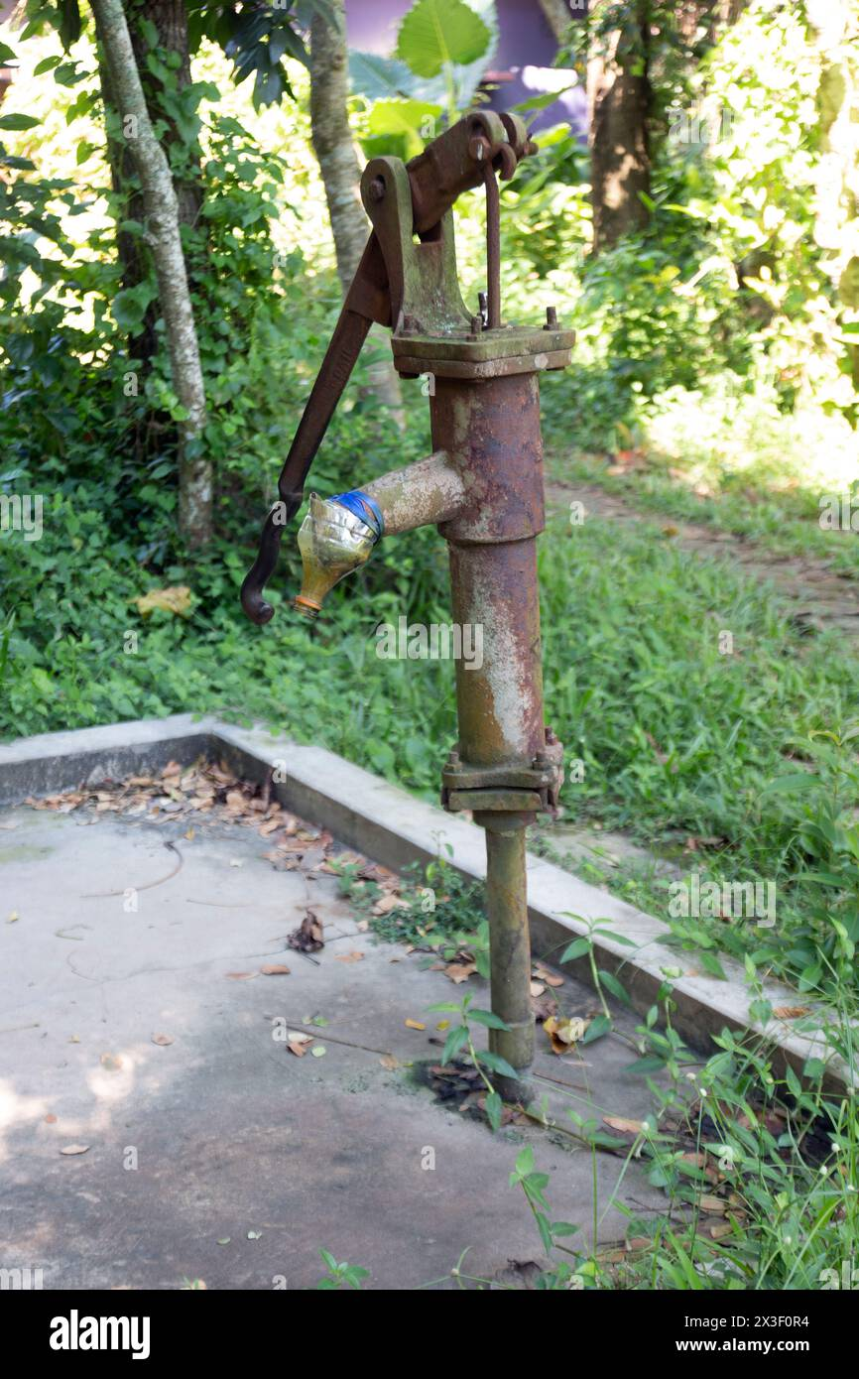
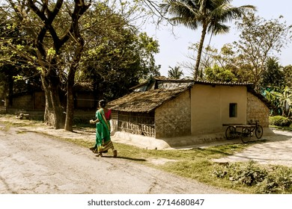
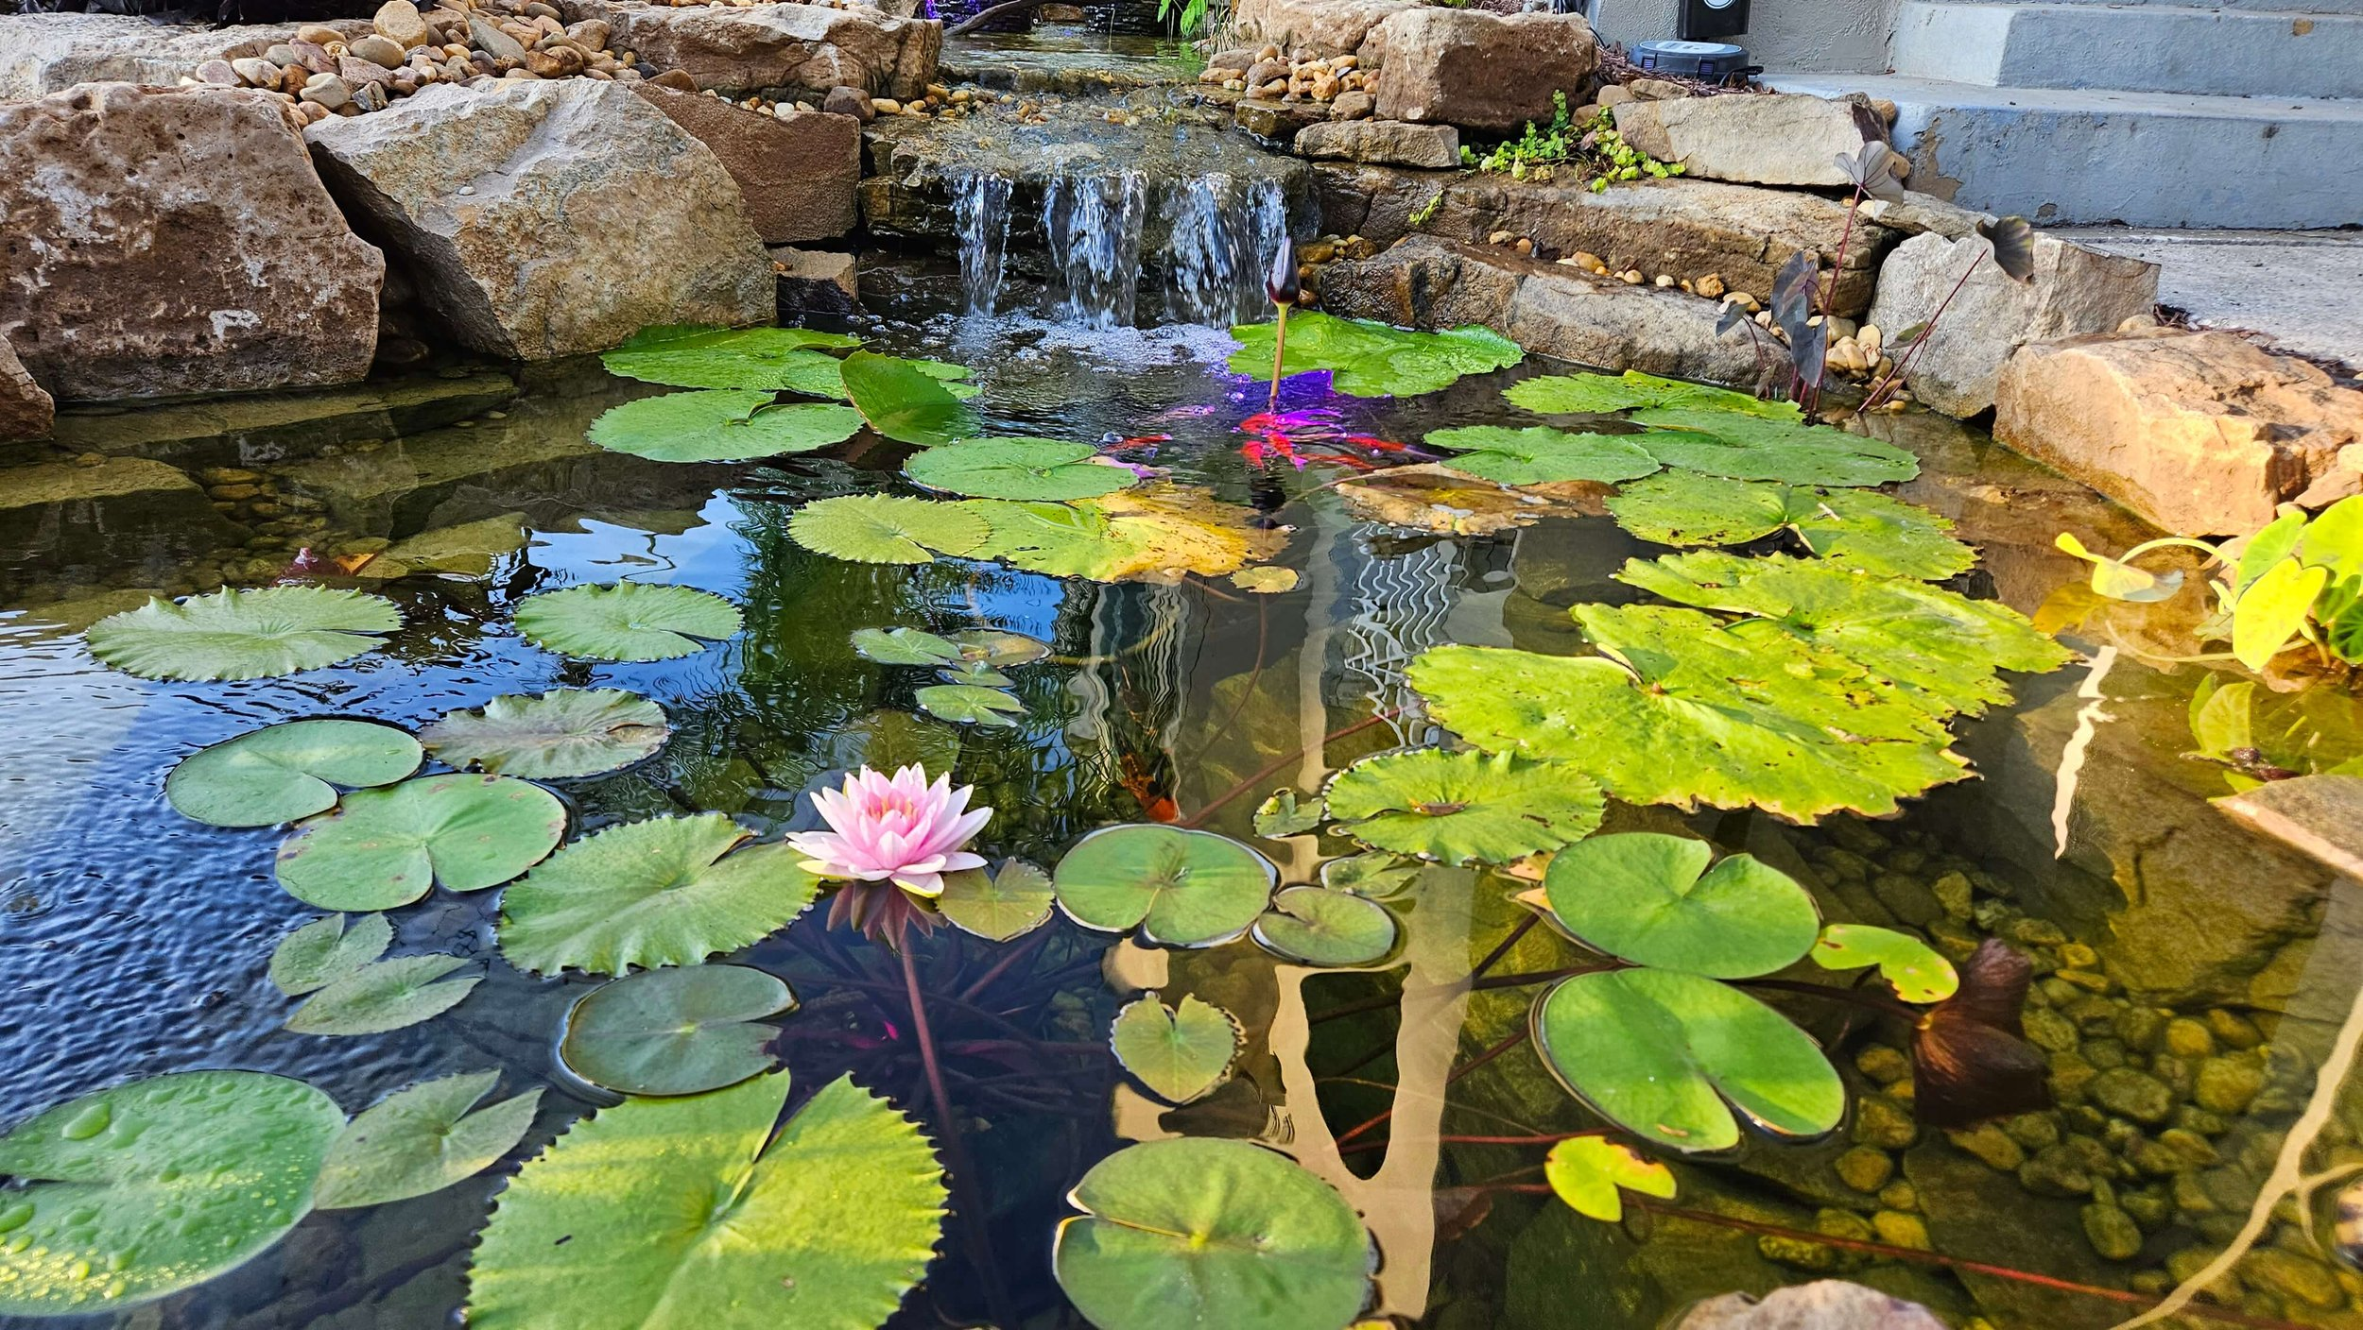
Say At village home objects.
What’s this?
Mat
Cock
Hen
Yard
Duck
Cow
Goat
Tube-well
Tree
Pond

Slide 9











Say the names of the indicated objects
Group work
$$√$$
$$√$$
$$√$$
$$√$$
$$√$$
$$√$$
$$√$$
$$√$$
$$√$$
$$√$$

Slide 10
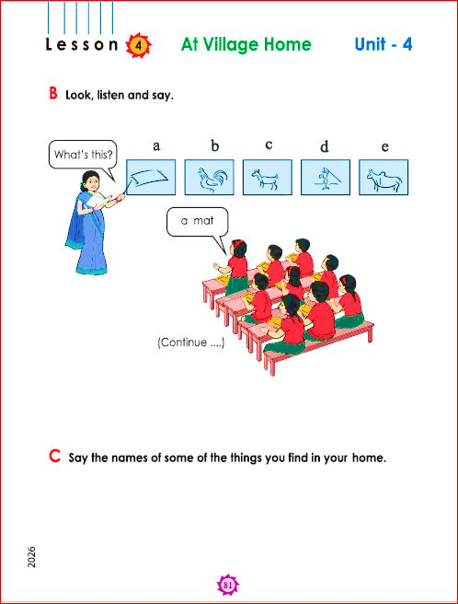
Say pictures name

Slide 11


Pair work

Slide 12
Open your book
Page 76,77
English for Today

Slide 13
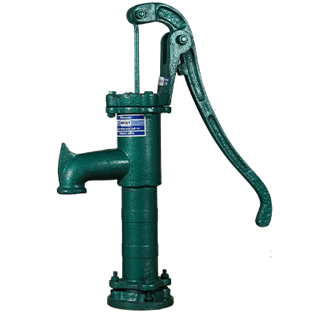
Individual work
Match the pictures with words
Tubewell
Mat
Cow

Slide 14

Chain Drill
We can talk about our own Village.

Slide 15
Assessment Indicators-90
Domain | Indicators
Knowledge | 1. S asks the simple question for getting information.
Skill | 2. S answers the simple question for giving information.
Attitude and values | 3. S feels confident to ask questions and answers accordingly.

Slide 16
Feedback
Help the students who can’t say about your village home.

Slide 17

Homework
Talk about your village Home.

Slide 18


