Slide 1


Slide 2



Introduction
Md. Jewel Hasan
B.S.S (Govt. Rajendra College)
M.S.S (Dhaka College)
B.Ed (National University)
Assistant Teacher
Gunohar Sadek Mallik Memorial High School
Muksudpur, Gopalganj
Mobile: 01723738377
E-mail:jewel01723@gmail.com
Class: Seven
Subject: English Grammar and Composition
Unit: Sixteen

Slide 3
After this lesson we will able to know
About Reporting verb
About Reported speech
About Inverted comma
About speech
About the Tense
About the sentence.

Slide 4
KINDS OF NARRATION
PARTS OF NARRATION
THERE ARE TWO KINDS OF NARRATION
THEY ARE :
1. DIRECT NARRATION: বক্তা যখন তার নিজের উক্তি নিজের মত করে বলে
Example: Rakib said to Sajid, “I eat rice”
2. INDIRECT NARRATION: বক্তা যখন অন্যের বক্তব্য তৃতীয় কোনো ব্যক্তির নিকট উপস্থাপন করে।
Example: Rakib told Sajid that he ate rice.
THERE ARE TWO PARTS OF NARRATION.
THEY ARE :
1.REPORTING VERB: Sentence শুরু থেকে comma and inverted comma এর পুর্ব পর্যন্ত অংশ ।
Example: Rakib said to Sajid, “How are you?”
Here ‘said’ is a reporting verb (shows who is speaking and to whom, Examples: said, told, asked, suggested, promised)
2. REPORTED SPEECH: Inverted comma এর ভিতরের অংশ
Example: Himi said to Tayeba, “How are you?”
Here _ “How are you?” is the reported speech (the actual words spoken inside the quotation marks)

Slide 5
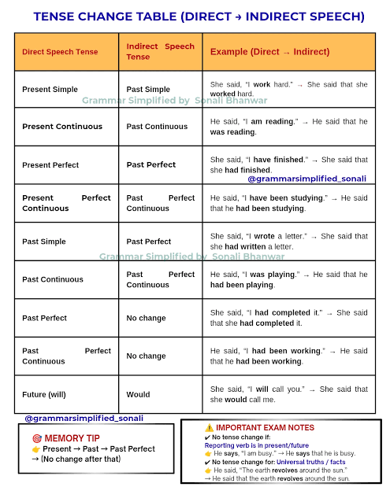
Tense পরিবর্তনের নিয়মঃ
Tense পরিবর্তনের নিয়মঃ
Present indefinite➔Past indefinite
Present continuous ➔past continuous
Present perfect➔past perfect.
Present perfect continuous➔past perfect continuous.
Past indefinite➔Past perfect
Past continuous➔ Past perfect contious
Past perfect➔Past perfect
Past perfect contionuous➔ past perfect continuous
Future in the past.
Shall➔should, Will➔would, Can➔could, May➔ might

Slide 6
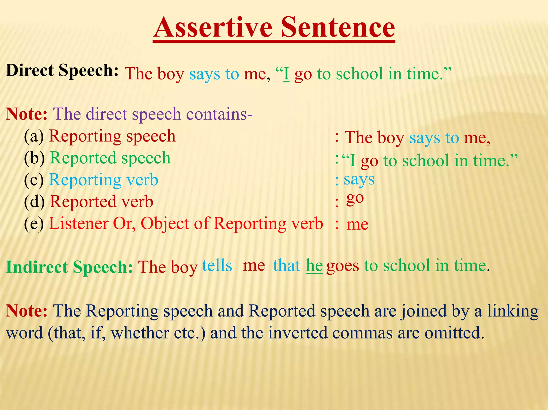
Assertive sentence
Assertive sentence যুক্ত direct narration কে indirect narration এ পরিবর্তনের নিয়মঃ
Structure: Reporting verb এর subject+said+object +comma+inverted comma উঠে গিয়ে that+Reported speech এর subject+ tense অনুযায়ী verb+extension.
Example:
He said to me,” I have done my duty”.
➔He said to me that he had done his duty.
He said,”I am writing a letter”.
➔He said that he was writing a letter.
He said,”The earth moves round the sun”.
➔He said that the earth moves round the sun.

Slide 7
Interrogative sentence
Rule:01: Interrogative sentence যুক্ত direct narration কে indirect narration এ পরিবর্তনের নিয়মঃ
Rule:02: Interrogative sentence এ যদি interrogative pronoun (who, whom, which, what, which) এবং interrogative adverb (why, when, how, where থাকে তাহলে direct narration কে indirect narration এ পরিবর্তনের নিয়মঃ
Structure: Reporting verb এর subject + asked/enquired of + object যদি থাকে + comma + inverted comma উঠে গিয়ে if/whether + Reported speech এর subject + tense অনুযায়ী verb + extension. (Sentence টি assertive এ রুপান্তরিত হবে।)
Example:
1.The old man said to the maid,” Can you give me some food?”
➔The old man asked the maid if he give him some food.
2.Mehedi said to Sourav,”Will you go to school?”
➔Mehedi asked Sourav if he would go to school.
3.He said to me,”Do you like the late spring?”
➔He asked me if he liked the late spring
Structure: Reporting verb এর subject + asked/enquired of + object যদি থাকে + (comma + inverted comma উঠে গিয়ে) (if/whether না বসিয়ে) (why, when, how, where, who, whom, which, what) etc বসে + Reported speech এর subject + tense অনুযায়ী verb + extension. (Sentence টি assertive এ রুপান্তরিত হবে।)
Example:
1. The teacher said to Rahim,”Why are you talking in the class?”
➔The teacher asked Rahim why he was talking in the class.
2.He said to me,” wher do you live?”
➔ He asked me where I lived
3. He said to me,” which book do you want?’
➔He asked me which book I wanted.

Slide 8
Imperative sentence
Role: 01: Imperative sentence যুক্ত direct narration কে indirect এ পরিবর্তনের নিয়মঃ
Role: 02: Imperative sentence টি negative হলে indirect এ
পরিবর্তনের নিয়মঃ
Structure: Reporting verb এর subject + requested (অনুরোধ বোঝালে)/orderd (আদেশ বোঝালে)/command/advise (উপদেশ বোঝালে) + object + (comma + inverted comma উঠে গিয়ে) to + Reported speech এর মূল verb থেকে শেষ পর্যন্ত ।
Example:
1.He said to me, "Please give me some food.”
➔He requested me to give him some food.
2.The teacher said to the students, "Always speak the truth.”
➔The teacher advised the students to speak the truth always.
Structure: Reporting verb এর subject + requested (অনুরোধ বোঝালে) / orderd(আদেশ বোঝালে) / command/advise (উপদেশ বোঝালে) + object + comma + inverted comma উঠে গিয়ে not to + Reported speech এর মূল verb থেকে শেষ পর্যন্ত ।
Example:
1.He said to me, "Never tell a lie.”
➔He advised me not to tell a lie .
2.The teacher said to the students, "Don't make a noise.”
➔The teacher advised the students not to make a noise.

Slide 9
Imperative sentence
Role:03: Imperative sentence টি Let দ্বারা শুরূ হলে indirect এ পরিবর্তনের নিয়মঃ
Structure: Reporting verb এর subject + proposed / suggested + object (comma + inverted comma উঠে গিয়ে ) that + Reported speech এর subject (we/they) + should + reported speech এর মূল verb থেকে শেষ পর্যন্ত ।
Example:
1.He said to me, "Let us go out for a walk.”
➔He proposed me that we should go out for a walk .
2.The teacher said to the students, "Let us write whatever they like.”
➔The teacher suggested the students that we should write whatever they like.

Slide 10
Optative sentence
Optative sentenceযুক্ত direct narration কে indirect narration এ পরিবর্তনের নিয়মঃ
Structure: Reporting verb এর subject + wished/prayed + (comma + inverted comma) উঠে গিয়ে that + Reported speech এর subject + might + মূল verb থেকে শেষ পর্যন্ত।
Example:
1.Father said to me, "May God blees you”.
➔Father prayed that God might bless me.
2.Father said to his son, "May you pass the examination.”
➔Father wished that his son might pass the examination.

Slide 11
Exclamatory sentence
Exclamatory sentence এ যদি আনন্দ বোঝায় তাহলে Exclaimed with joy that
এবং দু:খ বোঝালে exclaimed with sorrow that বসে ।
Structure: Reporting verb এর subject + exclaimed with joy that / exclaimed with sorrow that + (comma + inverted comma উঠে গিয়ে) + Reported speech এর subject+ verb এর past form + very / great + adjective + extension.
Example:
1.The man said, "How fine the bird is!”
➔The man exclaimed joy that the bird was very fine.
2. He said,” I am undone.”
➔ He exclaimed with sorrow that he was undone.

Slide 12

Home work
Direct: The teacher said to Kamal, "Why are you talking in the class? You should behave yourself.” Kamal replied, "Sir, I am sorry. I am asking Rahim to lend me his pen. My pen has run out.” “Be attentive and listen to my lecture,” Said the teacher.

Slide 13


