Slide 1


Slide 2
Identity
Joshim Uddin
Instructor (English)
Mujibnagar Govt. T.S.C
Meherpur
Subject: English Grammar
Class: Ten
Time: 40 mins

Slide 3
Todays our lesson is-
Parts of Speech

Slide 4

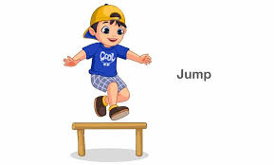

Book
London
Jump
Can you guess what these are?

Slide 5
Do you know Parts of Speech?
Every single word we use in a sentence is called a Part of Speech. Each plays a distinct role in constructing sentences and conveying meaning.

Slide 6
The eight parts of speech in English are:
Noun
Interjection
Pronoun
Parts of Speech
Conjunction
Verb
Preposition
Adjective
Adverb

Slide 7
Noun
*Words that name people, places, things, or ideas.
Examples: dog, London, happiness, book, teacher
Example in a sentence: The cat sat on the mat.

Slide 8
Pronoun
*Words that replace nouns to avoid repetition.
Examples: he, she, it, they, we, you, I, them, us
Example in a sentence: She went to the store because she needed milk.

Slide 9
Verb
*Verbs: Words that express actions or states of being.
Examples: run, jump, is, are, think, believe, feel
Example in a sentence: He runs fast.

Slide 10
Adjective
*Words that describe or modify nouns or pronouns.
Examples: red, happy, intelligent, beautiful
Example in a sentence: The blue car is fast.

Slide 11
Adverb
*Words that describe or modify verbs, adjectives, or other adverbs.
Examples: quickly, slowly, very, extremely, really, softly
Example in a sentence: She sings beautifully.

Slide 12
Preposition
*Words that show the relationship between a noun or pronoun and other words in a sentence.
Examples: in, on, at, under, over, before, after, with, to
Example in a sentence: The book is on the table.

Slide 13
Conjunction
*Words that connect words, phrases, or clauses.
Examples: and, but, or, so, because, yet, for
Example in a sentence: I like coffee, and she likes tea.

Slide 14
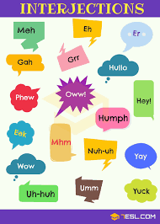
Interjection
*Words that express strong emotion or feeling.
Examples: Wow!, Ouch!, Oops!, Hey!, Hurray!, Oh!
Example in a sentence: Ouch! That hurt!

Slide 15


