Slide 1
E
M
C
o
E
L
W

Slide 2
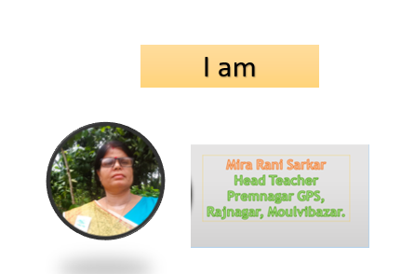


Slide 3
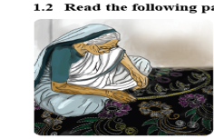

Slide 4



Slide 5




Slide 6

Word meanings

Slide 7

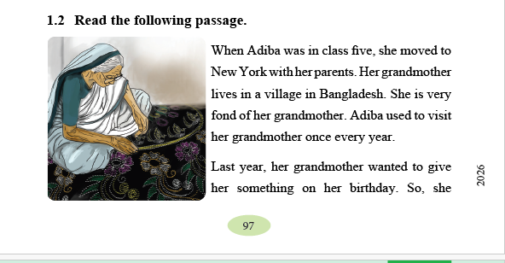

Slide 8
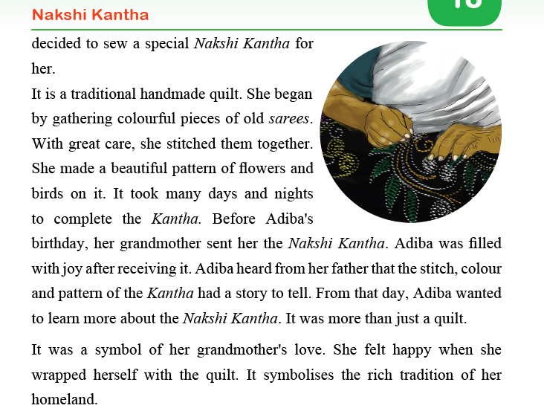

Slide 9





Slide 10



Slide 11


