Slide 1

my
dear
students

Slide 2

INTRODUCTION
Shahin Alam
Assistant Teacher
Koidola shahbazpur Govt.primary school
Jamalpur Sadar, Jamalpur
ENGLISH FOR TODAY
CLASS – ONE
UNIT -- 2
LESSON – 6

Slide 3
Learning outcomes
By end of the lesson students will be able to-------
1.1.1 recognize the sounds of the alphabet in familiar words
3.1.1 say proper sounds of the letters in familiar words
4.1.1 read the pictures of familiar objects and events

Slide 4

Greetings
Good morning, students.
How are you, my dear little students?
Good morning, teacher.
Fine, thank you, teacher.

Slide 5
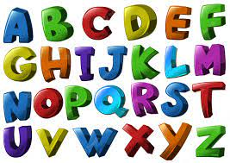

What did we learn yesterday ?
The Alphabet Song
https://www.youtube.com/watch?v=B5csN8gQY4E

Slide 6
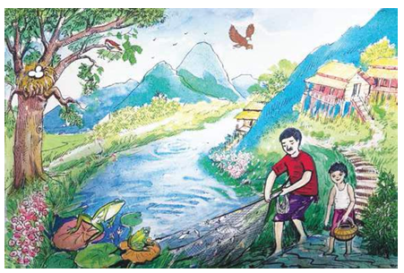
What can you see in the picture ?
Say the names of the things.
apple, ball ,cat, ant, cap, fish, dog, goat, elephant, egg.

Slide 7




Dear students-
Let’s watch a picture and think about this:

Slide 8
Today we are going to learn some English letters.
Alphabet (eE,fF).

Slide 9
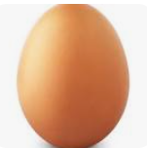
Look at the picture?
E
Egg
e
egg
What is this?
This is Egg.

Slide 10
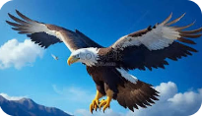
Look, listen and say
E
Eagle
a
eagle

Slide 11

Look, listen and say
fish
f
Fish
F

Slide 12

Look, listen and say
frog
f
Frog
F

Slide 13
Sound practice
e e e,
egg
e is for
Egg
E E E,
E is for
e e e
eagle
e is for
E E E
E is for
Eagle

Slide 14


Sound practice
f is for
f f f
fish
F F F
Fish
F is for
f is for
f f f
frog
F F F
Fish
F is for

Slide 15
Pair Work
eE
fF

Slide 16
Read and match the small and capital letters
e
f
F
E

Slide 17
Say the word…
egg
Eagle
fish
Fish

Slide 18
WCW
Find out the Letter “eE,fF”
D | f | E
e | C | F
H | E | c

Slide 19
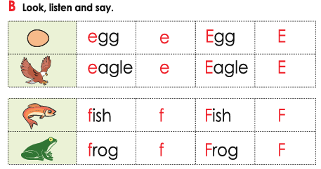
Dear students, open your textbook at page no - 23.

Slide 20
Matching Word with picture
Fish
frog
Egg
eagle

Slide 21
Home work
You will practice alphabet eE to fF at your home.

Slide 22

Thank
you

