Slide 1

my
dear
students

Slide 2

INTRODUCTION
Shahin Alam
Assistant Teacher
Koidola shahbazpur Govt.primary school
Jamalpur Sadar, Jamalpur
ENGLISH FOR TODAY
CLASS – ONE
UNIT -- 2
LESSON – 17

Slide 3
Learning outcomes
By end of the lesson students will be able to-------
1.1.1 recognize the sounds of the alphabet in familiar words
4.1.2 recognize and read aloud the capital letters properly
4.1.3 recognize and read aloud the small letters properly

Slide 4

Greetings
Good morning, students.
How are you, my dear little students?
Good morning, teacher.
Fine, thank you, teacher.

Slide 5
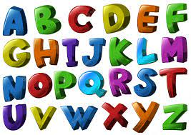

What did we learn yesterday ?
The Alphabet Song
https://www.youtube.com/watch?v=B5csN8gQY4E

Slide 6
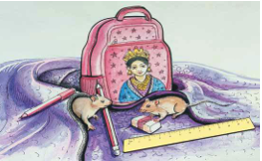
A Look at the picture. Say the names of the things and the objects that you see.
apple, ball ,cat, ant, cap, fish, dog, goat, elephant, egg.

Slide 7
Dear students-
Let’s watch a picture and think about this:

Slide 8
Today we are going to learn some English letters.
Alphabet (qQ,rR).

Slide 9
Look at the picture?
q
quilt
Q
Quilt
What is this?
This is Quilt.

Slide 10
Look, listen and say
queen
q
Q
Queen
What is this?
This is Queen
.

Slide 11
Look, listen and say
ruler
r
Ruler
R
What is this?
This is Ruler.

Slide 12
Look, listen and say
rat
r
Rat
R
What is this?
This is Rat.

Slide 13
Sound practice
quilt
q q q
q is for
Q Q Q
Q is for
Quilt
q q q
q is for
queen
Q Q Q
Q is for
Queen

Slide 14
Sound practice
r r r
r is for ruler
R R R
Ruler
R is for
r is for
r r r
rat
R R R
Rat
R is for

Slide 15
Pair Work
qQ
rR

Slide 16
Read and match the small and capital letters
q
r
R
Q

Slide 17
Say the word…
quilt
Queen
queen
Quilt

Slide 18
Say the word…
ruler
Rat
rat
Ruler

Slide 19
WCW
Find out the Letter “qQ rR”
D | R | E
r | C | q
p | Q | c

Slide 20
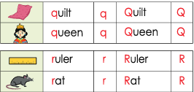
Dear students, open your textbook at page no - 51.
B.Look, listen and say.

Slide 21
Matching Word with picture
Ruler
Rat
quilt
Queen

Slide 22
Home work
You will practice alphabet qQ to rR at your home.

Slide 23

Thank
you

