Slide 1

my
dear
students

Slide 2
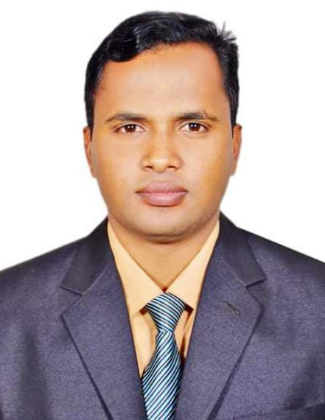

INTRODUCTION
ENGLISH FOR TODAY
CLASS – ONE
UNIT -- 2
LESSON – 17
Page:52
Shahin Alam
Assistant Teacher
Koidola shahbazpur Govt.primary school
Jamalpur Sadar, Jamalpur

Slide 3
Learning outcomes
By end of the lesson students will be able to-------
3.1.1 say proper sounds of the letters in familiar words
4.1.2 recognize and read aloud the capital letters properly
4.1.3 recognize and read aloud the small letters properly

Slide 4
Teaching Aids:
Picture of Activity C, E; letter cards/ wooden letters/ plastic letters; audio/video clip (if available)

Slide 5

Greetings
Good morning, students.
How are you, my dear little students?
Good morning, teacher.
Fine, thank you, teacher.

Slide 6
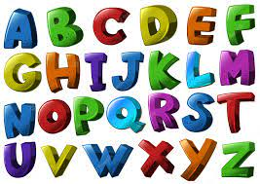

What did we learn yesterday ?
The Alphabet Song
https://www.youtube.com/watch?v=B5csN8gQY4E

Slide 7
c Listen, say and read.
q
Q
r
R

Slide 8
D Trace in the air. Trace and write.
q
q
q
q
Q
Q
Q
r
r
r
r
R
R
R
R

Slide 9
E Read and match the small and capital letters.
q
Q
r
R

Slide 10
E Read and match the small and capital letters.
h
r
D
p
Q

Slide 11

E Read and match the small and capital letters.

Slide 12
E Read and match the small and capital letters.
h
r
D
p
Q
R
H
P
q
d

Slide 13
E Read and match the small and capital letters.
Q
r
r
Q
q
Q
R
R
q
Q

Slide 14


G Project: Letter Craft. See the pictures and make your own fun letters.

Slide 15
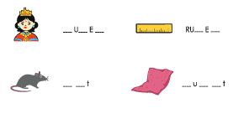
F What do you see in the pictures? Write the missing letter to complete the name of who or what you see
Q E N
L R
R a
Q I l

Slide 16
Home work
You will practice alphabet qQ to rR at your home.

Slide 17

Thank
you

