Slide 1

my
dear
students

Slide 2
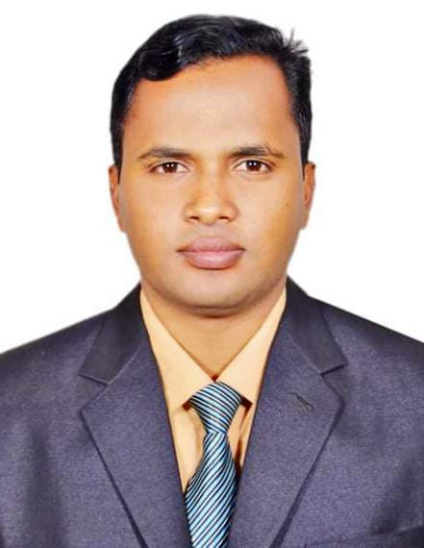

INTRODUCTION
ENGLISH FOR TODAY
CLASS – ONE
UNIT -- 2
LESSON – 09
Page:30
Shahin Alam
Assistant Teacher
Koidola shahbazpur Govt.primary school
Jamalpur Sadar, Jamalpur

Slide 3
Learning outcomes
By end of the lesson students will be able to-------
3.1.1 say proper sounds of the letters in familiar words
4.1.2 recognize and read aloud the capital letters properly
4.1.3 recognize and read aloud the small letters properly

Slide 4
Teaching Aids:
Picture of Activity C, E; letter cards/ wooden letters/ plastic letters; audio/video clip (if available)

Slide 5

Greetings
Good morning, students.
How are you, my dear little students?
Good morning, teacher.
Fine, thank you, teacher.

Slide 6
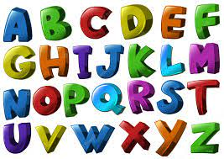

What did we learn yesterday ?
The Alphabet Song
https://www.youtube.com/watch?v=B5csN8gQY4E

Slide 7
c Listen, say and read.
g
G
h
H

Slide 8
D Trace in the air. Trace and write.
g
g
g
g
G
G
G
h
h
h
h
H
H
H
H

Slide 9
E Read and match the small and capital letters.
G
d
F
h
e

Slide 10
E Read and match the small and capital letters.
D
H
g
E
f

Slide 11
E Read and match the small and capital letters.
m
O
J
n
P
o
j
M
p
N

Slide 12
E Read and match the small and capital letters.
m
O
J
n
P
o
j
M
p
N

Slide 13
E Read and match the small and capital letters.
g
H
H
G
G
g
h
h
G
G

Slide 14
Home work
You will practice alphabet gG to hH at your home.

Slide 15

Thank
you

