Slide 1

my
dear
students

Slide 2


INTRODUCTION
ENGLISH FOR TODAY
CLASS – ONE
UNIT -- 2
LESSON – 12 Numbers 7,8
Page:37,38
Shahin Alam
Assistant Teacher
Koidola shahbazpur Govt.primary school
Jamalpur Sadar, Jamalpur

Slide 3
Learning outcomes
By end of the lesson students will be able to-------
4.1.4 read aloud cardinal numbers in figures properly
7.2.3 write cardinal numbers in figures neatly and legibly

Slide 4
Teaching Aids:
Teaching aids: Picture of activity A, B/ number card.
Picture of the activity C, D, number card.

Slide 5

Greetings
Good morning, students.
How are you, my dear little students?
Good morning, teacher.
Fine, thank you, teacher.

Slide 6
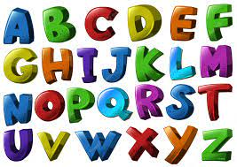

What did we learn yesterday ?
The Alphabet Song
https://www.youtube.com/watch?v=B5csN8gQY4E

Slide 7
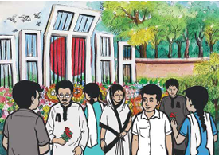
A. What do you see in the picture?

Slide 8


B Look, listen and say. Read the numbers.
7
6

Slide 9
c Trace in the air. Trace and write.
7
7
7
7
7
7
7

Slide 10
c Trace in the air. Trace and write.
7
7
7
7
7
7
7

Slide 11
c Trace in the air. Trace and write.
8
8
8
8
8
8
8

Slide 12
c Trace in the air. Trace and write.
8
8
8
8
8
8
8

Slide 13




c Trace in the air. Trace and write.

Slide 14
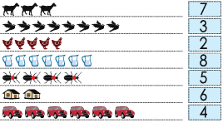
D Count and write the number of petals in each flower.

Slide 15
D Count the objects that you see each picture. Match with the numbers
7
3
2
8
5
6
4

Slide 16
Home work
You will practice alphabet 7,8 at your home.

Slide 17

Thank
you

