Slide 1
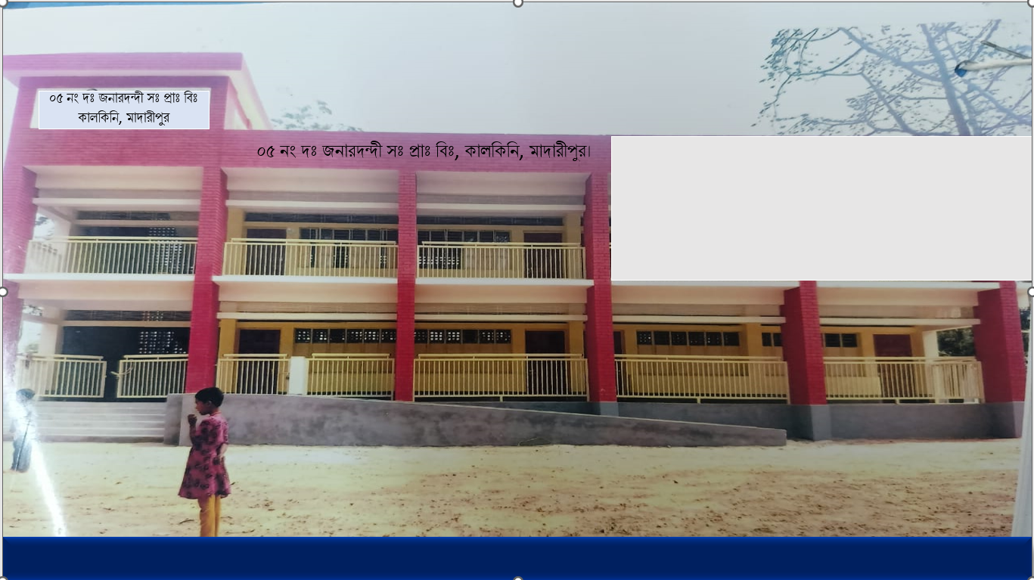



WEL COME
Class - Four
Subject - English
Unit - 17
I want
to join
English class
*05 No South Jonardondi GPS* * Kalkini, Madaripur. *

Slide 2
Introducing
Belayet Hossain
Assistant Teacher
05 No South Jonardondi GPS
Kalkini, Madaripur.
Gmail : belayet01715205765@gmail.com

Slide 3

INTRODUCING
Class : Four
Subject : English
Unit : 17
The Land of Mountains
Activity : 1.1, 1.2
Page : 77.
Time : 45 minutes

Slide 4
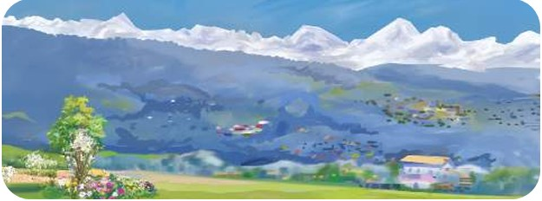
Can you guess what is our today's lesson?
What is the relationship between them?

Slide 5
Today's Our Lesson
The Land of Mountains
Unit - 17.
1.1, 1.2

Slide 6
Learning Outcomes
Students will be able to:-
Listening:-
4.3.1 - enjoy and understand simple stories.
Speaking:-
3.1.1 - ask and answer Wh questions.
Reading:-
5.1.1 - read simple paragraphs.
Writing:-
8.1.3 - write sentence from the text book or model.
10.1.1 - write short and simple paragraphs answering a
set of questions.

Slide 7
Who can you see in the picture?
New Words
Forest
Which field with trees.
Nepal is a land of beauty. It is a country of mountains, hills, lakes, forests, and temples. It is famous for its high mountains such as Mount Everest, Mount Annapurna, Mount Manaslu, Mount Daulagiri etc. Mount Everest is the highest mountain in the world. Sir Edmund Hillary and Tenzing Norgay were the first to successfully reach the summit ofEverest in 1953. Besides mountains, Nepal has lovely lakes. One of the most famous lakes is Phewa Lake in Pokhara. You can ride on boats on the lake. The reflection of the mountains in the clear water will make you happy. Nepal also has green forests filled with trees, animals and colorful birds. In Chitwan National Park, you can see elephants, rhinos and even tigers.

Slide 8

The Land of Mountains
Nepal is a land of beauty. It is a country of mountains, hills, lakes, forests, and temples. It is famous for its high mountains such as Mount Everest, Mount Annapurna, Mount Manaslu, Mount Daulagiri etc. Mount Everest is the highest mountain in the world. Sir Edmund Hillary and Tenzing Norgay were the first to successfully reach the summit ofEverest in 1953. Besides mountains, Nepal has lovely lakes. One of the most famous lakes is Phewa Lake in Pokhara. You can ride on boats on the lake. The reflection of the mountains in the clear water will make you happy. Nepal also has green forests filled with trees, animals and colorful birds. In Chitwan National Park, you can see elephants, rhinos and even tigers.

Slide 9
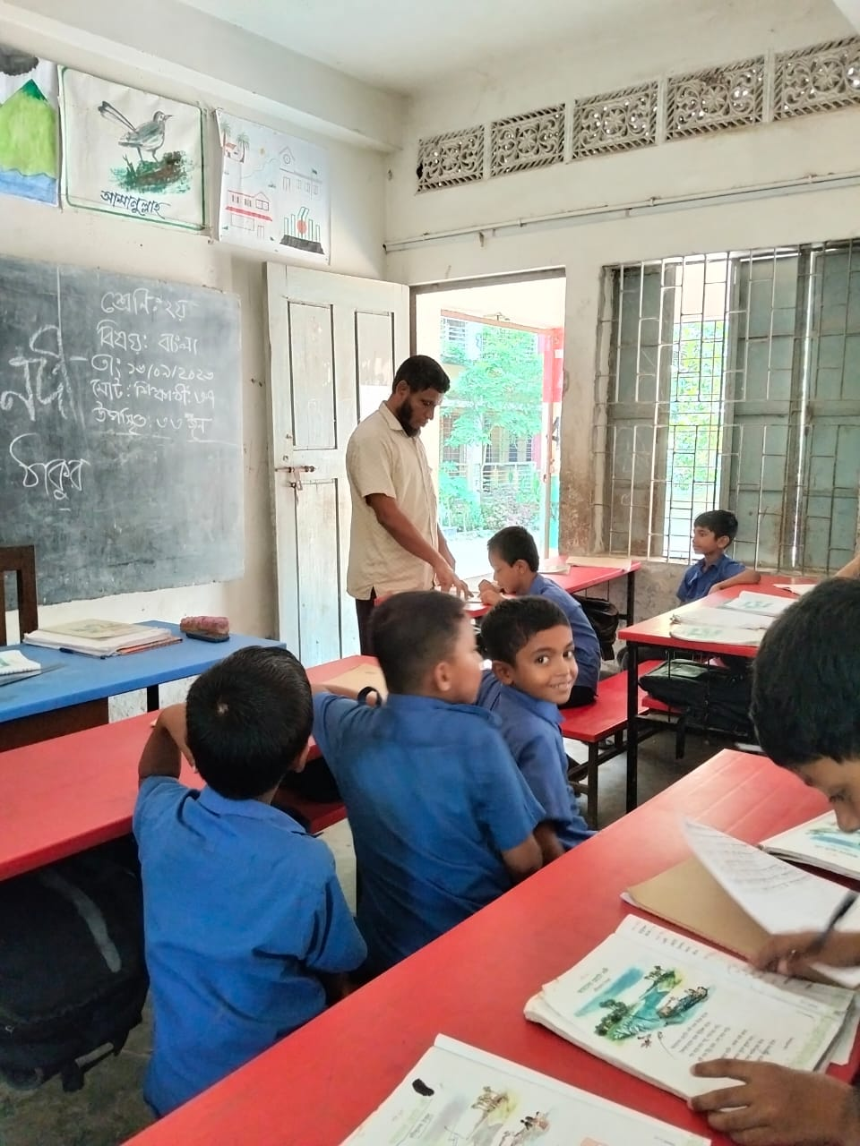
Teacher’s reading

Slide 10
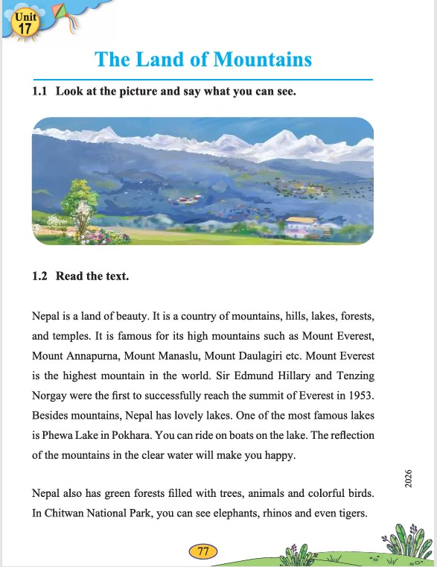
Open your English book at page - 77.

Slide 11
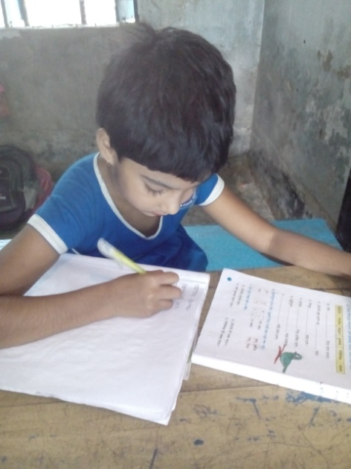
Individual Work
Make sentence by the words:
Land
Lake
World

Slide 12
Nepal is a land of beauty. It is a country of mountains, hills, lakes, forests, and temples. It is famous for its high mountains such as Mount Everest, Mount Annapurna, Mount Manaslu, Mount Daulagiri etc. Mount Everest is the highest mountain in the world. Sir Edmund Hillary and Tenzing Norgay were the first to successfully reach the summit of Everest in 1953. Besides mountains, Nepal has lovely lakes. One of the most famous lakes is Phewa Lake in Pokhara. You can ride on boats on the lake. The reflection of the mountains in the clear water will make you happy. Nepal also has green forests filled with trees, animals and colorful birds. In Chitwan National Park, you can see elephants, rhinos and even tigers.
Which country is the land of beauty?
What? is Nepal famous for?
Which mountain is the higest mountain in the world?
How kind of forest does Nepal has?
Which kinds of animal does Chitwan National Park found?
Answer
Please click answer button for answer
Pair Work
Answer
Time: 5 minute's
Answer
Answer
Answer

Slide 13

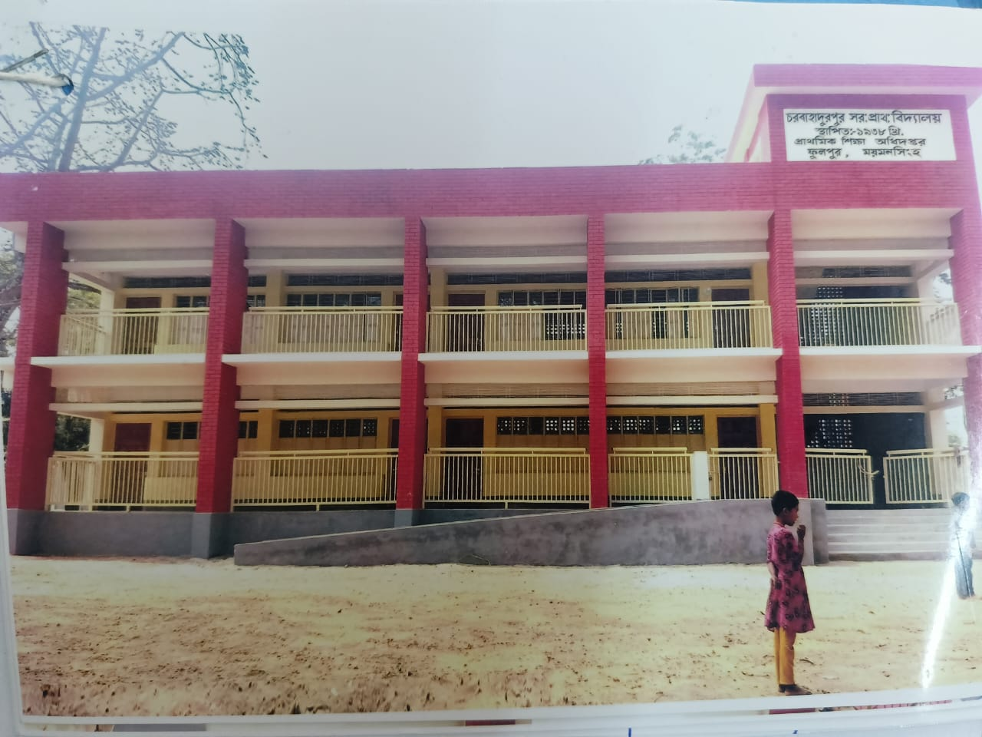

Group Work
Time: 10 minute's
The Land of Mountains

Slide 14
Individual Work
Read the sentences. Write T for True and F for False.
Nepal is a land of beauty.____
It is famous for its small mountains. ____
Mount Everest is the highest mountain in the world._____
Nepal has lovely lakes.____
Nepal also has green forests filled with trees. ___
T
F
T
T
T

Slide 15
Pair Work
Ask and answer.
What is the story about?
What animals can be seen in Chitwan National Park?
Why is Phewa Lake attractive to the tourists?
Why should one go to visit Nepal?
Which kinds of animal does Chitwan National Park found?

Slide 16
Evaluation
Look attentively. Now we play a game. Everybody close your eyes.
Which word is missing?
Open your eyes.
Clear
Nepal
Tigers

Slide 17
Evaluation
Write three sentences about The Land of Mountains.

Slide 18
Thanks to All

