Slide 1
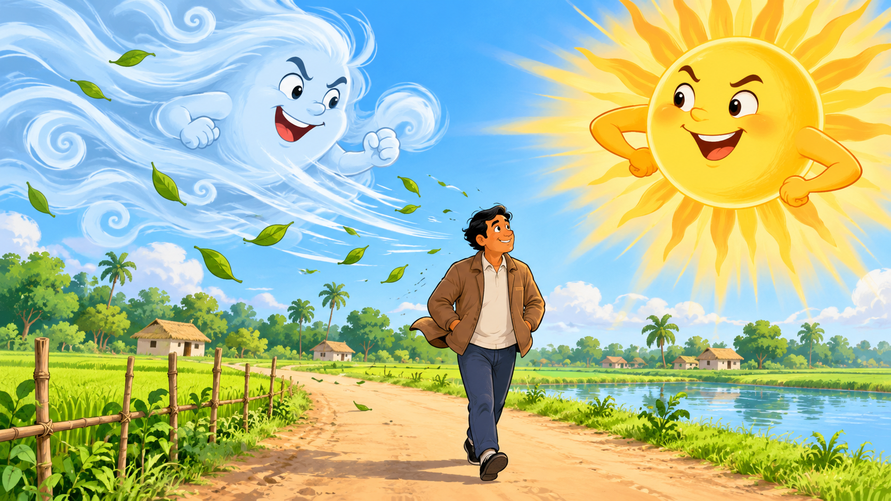
THE WIND
AND THE SUN
Unit 19
Session 92
Class Five
English for Today

Slide 2

Meet Your Teacher 👋
Mubarak Miah
Assistant Teacher
Julekhanagar Tea Garden
Govt. Primary School,
Sreemangal

Slide 3
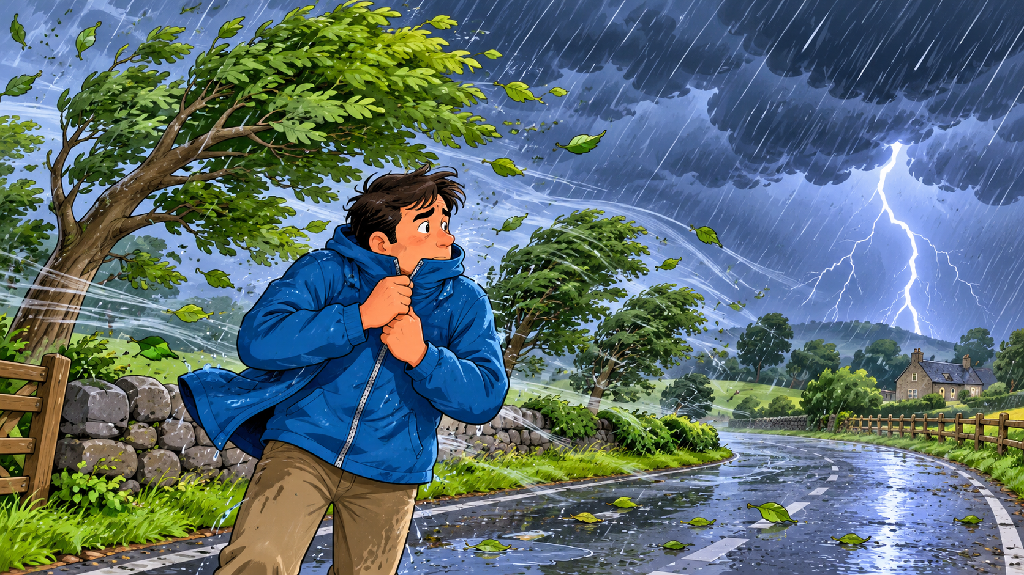
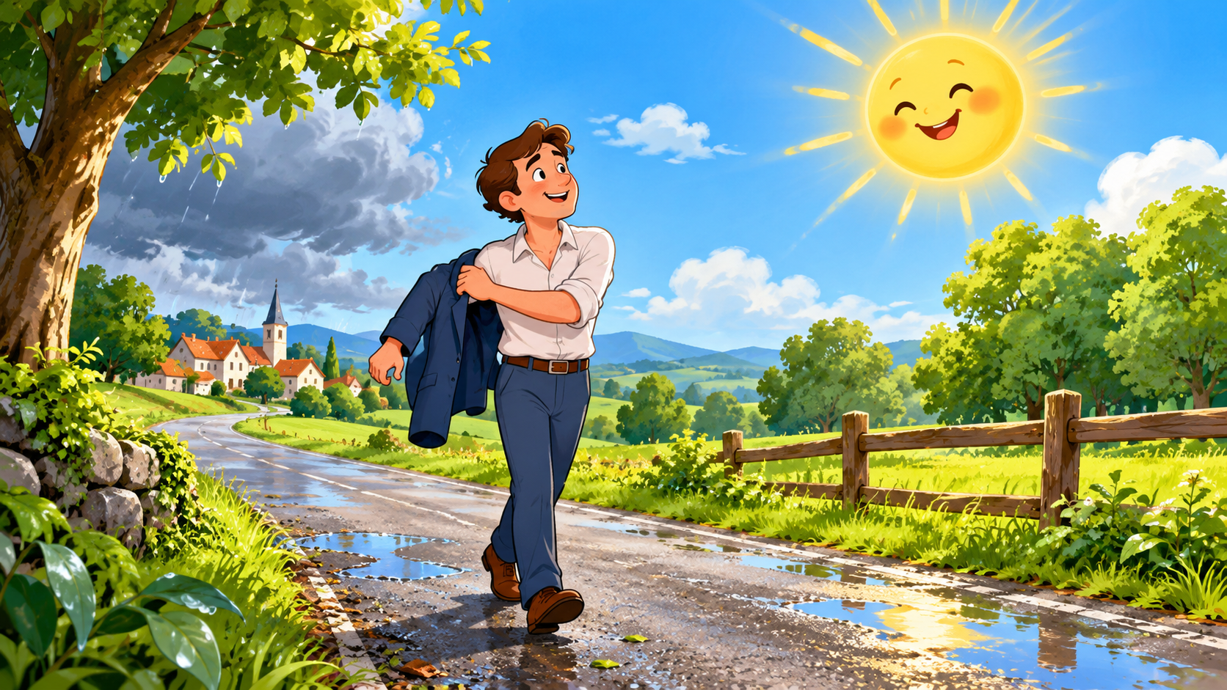
Warm-Up: Feel the Weather!
STRONG WIND
HOT SUNSHINE
Which one have you felt? Tell your partner!

Slide 4
Prediction Time!
Who is stronger?
WIND
SUN
Vote with your hands!

Slide 5
Today's Learning Goal
I can read the story aloud
with proper
STRESS & INTONATION.
Listen • Trace • Read • Enjoy

Slide 6
Word Power
GUST
দমকা বাতাস
STORM
ঝড়
JACKET
জ্যাকেট
POWERFUL
শক্তিশালী

Slide 7
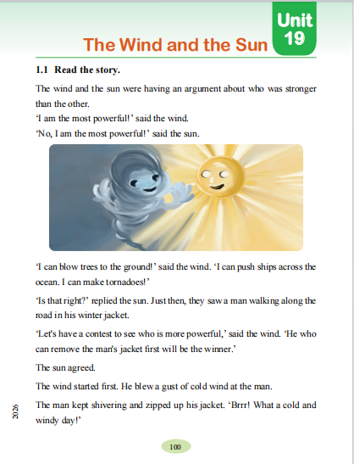
Textbook Time
1. Open page 100
2. Point with your finger
3. Listen carefully
4. Read together
PAGE 100

Slide 8
Story Part 1: The Challenge
Wind: “I am the most powerful!”
Sun: “No, I am the most powerful!”
They see a man wearing a jacket.
Who can make him remove it first?

Slide 9
Story Part 2: The Wind Tries
The wind blew hard.
Rain became a storm.
The man zipped his jacket HIGHER!

Slide 10
Story Part 3: The Sun Tries
The sun shone gently and warmly.
The man felt HOT.
He removed his jacket. The Sun won!

Slide 11
Think • Pair • Share
1
Who claimed to be more powerful?
2
What did the wind do to the man?
3
How did the sun win?

Slide 12
Stress & Intonation
“I am the MOST powerful!” ↗
“What STRANGE weather!” ↗
“I have WON!” ↘

Slide 13
Group Reading: Chain Drill
One sentence each. Read clearly. Help your friend!
1
2
3
4
5
→ → → →
Listen to your friend — then continue!

Slide 14
FLN Reading Ladder
1. LISTEN
Teacher reads first
2. POINT & REPEAT
Follow the words
3. TRACE & READ
Use your finger
4. READ ALONE
You can do it!

Slide 15
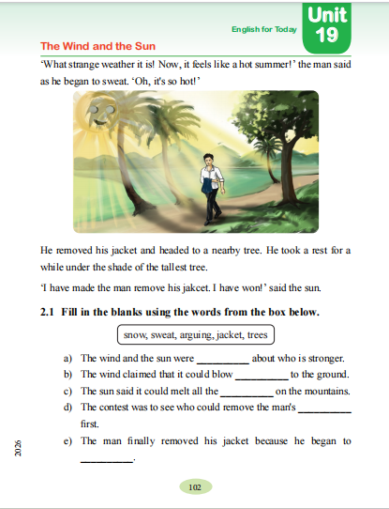
Quick Check
1. Who claimed to be more powerful?
2. What did the wind do to the man?
3. How did the sun win?
Think → Pair → Share

Slide 16
Assessment: Read Aloud
Read ONE sentence from the story.
Clear words
Correct stress
Natural intonation
Confident voice

Slide 17
Great Job!
Today we:
• read the story aloud
• used stress & intonation
• helped our friends
Home Reading:
Read pages 100–102 twice.
See you next class!

