Slide 1
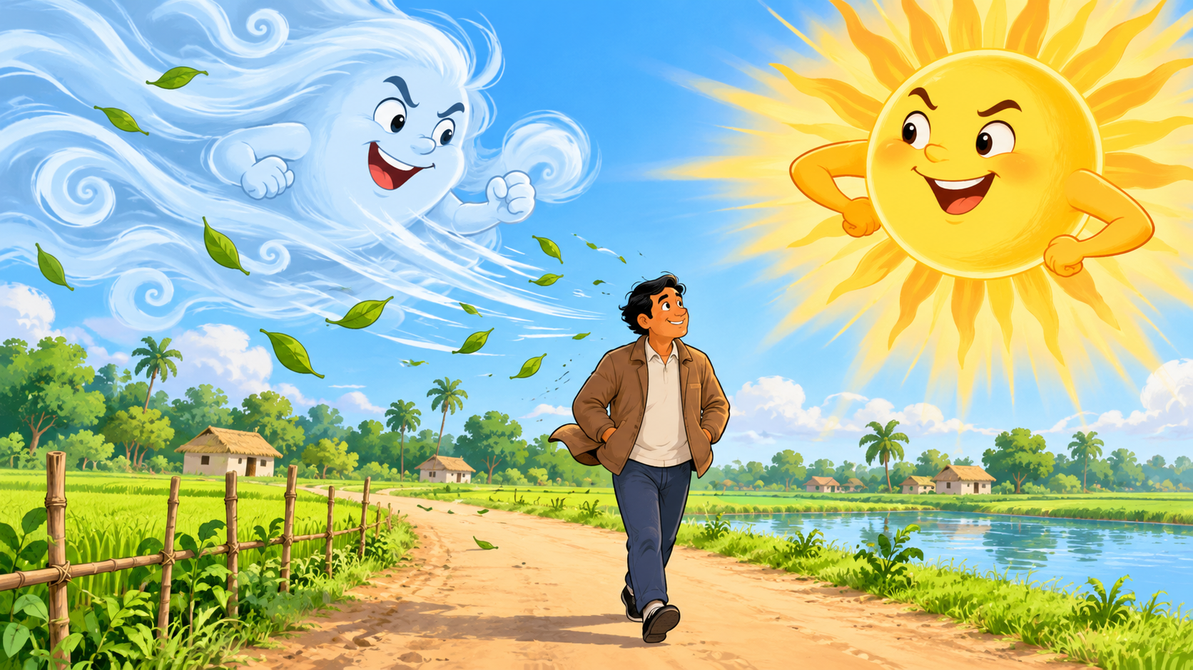

THE WIND AND THE SUN
SESSION 93
Fill in the blanks • Answer from the story
Class Five • English for Today
Mubarak Miah • Assistant Teacher

Slide 2
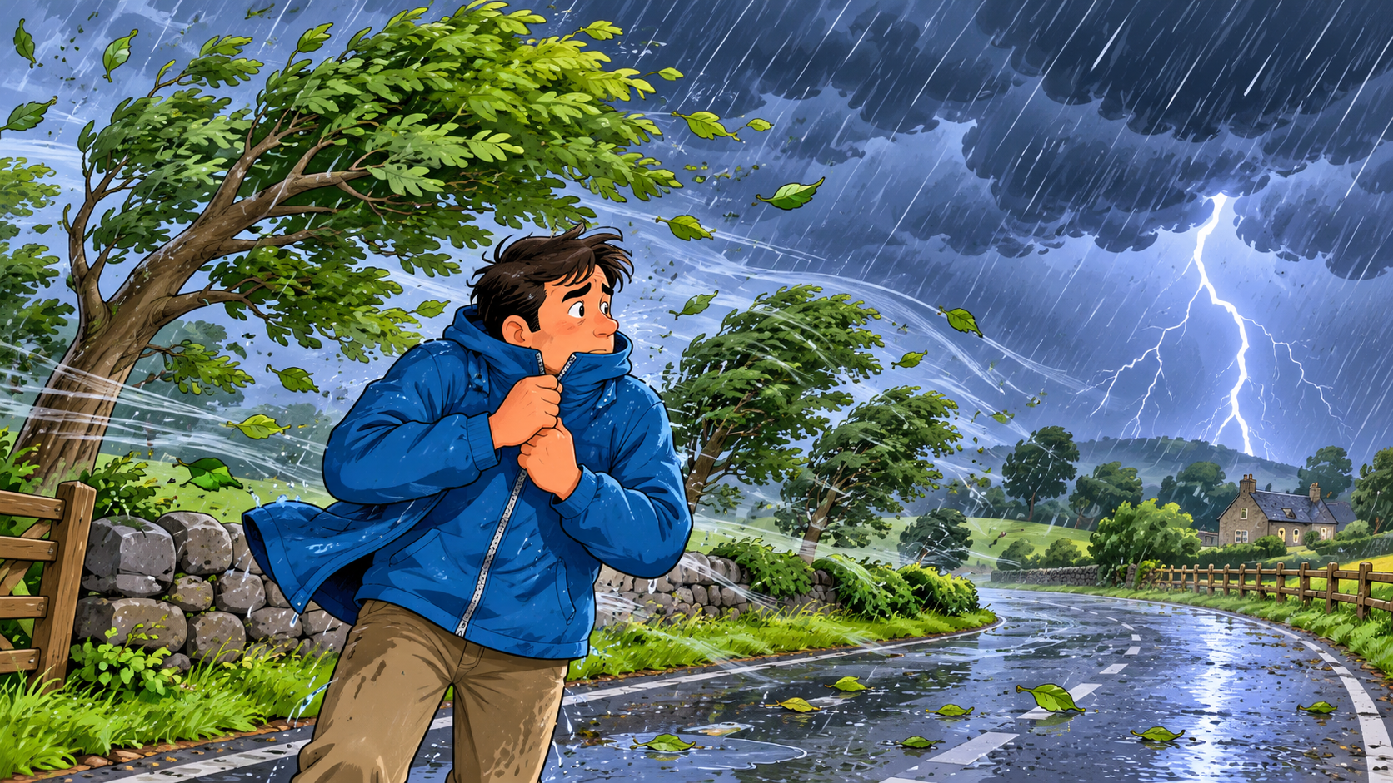
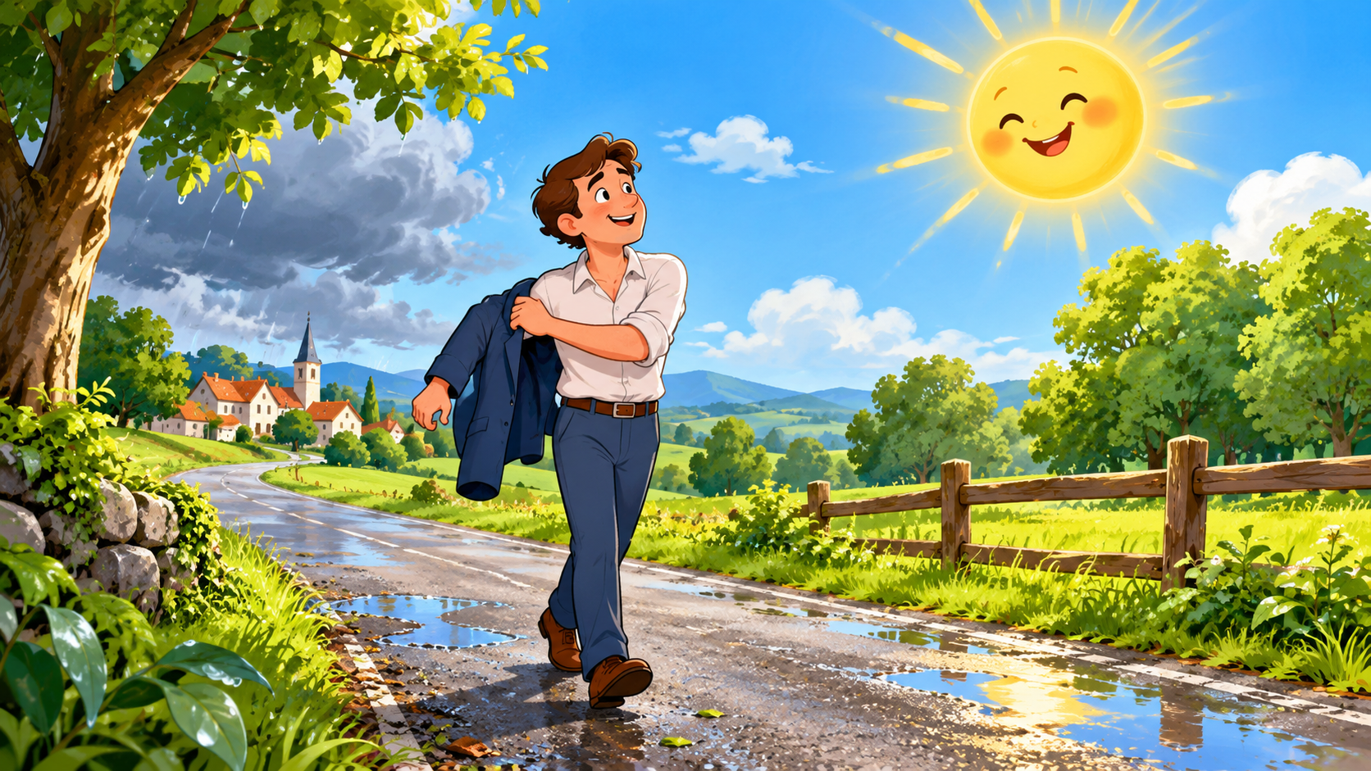
WELCOME BACK! WHO WON THE CONTEST?
What did the Wind do? What did the Sun do?

Slide 3
TODAY'S LEARNING GOALS 🎯
I can find SPECIFIC INFORMATION from the story.
💡 I can understand the GENERAL IDEA of a simple text.

Slide 4
WORD POWER 🔤
❄️ SNOW — তুষার
💦 SWEAT — ঘাম
🗣️ ARGUING — তর্ক করা
🧥 JACKET — জ্যাকেট
🌳 TREES — গাছগুলো
Say it → Act it → Remember it!

Slide 5
ACT THE WORD! 🎭
❄️ snow → shiver like it is cold
💦 sweat → wipe your forehead
🧥 jacket → pretend to zip it
🌳 trees → stretch your arms high
🗣️ arguing → two people disagree
Ready? Teacher says — YOU ACT!

Slide 6
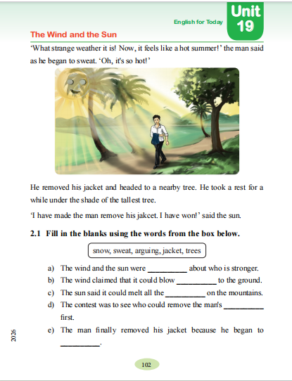
ACTIVITY 2.1 — FILL IN THE BLANKS ✏️
WORD BOX:
SNOW • SWEAT • ARGUING • JACKET • TREES
Read the whole sentence.
Look for the clue.
Choose ONE word.
Read the sentence again.

Slide 7
WORD DETECTIVE — ROUND 1 🔍
Word Box: snow • sweat • arguing • jacket • trees
A. The wind and the sun were ______ about who is stronger.
B. The wind claimed that it could blow ______ to the ground.
👉 Whisper your answer to your partner.

Slide 8
WORD DETECTIVE — ROUND 2 🔍
C. The sun said it could melt all the ______ on the mountains.
D. The contest was to see who could remove the man's ______ first.
E. The man removed his jacket because he began to ______.
💡 Use the story clue — not a guess!

Slide 9
PAIR CHECK
Exchange your exercise book.
Read each completed sentence aloud.
Put ✓ beside an answer you agree with.
If answers are different — FIND THE CLUE in the story.
Be kind. Help your friend.

Slide 10
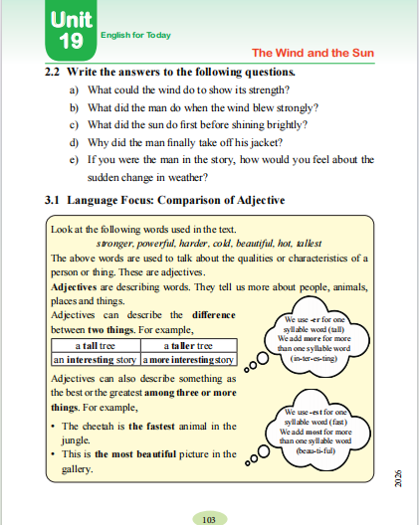
ACTIVITY 2.2 — STORY QUESTIONS 📖
A. What could the wind do to show its strength?
B. What did the man do when the wind blew strongly?
🔎 Find the answer in the story.
✍️ Write in a complete sentence.

Slide 11
STORY QUESTIONS - CONTINUE!
C. What did the sun do first before shining brightly?
D. Why did the man finally take off his jacket?
E. If you were the man, how would you feel about the sudden change in weather?
Think - Talk - Write

Slide 12
PAIR WRITING ROUTINE
1. READ the question.
2. FIND the clue in the story.
3. SAY the answer to your partner.
4. WRITE a complete sentence.
5. SWAP books and CHECK.
Sentence starters:
The wind - The man - The sun -

Slide 13
STORY DETECTIVE
SPECIFIC INFO:
What did the man do in the storm?
GENERAL IDEA:
Who used a better way to win - the Wind or the Sun?
Point to the story clue before you answer.

Slide 14
QUICK ASSESSMENT
1. Complete ONE missing word aloud.
2. Answer ONE story question.
3. Show the clue in the text.
I can choose the right word.
I can answer from the story.
I can help my partner.

Slide 15
WHAT DID WE LEARN TODAY?
We learned five new words.
We completed sentences from the story.
We answered questions in pairs.
We checked our partner's work kindly.
The story is easier when we FIND THE CLUE.

Slide 16
GREAT JOB!
HOME PRACTICE
Read Activities 2.1 and 2.2 once more.
Learn: snow, sweat, arguing, jacket, trees.
Tell one family member who won the story and why.
SEE YOU NEXT CLASS!

