Slide 1

Welcome

Slide 2
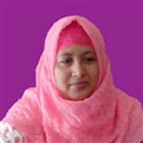


Introduction
Ayesha Siddiqua
Head Teacher
Rampur GPS
Laksam,Cumilla
Class : One & Two
Sub : English
Unit : 4
Lesson : 5
Topics : Colours
Time : 30 minutes

Slide 3
Learning COLOURS

Slide 4
At first, I wonder by how many ways I can teach the name of colors easily. So, I made a color board. I applied it in my classroom and my students responded well to this.

Slide 5
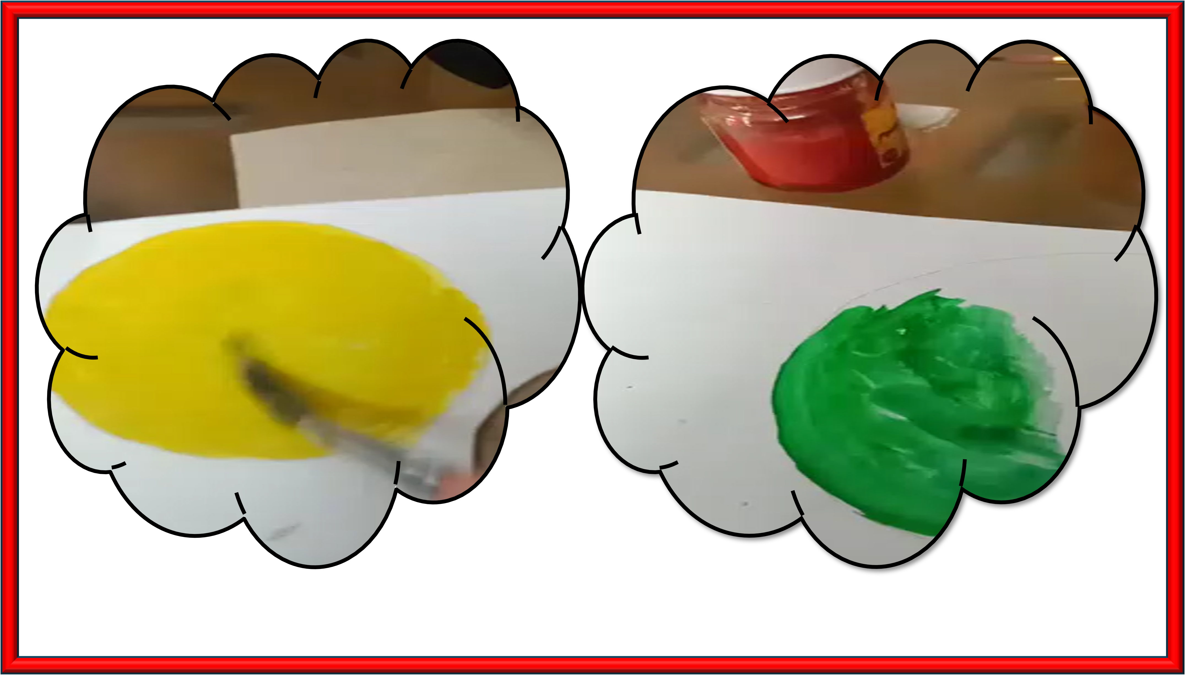

Slide 6
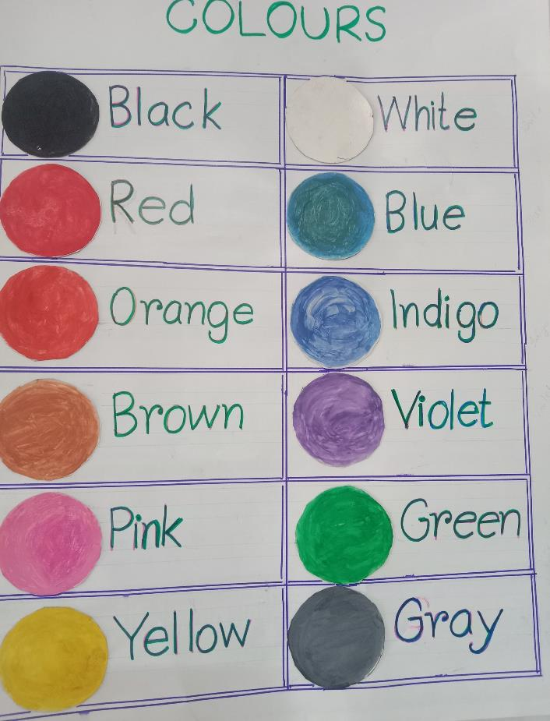

Slide 7
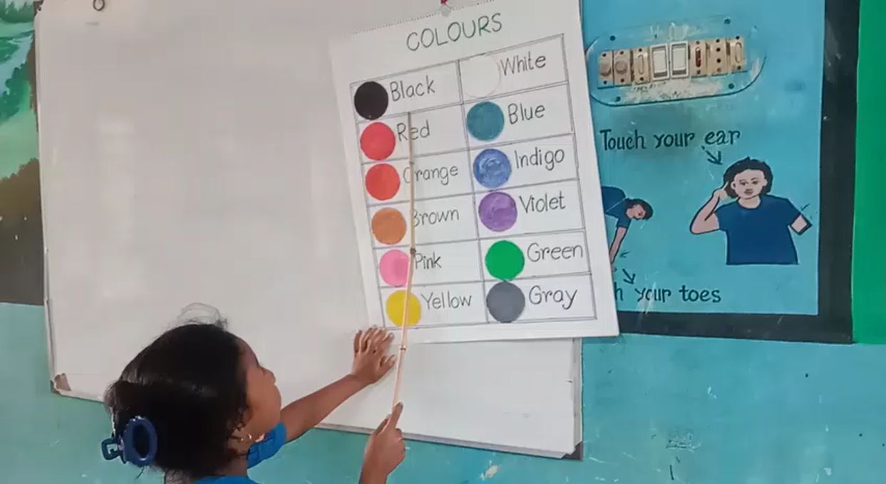

Slide 8
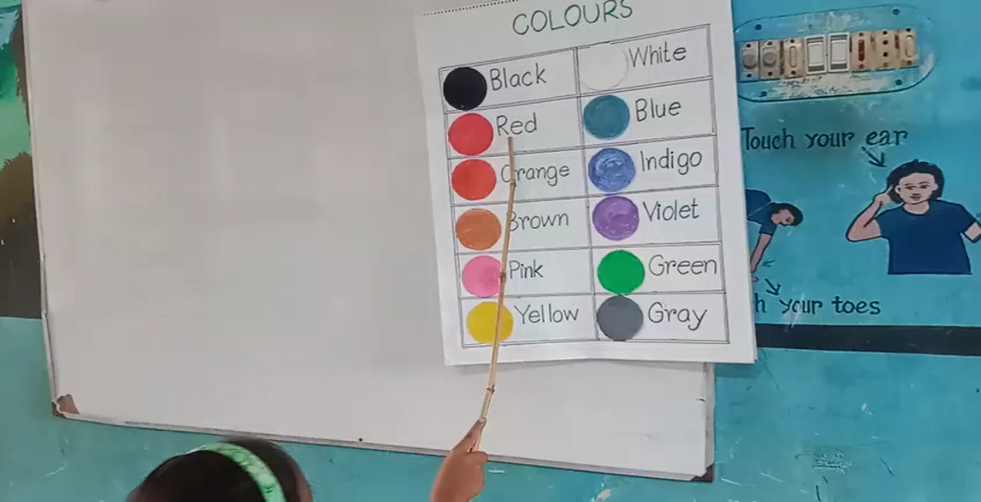

Slide 9
Match the Colours
Indigo
Black
Green
Gray
Red
Yellow
Brown
White
Pink
Violet
Blue
Orange

Slide 10


