Slide 2
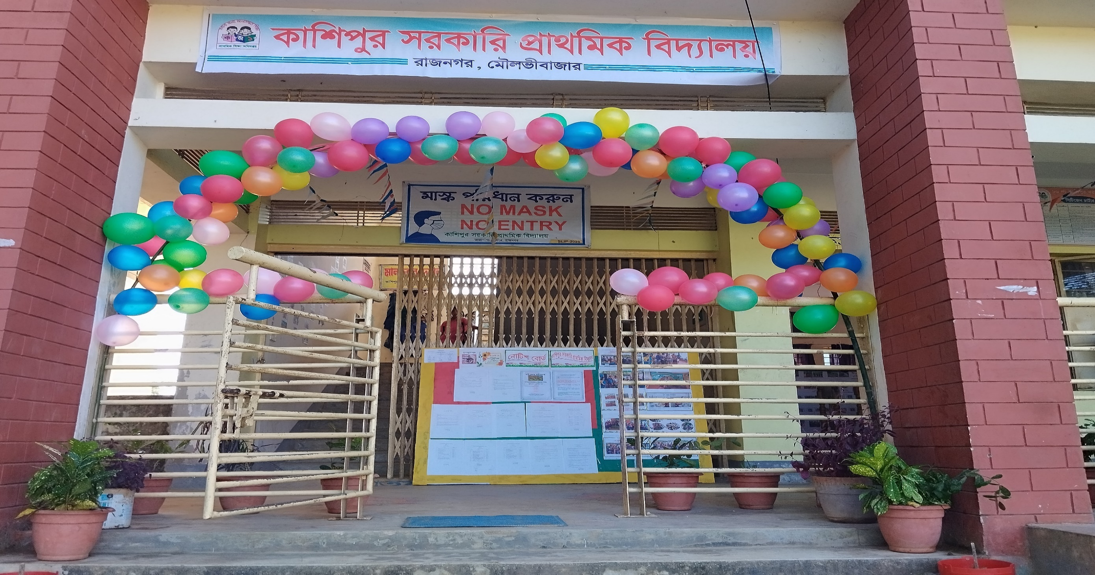
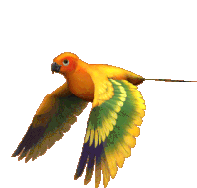
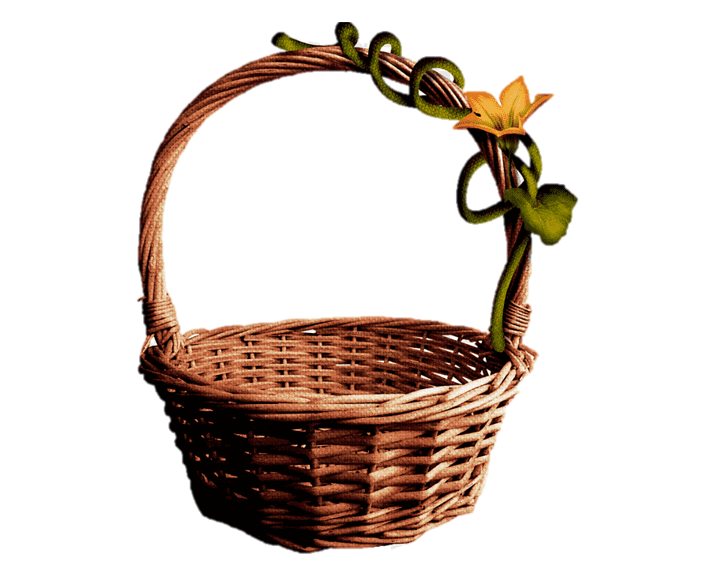
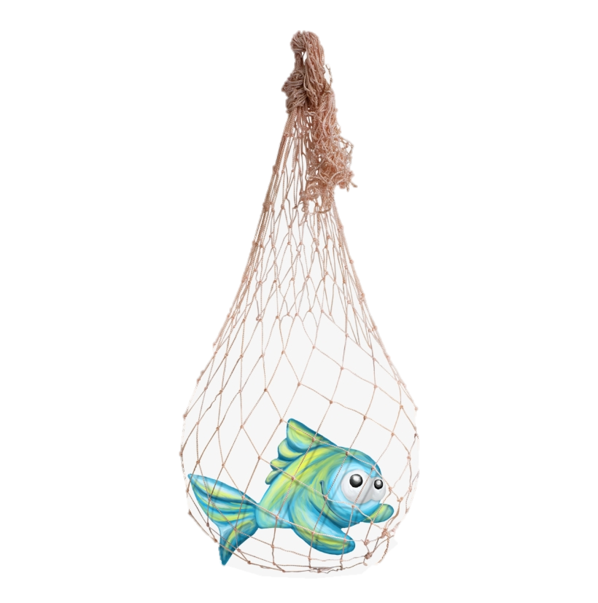



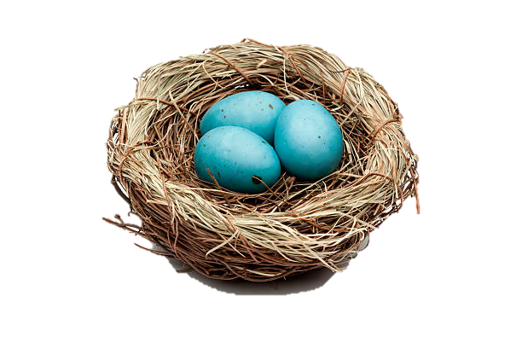
H
O
L
L
E

Slide 3




Presented by ,,
Smriti Rani Dey
Head Teacher
Kashipur GPS.
Rajnagar ,Moulvibazar
Best Teacher 2024 ,Sylhet Division
smritidey2011@gmail.com

Slide 4



Introduction
Class one
Unit 2
Lesson14(Mm,Nn)
Page 42

Slide 5
LISTENING:
1.1.1 recognize the sounds of the alphabet in familiar words .
1
SPEAKING:
3.1.1 say proper sounds of the letters in familiar words .
2
READING:
4.1.1 read the pictures of familiar objects and events.
3

Slide 6
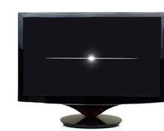
Let’s sing.

Slide 7

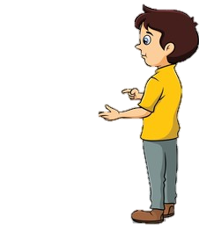
What did we learn yesterday ?
Kk
Ll

Slide 8
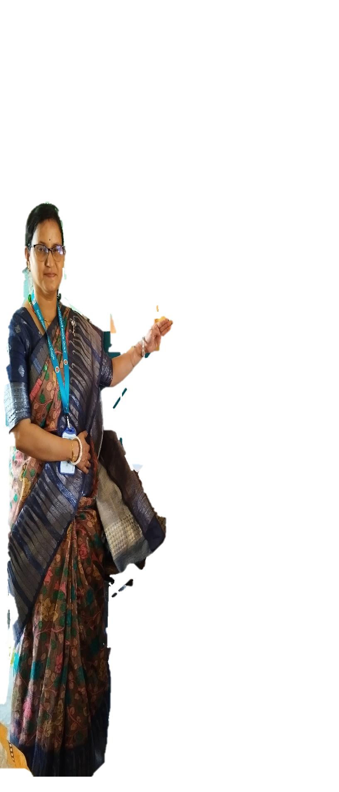
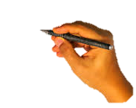
We are going to learn some English letters today ,
Mn Nn

Slide 9
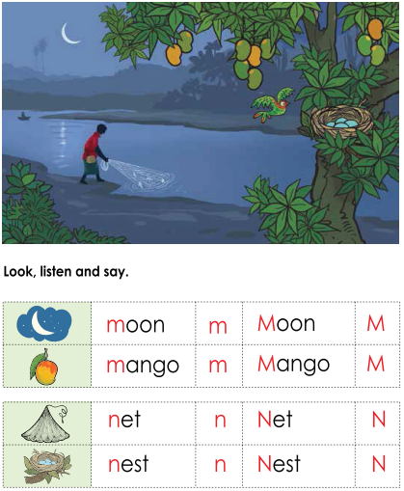
Open your book at page : 42
What can you see in the picture?

Slide 10
What can you see in the picture?
moon
mango
man
bird
net
nest

Slide 11

What’s this?
How do we say that in English?

Slide 12
Listen to me and repeat after me
moon
Moon
m
M

Slide 13
What’s this?
How do we say that in English?

Slide 14
Listen to me and repeat after me
mango
m
Mango
M

Slide 15
Listen to me and repeat after me
Small m
m
capital M
M

Slide 16
The letter name of M is
/em/

Slide 17
What’s this?
How do we say that in English?

Slide 18
Listen to me and repeat after me
net
n
Net
N

Slide 19
What’s this?
How do we say that in English?

Slide 20
Listen to me and repeat after me
n
nest
Nest
N

Slide 21
Listen to me and repeat after me
Small n
n
capital N
N

Slide 22
The letter name of N is
/en/

Slide 23





What’s this?
Pair work
nest
mango
moon
net

Slide 24
Say the sound of letter
Pair work
m
n
/em/
M
N
/en/

Slide 25
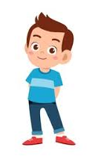
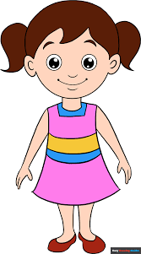
When I say the word(moon,mango,net,nest)you will touch the picture .Whoever touches first get 1 Point
Group 1
Group 2
1+1+ | 1+1+
Group 1
Group 2
Let’s play touch the board.

Slide 26

Matching letter with picture.
Group 1
Group 2
n
m
m
n
Group work

Slide 27

Lets play a game (kims game).
Close your eyes
Open your eyes
Which word have I covered

Slide 28
What’s this?
IW
nest
mango
moon
net

Slide 29
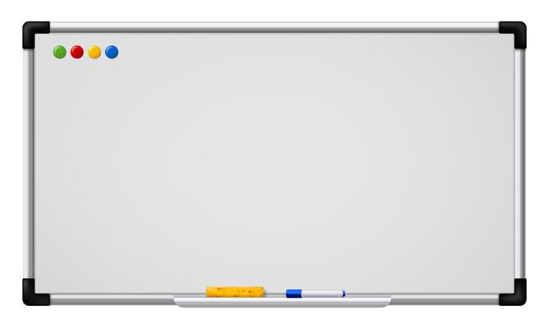
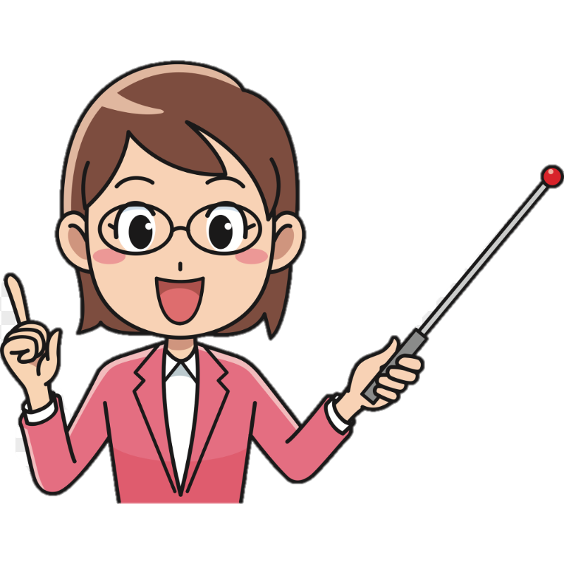
Assessing learning
Listen to the audio and round the correct letter.
g
f
k
h
/em/
e
c
d
m

Slide 30
Assessing learning
Listen to the audio and round the correct letter.
g
f
k
h
/en/
n
c
d
m

Slide 31


Assessing learning
n
m
mango
net
nest
moon
n
Say the first letter ..
m

Slide 32

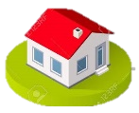
Draw and colour a mango.

