Slide 1

Welcome
To
Online Class
Bhatpara High School (Kuthi)
Gangni, Meherpur.

Slide 2
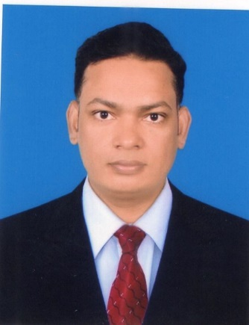
Introduction
Md. Ajim Uddin (Ssagor)
Assistant Teacher (English)
Bhatpara High School (Kuthi)
Gangni, Meherpur.

Slide 3
Class = Nine
Subject = English 2nd Paper
Topic = Conjunction , Verb.

Slide 4
Conjunctions
Sub-ordinating Conjunctions = As, Since, When, If, That, So That, In order that, Though, Although, So……That, As…….So, Unless, Until, Till, Who, Whom, Whose etc .
Examples=
1. I went to market so that I could buy some vegetables.
2. You will make a good result If you study more.
3. Though they are poor , they are honest.

Slide 5
Conjunctions
Co-ordinating Conjunctions = For, And, Nor, But, Or, Yet, So.
(FANBOYS)
Examples=
1. I waited for her but she did not come.
2. I went to school and took an online class.
3. You are not alone, for I am here for you.
* He said that he would come in time but he phoned me that he would be late.

Slide 6
Finite/Non-finite Verb
* Different forms of verb
Present form = Go
Past form = Went
Present Participle form = Going
Past Participle form = Gone
Perfect Participle form = Having gone
Infinitive form = To go
Gerund form = Going

Slide 7
How to identify
Present form
Past form
Finite Verb
Examples ;
1. They go to school regularly.
2. I went to school yesterday.

Slide 8
How to identify
Infinitive form
Perfect participle
Non-finite Verb
Examples ;
1. I went to market to buy some vegetables.
2. Having finished the work, I returned home.

Slide 9
How to identify
(Going,Gone)
Note – If ‘verb-ing’ and ‘past participle form of verb(v.p.p)’ take auxiliary verb before them, those verbs will be considered as finite verb.
On the other hand, If ‘verb-ing’ and ‘past participle form of verb(v.p.p)’ do not take auxiliary verb before them, those verbs will be considered as non-finite verb.

Slide 10
How to identify
Present Participle/ Gerund form
Past Participle form
Finite/Non-finite Verb
Examples ;
1. I saw a man working in the field.
2. I will not buy a broken chair.
3. Walking is good for health.
Examples ;
1. The man was working in the field.
2. She has broken the chair.

Slide 11
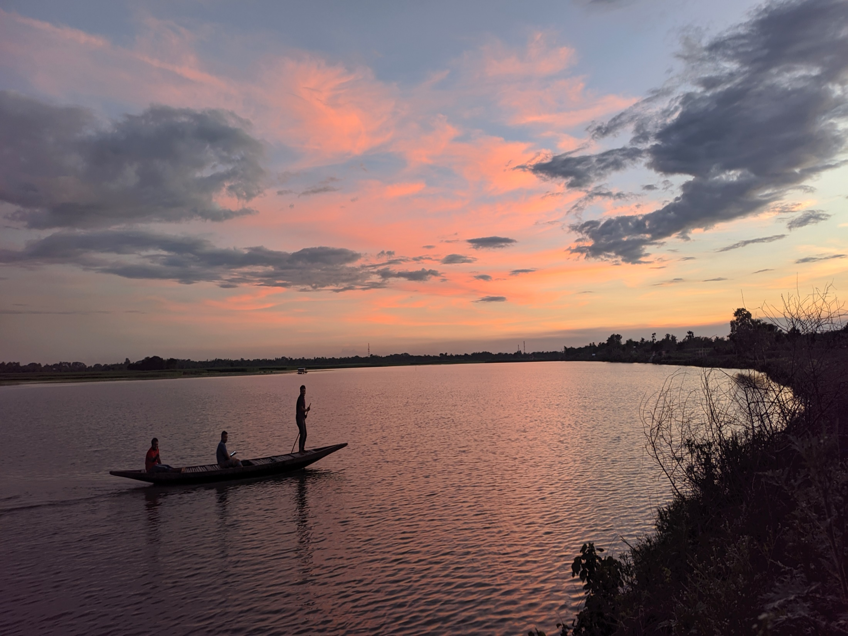
The End

