Slide 1
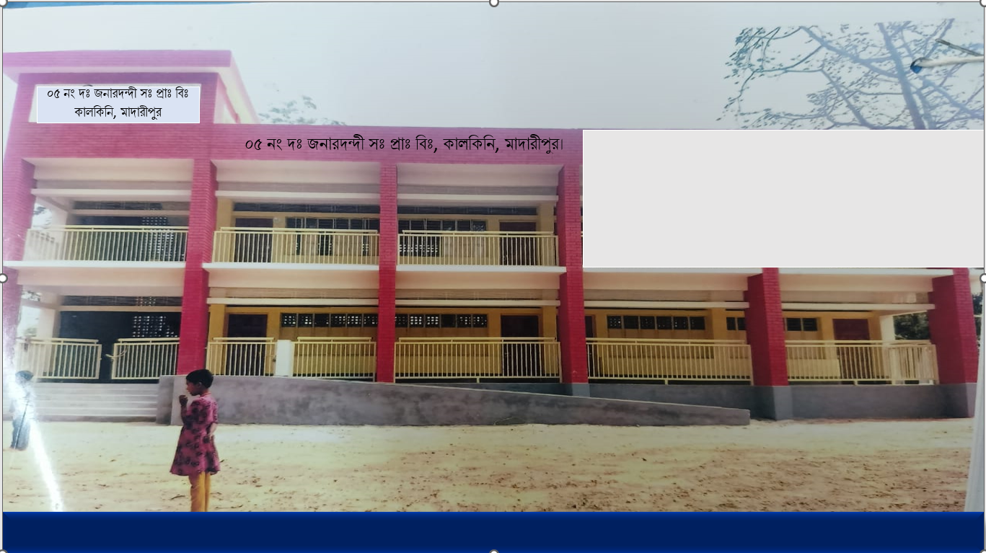



WEL COME
Class - Three
Subject - English
Unit - 8
I want
to join
English class
*05 No South Jonardondi GPS* * Kalkini, Madaripur. *

Slide 2
Introducing
Belayet Hossain
Assistant Teacher
05 No South Jonardondi GPS
Kalkini, Madaripur.
Gmail : belayet01715205765@gmail.com

Slide 3

INTRODUCING
Class : Three
Subject : English
Unit : 8, Lesson 1
The Ant and the Grasshopper
Activity : A, B
Page : 109 & 110.
Time : 45 minutes

Slide 4
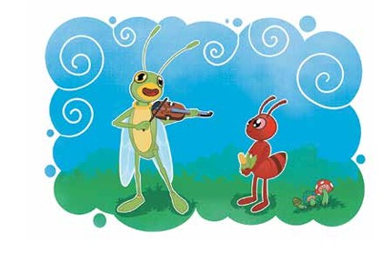
Can you guess what is our today's lesson?
What is the relationship between them?

Slide 5
Today's Our Lesson
The Ant and the Grasshopper
Unit - 8.
Lesson 1

Slide 6
Learning Outcomes
Students will be able to:-
Listening:-
4.3.1 - enjoy and understand simple stories.
Speaking:-
3.1.1 - ask and answer Wh questions.
Reading:-
5.1.1 - read simple paragraphs.
Writing:-
8.1.3 - write sentence from the text book or model.
10.1.1 - write short and simple paragraphs answering a
set of questions.

Slide 7
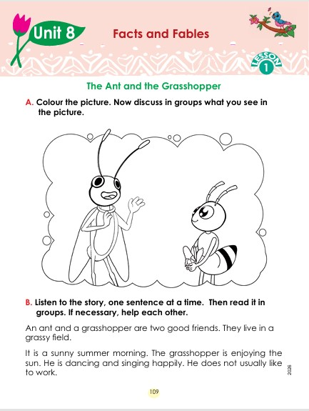
Who can you see in the picture?
New Words
Like
Choose something.
An ant and a grasshopper are two good friends. They live in a grassy field. It is a sunny summer morning. The grasshopper is enjoying the sun. He is dancing and singing happily. He does not usually like to work.

Slide 8
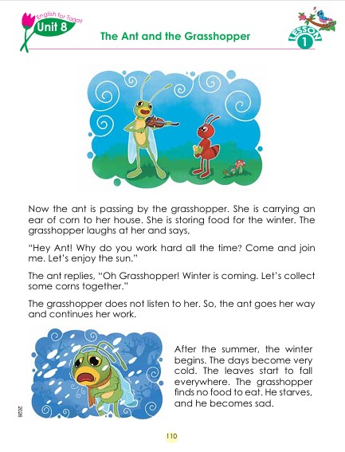
Who can you see in the picture?
New Words
House
Where people live.
Now the ant is passing by the grasshopper. She is carrying an ear of corn to her house. She is storing food for the winter. The grasshopper laughs at her and says, “Hey Ant! Why do you work hard all the time? Come and join me. Let’s enjoy the sun.” The ant replies, “Oh Grasshopper! Winter is coming. Let’s collect some corns together.” The grasshopper does not listen to her. So, the ant goes her way and continues her work.
After the summer, the winter begins. The days become very cold. The leaves start to fall everywhere. The grasshopper finds no food to eat. He starves, and he becomes sad.

Slide 9

An ant and a grasshopper are two good friends. They live in a grassy field. It is a sunny summer morning. The grasshopper is enjoying the sun. He is dancing and singing happily. He does not usually like to work.
Now the ant is passing by the grasshopper. She is carrying an ear of corn to her house. She is storing food for the winter. The grasshopper laughs at her and says, “Hey Ant! Why do you work hard all the time? Come and join me. Let’s enjoy the sun.” The ant replies, “Oh Grasshopper! Winter is coming. Let’s collect some corns together.” The grasshopper does not listen to her. So, the ant goes her way and continues her work.
After the summer, the winter begins. The days become very cold. The leaves start to fall everywhere. The grasshopper finds no food to eat. He starves, and he becomes sad.

Slide 10
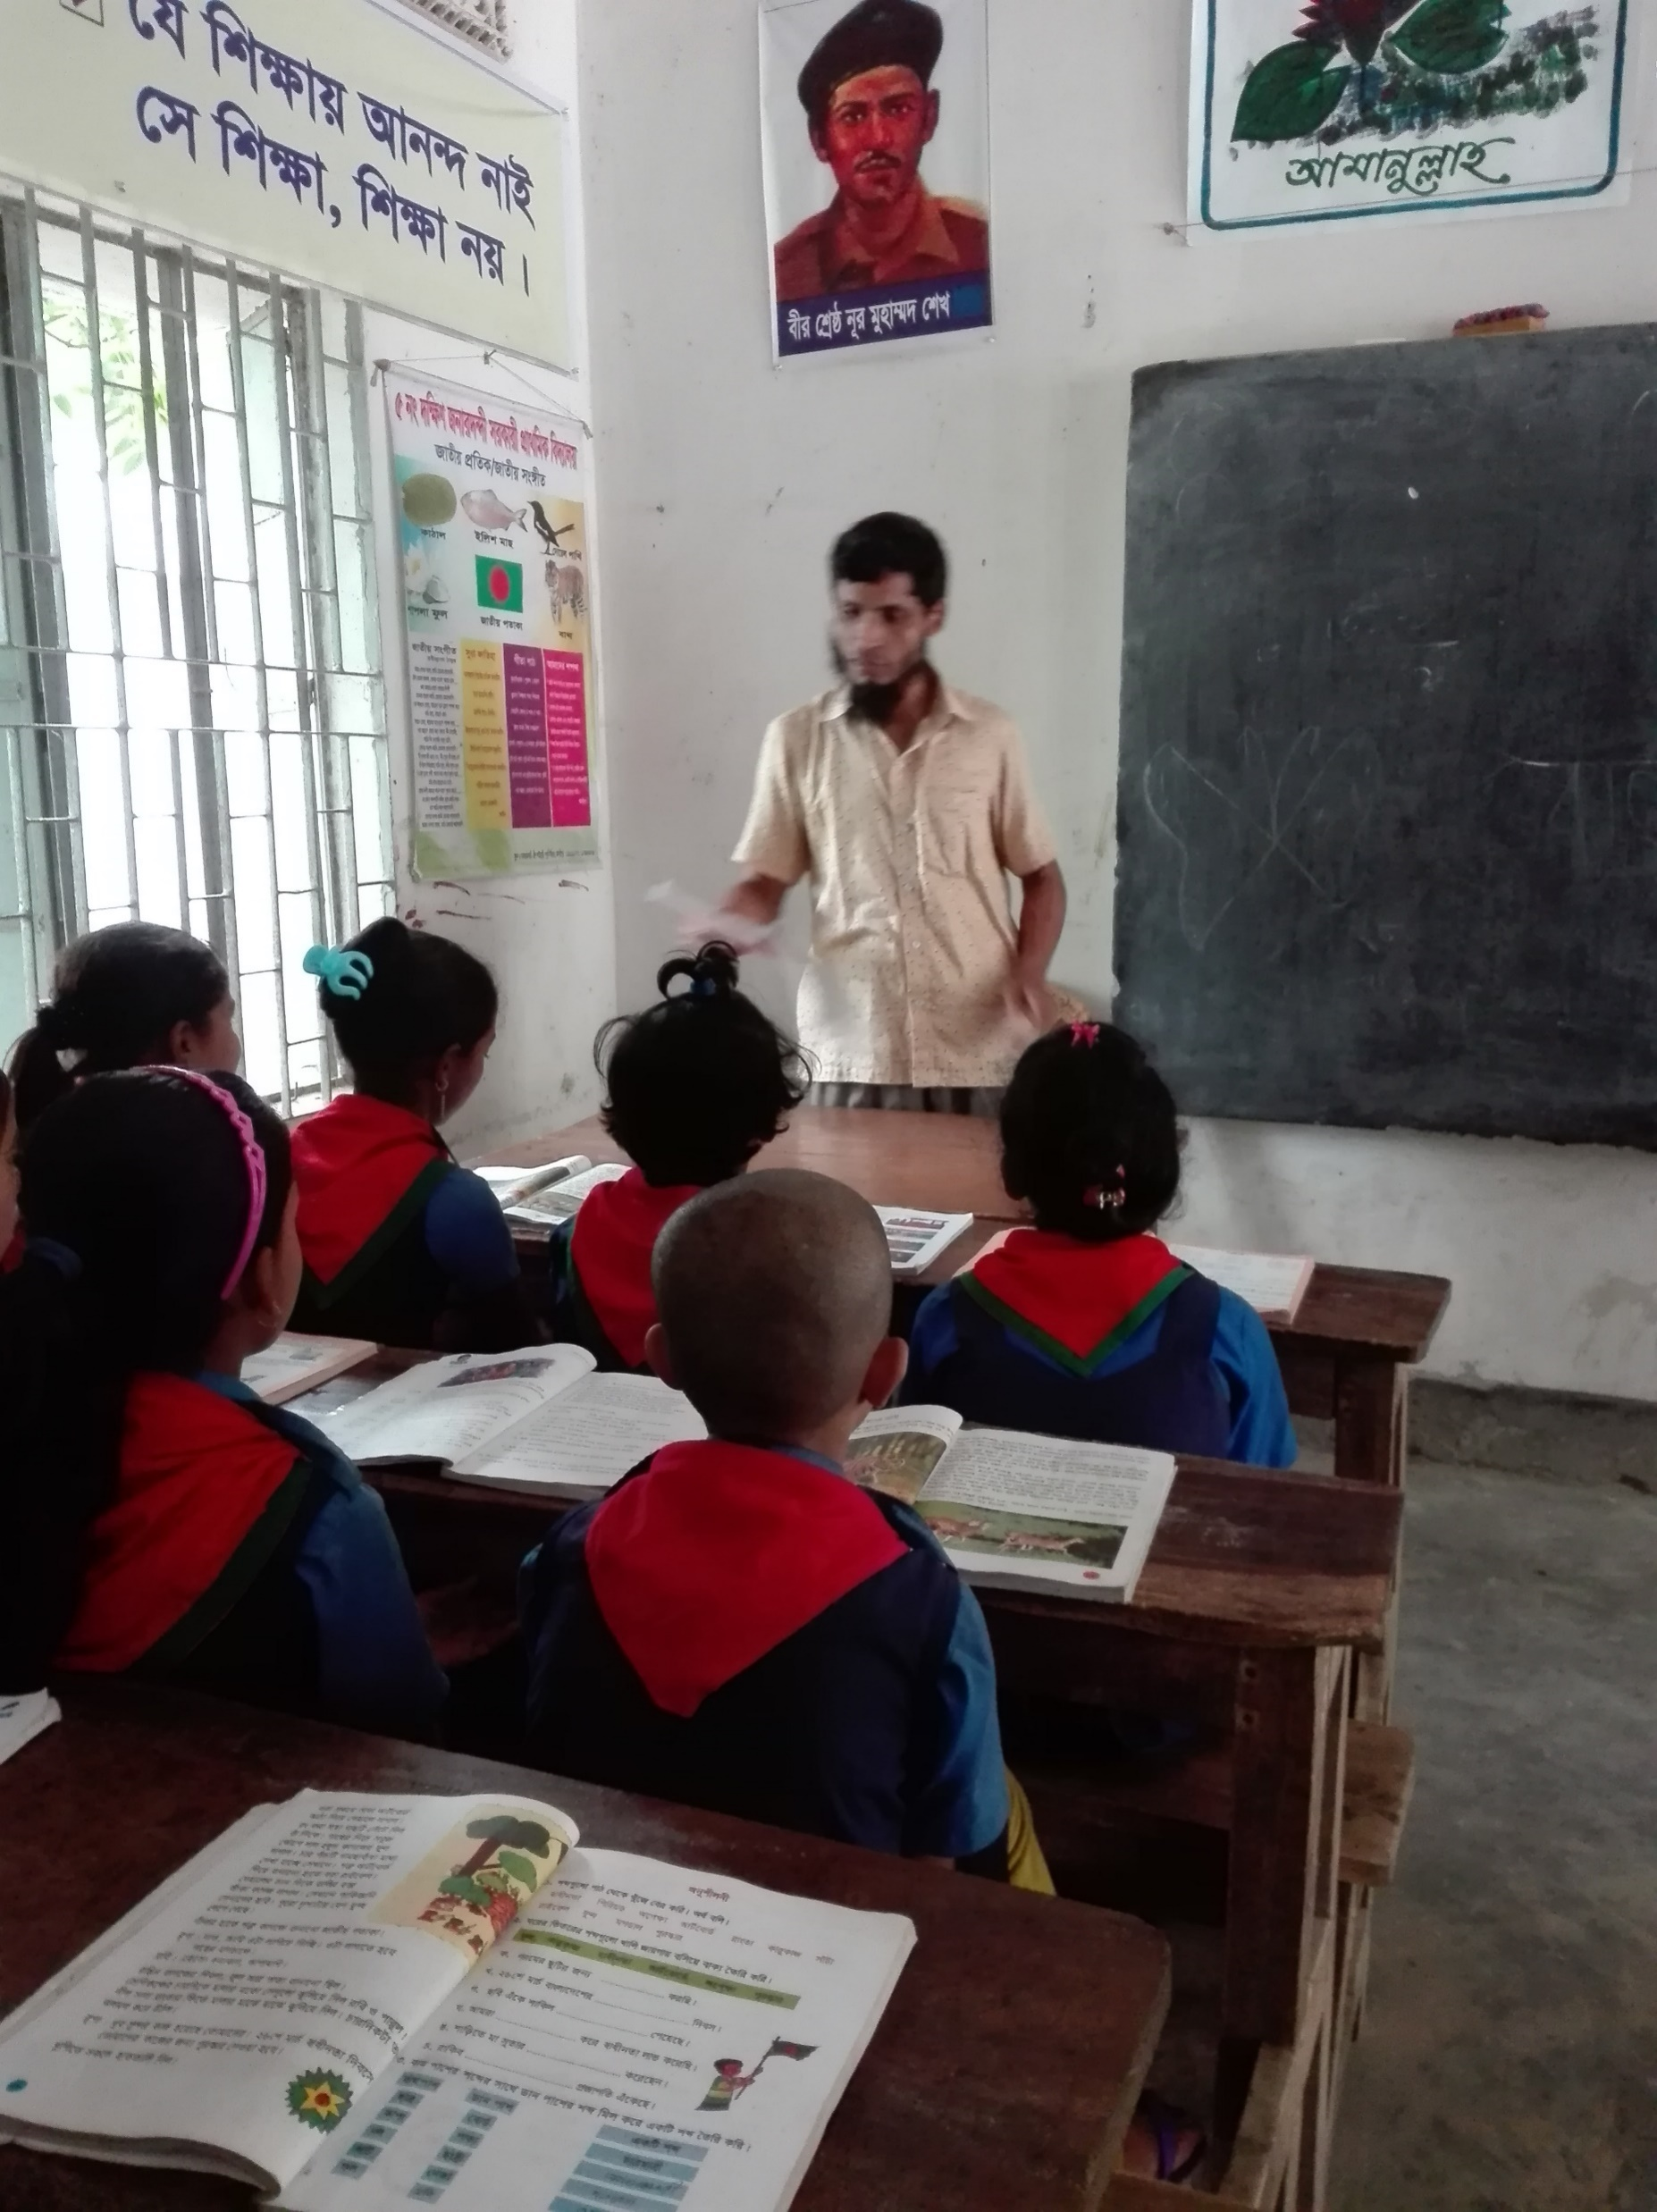
Teacher’s reading

Slide 11

Open your English book at page-109-110

Slide 12
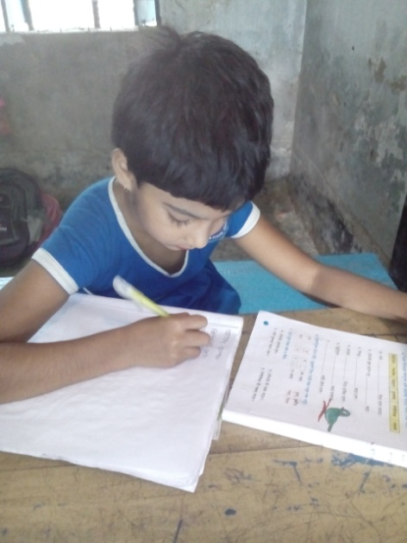
Individual Work
Make sentence by the words:
Grassy
Field
Like

Slide 13
An ant and a grasshopper are two good friends. They live in a grassy field. It is a sunny summer morning. The grasshopper is enjoying the sun. He is dancing and singing happily. He does not usually like to work.
Now the ant is passing by the grasshopper. She is carrying an ear of corn to her house. She is storing food for the winter. The grasshopper laughs at her and says, “Hey Ant! Why do you work hard all the time? Come and join me. Let’s enjoy the sun.” The ant replies, “Oh Grasshopper! Winter is coming. Let’s collect some corns together.” The grasshopper does not listen to her. So, the ant goes her way and continues her work.
After the summer, the winter begins. The days become very cold. The leaves start to fall everywhere. The grasshopper finds no food to eat. He starves, and he becomes sad.
Who are good friends?
Where do they live?
Who are enjoying the sun?
Who laughs at her?
Who is comming?
Answer
Please click answer button for answer
Pair Work
Answer
Time: 5 minute's
Answer
Answer
Answer

Slide 14
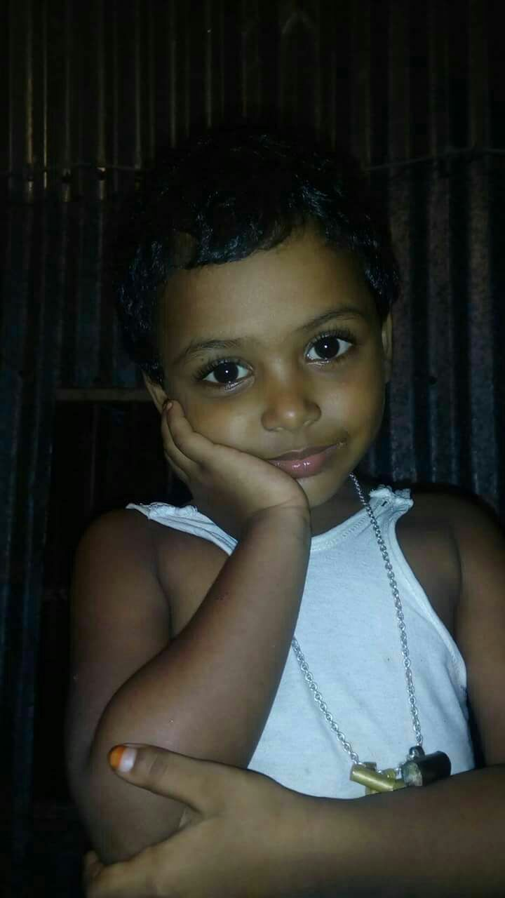
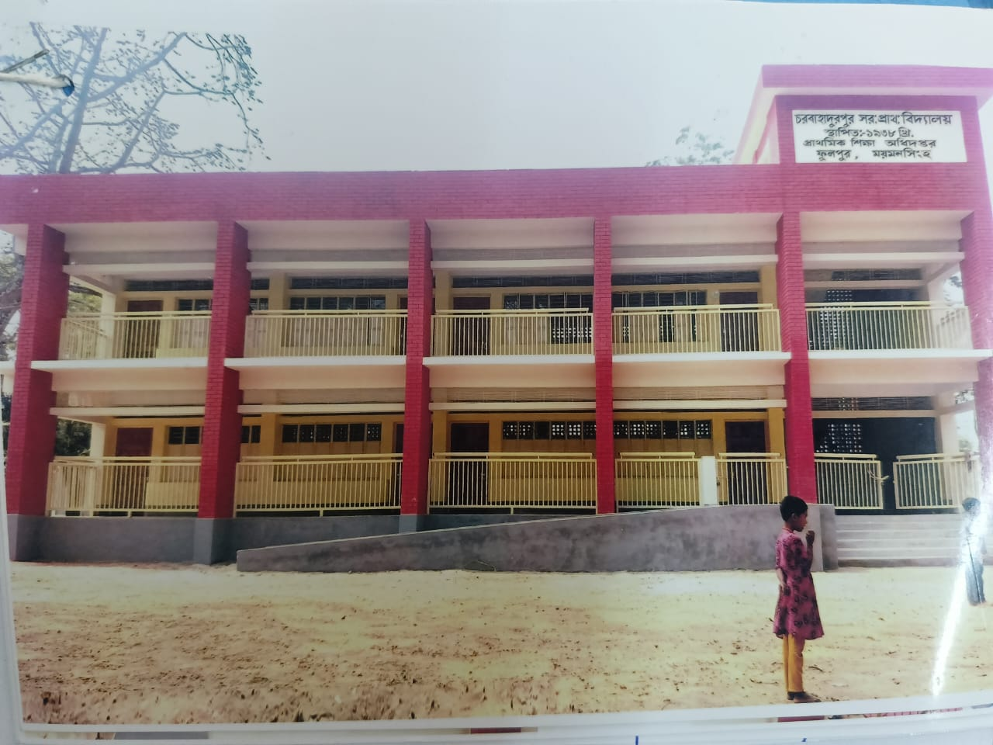
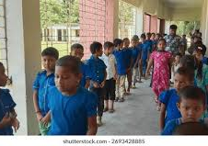
Group Work
Time: 10 minute's
The Ant and the Grasshopper

Slide 15
Individual Work
Read the sentences. Write T for True and F for False.
An ant and a grasshopper are two good friends.____
They live in a grassy house.____
It is a sunny summer evening._____
The grasshopper is enjoying the sun.____
He does not usually like to work.___
T
F
F
T
T

Slide 16
Choose the correct answer.
1. It is a sunny summer.....

(a) afternoon
(b) morning
Match them
(c) night
(d) evening
2. The grasshopper is enjoying the..........
(a) star
(b) moon
Match them

(c) sky
(d) sun

Slide 17
Pair Work
Ask and answer.
What is the story about?
What is the grasshopper doing in the summer morning?
What is the ant doing in the summer?
How does the grasshopper pass the winter?
How does the ant pass the winter?

Slide 18
Pair Work
Match the words in column A with the words of
similar meaning in column B. One is done for you.
A | B
house like hard replie why | reason difficult home choose answer

Slide 19
Pair Work
Let’s read the text in section A again. List the nouns, pronouns and verbs in the following table.
Noun | Pronoun | Verb
Sun | he | passing

Slide 20
Evaluation
Look attentively. Now we play a game. Everybody close your eyes.
Which word is missing?
Open your eyes.
Now
Sun
House

Slide 21
Evaluation
Write three sentences about The ant and the Grasshopper.

Slide 22
Thanks to All

