Slide 1
WELCOME

Slide 2
INTRODUCTION
MD. ABDUL KARIM
Assistant Teacher In (ICT)
CHASAI DHARIBON M.B DAKHIL
Class: Eight
Subject: English
Unit: 01
Lesson: 02
Time: 40 minutes

Slide 3
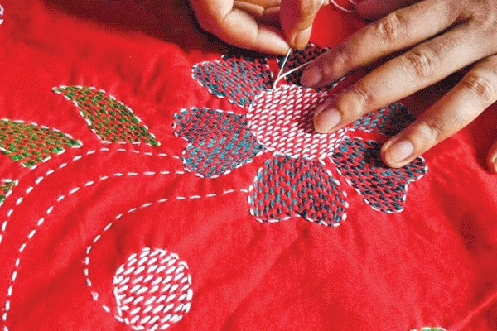
Look at the picture. What do you see in the picture?

Slide 4
Unit : One
Lesson: Two
Nakshi Kantha
By the end of the lesson, students will be able to:
Describe what Nakshi is.
How it is made.
Explain its cultural importance.
Learning Outcome

Slide 5
Key words:
Quilt- কাথা
Embroidered- অলংকারকৃত
Artistic - শৈল্পিক
Indigenous - দেশীয়

Slide 6
Read the text below.
Nakshi Kantha is a kind of embroidered quilt. The name was taken from the Bangla word, ‘ Naksha’ which means artistic pattern. It is a kind of traditional craft and is said to be indegenous to Bangladesh and West Bengal in India. The art has been practised in rural Bengal for centuries. The name Nakshi Kantha become popular after the poet Josimuddin’s poem ‘Nakshi Kanthar Math’ was published in 1929.
Traditional Kanthas are made for family use. Old or New cloth and thread are used to make these quilt. Mymensingh,Jamalpur,Rajshahi,Faridpur, Bogura and Joshore are most famous for this craft. Now it is produced commercially. You can find them in many expensive shops in cities. The quilts are now in great demand because of the colourful pattern and design embroidered on them.

Slide 7
Nakshi is a kind of-----
(i) painting (ii) embroidere quilt (iii) sculpture (iv) pottery
(b) The word ‘Naksha’ means------
(i) cloth (ii) thread (iii) artistic pattern (iv) quilt
(c) Nakshi is indigenous to ---------
(i) Bangladesh only (ii) India only (iii) Bngladesh and West Bengal (iv) Nepal
(d) The has been practiced for--------
(i) years (ii) decades (iii) centuries (iv) months
(e) Who wrote ‘Nakshi Kanthar Math’?
(i) Rabindranath tagore (ii) Kazi Nazrul Islam (iii) Josimuddin (iv) Faruk Ahmed.
Choose the best questions from the alternatives

Slide 8
What is Nakshi Kantha?
How is it made?
Why is it called Nakshi Kantha?
Group Work

Slide 9

Home Work
Write a short paragraph on :’Nakshi Write Kantha’

Slide 10
Thank you my dear students
Goodbye

