Slide 1
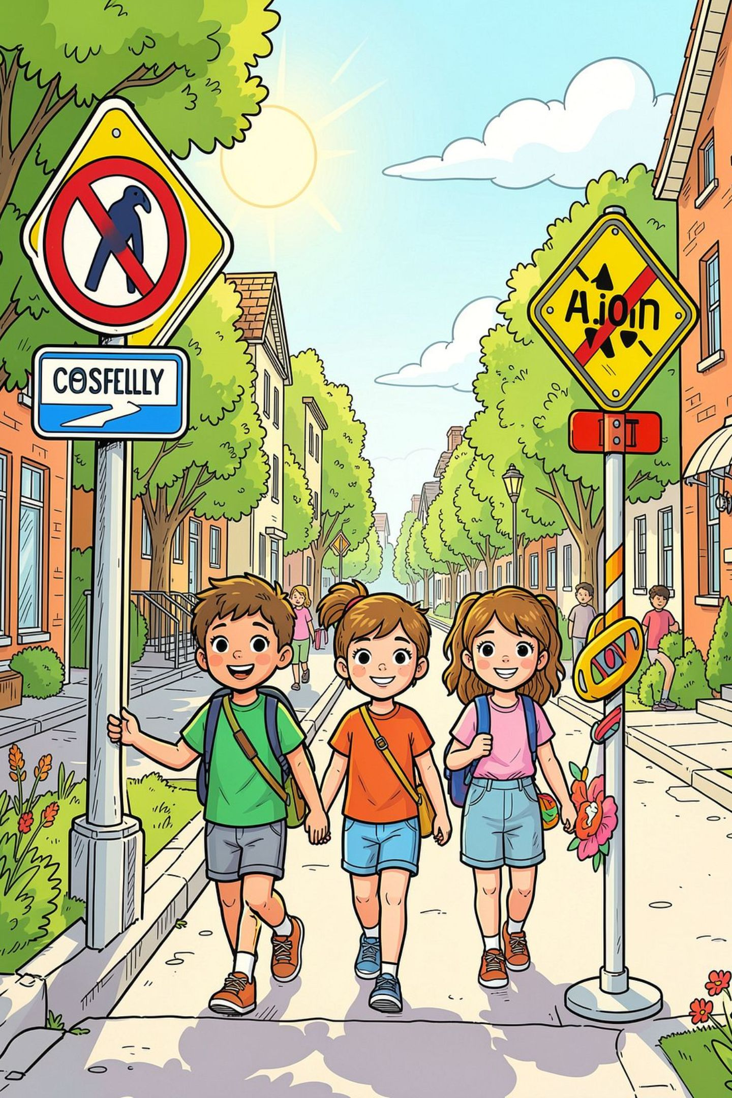
Road Safety Heroes: Understanding Our Signs
Class 2 · English Lesson
ROAD SIGNS
SAFETY

Slide 2


Mohammad Billal Hosain
Head Teacher
Dighirpar Gps
Kasba Brahmanbaria

Slide 3
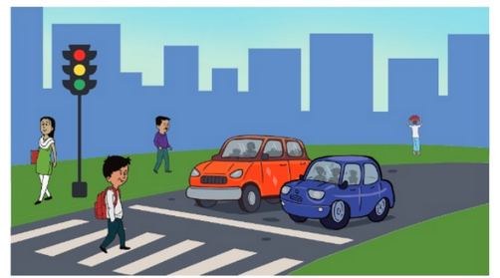
Lesson
Subject:English
Class:Two
Unit:7
Lesson:6
Time: 50 Minutes
Lesson Tittle- Traffic Light
Page-73-74
Activity-H
Date: 03.09.2026

Slide 4

Learning Objectives
By the end of this lesson, you will be able to:
1
2
3
Identify
Understand
Recognise
Recognise common shapes and colours used on road signs
Know the difference between warning signs and regulatory signs
Identify signs that help you stay safe as a pedestrian and cyclist

Slide 5
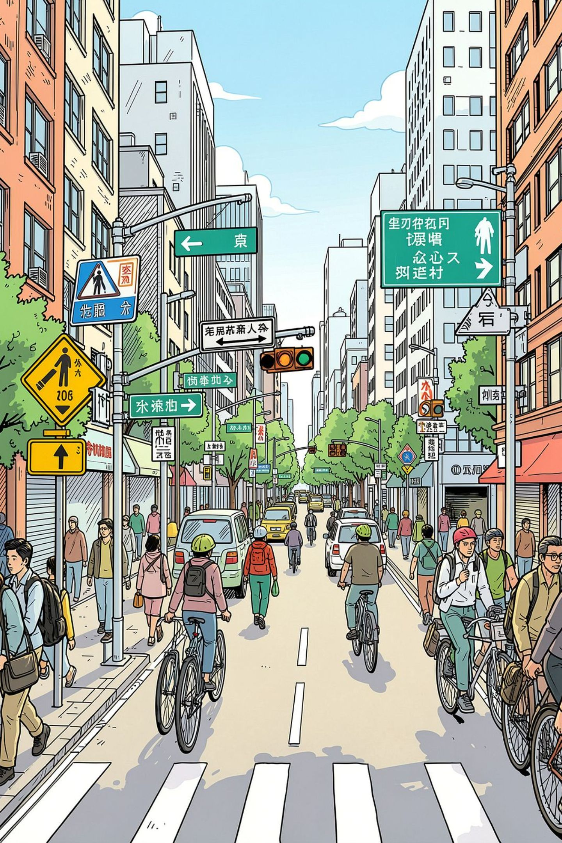
Why Do We Have Signs?
🗣️ Silent Language
🚦 Keep Order
Signs speak to everyone on the road — without using words
They prevent accidents and keep traffic moving smoothly
🛡️ Stay Safe
Whether walking or cycling, signs tell you what you can and cannot do

Slide 6
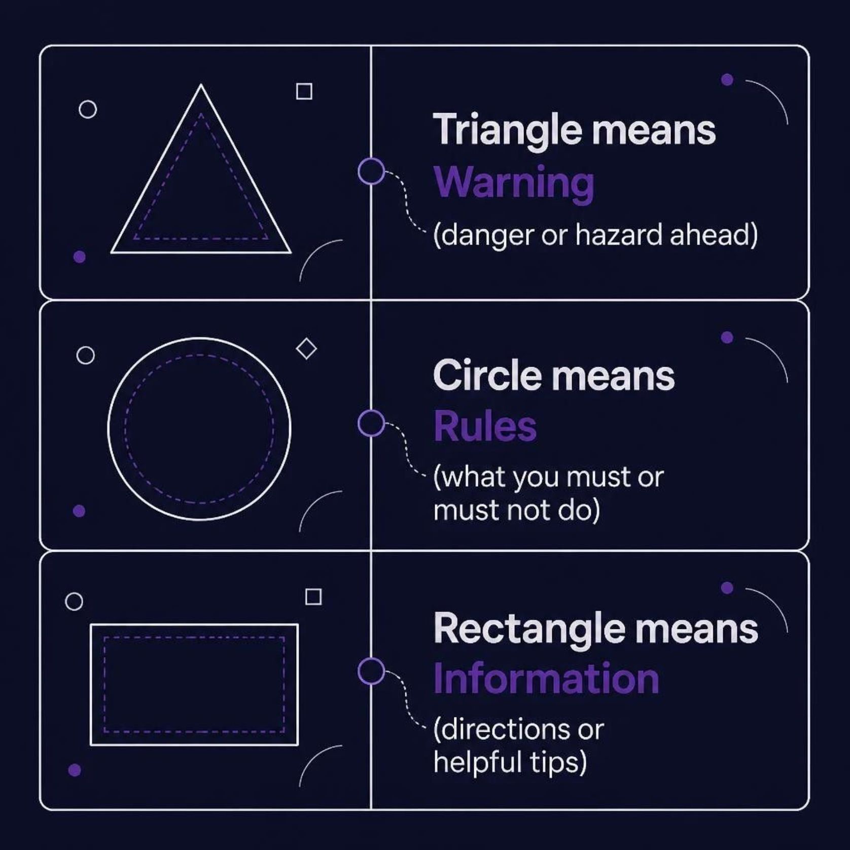
The Language of Shapes
Every shape on a road sign has a special meaning. Learn the shapes and you'll understand the message!
Shape = Meaning
Road signs use simple shapes so anyone — young or old — can understand them quickly, even from a distance.

Slide 7
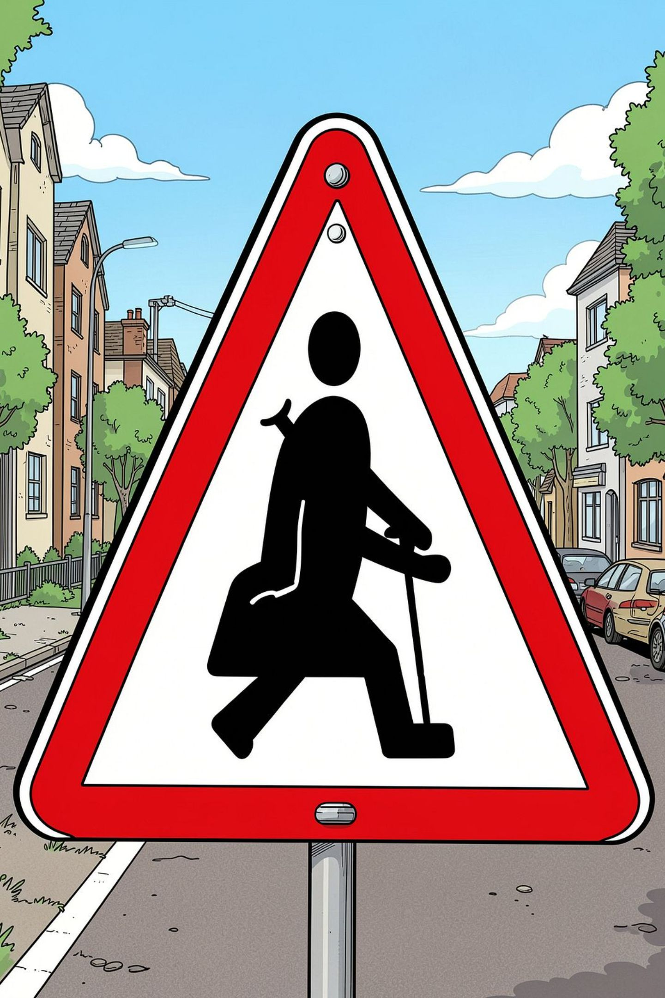

⚠️ Watch Out: Warning Signs
How to Spot Them
Usually white with a red border and triangular in shape
What They Mean
Danger or hazard ahead — slow down and pay extra attention
Examples
Pedestrian crossing ahead · Road narrows · Slippery surface

Slide 8
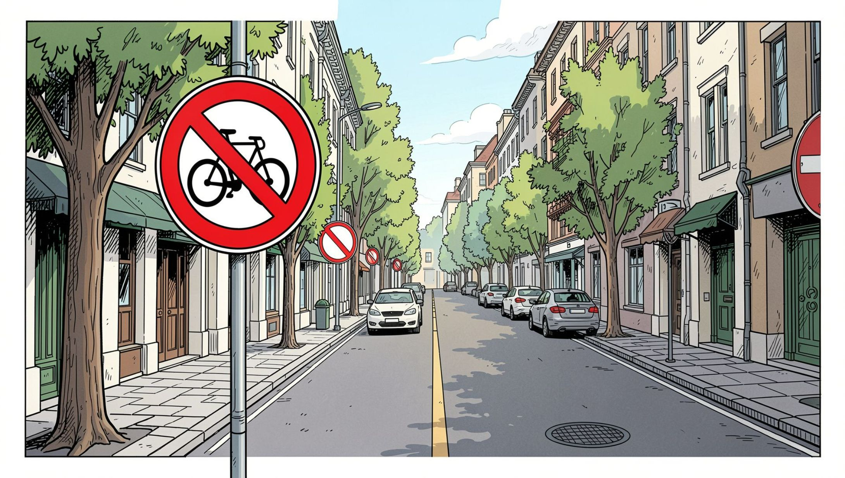
🔴 The Power of Red Circles
Red Border = Prohibition
A red circle tells you what you must NOT do. If you see red, stop and check the rules!
🚫 No Cycling
🚫 No Entry
🚫 No Pedestrians

Slide 9
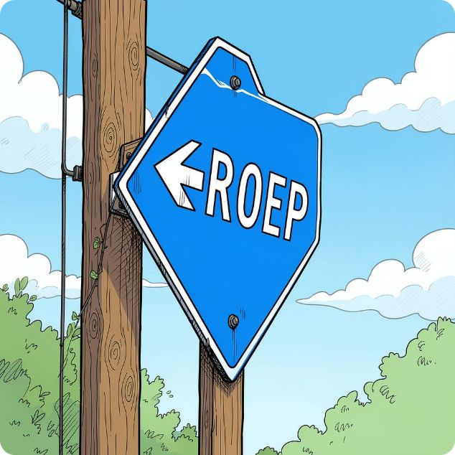
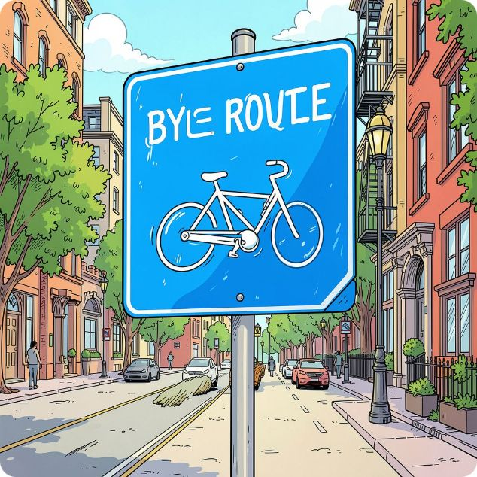
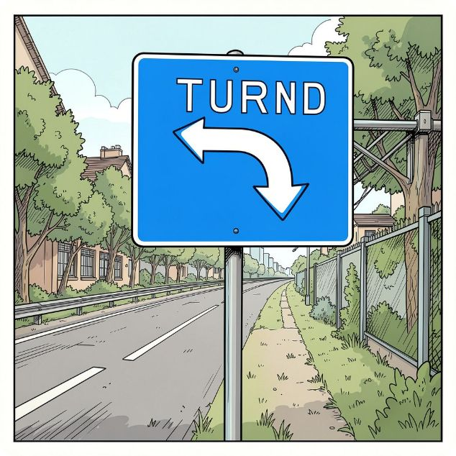
🔵 Important Blue Signs
Blue circles give you instructions — they tell you what you must do to stay safe and follow the correct path.
Keep Left
Cycle Route Only
Turn Ahead
Stay on the left side of the road or path
This path is for cyclists — follow it carefully
Get ready to turn in the direction shown

Slide 10
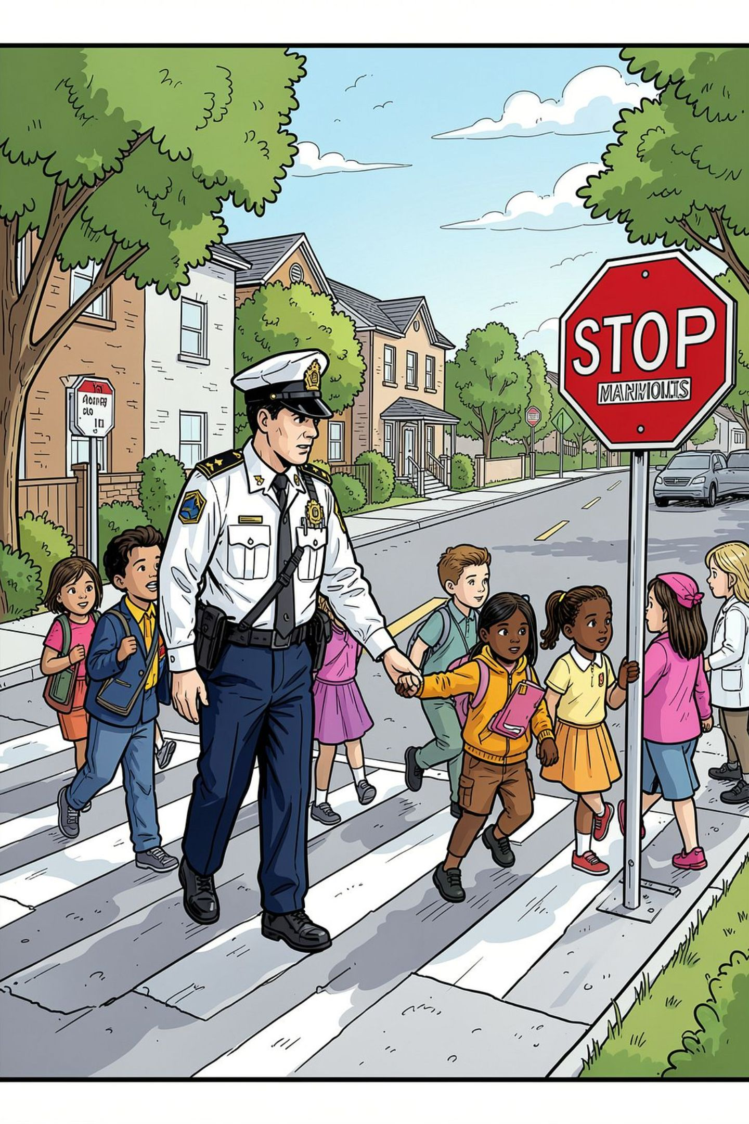



🏫 Special Signs for Students
School Crossing Patrol
Pedestrian Crossing
Look for the person in uniform helping you cross safely
A safe place to cross — always use it when walking
School Zone
Drivers must slow down — children are nearby!

Slide 11


🧠 Mini Quiz: Can You Spot the Sign?
Test what you've learned! Think carefully about each question.
1
2
3
Question 1
Question 2
Question 3
What does a triangle with a red border tell us?
What is the difference between a red circle and a blue circle?
If you see a school crossing sign, what should you do?
Discuss your answers with a partner or your teacher!

Slide 12
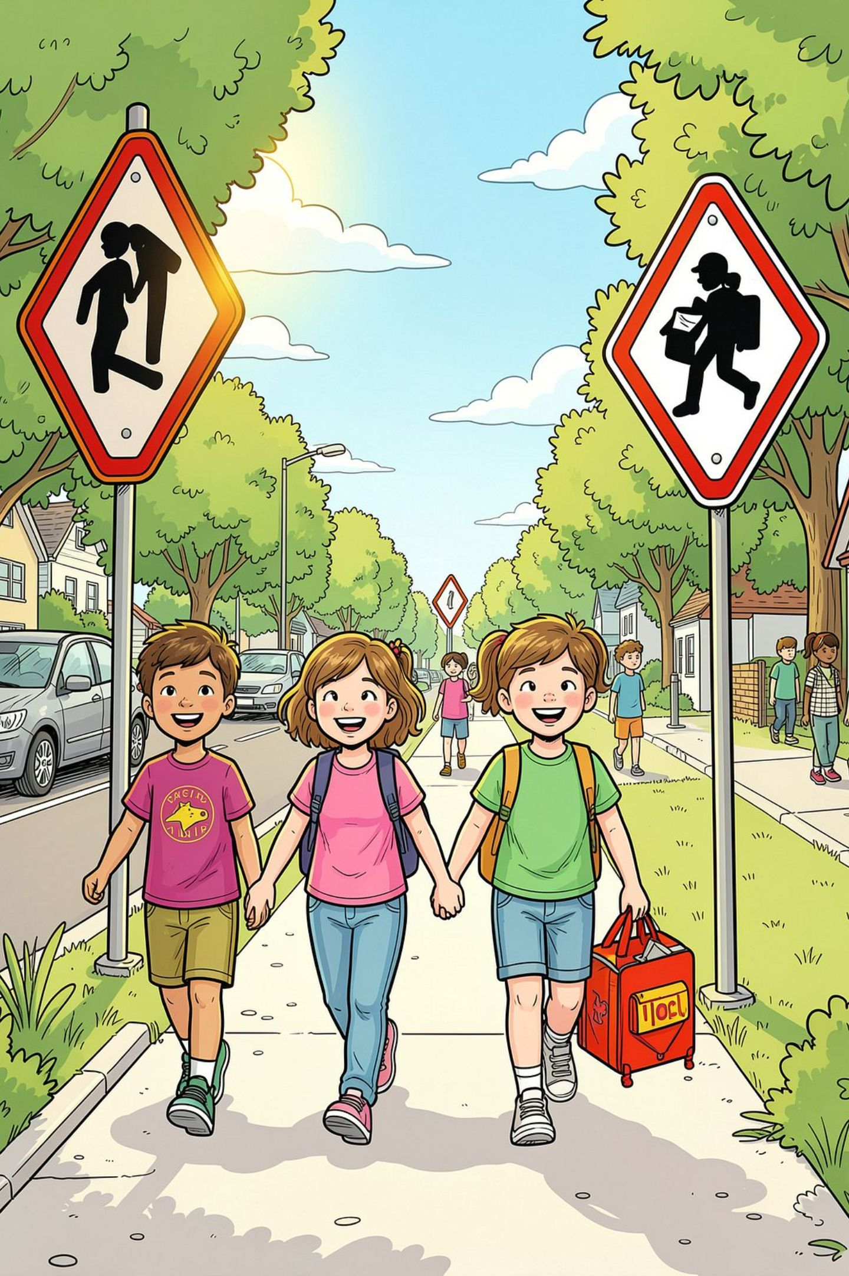
Stay Safe and Keep Moving! 🦸
🛑 Stop
Always stop at the curb
👀 Look
Look both ways carefully
👂 Listen
Listen for traffic sounds
💭 Think
Think before you cross
Remember: road signs are there to protect you. Be a road safety hero every time you leave your home!

Slide 13

Good Bye

