Slide 1


Slide 2
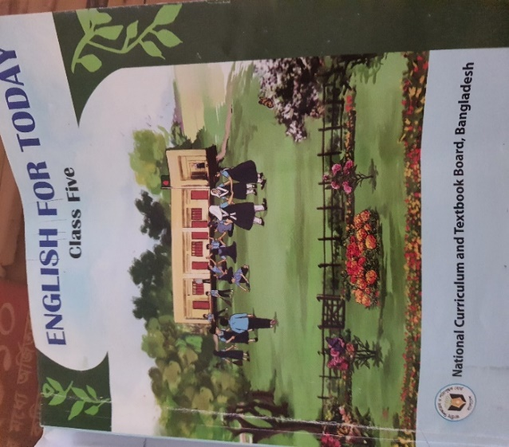
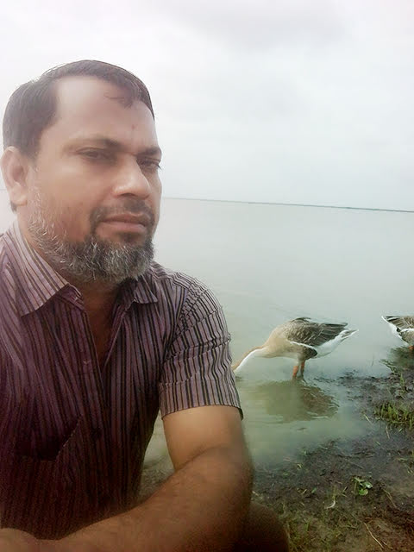

IDENTITY
Title –Quality Time Together
Class - Five
Subject- English
Unit-13 , Page -69
Activity-1.1
Time-50 minutes
Date--3/9/2026
Mohammad Babul Hossen
Assistant teacher
Noagoan west GPS
Sarail , Brahmonbaria.
E-mail-mbabul307@gmail.com

Slide 3
Learning Outcomes
Learning Outcomes:
* Read aloud story with proper stress , intonation.
*Comprehend and express the meaning and uses of familiar words.
* Get the general ideas from simple texts.
.

Slide 4
Review of the prior knowledge
Review of prior knowledge :
Do your parents have mobile or laptop at your home ?
When do you use it ?
How long do you use it?
Does it disturb your sleep or keep you away from your friend ?
(Conduct a brief discussion regarding overuse of mobile phone .)

Slide 5

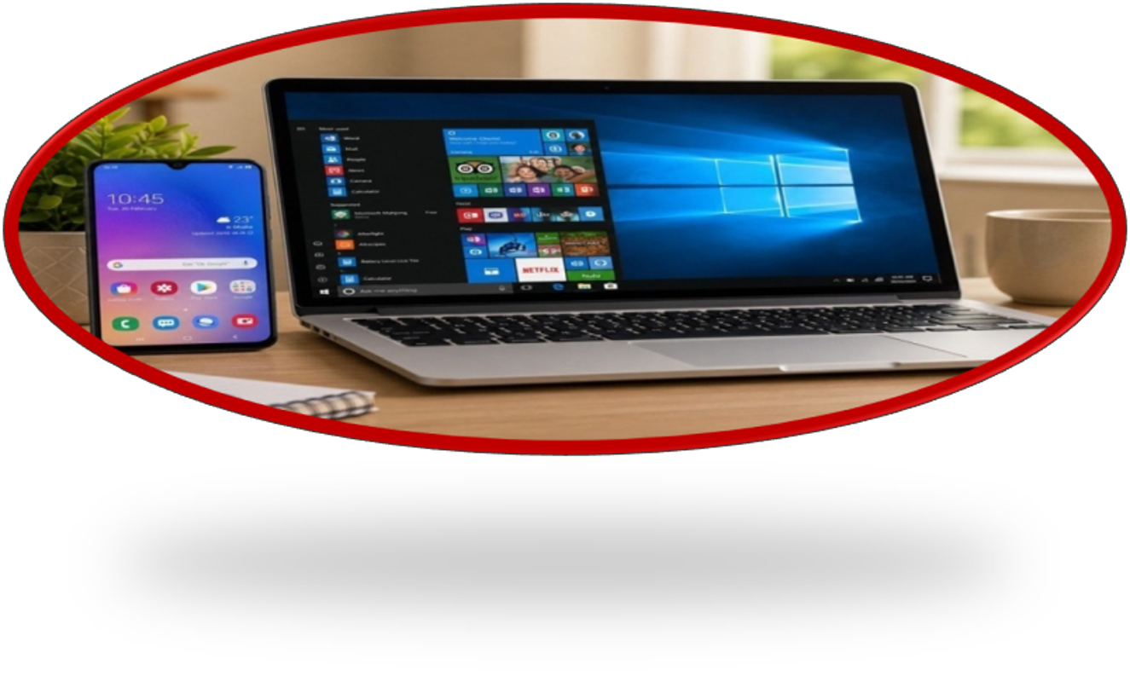

Slide 6

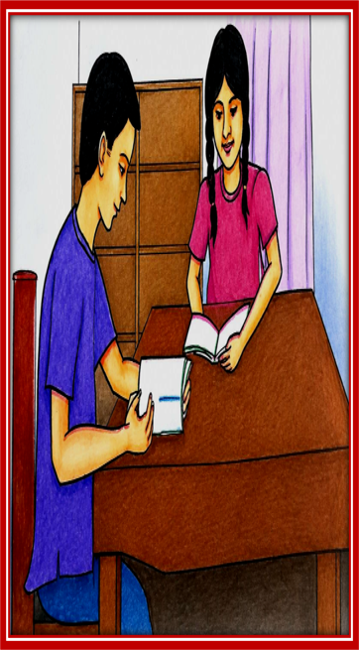
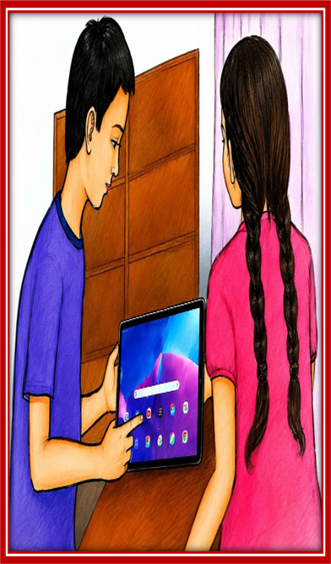
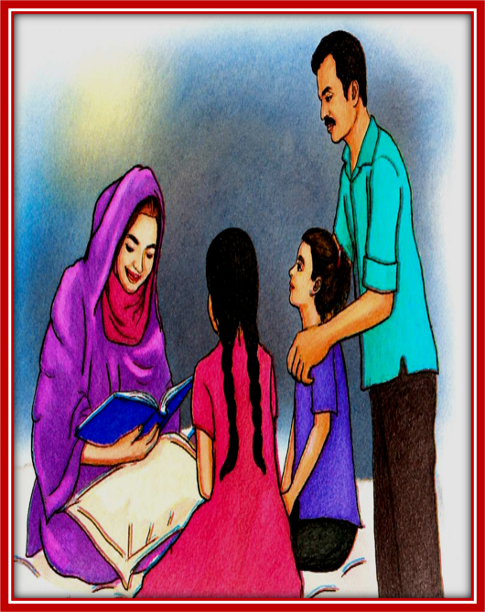

Slide 7
Our today’s topic is-
Quality Time Together

Slide 8

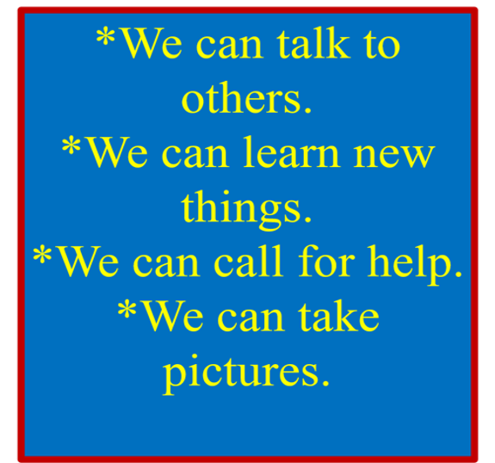
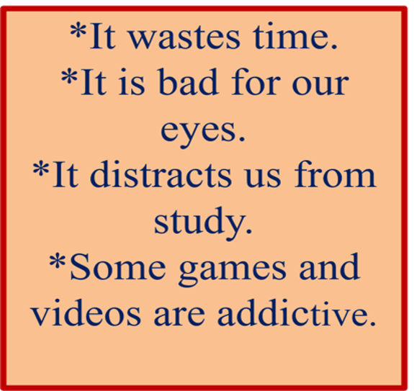

Slide 9



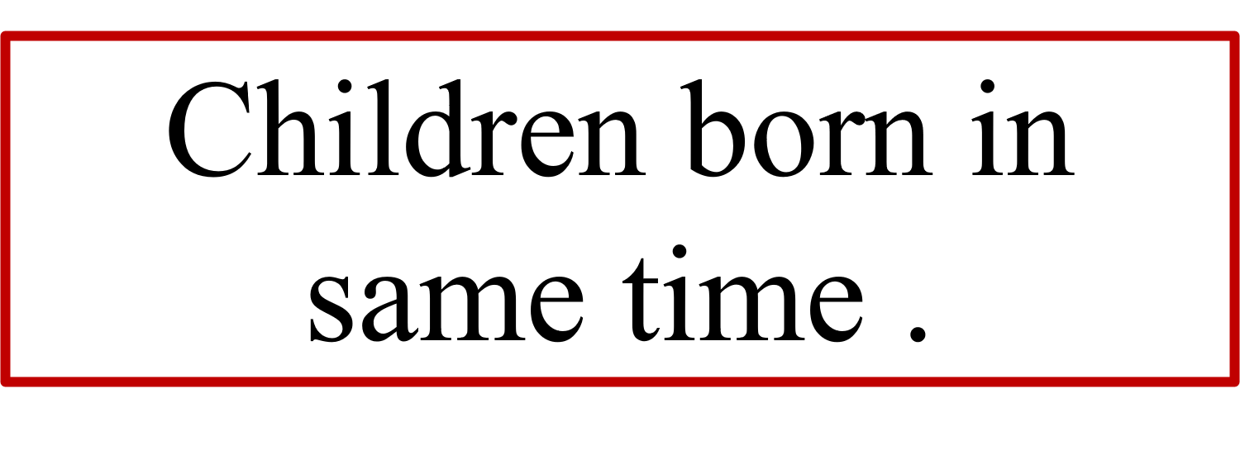

Slide 10




Slide 11

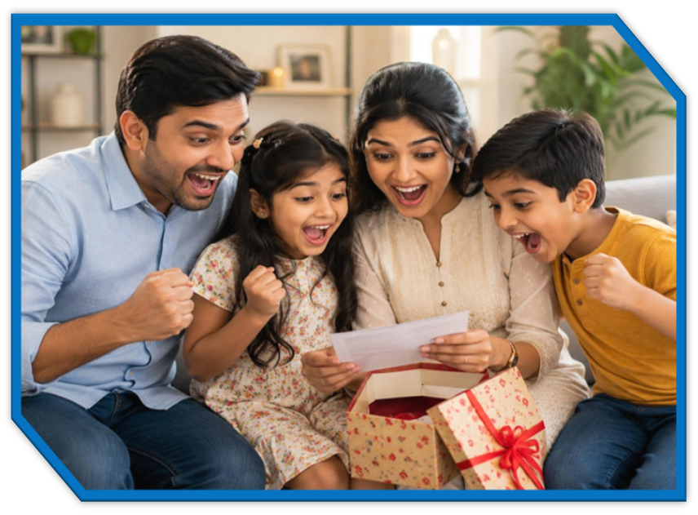


Slide 12

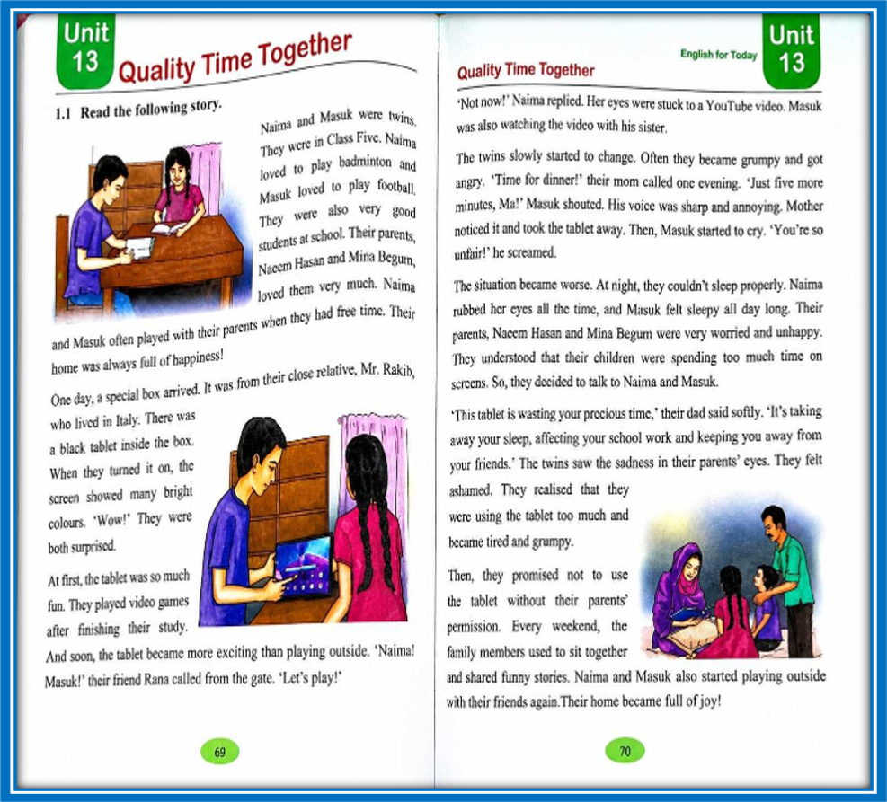
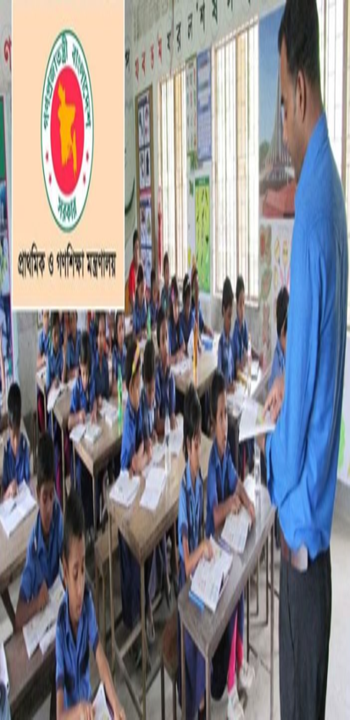

Slide 13

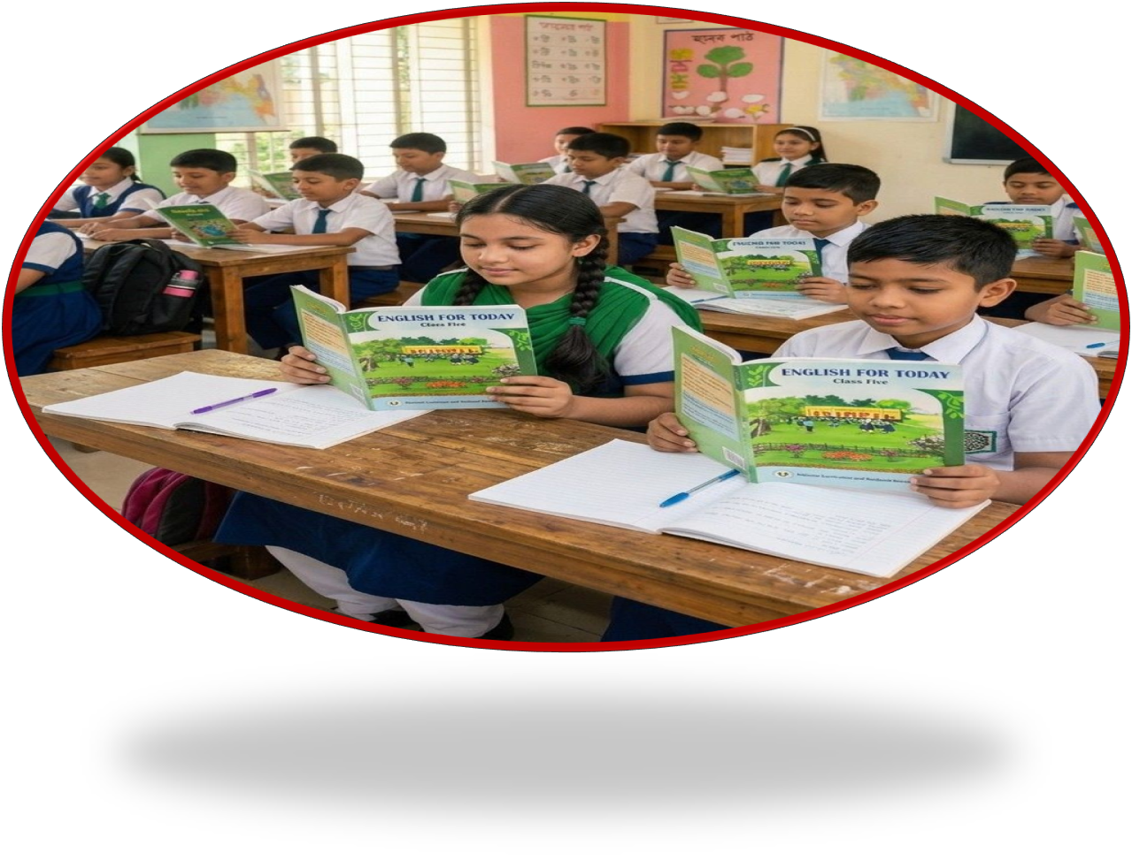

Slide 14
Ask and answer the questions
i. Who were twins
Answer:
ii. What Class Naima and Masuk were in?
Answer: Naima and Masuk were in class Five.
iii. What was their father’s name?
Answer: Their father’s name is Naeem Hasan.
iv. What was inside the box?
Answer: There was a tablet inside the box.
v. Why were Naima and Masuk surprised when they turned on the tablet ?
Answer: Naima and Masuk were surprised when they turned on the tablet because it showed many

Slide 15
Group work
Group - Adjective
Group - Adverb
Find out 10 adjective from the story .
Find out 10 adverb from the story

Slide 16

Home Work
Suppose ,you are Naima or Masuk.Write two sentences about what you would like to do in your free time now.

