Slide 1



Slide 2


Slide 3
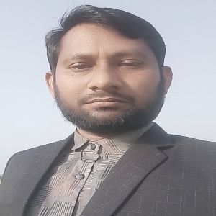
Teacher’s Identity
Habibur Rahman Assistant Teacher,
Parul GPS.
Fulchhari, Gaibandha

Slide 4
Learning out comes
Students will be able to
1.1.1 recognize the sounds of the alphabet in familiar words
3.1.1 say proper sounds of the letters in familiar words .
4.1.1 read the pictures of familiar objects and events.

Slide 5
Class one
alphabe

Slide 6
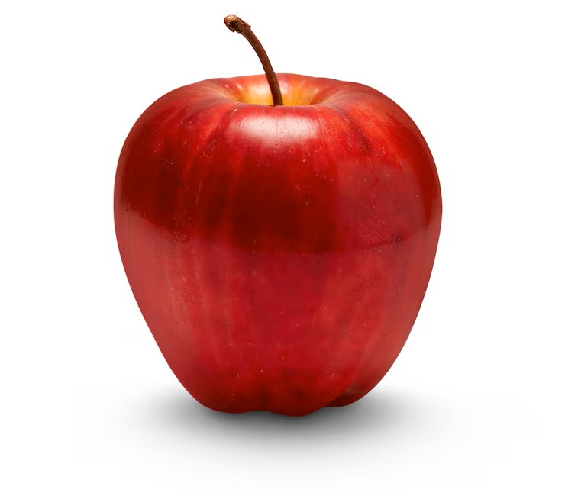
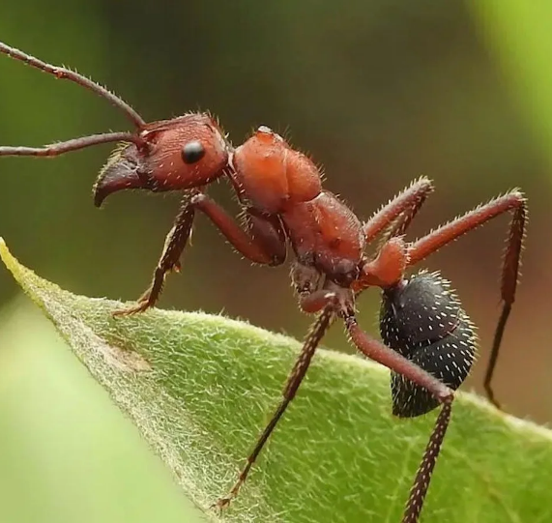

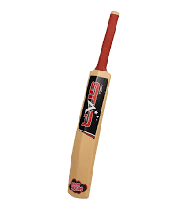
Look, listen and say
A a
B
b

Slide 7
Matching letters
A
b
B
a

Slide 8
Open your book
Page 14
English for Today

Slide 9


ant
a
Ant
A
apple
a
Apple
A

Slide 10
bat
b
Bat
B
ball
b
Ball
B

Slide 11
Missing Letter
all
at
b
B
pple
nt
A
a

Slide 12
Look, listen and say
a
A
b
B

Slide 13
Trace in the air. Trace and write
a
A
b
B

Slide 14
Assessment Indicators-12
Domain | Indicators for letters (a A, b B )
Knowledge | 1. S says the words of familiar objects.
 | 2. S recognizes the sounds of the letter.
Skill | 3. S identifies the sounds of the letter.
 | 4. S pronounces the letter correctly.
Attitude and values | 5. S shows interest in learning the letters.

Slide 15
Feedback
Help the students who can’t say the words or sounds of the letters
a A, b B. Reassess and make sure they are learning

Slide 16
Homework
Write:
a A, b B

Slide 17

“See you later in the next class.
Bye.”

