Slide 1
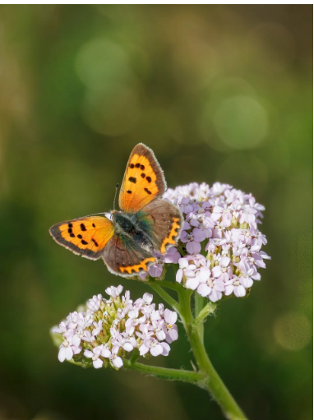
Good
morning
Prepared by: Md. Saifuddin-Ass. Teacher , Afzal Nagar GPS. Satkania, Chattogram.

Slide 2
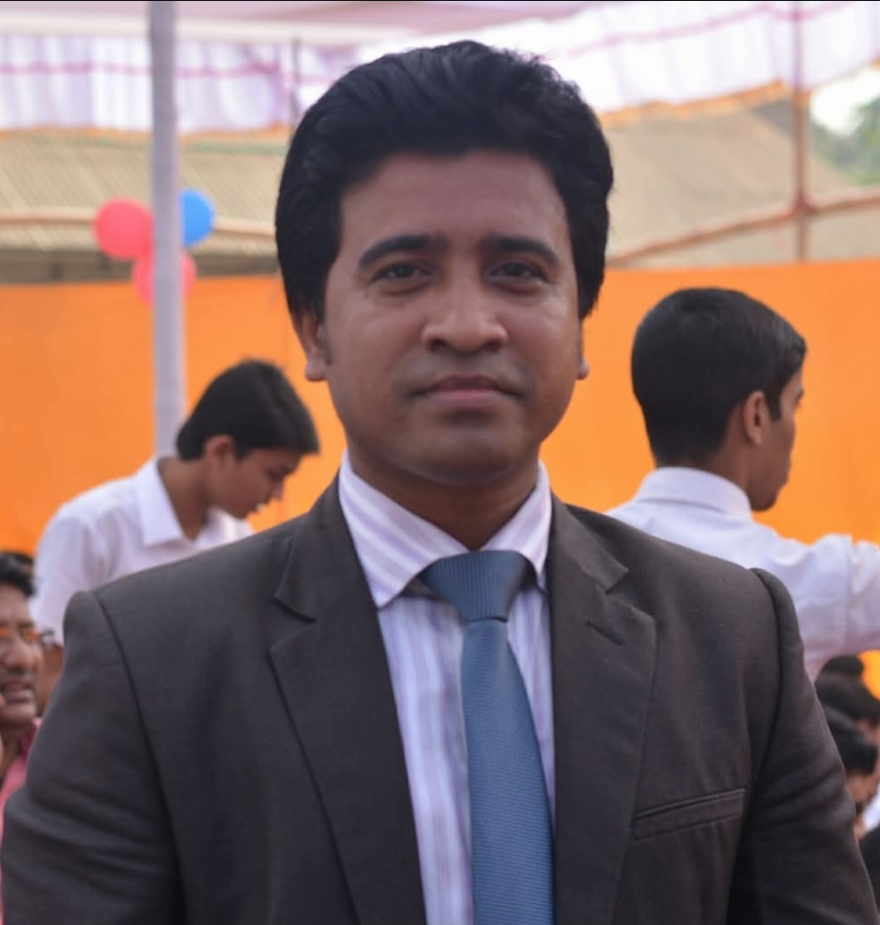
Teacher Profile
Md. Saifuddin
Ass. Teacher of Afzalnagar GPS.
Satkania, CTG.
Prepared by: Md. Saifuddin-Ass. Teacher , Afzal Nagar GPS. Satkania, Chattogram.

Slide 3

Let's see a picture!
Prepared by: Md. Saifuddin-Ass. Teacher , Afzal Nagar GPS. Satkania, Chattogram.

Slide 4
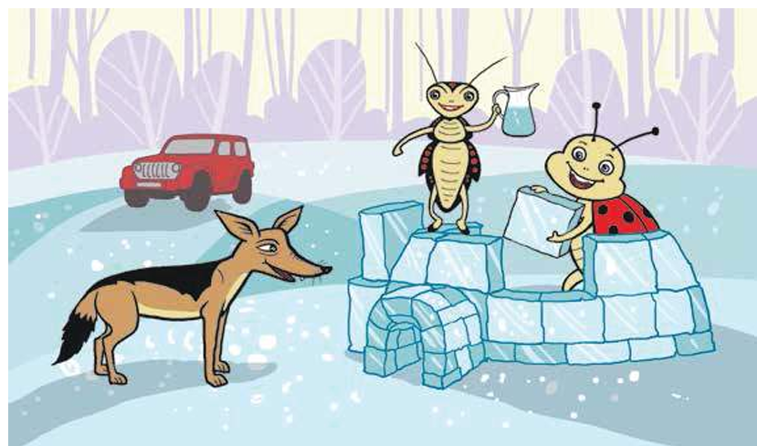
Prepared by: Md. Saifuddin-Ass. Teacher , Afzal Nagar GPS. Satkania, Chattogram.

Slide 5
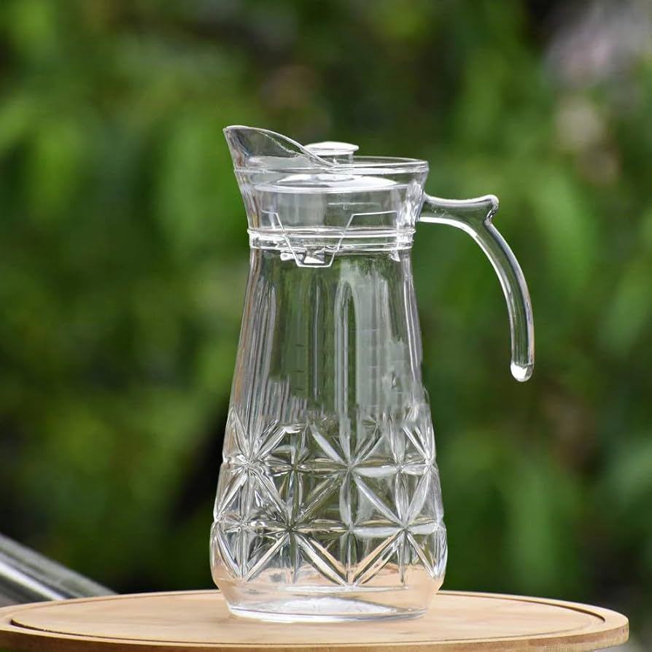
Jug
J
Prepared by: Md. Saifuddin-Ass. Teacher , Afzal Nagar GPS. Satkania, Chattogram.

Slide 6
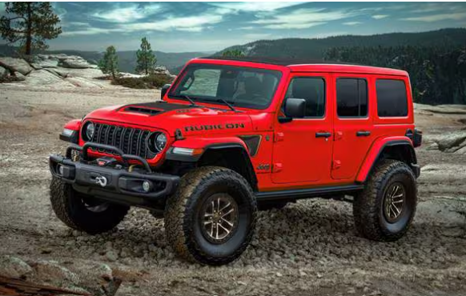
jeep
j
Prepared by: Md. Saifuddin-Ass. Teacher , Afzal Nagar GPS. Satkania, Chattogram.

Slide 7
Let’s go watching a nice video of Jj
https://www.youtube.com/watch?v=8wNIYNyG37g&list=RD8wNIYNyG37g&start_radio=1
Prepared by: Md. Saifuddin-Ass. Teacher , Afzal Nagar GPS. Satkania, Chattogram.

Slide 8
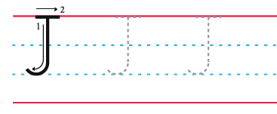
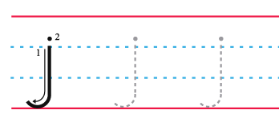
Trace in the air
Prepared by: Md. Saifuddin-Ass. Teacher , Afzal Nagar GPS. Satkania, Chattogram.

Slide 9

How to write letter Yy
Prepared by: Md. Saifuddin-Ass. Teacher , Afzal Nagar GPS. Satkania, Chattogram.

Slide 10

Thank you
for staying with me.
Prepared by: Md. Saifuddin-Ass. Teacher , Afzal Nagar GPS. Satkania, Chattogram.

