Slide 1


Slide 2
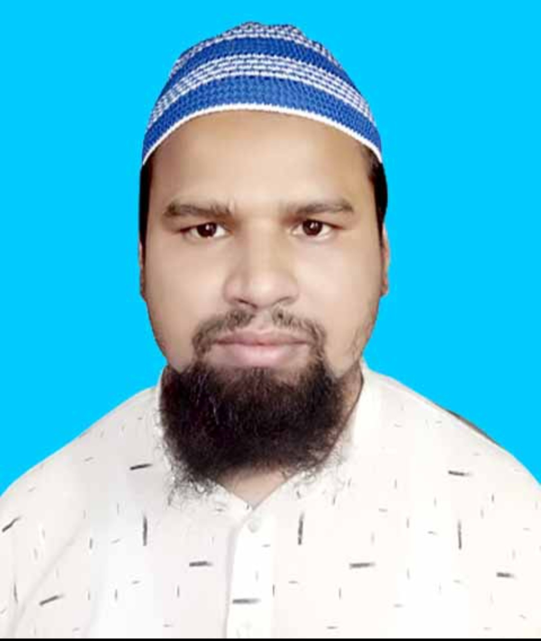
TEACHER’S IDENTITY
Md. Farid Uddin
Lecturer In English
Chipatali J.G.M Kamil (M.A) Madrasah.
Hathazari, Chattogram

Slide 3
LESSON DECLARATION
Although he is sick, he still continues working.
Globalization is a term that is commonly used by man.
What thing do you notice here?
Yes, you are right, these are
SENTENCE CONNECTORS

Slide 4

After completing this the students are able to..
Fill up the gaps with suitable connectors.
Understand the need of connectors.

Slide 5
1. Use appropriate sentence connectors in the blank spaces of the following passage.
Mobile phone has added a new dimension in our communication system. It has made the world closer to us. (a) —— it has made worldwide communication easier. We use it for our day to day communication. (b) ——, it has been a part and parcel in our life as we cannot go for a single day without using it. We use it for rapid communication. (c) ——, mobile phone is not free from defect. It has some negative sides as well. (d) ——, excessive use of mobile phone may damage our hearing power. (e) ——, it is a means of money wastage. (f) ——, it is seen that many underworld crimes are being done with the use of mobile network. (g) ——, the radiation from mobile phone may cause cancer to the users. (h) ——, we are not aware of these harmful effects. (i) ——, we are not aware of using the mobile phone. (j) ——, we must have to be conscious of the negative impact of mobile phone.

Slide 6
■ Answer:
(a) Now/ Nowadays (b) So/ Thus/ In fact (c) However (d) For example/ Firstly (e) Secondly/ Besides/ Moreover (f) Sometimes (g) Furthermore/ Finally/ Lastly (h) However (i) But/ Yet (j) So/ Therefore/ Thus

Slide 7
2. Use appropriate sentence connectors in the blank spaces of the following passage.
Man is a social being. (a) ——, man cannot live alone. (b) ——, man has been living together from time immemorial. Living in society is not an easy task. We have to follow certain rules and regulations of the society. (c) ——, we should be cooperative. (d) ——, we must help others when they are in need. (e) ——, we have to be careful not to hurt others by our words or activities. (f) ——, we must control our emotions and behave rationally with others. (g) ——, we should not think and live only for us. (h) ——, we should always think and work for the betterment of the society. (i) ——, we should remain prepared to sacrifice our lives for the greater interest of the society. (j) ——, sacrificing our lives for the society makes us immortal.

Slide 8
■ Answer:
(a) So (b) This is why (c) First of all (d) So/ In other words (e) Secondly (f) Besides/ So (g) Thirdly (h) Rather (i) Finally (j) Thus/ In fact

Slide 9
3. Use appropriate sentence connectors in the blank spaces of the following passage
Unemployment is a great problem in our country. (a) ——, it is the burning question of the day. (b) ——, almost all countries of the world suffer from the curse of unemployment problem. (c) ——, Bangladesh is the worst sufferer of this so-called problem. (d) —— nowhere in the world this problem is so acute as in our country. (e) ——, there are many reasons behind it. (f) ——, our country is industrially backward. (g) ——, our system of education fails to give a student an independent start of life. (h) ——, it has little provision for vocational training. (i) ——, our students and youths have false sense of dignity. (j) ——, they run after jobs blindly.

Slide 10
■ Answer:
(a) In fact (b) Nowadays/ At present (c) Unfortunately/ But/ However (d) In other words (e) Obviously (f) First of all (g) Secondly (h) Thirdly (i) Besides (j) So

Slide 11
4. Use appropriate sentence connectors in the blank spaces of the following passage.
Trees are a vital part of our environment. (a) ——, they bear a great impact on the climate. (b) —— we are not careful about them. (c) ——, we destroy trees at random. (d) ——, one day the country will bear the consequence of greenhouse effect. (e) —— ours is an agricultural country, our economy depends on it. (f) ——, our agriculture is dependent on rain. (g) ——, trees play a vital role on our climate. (h) ——, trees keep the soil strong. (i) ——, trees save us from flood (j) —— many other natural calamities.

Slide 12
■ Answer:
(a) Moreover/ In fact (b) But (c) Rather (d) As a result/ Consequently (e) As/ Since (f) In addition/ Moreover (g) So/ Therefore (h) Besides/ Moreover (i) Again (j) and/ as well as

Slide 13
5. Use appropriate sentence connectors in the blank spaces of the following passage.
Rangpur Town Hall is a place of cultural activities. (a) —— in 1971 it became a torture cell used by the Pakistani army. (b) —— the army brought here innocent Bangalees. After that they started to bring Bangalee women here. Among them Mansura Begum was one who was the wife of a freedom fighter. (c) —— she was young and beautiful, she drew the attention of local collaborators. (d) —— they informed the Pakistani army. (e) —— the Pakistani army abducted Mansura. On the day of occurrence Pakistani soldiers surrounded her house. (f) —— they searched her husband who joined the Mukti Bahini. (g) —— they found her father-in-law.

Slide 14
They started to beat him mercilessly. The old man got unconscious. (h) —— the barbarous soldiers did not stop beating him. Mansura rushed to her father-in-law, grabbed his bleeding body and begged the military not to kill him. (i) —— they did not listen to her. They picked up the old man on the military truck. (j) ——, they pulled and dragged Manusra on to the truck.
■ Answer:
(a) But (b) At first (c) As/ Since (d) So (e) Then/ After that (f) Afterwards/ Then (g) Suddenly/ Then/ Instead (h) But (i) But (j) Finally/ Lastly/ At the end

Slide 15
6. Use appropriate sentence connectors in the blank spaces of the following passage.
Honesty is a noble virtue. The man possessing this invaluable quality is the happiest man on earth, (a) ——. To be honest, a man should have trustworthiness. (b) ——, nobody trusts a liar. A liar may prosper for the time being. (c) ——, he goes to the dogs. (d) —— we should be honest. It is said that honesty is the best policy. (e) —— dishonesty is the sign of downfall. God helps those who are honest. (f) ——, dishonest people are cursed. (g) ——, children should be taught honesty from childhood. It is widely observed that children follow their parents. (h) ——, parents should be honest and upright in their business of life. (i) ——, children should be allowed to mix with those friends who are honest. (j) —— they can mould their characters.

Slide 16
■ Answer:
(a) indeed (b) Because (c) but/ eventually (d) So/ For this reason (e) Whereas (f) On the contrary (g) Hence/ So (h) That’s why/ So/ Therefore (i) Moreover/ Besides (j) Thus

Slide 17
7. Use appropriate sentence connectors in the blank spaces of the following passage.
Water is a vital element of the environment (a) —— this element is polluted in many ways. (b) ——, farmers use chemical fertilizers and insecticides in their field. (c) —— rain and flood wash away these chemicals, they get mixed with water in rivers, canals and ponds (d) —— pollute it. (e) ——, mills and factories throw their poisonous chemicals and waste product into water. (f) ——, water vehicles also pollute water by dumping food waste and human waste into it. (g) —— insanitary latrines and unsafe drains also contribute to water pollution. Water is called life. (h) —— we cannot allow this pollution to continue. We have to raise an awareness about it. (i) ——, laws should be enforced strictly. (j) —— we fail to check water pollution, we will suffer.

Slide 18
■ Answer:
(a) but (b) Firstly (c) When (d) and (e) Secondly (f) Furthermore/ Moreover (g) Finally/ Again (h) So (i) In this respect/ Therefore/ Moreover (j) If

Slide 19
8. Use appropriate sentence connectors in the blank spaces of the following passage.
It was the night before my math exam in the 2nd semester. I could not do better in the math exam of 1st semester. (a) ——, I was really serious about the exam. (b) ——, I was careful enough not to spend a single moment in vain. But the night did not pass smoothly at all. (c) ——, it was full of mishaps. (d) ——, the electricity went out. I waited for it for about an hour, however, there was no sign of its coming. (e) —— , I lighted a candle and began to study again. The flickering light of the candle was creating problems for me. Soon, I began to feel a bad headache. I really wanted to get rid of it. (f) ——, I left my reading room and stood in the balcony for some time. I began to feel better but could not stay there for long. (g) —— I left the place. (h) —— , I went to my reading room again. (i) ——, to add to my gladness the electricity came. I could finish my study within two hours. (j) ——, I went to bed with a happy mind.

Slide 20
■ Answer:
(a) This is why/ So/ For this reason (b) Besides (c) Actually/ Truly speaking (d) Suddenly (e) Then (f) So (g) Soon (h) However (i) At this moment (j) At last

Slide 21
9. Use appropriate sentence connectors in the blank spaces of the following passage.
Many people think that money can do everything in life. (a) —— it is a must for our life, it is not the thing that necessarily brings happiness. (b) —— it is absolutely a psychological matter. The person who is contented with what he gets and (c) —— he has is really happy. Money can do something with happiness (d) —— it cannot give us happiness. (e) ——, we can see that the richest men of our society are not the happiest men. (f) ——, they lead a life burdened with cares and anxieties (g) —— pass sleepless nights. (h) ——, there are a large number of poor men (i) —— are happy and enjoy a sound sleep. (j) ——, money cannot ensure happiness.

Slide 22
■ Answer:
(a) Although/ Though (b) Actually/ In fact (c) what (d) but (e) That is why/ For this reason/ So/ Therefore/ For example (f) Virtually/ Instead/ Rather (g) and (h) On the other hand/ On the contrary (i) who (j) This way/ That is to say/

Slide 23
10. Use appropriate sentence connectors in the blank spaces of the following passage.
Time and tide wait for none. (a) —— no one can stop the onward march of time. (b) ——, we should not waste a single moment in vain. (c) —— we should make proper use of every single moment of time. (d) —— the students should understand the value of time. It is a matter of great regret that some of the students pass their valuable time in Facebook. (e) —— they kill their time. (f) —— they cannot prepare their lessons well. (g) —— they always have a poor preparation for their examination. (h) —— they cannot do well in the examination. (i) —— they do not stop wasting time. (j) —— they continue to waste their time using Facebook till it is too late for them.

Slide 24
■ Answer:
(a) In fact (b) Therefore/ That’s why (c) Instead/ Rather (d) Especially (e) Thus (f) As a result/ For this (g) Hence (h) So/ As a result/ Consequently/ As a consequence (i) But/ Yet/ Even though (j) Nevertheless/ Rather

Slide 25
11. Fill in the blanks with suitable linking words/ sentence connectors.
Trees are a vital part of our environment. (a) ——, they bear a great impact on the climate. (b) —— we are not careful about them. (c) ——, we destroy trees at random. (d) ——, one day the country will bear the consequence of greenhouse effect. (e) —— ours is an agricultural country, our economy depends on agriculture. (f) ——, trees play a vital role on our climate. (g) ——, trees keep soil strong and protect it. (h) ——, trees save us from flood and many other natural calamities. (i) ——, trees provide us timber which is of great use specially in construction works and for making furniture. (j) ——, trees are our best friends.

Slide 26
■ Answer:
(a) Actually/ In fact (b) Yet/ Still/ But (c) Rather (d) Ultimately/ As a result/ Consequently (e) Since/ As (f) In addition/ Besides (g) For example/ For instance/ Firstly (h) Besides/ Secondly (i) Moreover/ Finally/ Again (j) Above all/ To sum up/ Thus

Slide 27
12. Use appropriate sentence connectors in the blank spaces of the following passage.
Unemployment is a great problem in our country. (a) ——, it is the burning question of the day. (b) ——, almost all countries of the world suffer from the curse of unemployment problem. (c) ——, Bangladesh is the worst sufferer of this so-called problem. (d) —— nowhere in the world this problem is so acute as in our country. (e) ——, there are many reasons behind it. (f) ——, our country is industrially backward. (g) ——, our system of education fails to give a student an independent start of life. (h) ——, it has little provision for vocational training. (i) ——, our students and youths have false sense of dignity. (j) ——, they run after jobs blindly.

Slide 28
■ Answer:
(a) In fact/ Actually (b) Nowadays/ At present (c) But/ Unfortunately (d) Truly/ Because (e) Obviously (f) First of all (g) Secondly/ Besides (h) Thirdly/ Moreover (i) Last but not the least/ Last of all/ Lastly/ In addition (j) So/ For this reason/ That is why

Slide 29
13. Use appropriate sentence connectors in the blank spaces of the following passage.
Honesty is a noble virtue. The man (a) —— possesses this uncommon quality is the happiest man in the world. Truly speaking, a man should have trustworthiness (b) —— nobody believes a liar. A liar may prosper for the time being, (c) —— ultimately he goes to the dogs. (d) —— we should be honest in our life. It is believed that honesty is the best policy (e) —— dishonesty is the sign of downfall, God helps those who are honest. (f) —— dishonest people are cursed. Childhood is the best time (g) —— children should be taught honesty. It is seen that children follow their parents, (h) —— parents should be honest. (i) —— they should be allowed to mix with those friends who are really honest. (j) —— they build up their character.

Slide 30
■ Answer:
(a) who (b) because (c) but (d) So/ That’s why (e) whereas (f) On the other hand/ On the contrary (g) when (h) for which/ and so (i) Again/ Besides (j) Thus

Slide 31
14. Fill in the blanks with suitable linking words/ sentence connectors.
Unemployment is a great curse. (a) —— all the countries of the world suffer from the curse. (b) —— nowhere in the world, this problem is so acute as in our country. (c) —— there are many reasons behind it. (d) ——, our country is industrially backward. (e) —— our traditional education system is not service oriented. (f) ——, our students and youths have false sense of dignity. (g) ——, they run after jobs only. (h) ——, unemployment problem should be removed at any cost. (i) —— our education system should be changed. (j) —— more mills and factories should be established.

Slide 32
■ Answer:
(a) At present/ Nowadays (b) But (c) Actually/ Obviously (d) Firstly (e) Secondly (f) Thirdly (g) So/ That is why (h) However/ Anyway (i) For this (j) Besides/ Moreover

Slide 33
15. Use appropriate sentence connectors in the blank spaces of the following passage.
We must be aware of the dangers of smoking. It is harmful to us in various ways. It causes various diseases (a) —— blood pressure, heart attack, bronchitis, cancer, etc. (b) —— it pollutes air. (c) —— smoking causes harm to (d) —— the smokers (e) —— the non-smokers who remain by them. (f) —— we should give up smoking. (g) —— it is (h) —— great an addiction to get rid of. (i) —— nothing is impossible for us. (j) —— we are determined to give up it, we can certainly do it.

Slide 34
■ Answer:
(a) such as/ like (b) Moreover/ Also (c) Besides (d) not only/ both (e) but also/ and (f) So/ Therefore (g) However (h) such/ too (i) But (j) If

Slide 35
16. Use appropriate sentence connectors in the blank spaces of the following passage.
Education is essential in our life. (a) —— we are not properly educated, we cannot live an honorable life in society. It teaches us (b) —— how to earn but also how to spend. (c) ——, it teaches (d) —— to live in amity with others in society. (e) ——, we must get proper education. (f) —— we should bear in mind (g) —— education is not only what we learn at educational institutions but also (h) —— we learn outside these institutions. (i) ——, education is a lifelong process. It begins just after our birth (j) —— ends only in death.

Slide 36
■ Answer:
(a) If (b) not only (c) Besides/ Again (d) how (e) So (f) But/ In this context (g) that (h) what (i) In fact (j) and

Slide 37
17. Use appropriate sentence connectors in the blank spaces of the following passage.
We should always keep in mind (a) —— all kinds of physical exercise are not suitable for all. (b) —— different people have different capacities. (c) ——, harder exercise (d) —— wrestling and gymnastics are suitable for young people (e) —— they have energy to perform them. Weaker and old people should take the milder exercise (f) —— walking, jogging and free hand exercise. Over exercise never does good (g) —— it breaks down the health. (h) ——, we should always take those exercises (i) —— would suit us. Physical exercise is important for the preservation of good health. It (j) —— builds our character.

Slide 38
■ Answer:
(a) that (b) Because (c) For example (d) such as (e) as/ because (f) such as (g) rather (h) So (i) which/ that (j) also

Slide 39
18. Use appropriate sentence connectors in the blank spaces of the following passage.
We cannot walk on a road in the darkness without light. (a) ——, we cannot step forward in our life without education. (b) ——, throughout the ages, education has always been compared to light and (c) —— ignorance has been compared to darkness. (d) ——, the light of education enlightens us. (e) ——, it broadens our mind and widens our outlook. (f) ——, it is education which helps us to become a good citizen. (g) ——, education creates good citizen and ensures the smooth development of a country. (h) ——, ignorance stands on the way of the development of an individual. (i) —— ignorance has a detrimental effect on the overall development of a nation. (j) ——, we should come forward to educate every single person of our country and thereby, ensure the development of our country.

Slide 40
■ Answer:
(a) Likewise/ Similarly (b) For this reason/ That is why (c) on the contrary/ on the other hand (d) In fact (e) Besides (f) Moreover (g) Thus/ In fact/ Actually/ Truly (h) On the contrary/ On the other hand (i) In fact/ Actually (j) So/ Therefore/ Hence/ This is why

Slide 41


