Slide 1


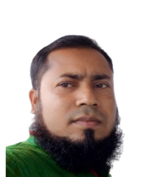
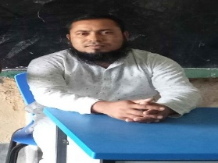
Class - Three
Subject - English
Unit - 5
সবাইকে স্বাগতম।
Class - Three
Subject - English
Unit - 5
৩৬ নং কংশেরকুল সঃ প্রাঃ বিঃ * ভালুকা,ময়মনসিংহ।
9/4/2026
1

Slide 2

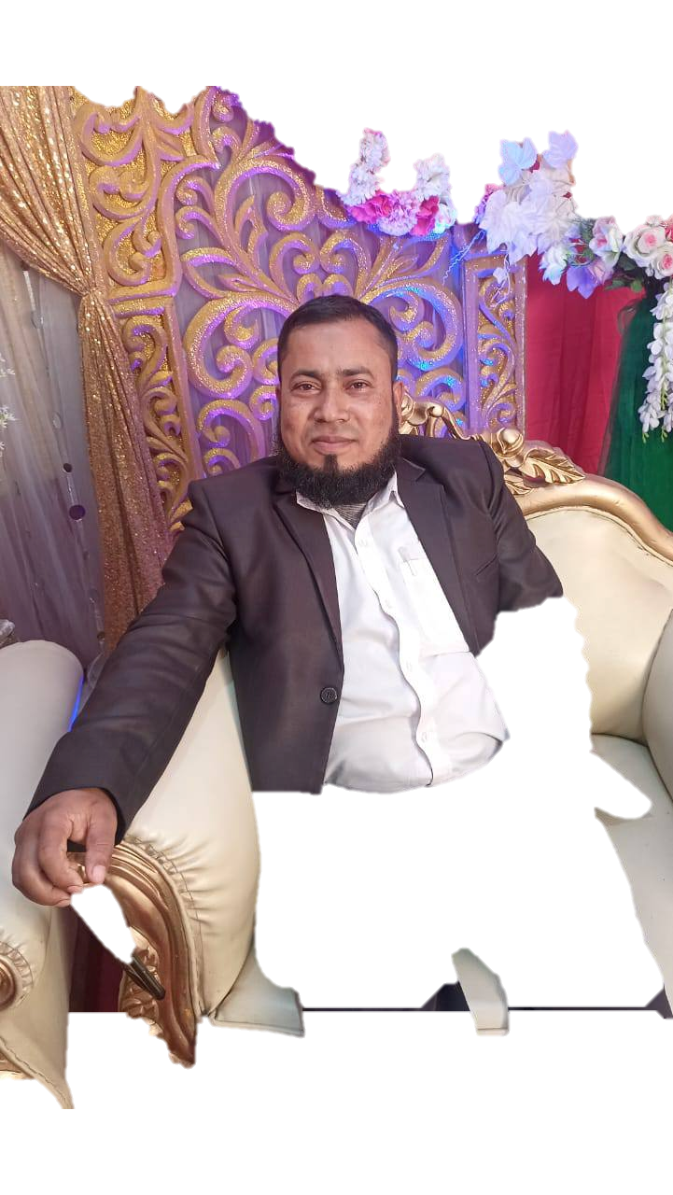
Teacher’s Identity
Shohel Miah
Assistant Teacher
Kongsherkul Govt’ Primary School.
Bhaluka,Mymensingh.
Mobile: 01721491411
Email:-shohelkgps@gmail.com

Slide 3
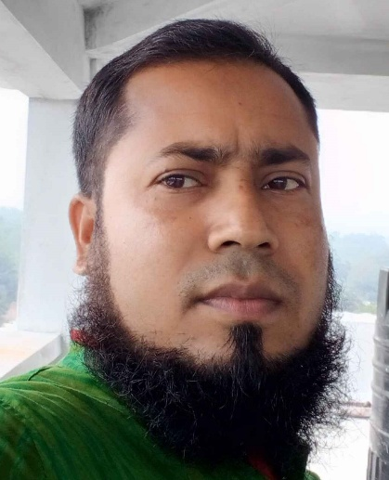


Lesson’s Identity
Class : Three
Subject : English
Unit : 5, Lesson 4
Oyshi's city life
Activity : A, B, C, D
Page : 76 & 77.
Time : 45 minutes
Date:04/09/2026

Slide 4
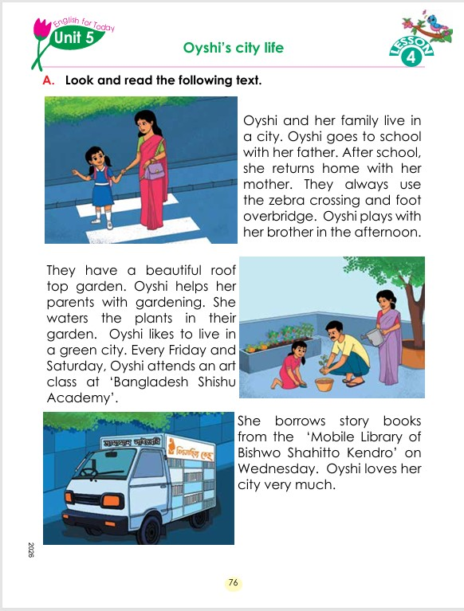
Can you guess what is our today's lesson?
What is the relationship between them?

Slide 5
Today's Our Lesson
Oyshi's city life
Unit - 5.
Lesson 4

Slide 6
Learning Outcomes
Students will be able to:-
Listening:-
4.3.1 - enjoy and understand simple stories.
Speaking:-
3.1.1 - ask and answer Wh questions.
Reading:-
5.1.1 - read simple paragraphs.
Writing:-
8.1.3 - write sentence from the text book or model.
10.1.1 - write short and simple paragraphs answering a
set of questions.

Slide 7
Who can you see in the picture?
New Words
City
Where people live in modern.
Oyshi and her family live in a city. Oyshi goes to school with her father. After school, she returns home with her mother. They always use the zebra crossing and foot overbridge. Oyshi plays with her brother in the afternoon.
They have a beautiful roof top garden. Oyshi helps her parents with gardening. She waters the plants in their garden. Oyshi likes to live in a green city. Every Friday and Saturday, Oyshi attends an art class at ‘Bangladesh Shishu Academy’.

Slide 8
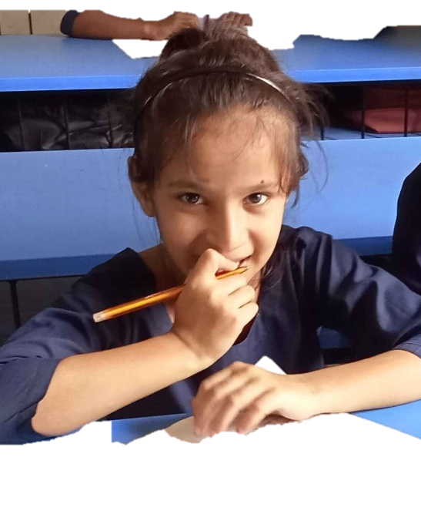
She borrows story books from the ‘Mobile Library of Bishwo Shahitto Kendro’ on Wednesday. Oyshi loves her city very much.

Slide 9
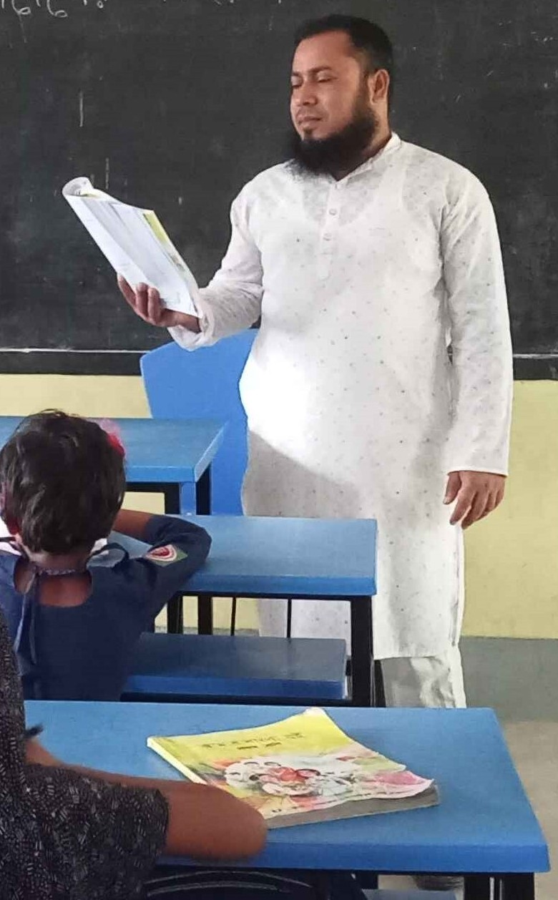
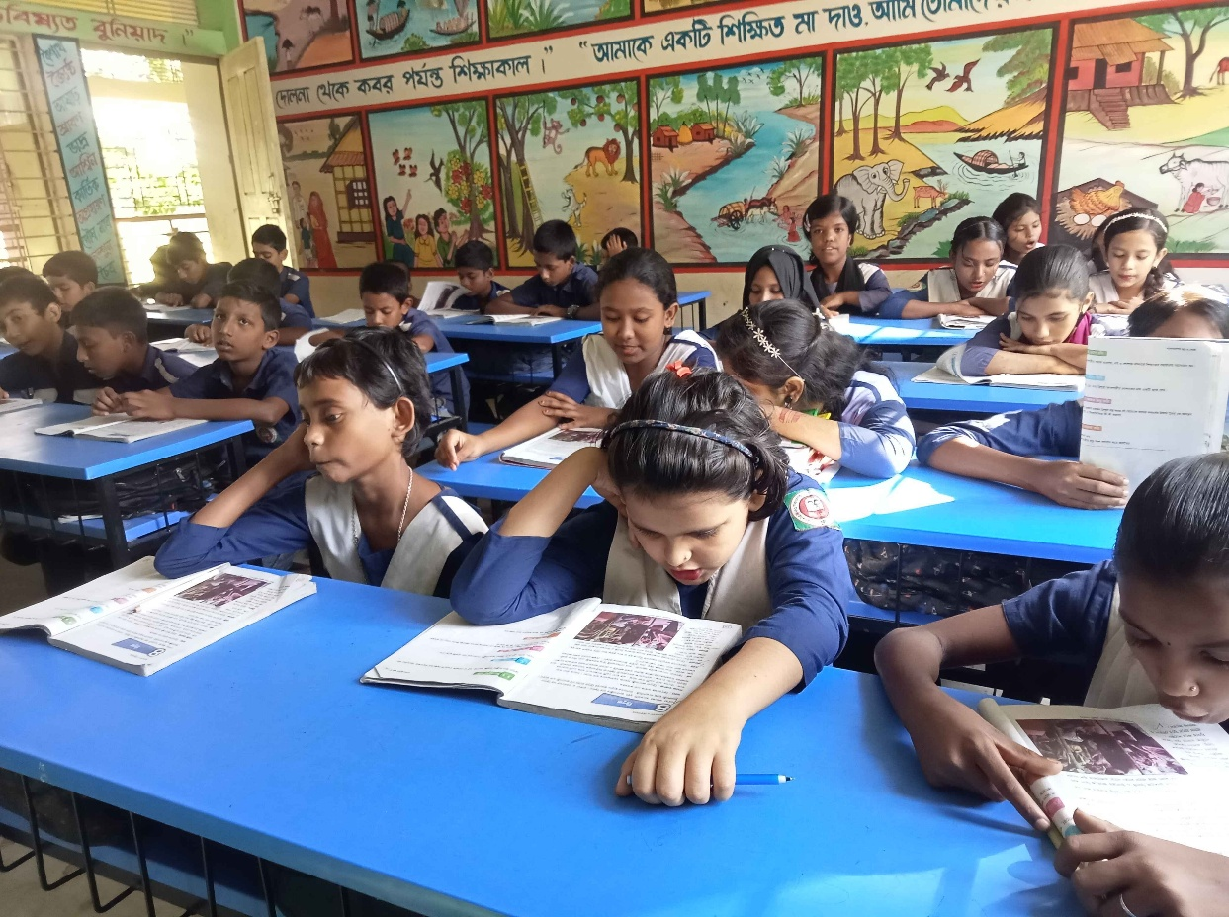
Teacher’s reading

Slide 10
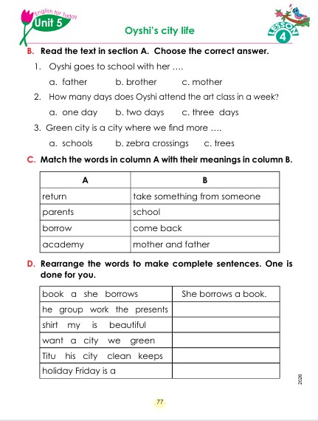

Open your English book at page-76-77

Slide 11
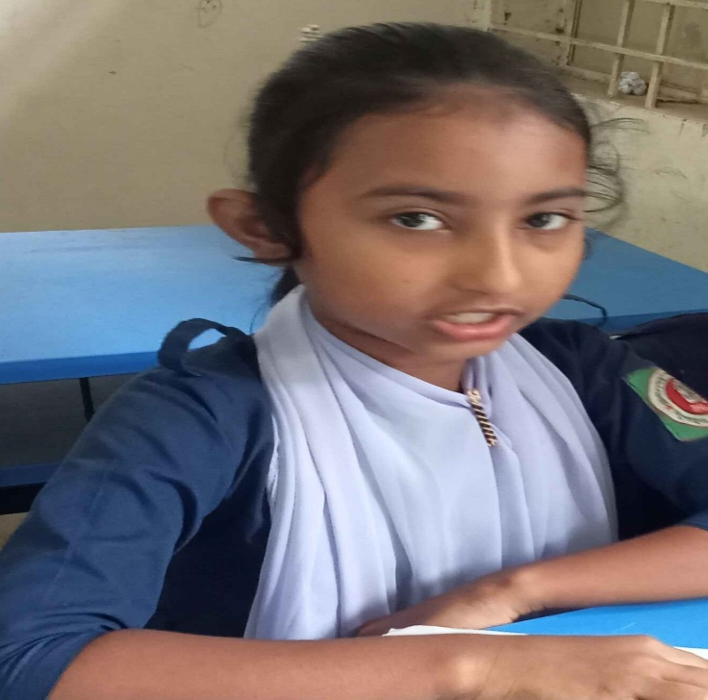
Individual Work
Make sentence by the words:
City
School
River

Slide 12
Oyshi and her family live in a city. Oyshi goes to school with her father. After school, she returns home with her mother. They always use the zebra crossing and foot overbridge. Oyshi plays with her brother in the afternoon.
They have a beautiful roof top garden. Oyshi helps her parents with gardening. She waters the plants in their garden. Oyshi likes to live in a green city. Every Friday and Saturday, Oyshi attends an art class at ‘Bangladesh Shishu Academy’.
She borrows story books from the ‘Mobile Library of Bishwo Shahitto Kendro’ on Wednesday. Oyshi loves her city very much.
Where does Oishi live?
How does Oishi go to school?
When does Oishi return home?
Who helps her parents?
Where does Oishi attends?
Answer
Please click answer button for answer
Pair Work
Answer
Time: 5 minute's
Answer
Answer
Answer

Slide 13
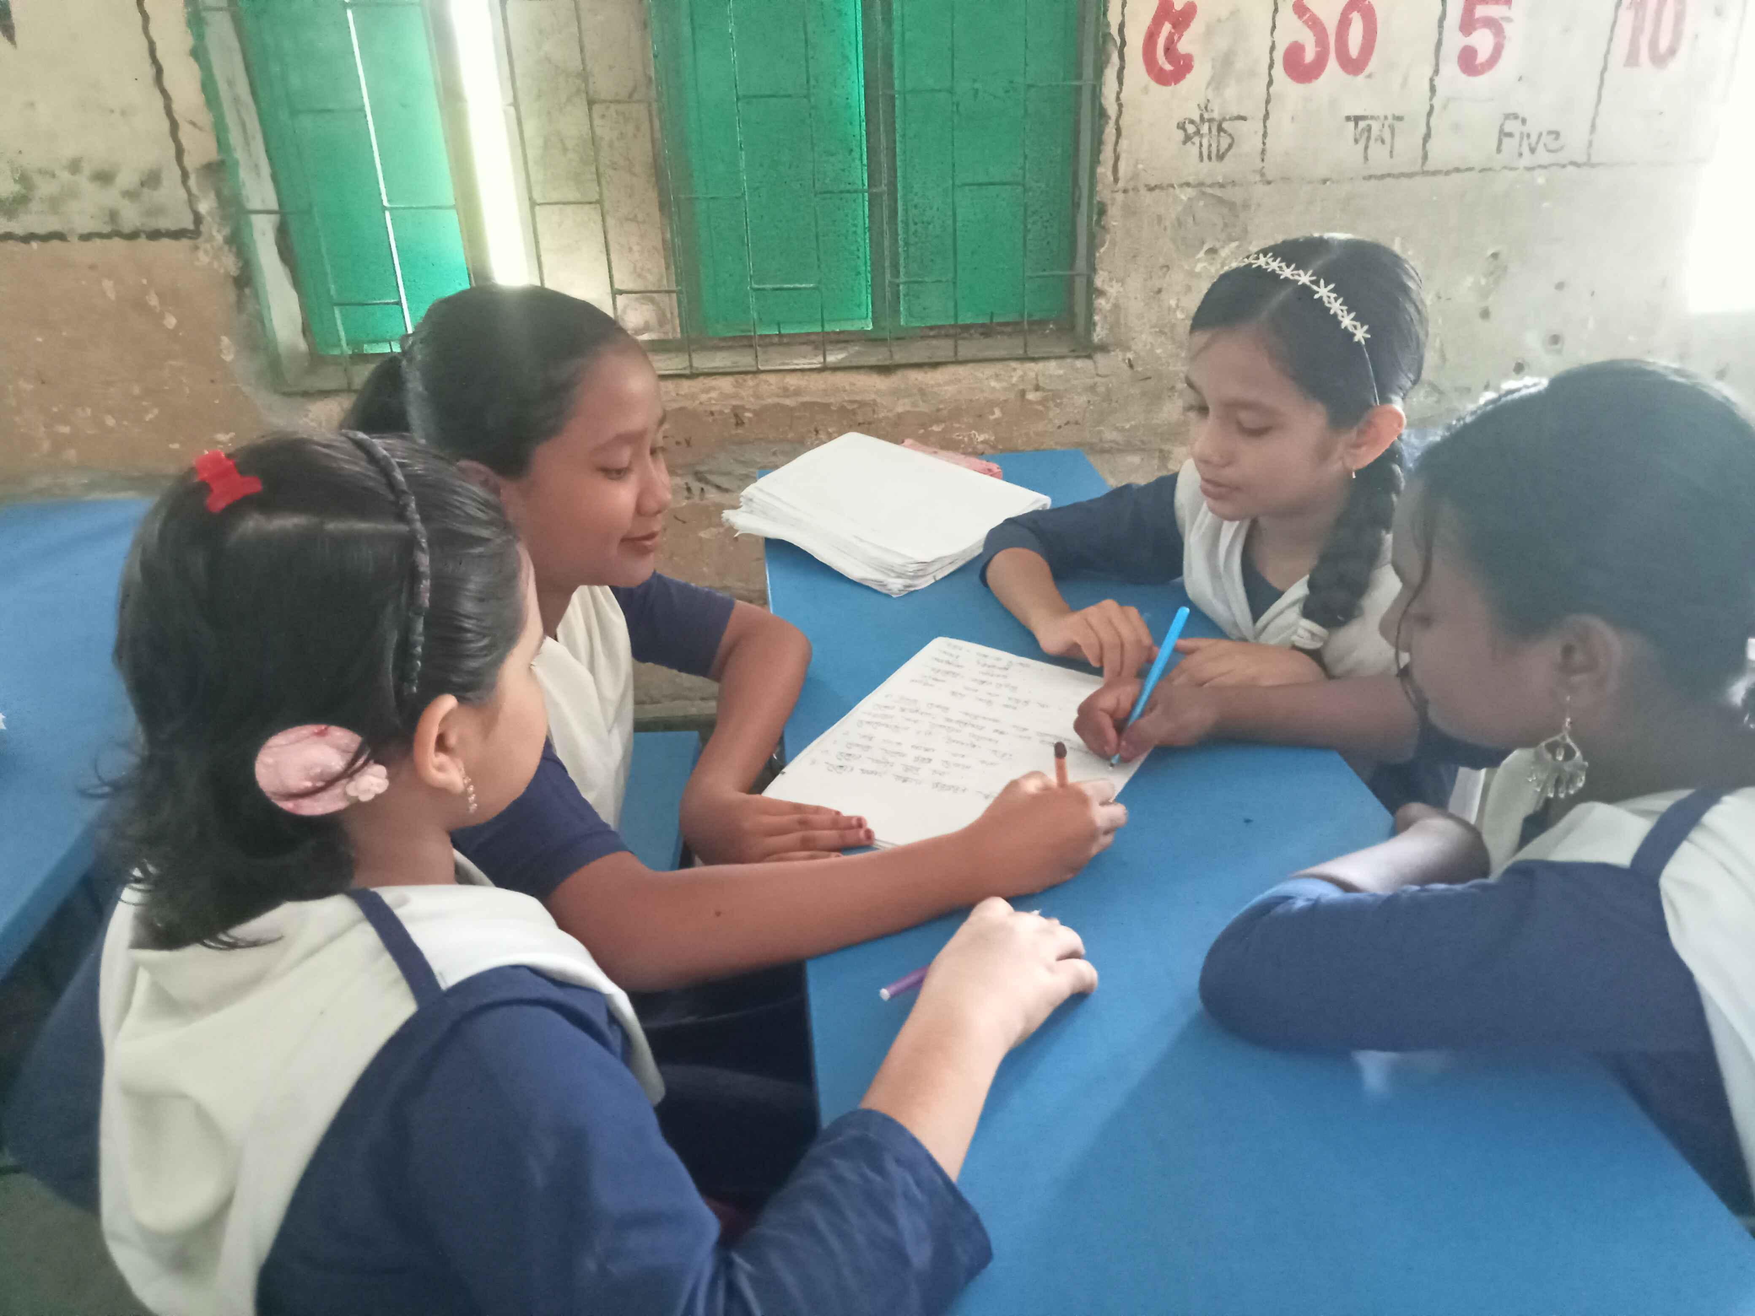
Group Work
Time: 10 minute's

Slide 14
Individual Work
Read the sentences. Write T for True and F for False.
Oishi and her family live in a city.____
Oishi goes to school with her father.____
Oishi playes with her mother ._____
She helps her parents with gardening.____
She borrows story books.___
T
T
F
T
T

Slide 15
Choose the correct answer.
1. Oishi goes to school with her...

(a) mother
(b) father
Match them
(c) sister
(d) brother
2. How many days does Oyshi attend the art class in a week?
(a) one days
(b) three days
Match them

(c) four days
(d) two days

Slide 16
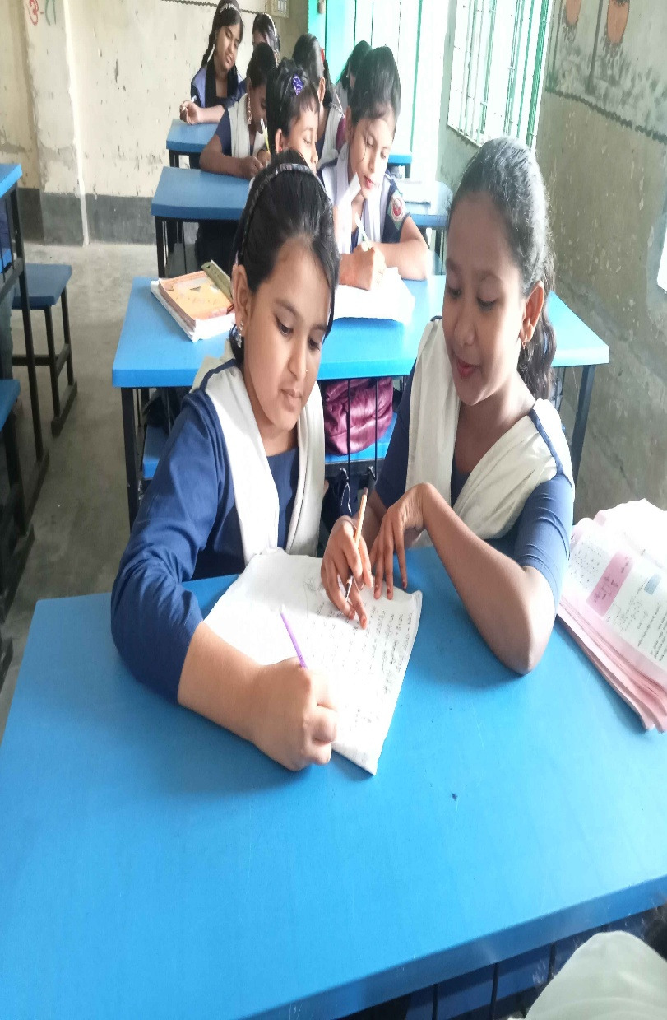
Pair Work
Ask and answer.
What is the story about?
Where does Oish's family live?
When does Oishi return home?
Who helps her parents?
Where does Oishi attends?

Slide 17
Pair Work
Match the words in column A with the words of
similar meaning in column B. One is done for you.
A | B
return parents borrow academy study | learn take something from some one come back mother and father school

Slide 18
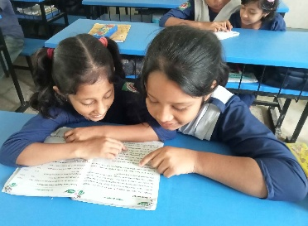
Pair Work
Let’s read the text in section A again. List the nouns, pronouns and verbs in the following table.
Noun | Pronoun | Verb
Oishi | He | Live

Slide 19
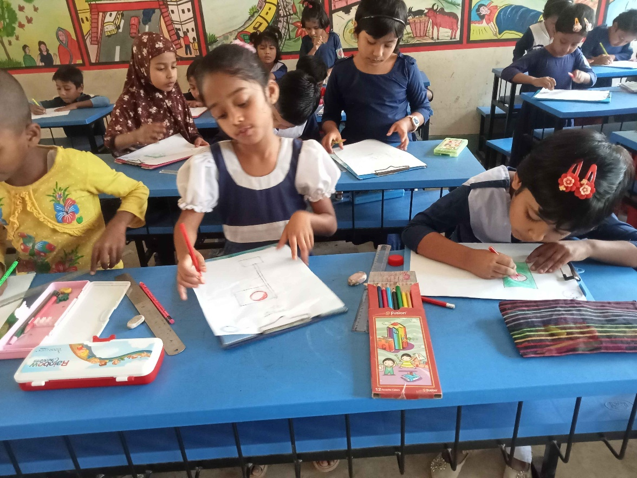
Evaluation
Look attentively. Now we play a game. Everybody close your eyes.
Which word is missing?
Open your eyes.
City
Class
Afternoon

Slide 20
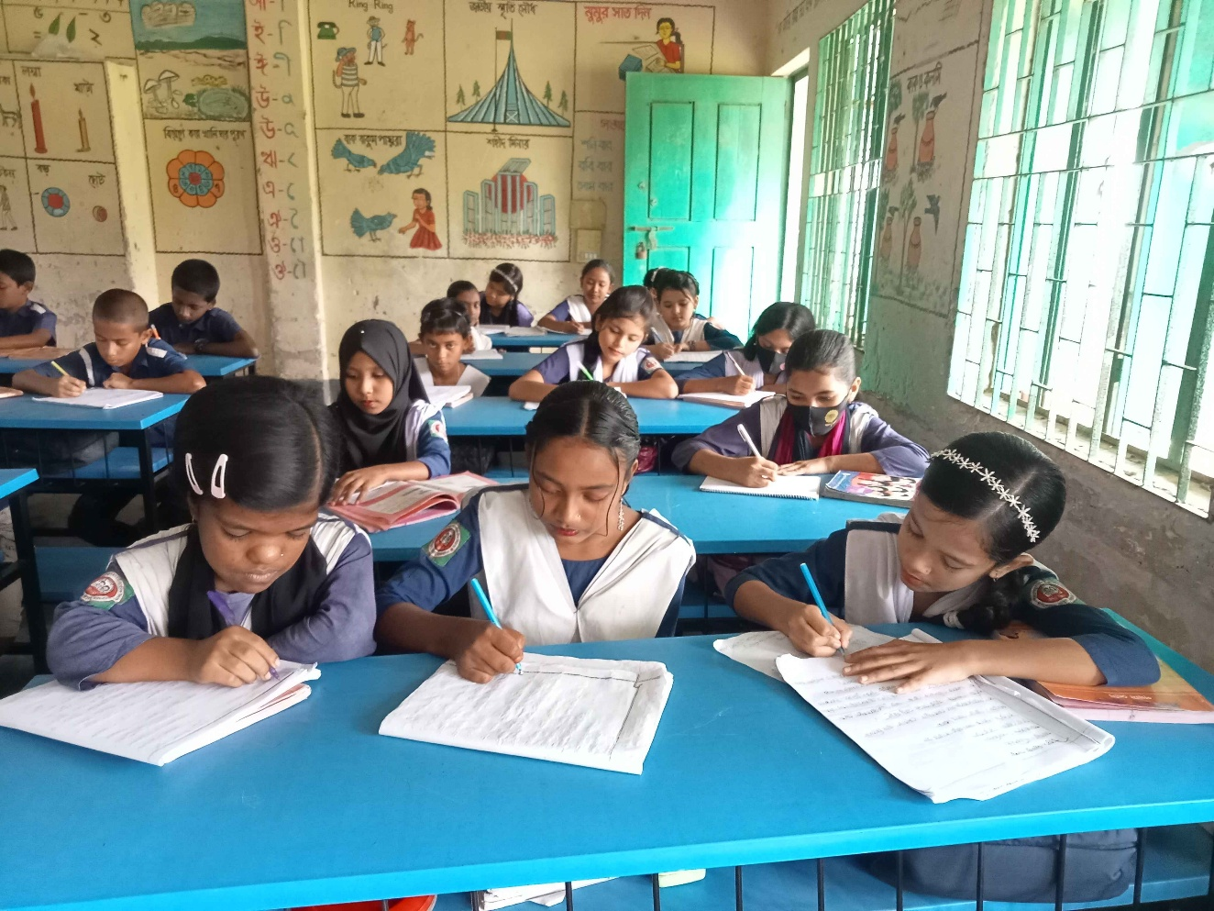
Evaluation
Write three sentences about City life.

Slide 21

Home Work
Write a composition about “Your City Life”

Slide 22

Thank you for staying with us.

