Slide 1
Artificial intelligence in
HEALTHCARE
Presented by:
Md. Peas

Slide 2
content
Introduction
Objective
Precision Medicine
AI in Medical Visualization
VR in Medical Sector
Learning Experience
Decision Maker
Conclusion

Slide 3
introduction
Artificial intelligence is used in healthcare to discover links between genetic codes, power surgical robots and maximize hospital efficiency.

Slide 4
OBJECTIVES
Enhance preventive care and quality of life
Produce more accurate diagnoses and treatment plans
Lead to better patient outcomes overall

Slide 5

Precision medicine
Genetic make up
Age
Gender
Lifestyle
Disease profile
Emotional State
Health monitoring data
Health records

Slide 6
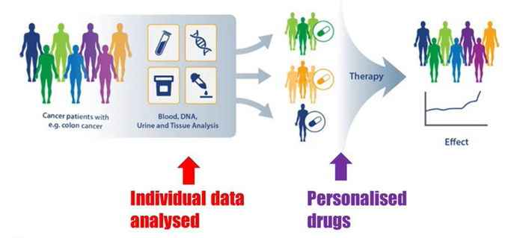
Precision medicine

Slide 7
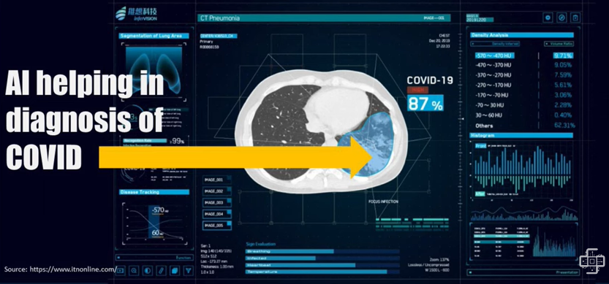
Ai in medical visualization

Slide 8
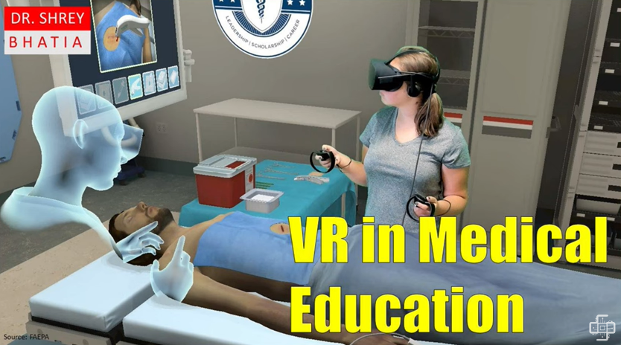
VR in medical Sector

Slide 9
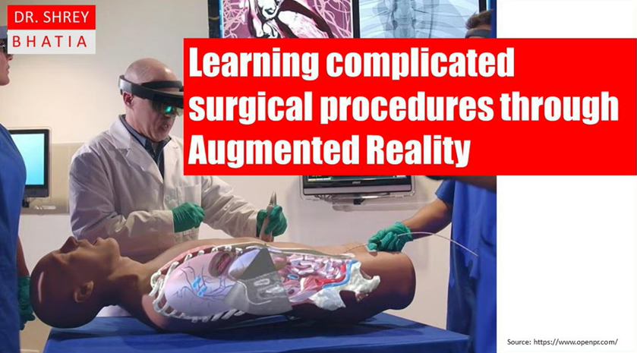
Learning Experience

Slide 10
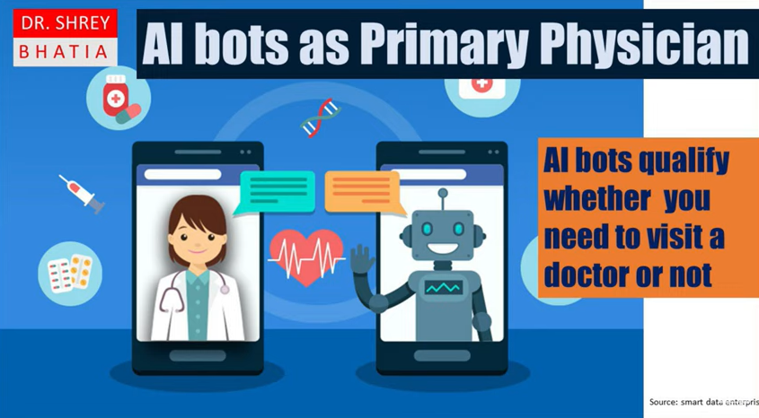
Decision maker

Slide 11
Conclusion
AI can help doctors and medical providers deliver more accurate diagnoses and treatment plans.
Its predictive and proactive by analyzing big data to develop improved preventive care recommendations for patients.

Slide 12
Thank you

