Slide 1


Slide 2
Teacher’s Identity
Salina Begum
Assistant Teacher
Alfadanga Model Govt. Primary School.
Alfadanga Faridpur.

Slide 3

LESSON’S IDENTITY
Class: Three
Subject: English
Unit: 4 , Row, Row, Row your boat
Lesson:1-2 ( C )
Time: 45 minutes

Slide 4


Welcome
To
Our English class

Slide 5
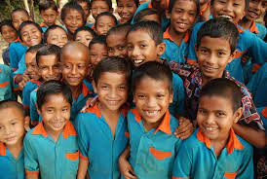
How are you?

Slide 6
Learning outcomes
Student will be able to recite the rhyme .

Slide 7

Let’s recite the rhyme

Slide 8


Slide 9

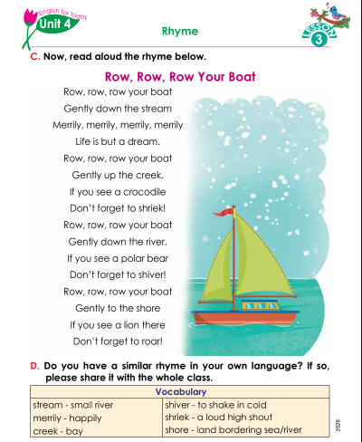
Open your book

Slide 10
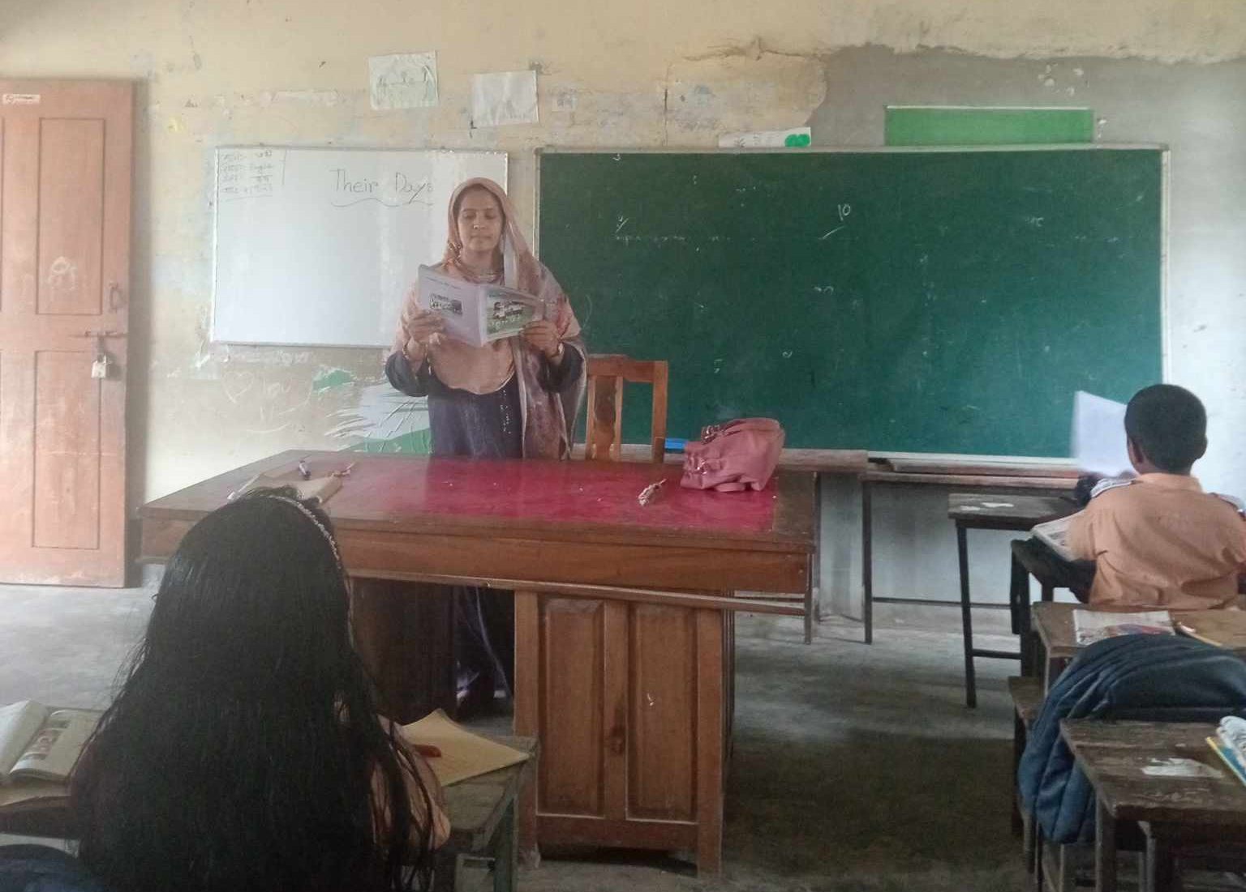

Slide 11
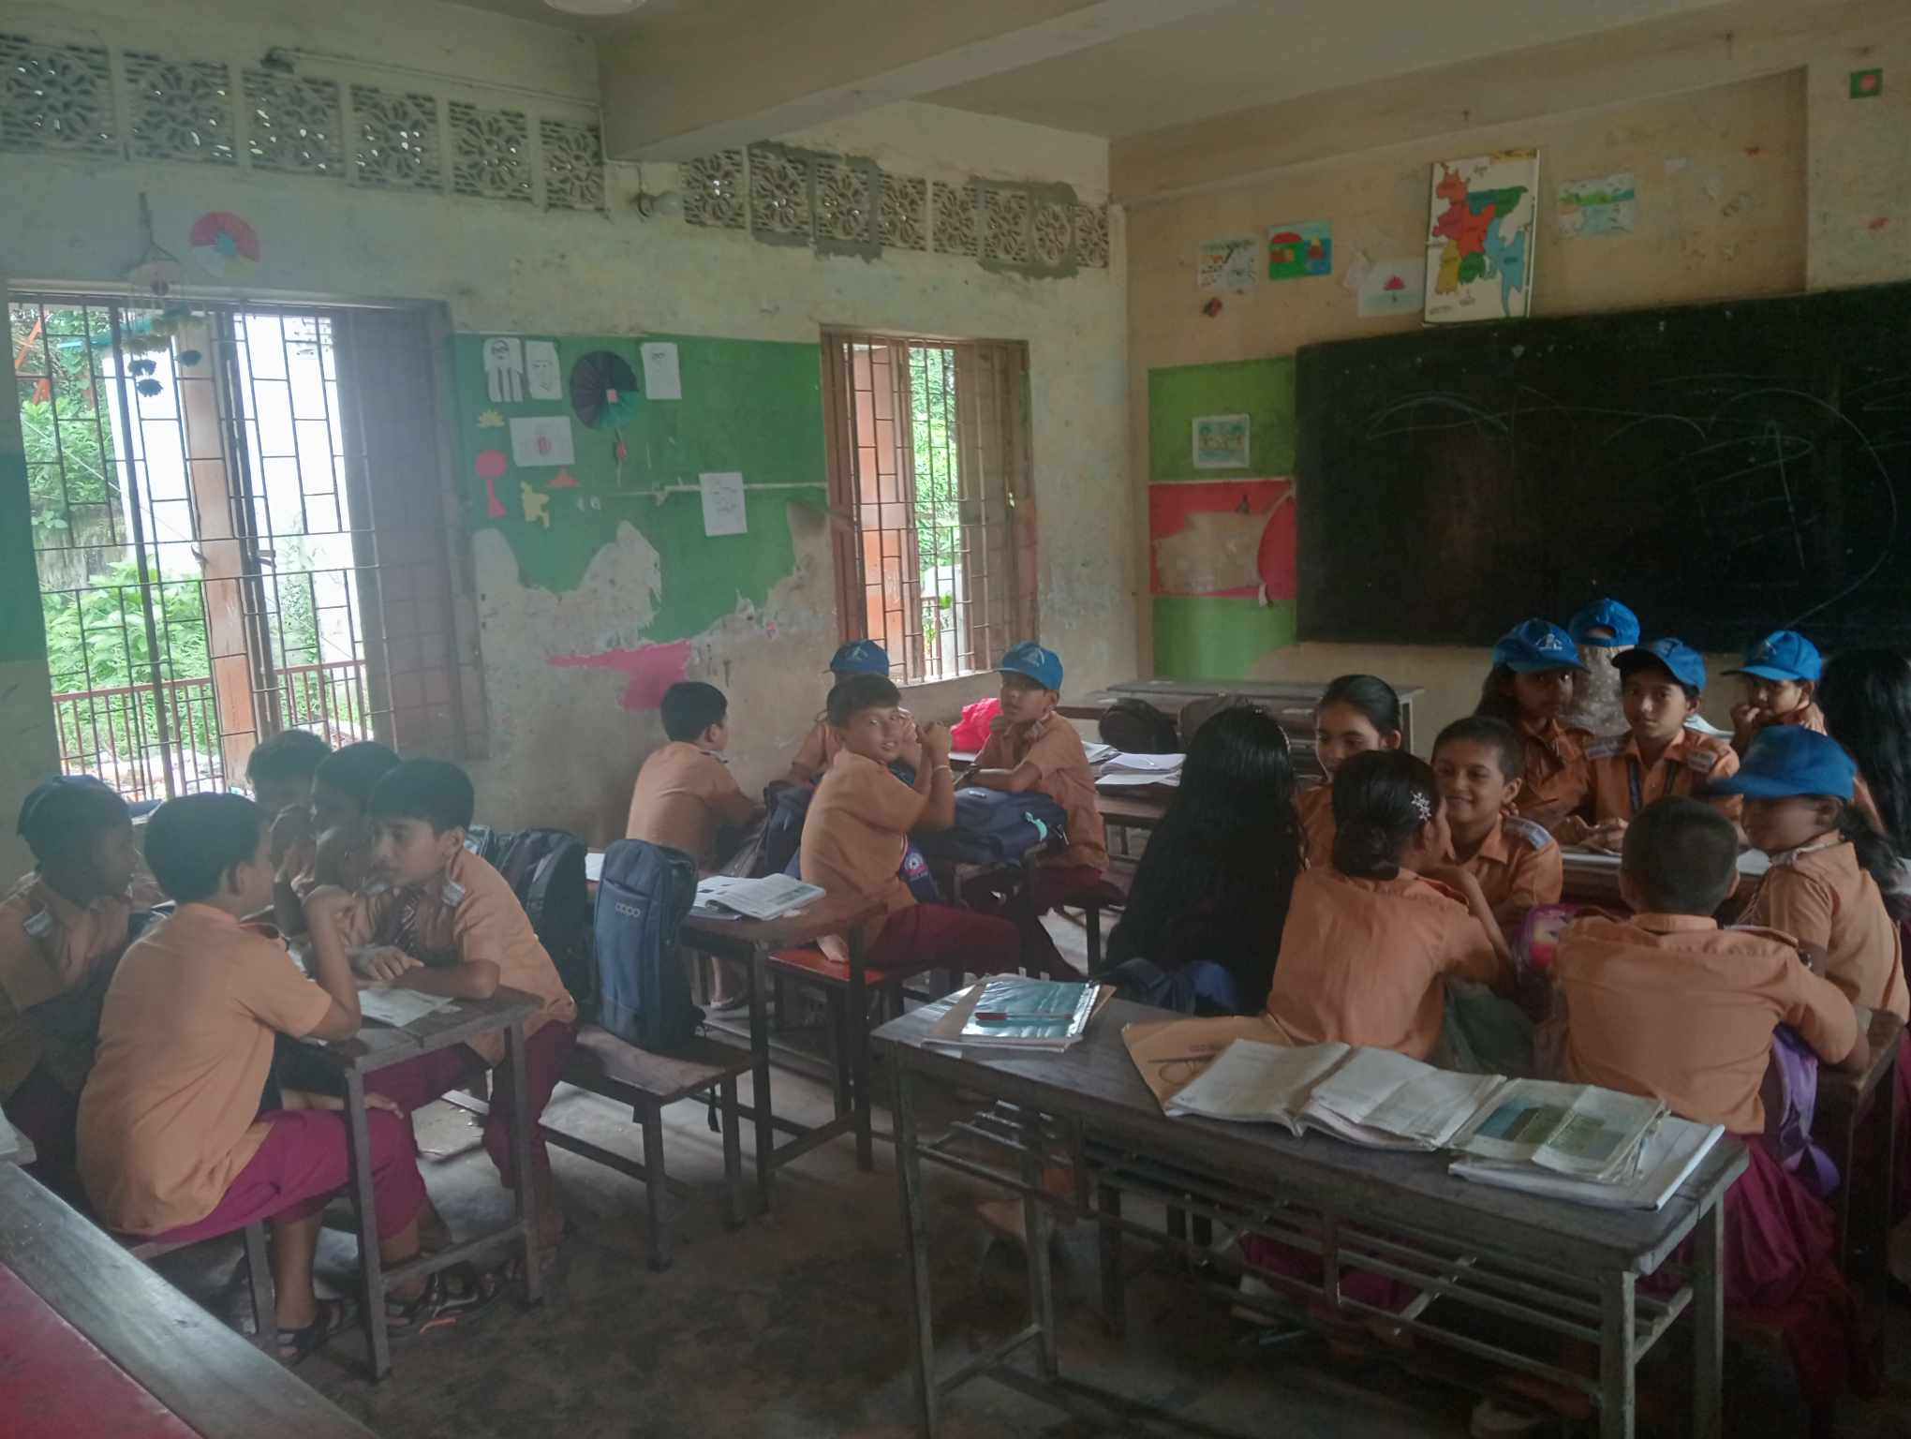
Group reading

Slide 12
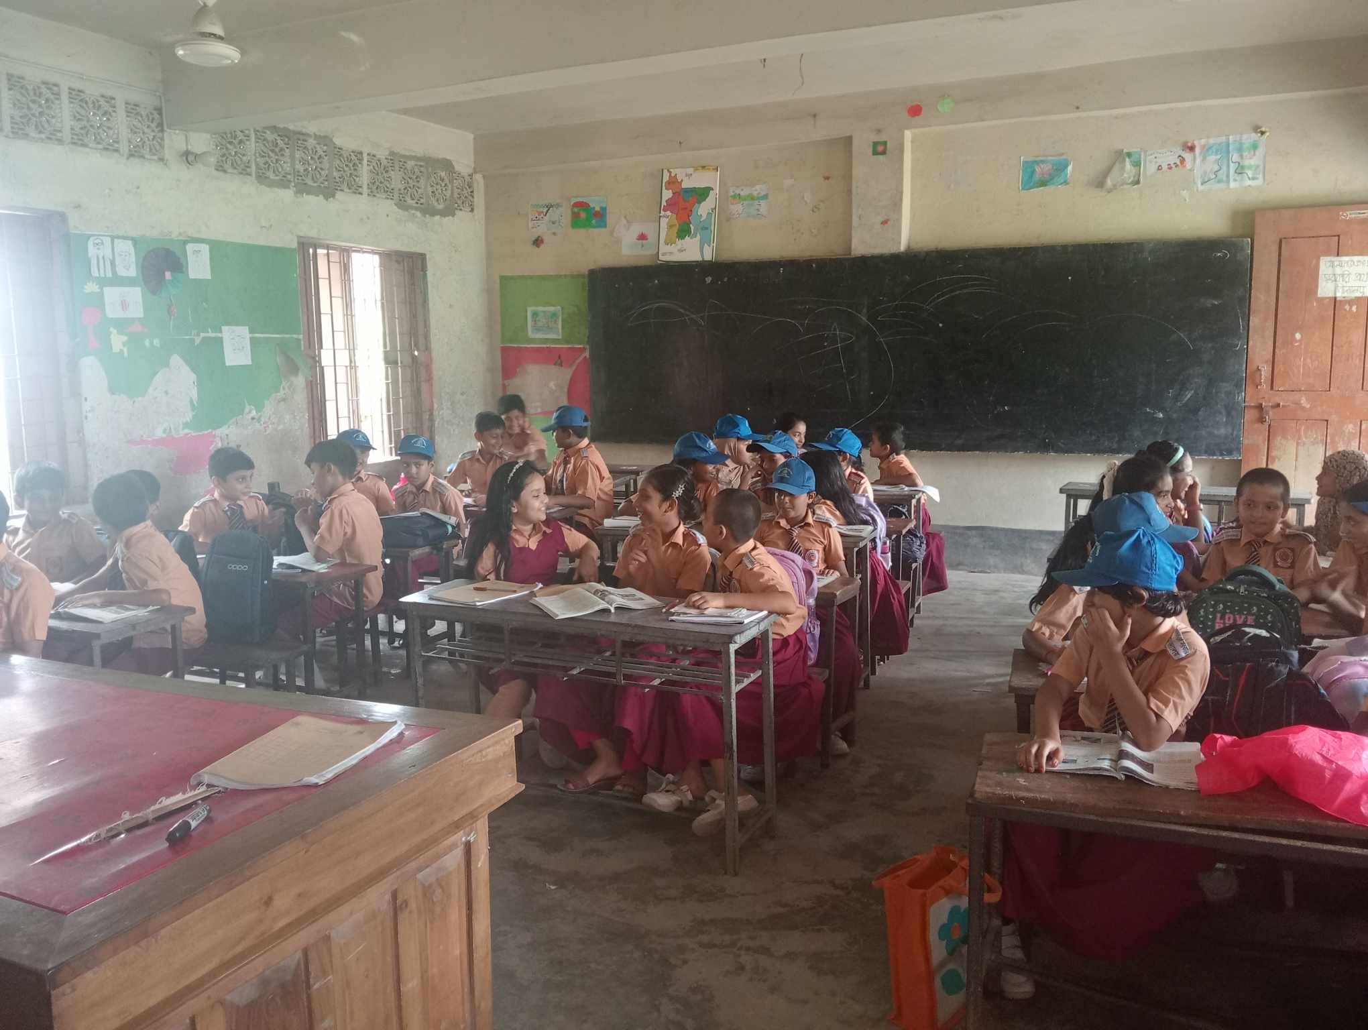
Pair reading

Slide 13
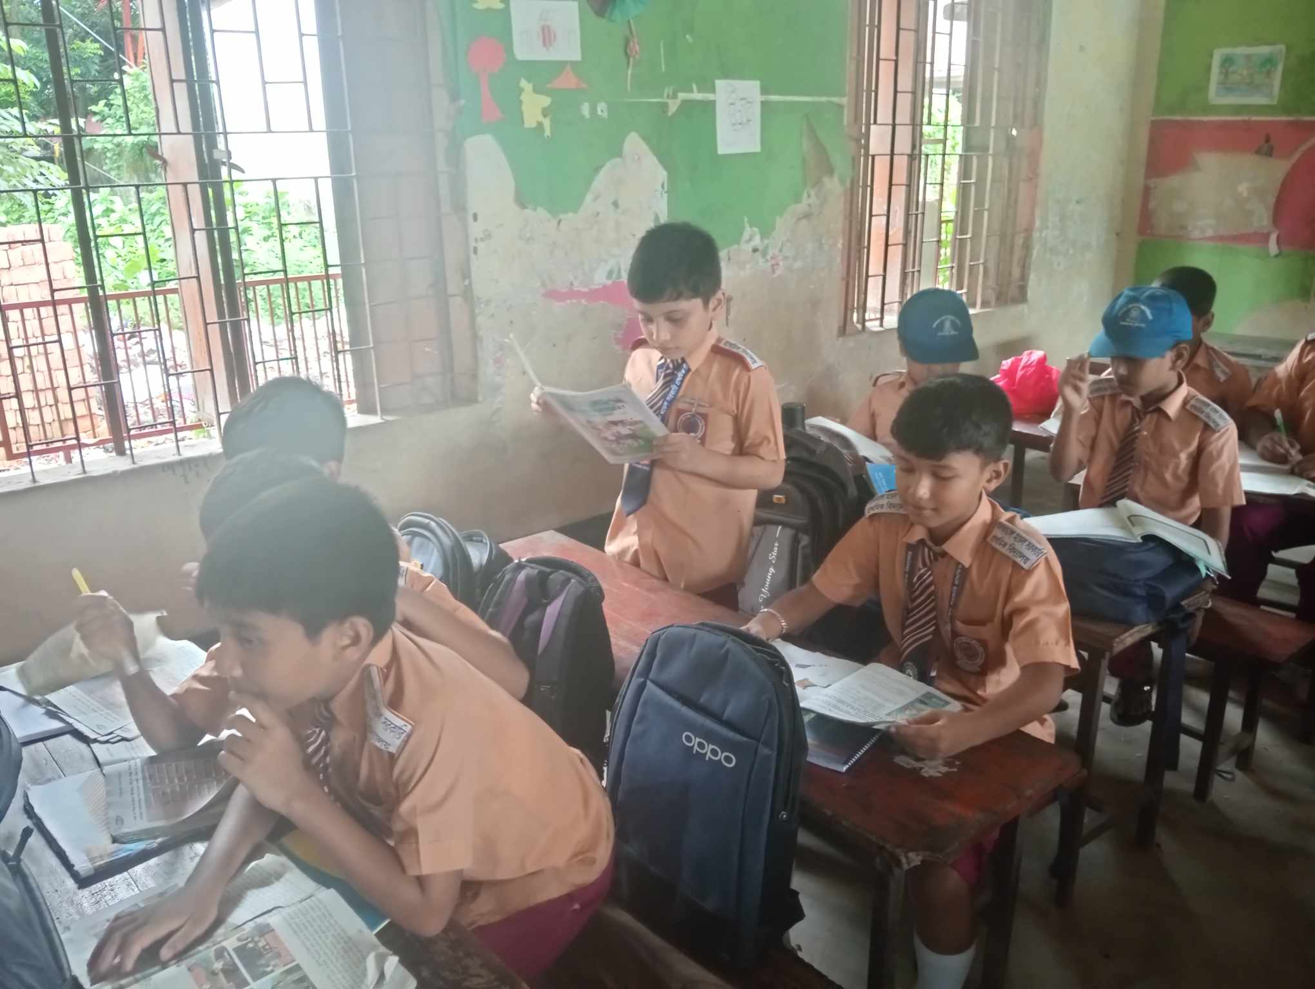
Individual reading

Slide 14
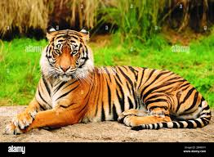

Slide 15

Thanks

