Slide 1



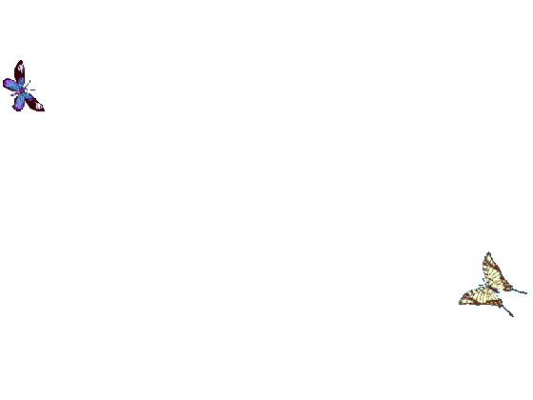
WELCOME TO ALL IN TODAY’S
ENGLISH LESSON

Slide 2


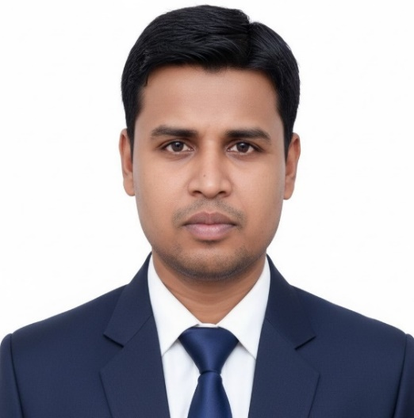

Presented By
Rajib Dutta
Assistant teacher
Bhingrol Govt.Primary School
Anowara, Chottogram
Email: rajibduttaat@gmail.com

Slide 3

Let’s we sing a song.
Good Morning, Good Morning
How are you today?
I am fine , I am fine
I wish you a good day.
Md. Mofakkarul Alam, Assistant Teacher, Goraduba govt. Primary School, Kendua, Netrokona.

Slide 4

Class : Two
Subject : English
Time : 45 minute
*Rajib Dutta. Bhingrool gps. Anowara*. Ctg

Slide 5
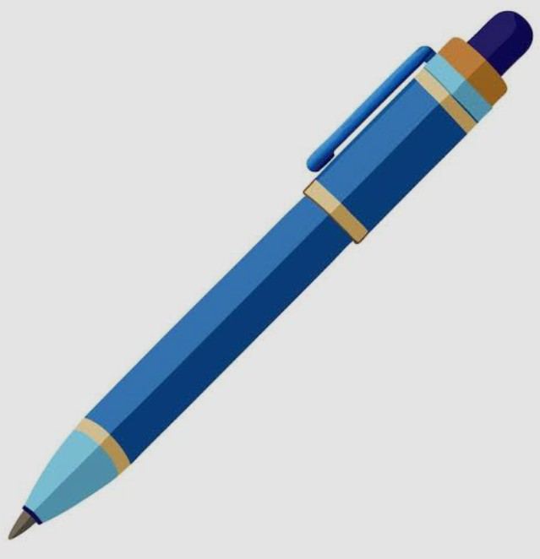
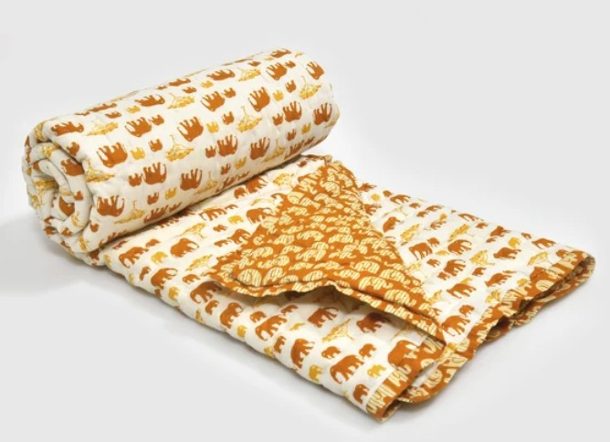
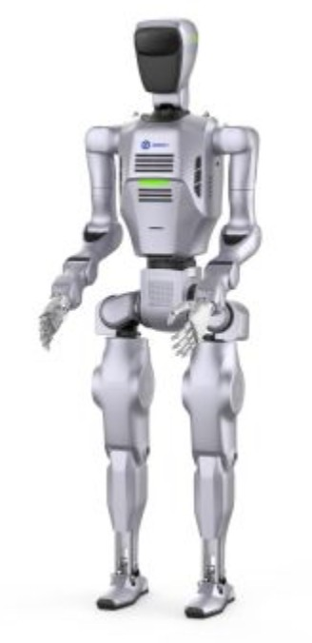

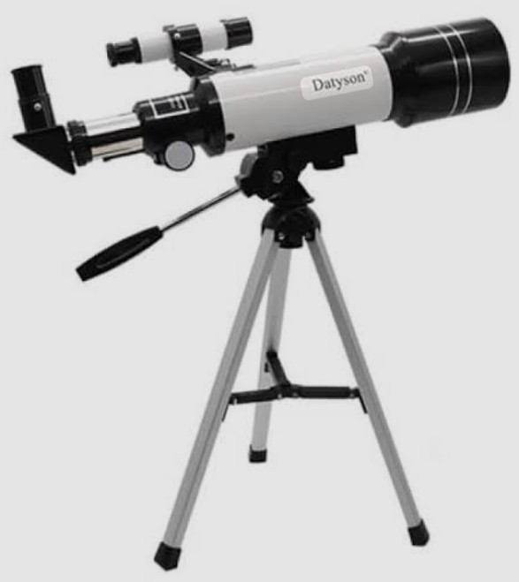
What can you see in the pictures?
Pen
Quilt
Robot
Star
Telescope
Pen, Quilt, Robot, Star, Telescope.
*Rajib Dutta. Bhingrool gps. Anowara*. Ctg

Slide 6
Today’s lesson
Alphabet Uu-Zz
Pp Qq Rr Ss Tt
Unit : 2
Lesson : 8
Page : 21
*Rajib Dutta. Bhingrool gps. Anowara*. Ctg

Slide 7
Learning outcomes
At the end of the lesson students will be able to-
1.1.1 become familiar with English sounds by listening to common English words.
1.1.1 repeat after the teacher simple words and phrases with proper sounds and stress.
1.1.2 say simple words and phrases with proper sounds and stress.
1.2.1recognize and read the alphabet both small and capital (non-cursive).
1.3.1 recognize and read the name of objects having the same initial and final sounds.
*Rajib Dutta. Bhingrool gps. Anowara*. Ctg

Slide 8
Look listen and say-
Pp
pen
*Rajib Dutta. Bhingrool gps. Anowara*. Ctg

Slide 9
Qq
Look listen and say-
Quilt
*Rajib Dutta. Bhingrool gps. Anowara*. Ctg

Slide 10
Rr
Look listen and say-
Robot
*Rajib Dutta. Bhingrool gps. Anowara*. Ctg

Slide 11
Look listen and say-
Ss
Star
*Rajib Dutta. Bhingrool gps. Anowara*. Ctg

Slide 12
Look listen and say-
Tt
Telescope
*Rajib Dutta. Bhingrool gps. Anowara*. Ctg

Slide 13
Pair work
Read and say. Trace and write-
Pen
Star
Quilt
Robot
Telescope
*Rajib Dutta. Bhingrool gps. Anowara*. Ctg

Slide 14
Individual work
Write word
P=
Q=
Pen
Quilt
R=
S=
Robot
Star
T=
Telescope
*Rajib Dutta. Bhingrool gps. Anowara*. Ctg

Slide 15
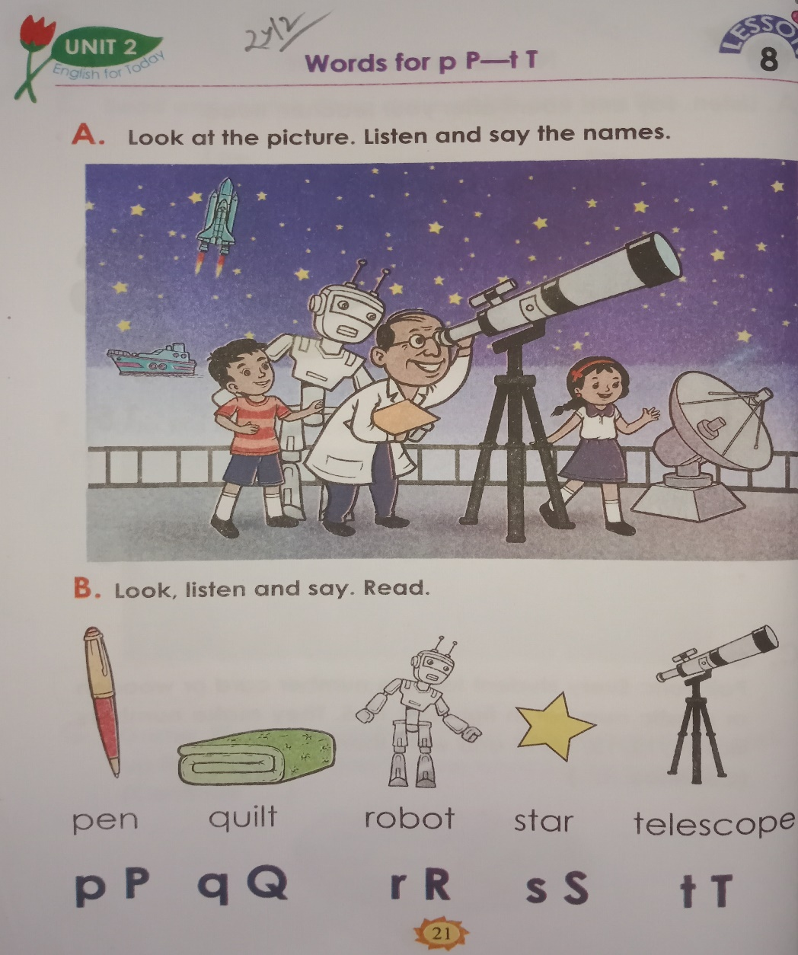
Open your English book Page 21
*Rajib Dutta. Bhingrool gps. Anowara*. Ctg

Slide 16
Click the right letter
Evaluation
Pen
wrong
wrong
wrong
wrong
E
N
P
*Rajib Dutta. Bhingrool gps. Anowara*. Ctg

Slide 17
Click the right letter
Evaluation
Quilt
wrong
wrong
wrong
wrong
Q
I
U
T
L
*Rajib Dutta. Bhingrool gps. Anowara*. Ctg

Slide 18
Click the right letter
Evaluation
Robot
wrong
wrong
wrong
wrong
O
B
O
T
R
*Rajib Dutta. Bhingrool gps. Anowara*. Ctg

Slide 19
Evaluation
Click the right letter
Star
wrong
wrong
wrong
wrong
T
R
S
A
*Rajib Dutta. Bhingrool gps. Anowara*. Ctg

Slide 20
Evaluation
Click the right letter
Telescope
wrong
wrong
wrong
wrong
S
L
E
T
E
*Rajib Dutta. Bhingrool gps. Anowara*. Ctg

Slide 21



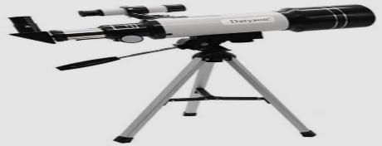
Say, read and match
pen
telescope
quilt
robot
star
*Rajib Dutta. Bhingrool gps. Anowara*. Ctg

Slide 22


Good bye every one
Thanks to all
See you again…
*Rajib Dutta. Bhingrool gps. Anowara*. Ctg

