Slide 1

Wellcome to all

Slide 2


Class: One
Sub: English
Unit: 2
Lesson: 19
Session: 1
Activity:A,B
Page: 57
Hosneara khatun
Head Teacher
Dhuliadanga GPS
Singra , Natore.

Slide 3
Learning outcomes
1.1.1 Recognize the sounds of the alphabet in familiar words.
3.1.1 Say proper sounds of the letters in familiar words.
4.1.1 Read the pictures of familiar objects and events.

Slide 4
Let’s sing a
alphabet
song

Slide 5
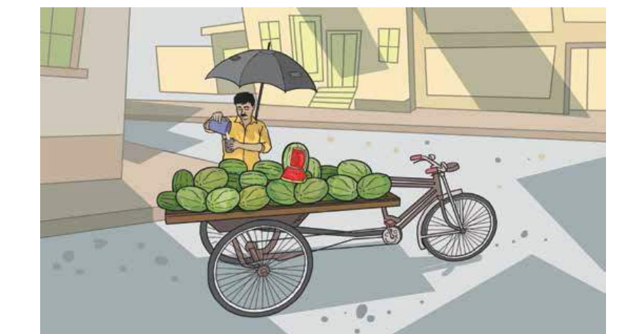
What can you see in the picture?
Say the name of the objects either in English or Bangla .

Slide 6

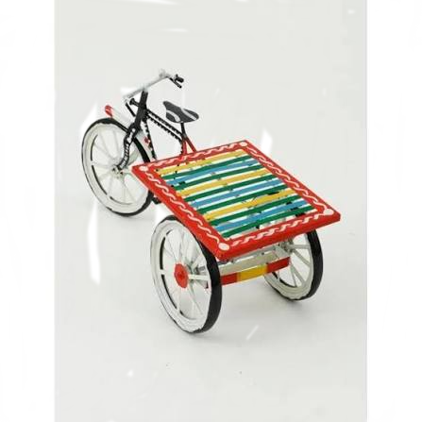

Let’s see more picture
Say the name of the objects either in English or Bangla .
Today we will learn about umbrella ,van, water and know how to pronounce them in English .

Slide 7

Let,s see a picture
Say the name of the objects either in English or Bangla .
umbrella
Listen to me and repet after me 2/3 times .

Slide 8

u
umbrella
Say the sound of the letter ‘u’ aloud.
U
Umbrella
Say the sound of the letter ‘u’ aloud.
Do they have same or different sound ?
The sound are the same for small ‘u’ and capital ‘U,

Slide 9

Let,s see another Picture
Say the name of the objects either in English or Bangla .
van.
Listen to me and repet after me 2/3 times .

Slide 10

van
v
Say the sound of the letter ‘v’ aloud
Van
V
Say the sound of the letter ‘V’ aloud
Do they have same or different sound ?
The sound are the same for small ‘v’ and capital ‘V’

Slide 11


Say the name of the objects either in English or Bangla .
Water
Listen to me and repet after me 2/3 times .

Slide 12
w
Water
Say the sound of the letter w aloud.
W
Water
Say the sound of the letter W aloud.
Do they have same or different sound ?
The sound are the same for small ‘w’ and capital ‘W’

Slide 13
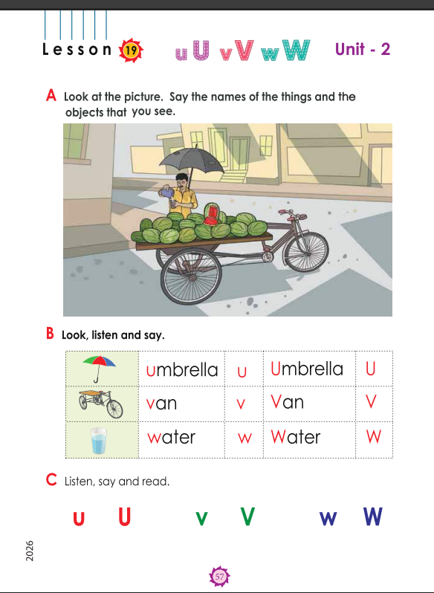
Now open your book at page 57.

Slide 14
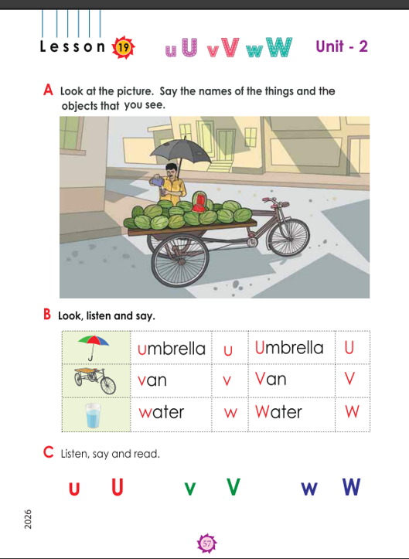
Group work
Make 4/5 Groups and tell them practice these letters sound to themselves.

Slide 15
Pairwork
One student will point at the picture in their book (umbrella ,van,water) and the other will say the word .

Slide 16
Another pairwork
One student shows the letter in the text book, the other student says the sound of letters
Changing the partner and repeat th pairwork .

Slide 17
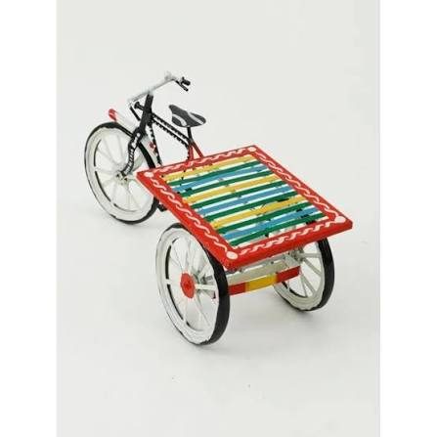
Assessment
Say the words
w,W
u ,U
v,V
Say the initial sound of the letter

Slide 18
What have we learnt today?
Today we have learnt the proper
sounds of
u,U------v ,V------ w ,W

Slide 19
Goodbye ,my dera student .See you in the next class

