Slide 1
Dear students,
Welcome today our
English First Paper Class

Slide 2
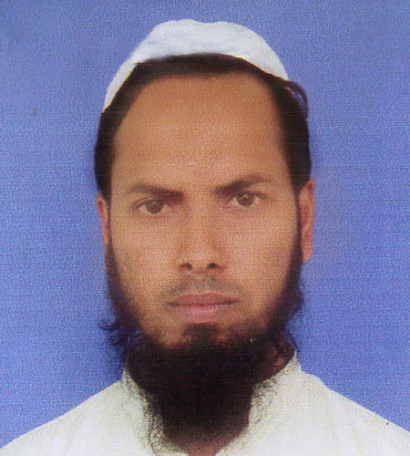
Teacher’s Identity
Md Nizam uddin ( Assistant Teacher)
Ranigonj High School
Ranigonj Bazar, Jagannathpur
Sunamgonj.

Slide 3
Class test – 01
Unit -04
Lesson- 03
International mother language day -01
Questions no- 01,02,03
Marks – 12

Slide 4
1.Choose the best answer from alternatives
What’s the synonym of the word procession ?
i. meeting ii. rallies iii. both iv. None
b) Who said, urdu would be the only state language ?
Mujib ii. Osmani iii. Butto iv. Zinnah
c) The students of ……… university defied the law .
i. Rajshahi ii. Shahjalal iii. Dhaka iv. khulna

Slide 5
2. Answer the following questions
Who is Zinnah ?
Where did raise the declaration ?
3. Fill in the gaps with suitable words
All Bangladeshis …….a)…… the memory of the ……..b)…….on 21 February . They walk…….c)……to the Shaheed Minar. They pay……..d)…..to the memory of the martyrs. They ……..e) …….flowers and pray for the souls of them.

Slide 6
Matching with answer
Questions no -01
a) rallies
b) Zinnah
c) Dhaka
Questions no -03
a) remember
b) event/ martyrs/ sacrifice/movement
c) barefooted
d) tribute
e) offer/ wreaths

Slide 7
Thank you

