Slide 1


Slide 2


Welcome to all

Slide 3
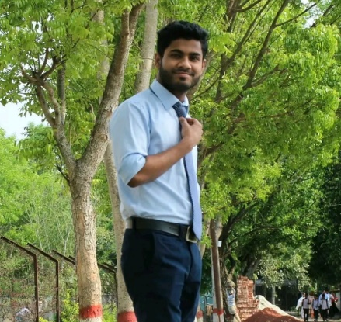

Teachers Identity
Md. Saydur Rahaman
Assistant Teacher
Uttarchandpur GPS
Damurhuda,Chuadanga

Slide 4
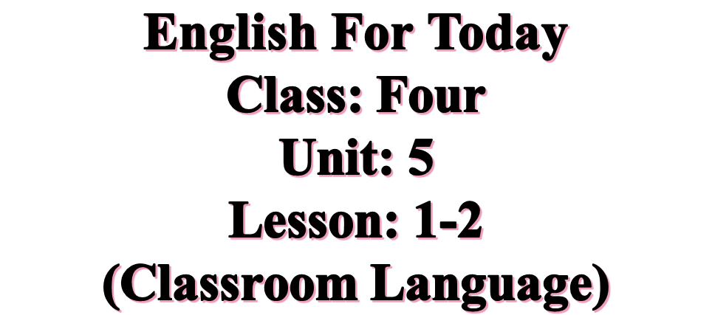
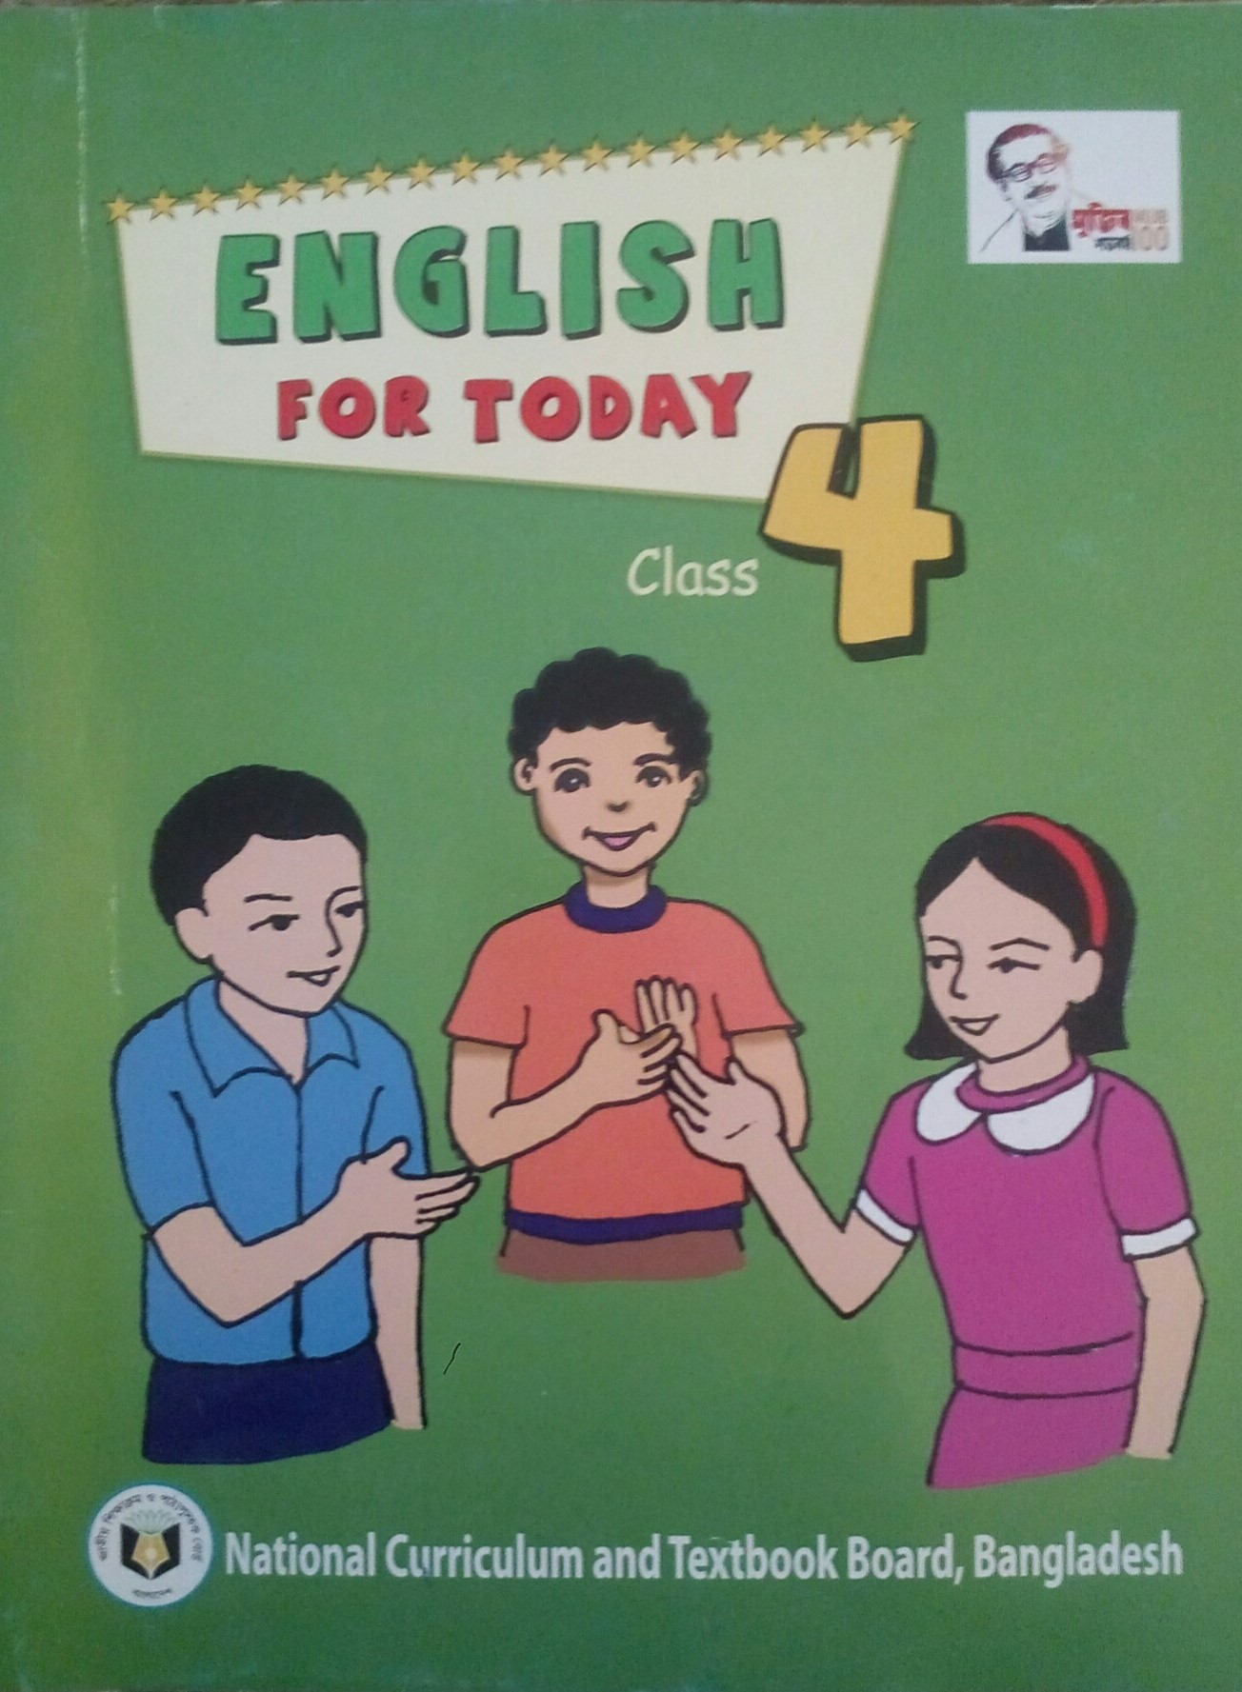
Introduction of the Lesson

Slide 5

Learning outcomes
Students will be able to
Listening
2.1.1 carry out simple commands and instructions.
3.4.1 understand statements made by the teacher and students.
Speaking
1.1.1 repeat after the teacher.
7.1.1 Give instructions and commands
Reading
6.1.1 Read instructions and carry them out

Slide 6
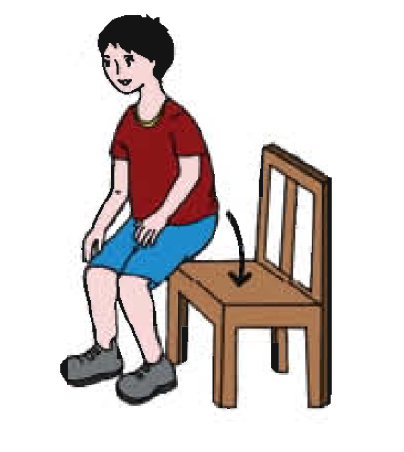
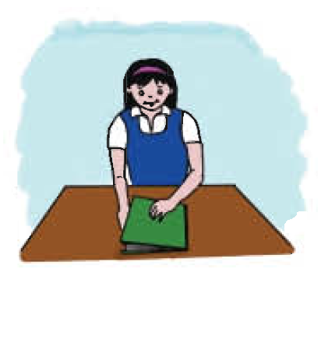
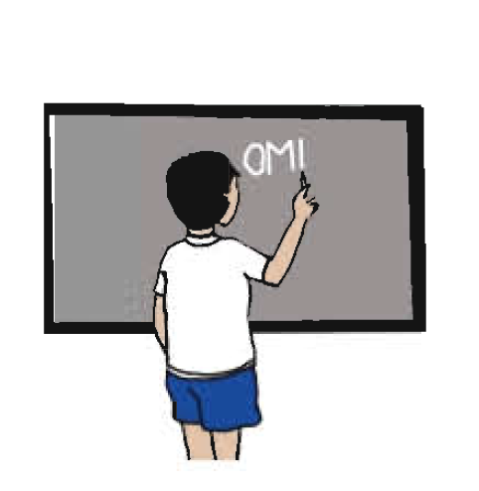
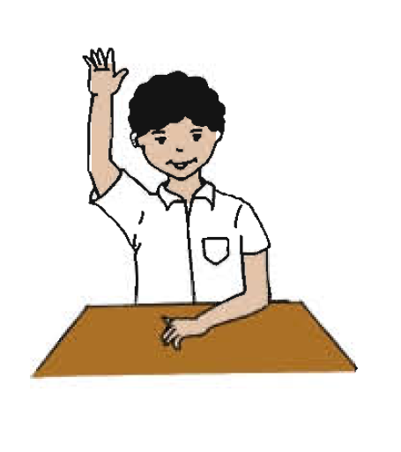

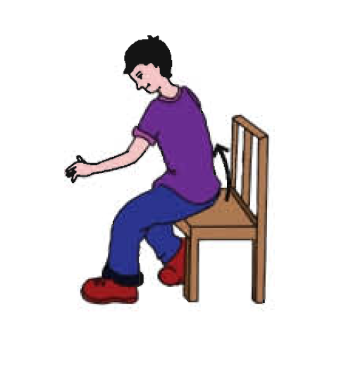
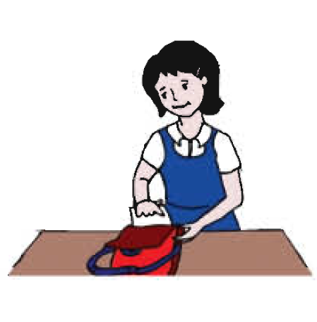
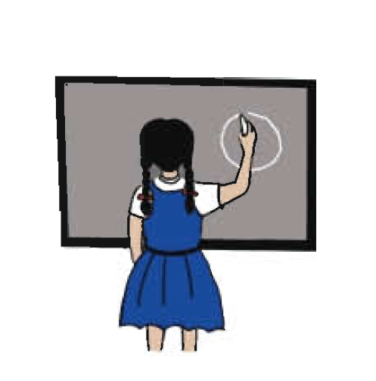
Ok let’s see some pictures.
Do you like picture?
Think alone about the pictures.
Now tell me what you have discussed.
Discuss with your friends.

Slide 7
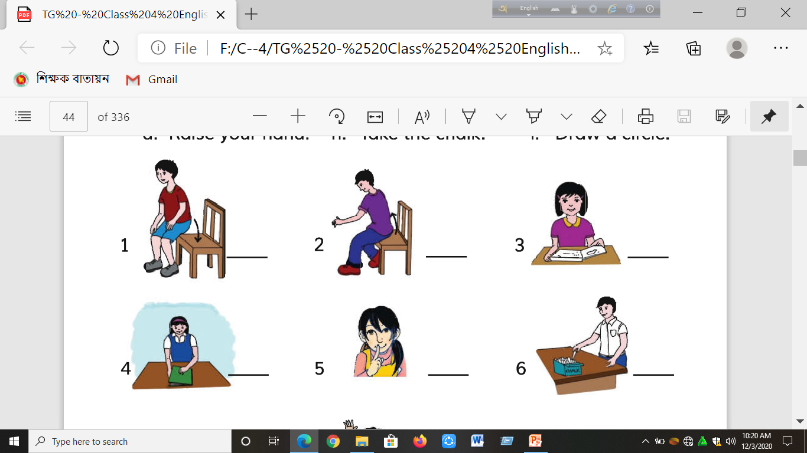
Sit down
Stand up

Slide 8
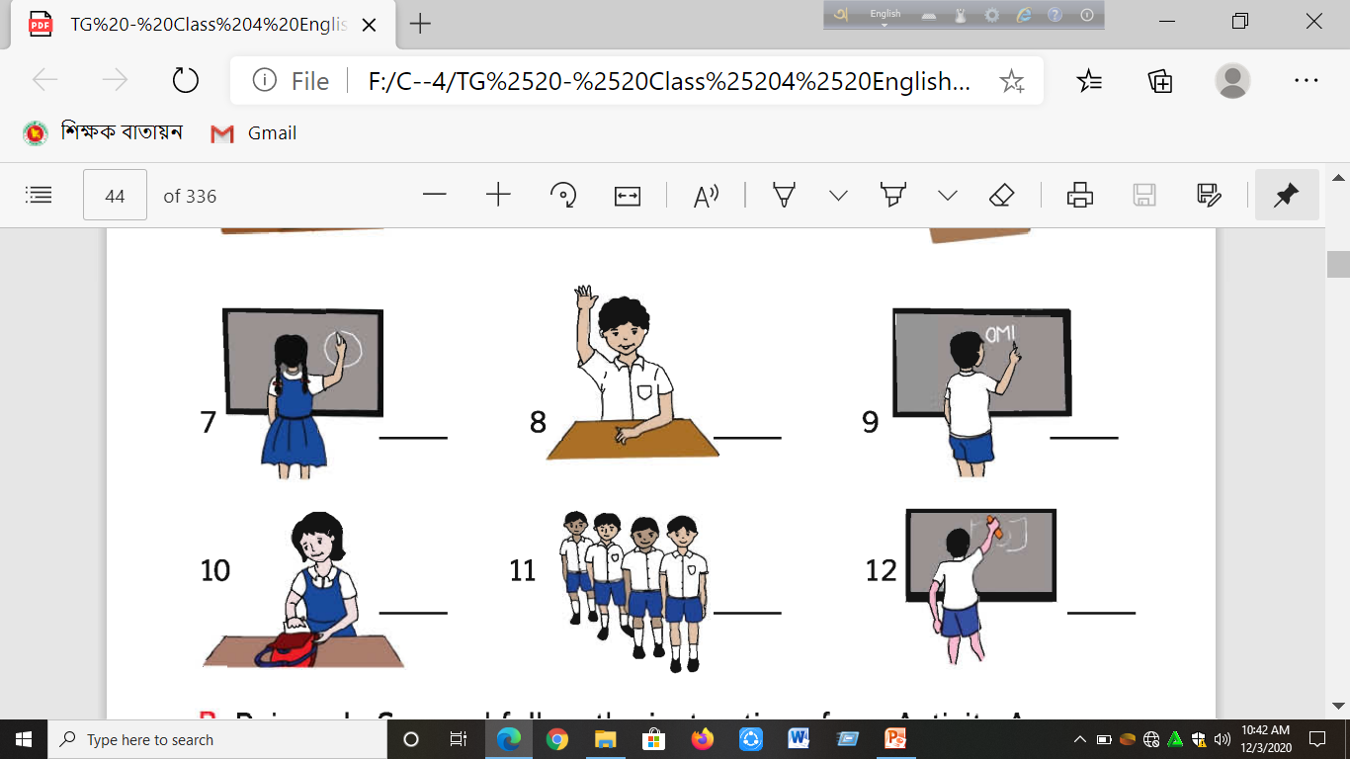

Raise your hand
Draw a circle on the board

Slide 9
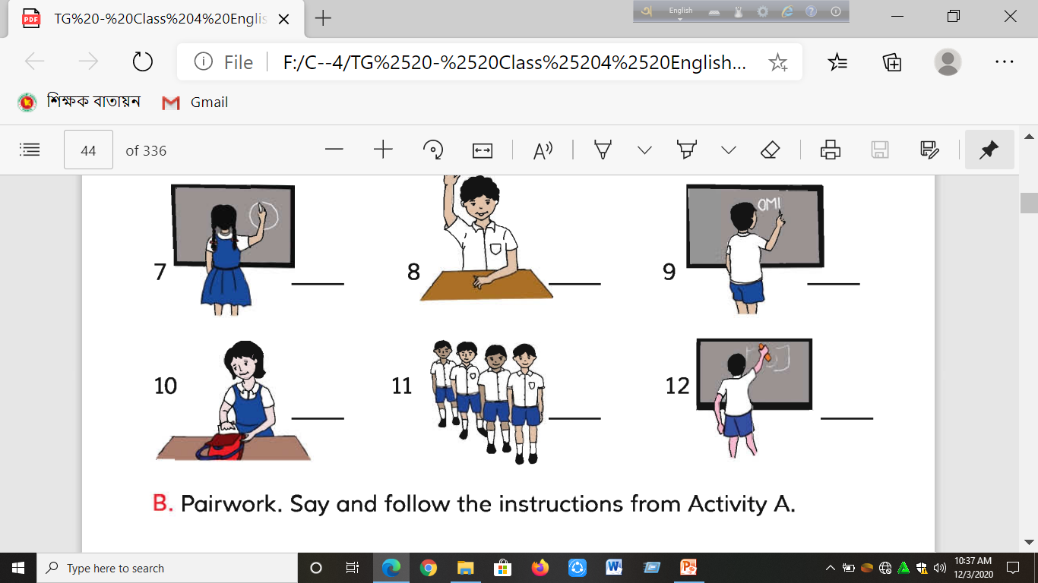
Open Your book
Write your name on the board

Slide 10

New words with pronunciations and bangla meaning.
Open (ওপেন) = খোলা
Stand (স্ট্যান্ড) = দাঁড়ানো
Draw (ড্র) = আঁকা
Raise (রাইজ) = ওঠা
Down (ডাউন) = নিচে
Circle (সার্কেল) = বৃত্ত
Write (রাইট) = লেখা
Students write down the meaning of the words on your notebook.

Slide 11

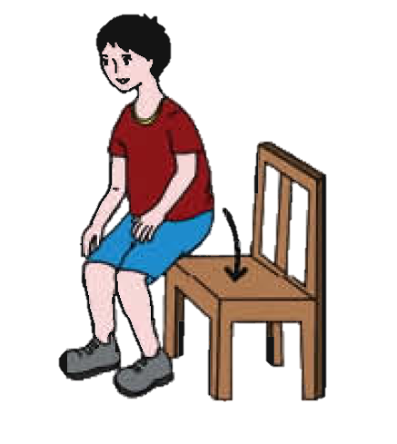
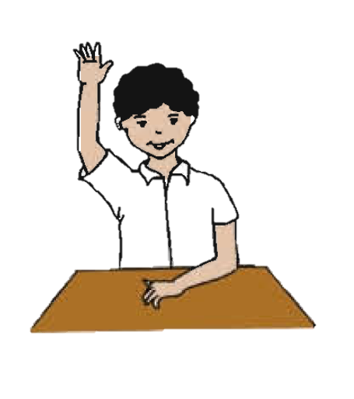
Practice
See the picture attentively.
Then write the classroom language on your notebook.
1
2
3
Sit down
Raise your hand
Open your book
4
5
6
Stand up
Draw a Circle
Write your name

Slide 12
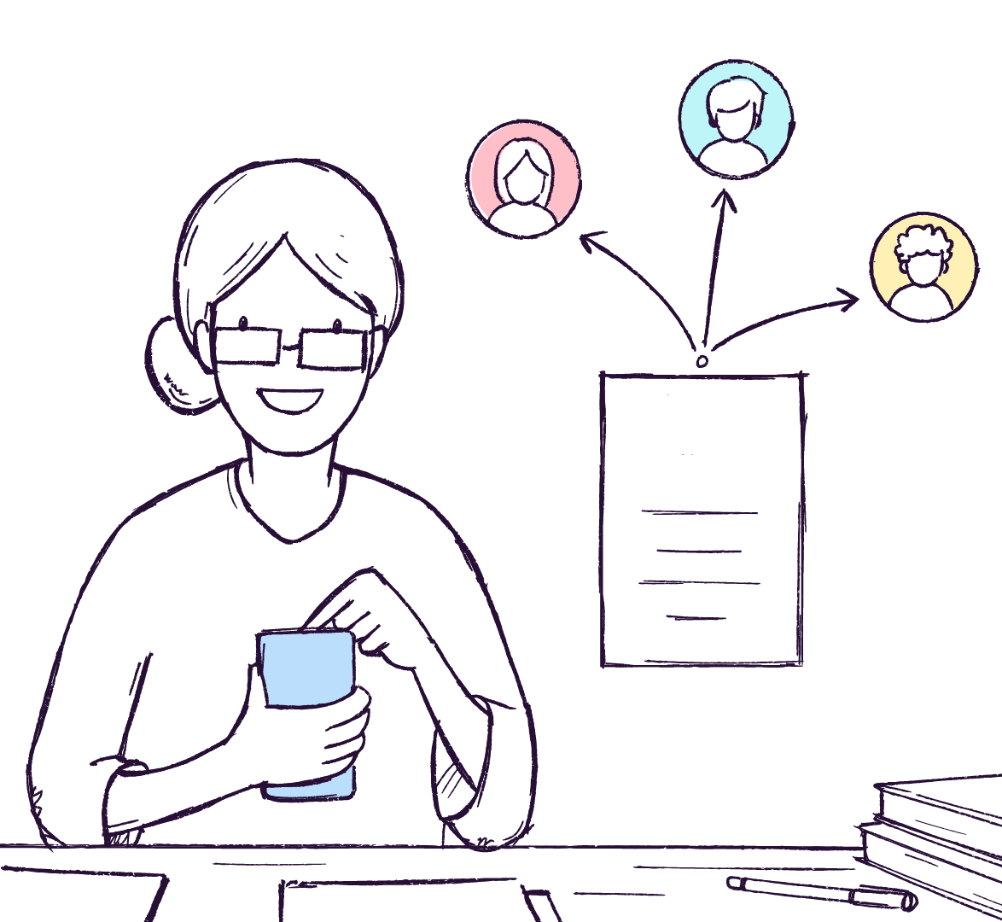
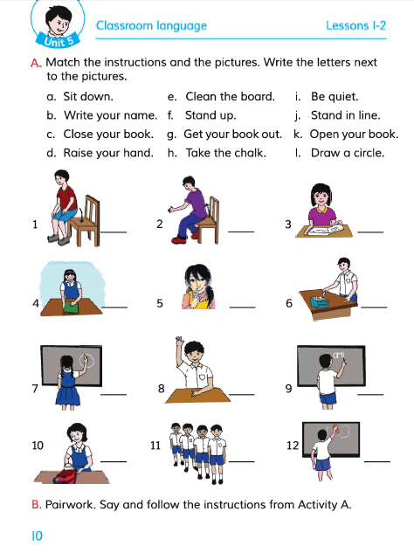
Open your book at page 10.

Slide 13


Pair work
Match the instructions and the pictures . Write the letters next to the picture
Sit down
Stand up
Draw a circle on the board
Open your book

Slide 14
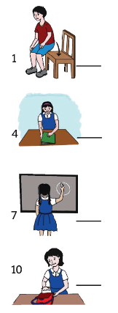
Assesment 1
Match the instructions with the pictures and say to your teacher.
Draw a circle
Sit Down

Slide 15
Final Evaluations.
Fill in the blanks with correct words.
Stand .
Write your .
a circle.
Open Your .
Down.
your Hand.
up
Name
Draw
book
Sit
Raise

Slide 16




Write five other classroom commands that you know.

Slide 17

My Dear Students

