Slide 2



MD KOYES AHMED
Unit 5
Days of the week
Lesson 5:
How does a plant grow?
Session: 9
C, D
Page : 51
Assistant Teacher
Mohammadpur A. Gofur GPS
Dakshin Surma, Sylhet.
E-mail: koyesdsurma.syl@gmail.com
Mobile: 01710504502.

Slide 3
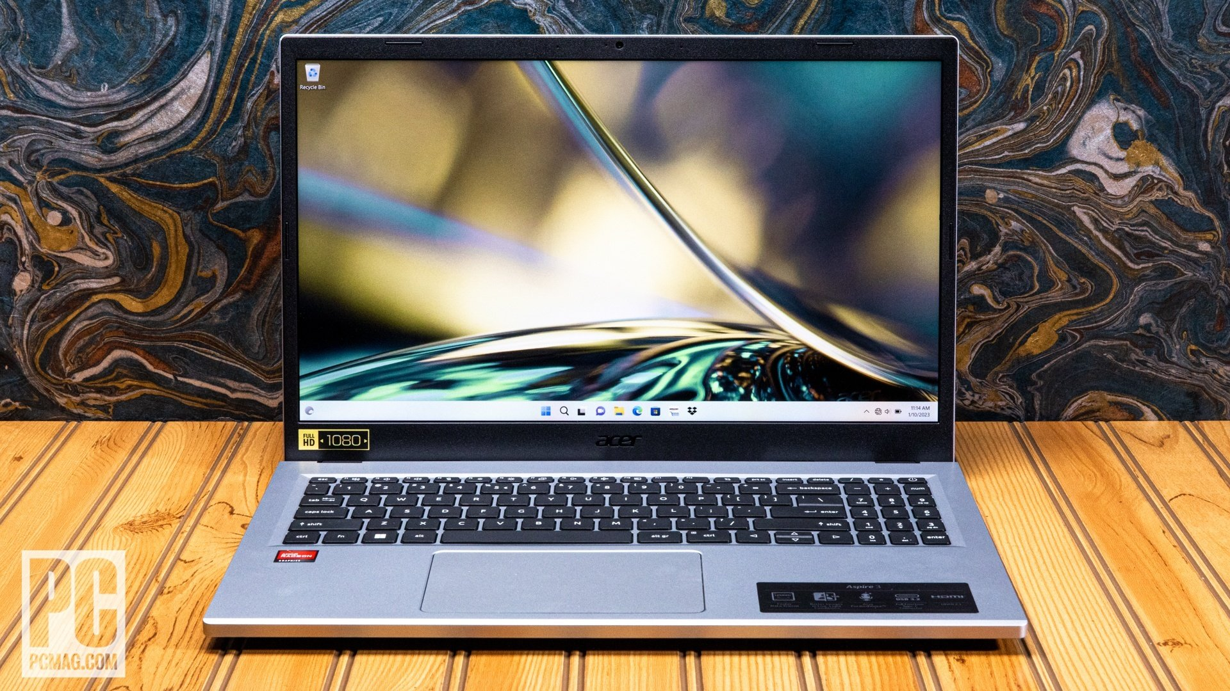
Click on the
monitor

Slide 4
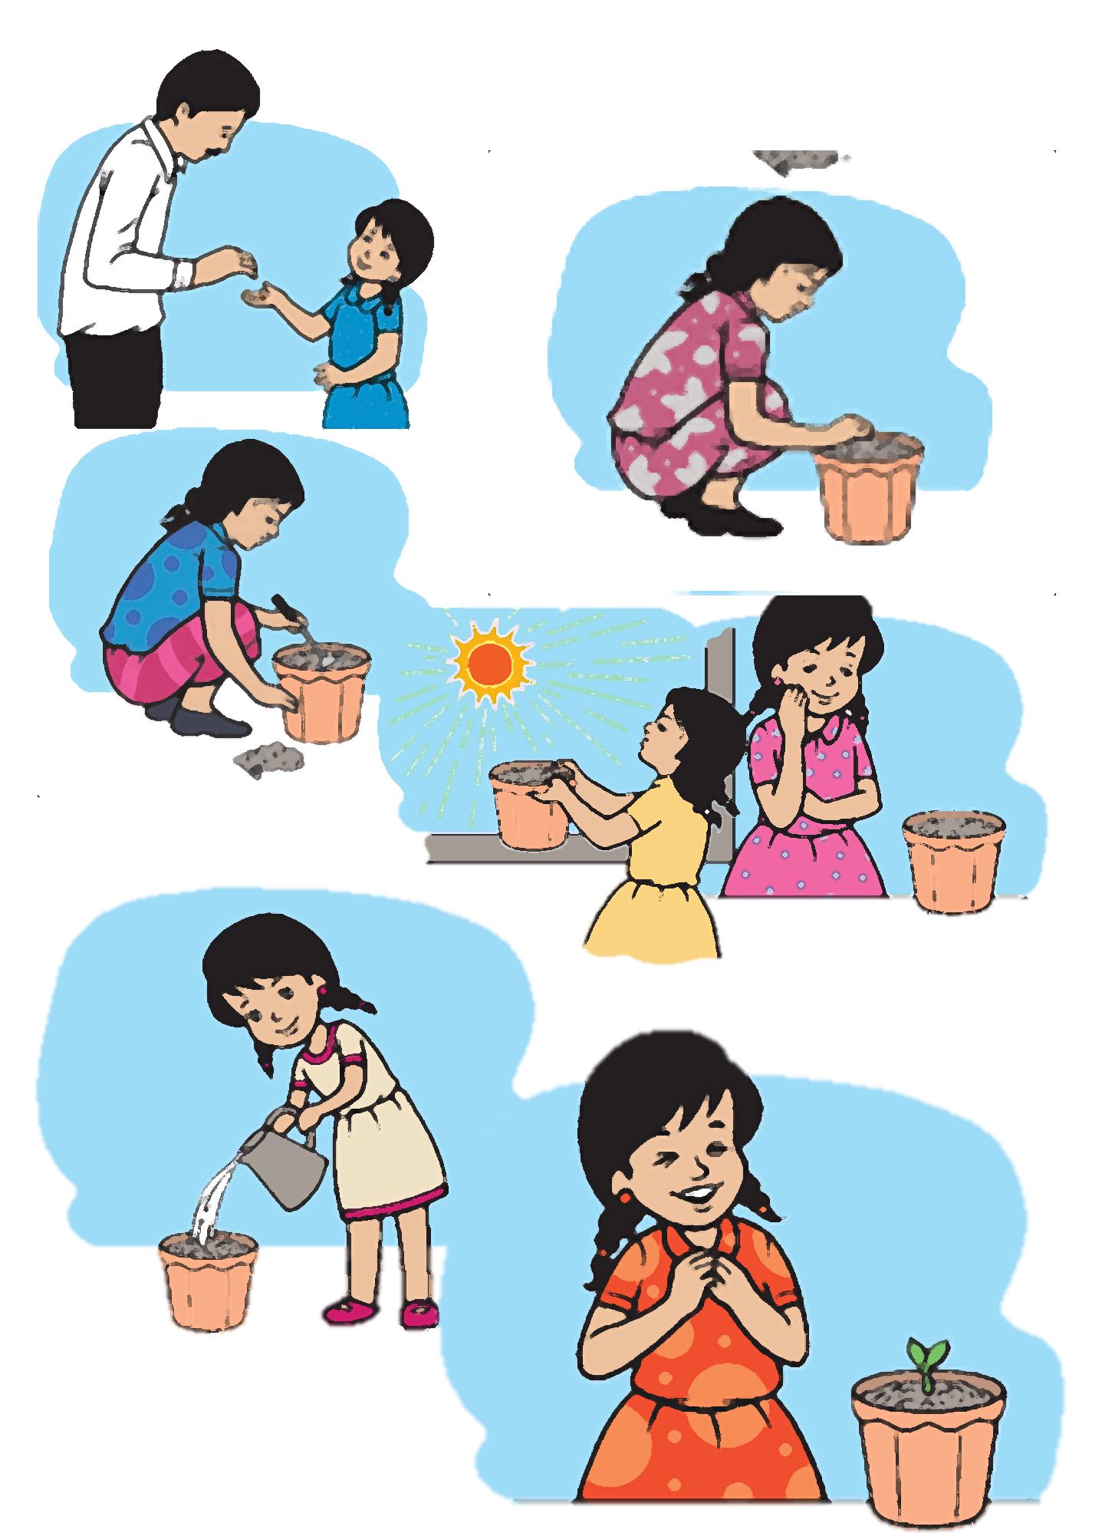

Slide 5

Today we going to
Put the sentences in the correct order and write the missing days?

Slide 6
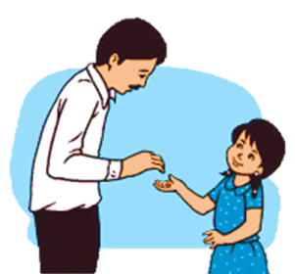

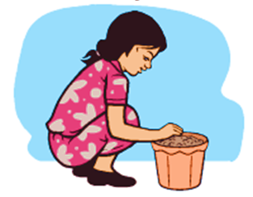
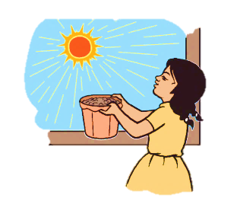
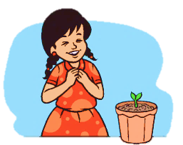

Slide 7

Click on Picture
□ Rima puts the pot in the sun.
3

Slide 8
Click on Picture
□ Rima’s father gives her a seed.
1

Slide 9
Click on Picture
□ There’s a small plant.
4

Slide 10
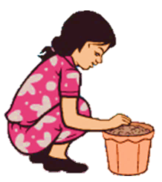
Click on Picture
□ Rima puts the seed in the pot.
2

Slide 11
C. Put the sentences in the correct order. Number them from 1 ─ 4
□ Rima’s father gives her a seed.
1
Click on number
□ Rima puts the seed in the pot.
2
□ Rima puts the pot in the sun.
3
□ There’s a small plant.
4

Slide 12

D. Say and write the missing days.
Sunday
Monday
Tuesday
Wednesday
Thursday
Friday
Saturday

Slide 13
Say the missing days
1
On Sunday, Rima’s father gives her a seed.
2
On Monday, Rima puts soil in a pot.
3
Rima waters the seed on Tuesday.
4
On Wednesday, Rima puts the pot in the sun.
5
Rima waters the seed again on Thursday.
6
On Friday , Rima waits.
7
On Saturday, Rima sees something in the pot. It’s a small plant with two leaves !!.

Slide 14


Slide 15

Notes:
Summary Session:
Now summarise the session by asking ss ,” What have we learnt today?”
Ask some questions from the text. Help them to answer properly.

Slide 16

Write down the name of seven days in a week
in the handwriting notebook

