Slide 1
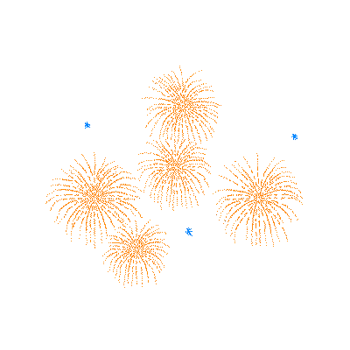



Slide 2
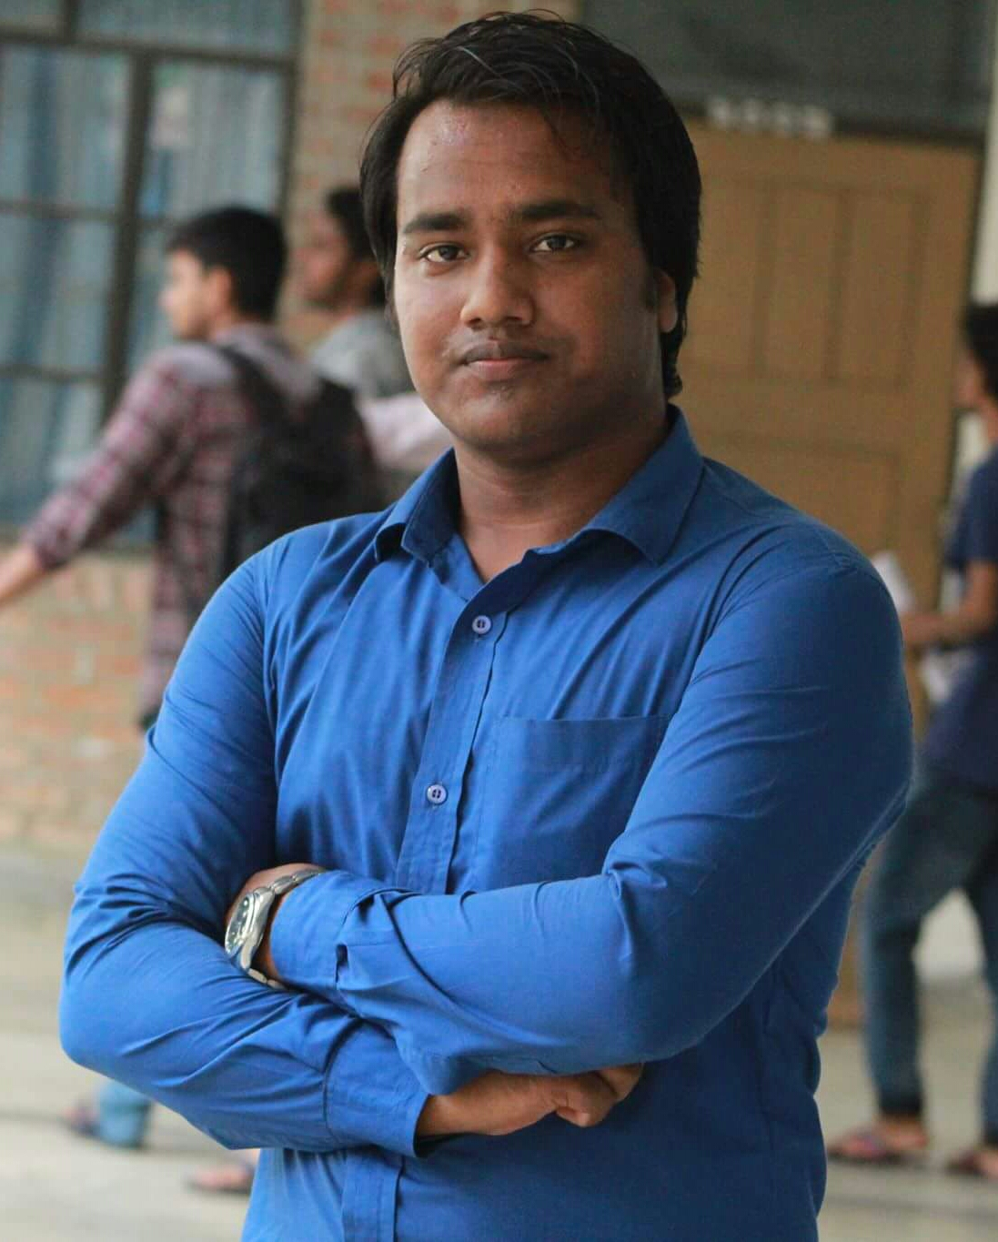
Teachers Identity
Fakhrul Islam Rahel
Assistant Teacher
Upor Jingabri Government Primary School.
Kanaighat, Sylhet.
Mobile : +8801717-952504
Email : islam.sust71@gmail.com

Slide 3


Lesson Identity
Chapter Headline : My Family
Class : Two
Subject : English
Unit : 8
Lesson : 1
Page : 74
Time : 40 Minutes

Slide 4
Learning Outcomes
Students will be able to…..
Listening:
4.1.1 enjoy the rhythm and music of simple rhymes.
Speaking:
4.1.1 repeat rhymes after the teacher.
4.1.2 recite rhymes independently.

Slide 5
নাম
Name
Year
বছর
Student
শিক্ষক
Everyday
প্রতিদিন

Slide 6
Draw
আঁকা
Brother
ভাই
ছবি
Picture
Colour
রং

Slide 7
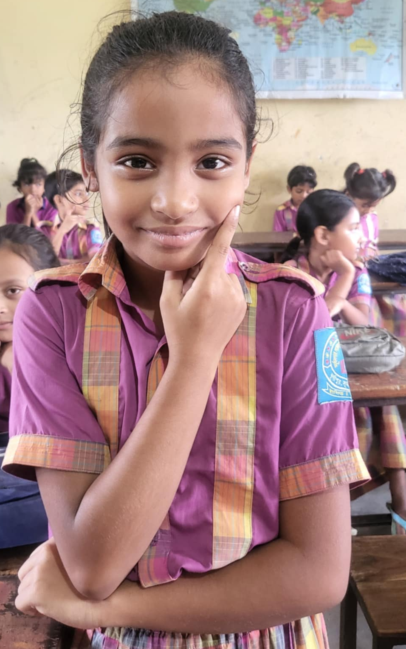
My name is Mita.

Slide 8
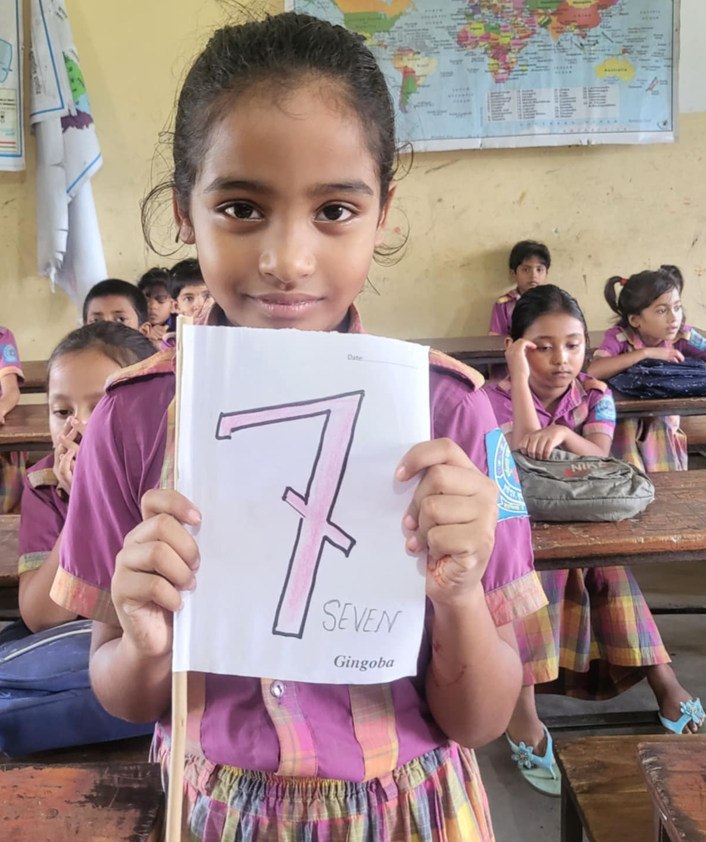
I am seven years old.

Slide 9
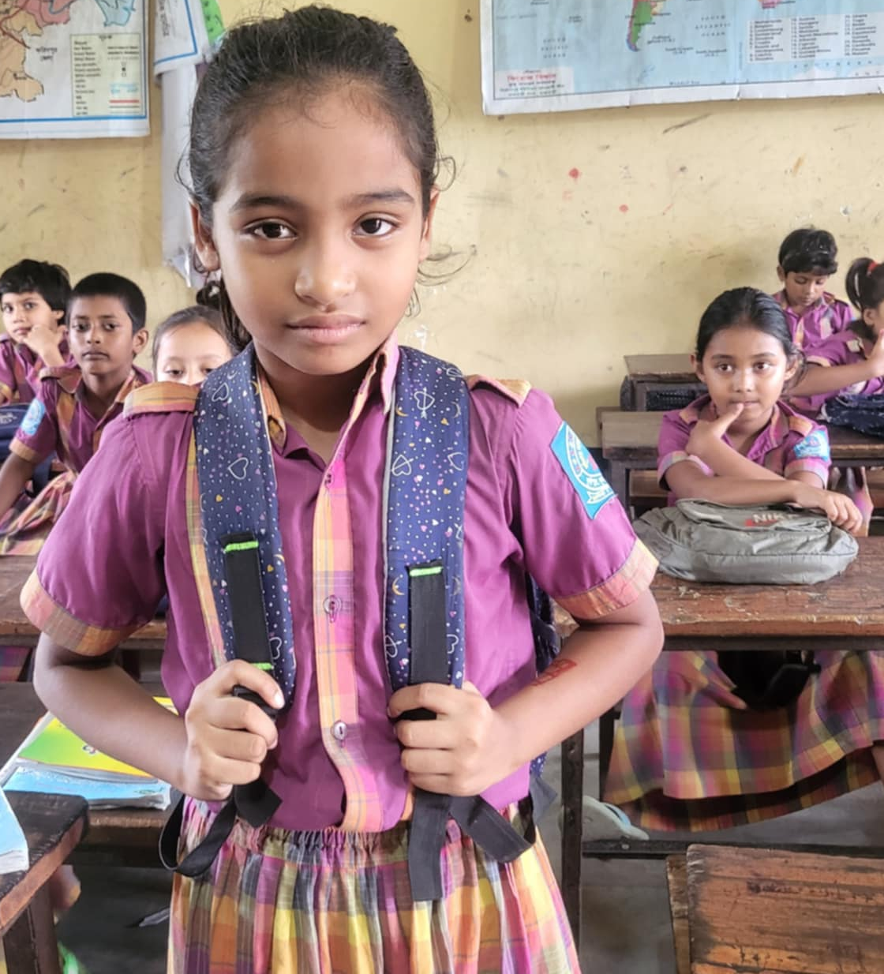
I am a student.

Slide 10
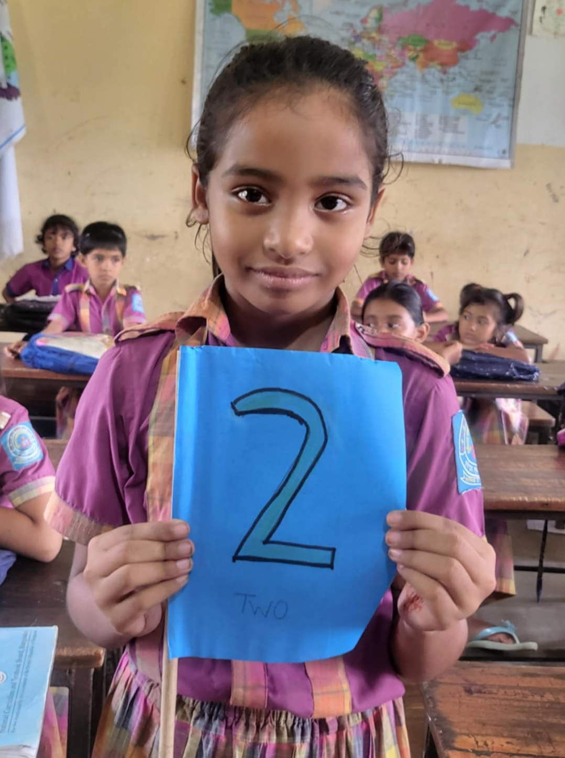
I am in class 2.

Slide 11
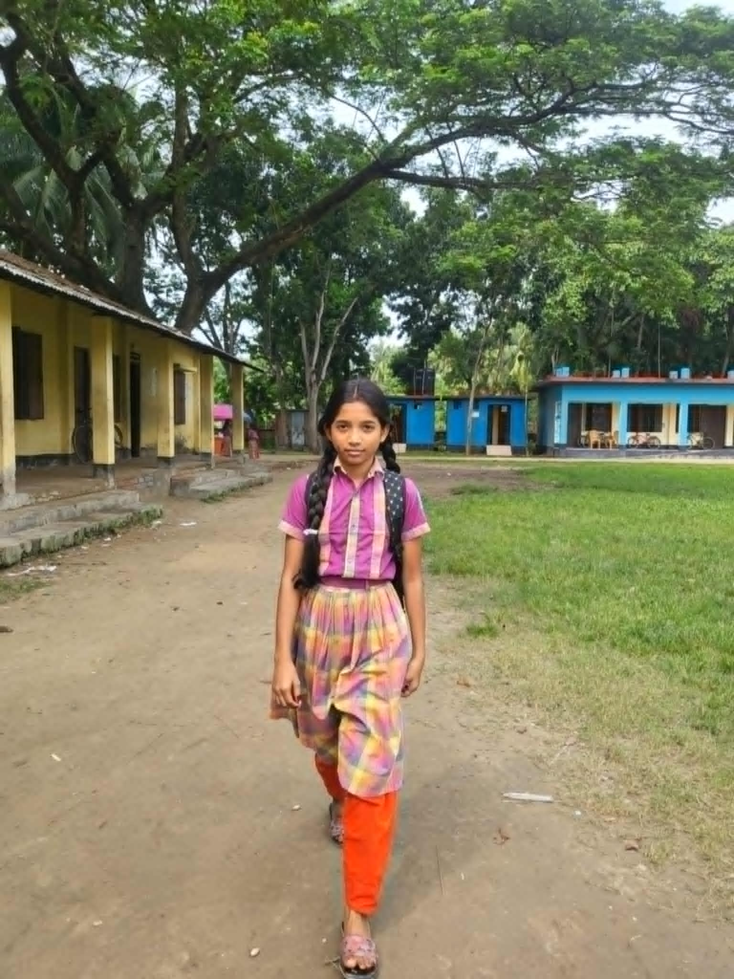
I go to school everyday.

Slide 12
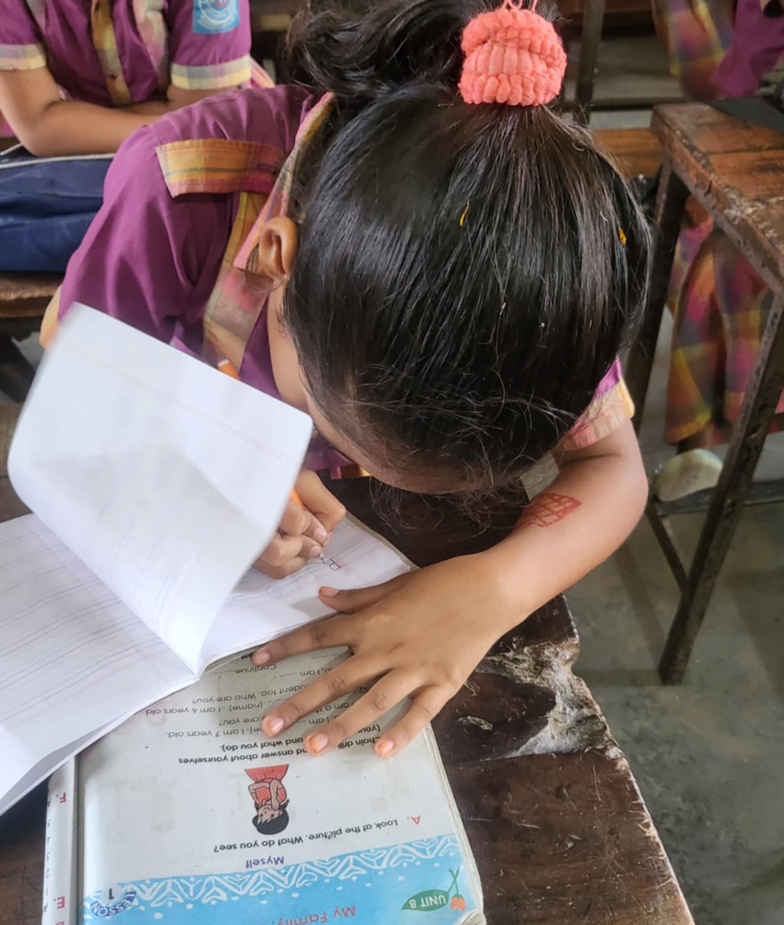
I do my homework in the evening..

Slide 13
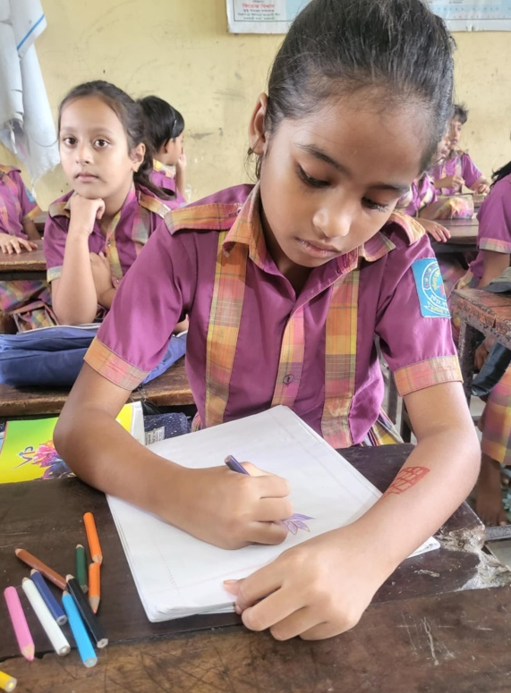
I like to draw pictures and colour them.

Slide 14
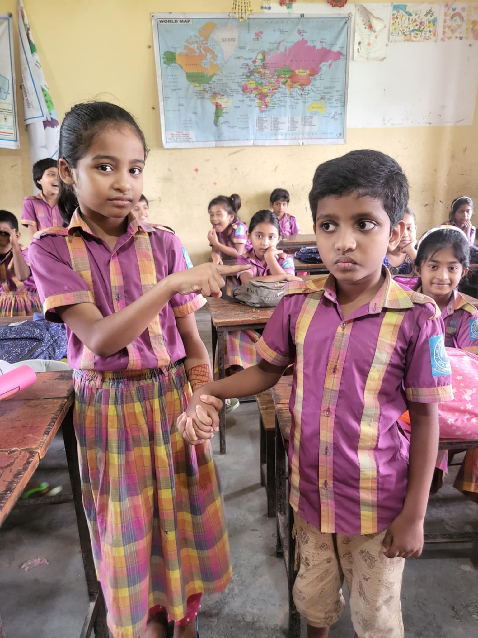
I have a brother.

Slide 15
I love to play with him.

Slide 16

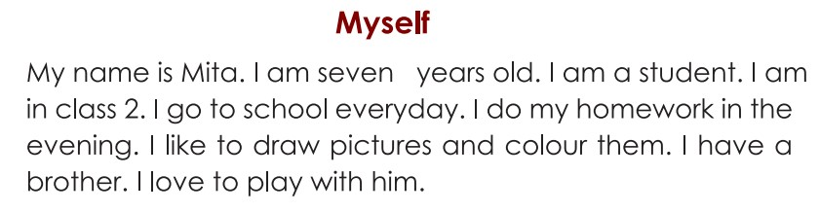

Slide 17
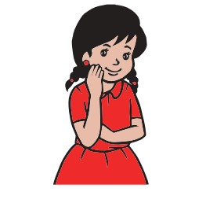
Ask and answer the following questions.
1. Who is Mita?
1.Mita is a student.
2. How old is she?
2. She is 7 years old.
3. Which class is she in?
3. She is in class 2.
4. What does she like to do?
4. She likes to draw pictures and colour them.

Slide 18
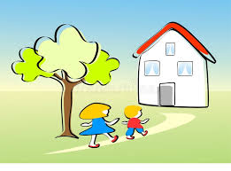
HOMEWORK
Write in 3 sentences about yourself.

Slide 19

GOOD BYE

