Slide 1


Welcome
To
My Class

Slide 2
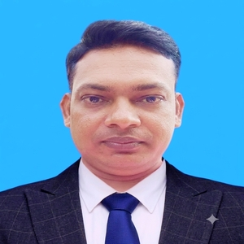
Presented by
Md. Ajim Uddin Ssagor
Assistant Teacher (English)
Bhatpara Secondary School (Kuthi)
Gangni, Meherpur.

Slide 3

Introduction
Class: Nine
Subject: English 2nd Paper
Topic: Changing Sentence
Chapter: 09
Exclamatory to Assertive

Slide 4
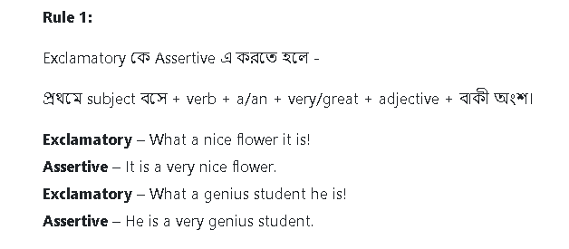

Slide 5
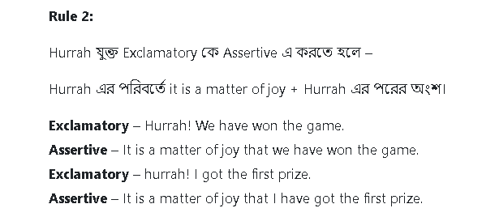

Slide 6
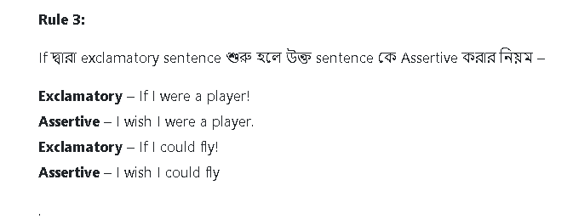

Slide 7
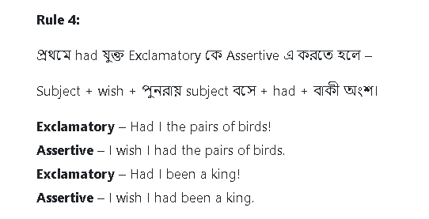

Slide 8
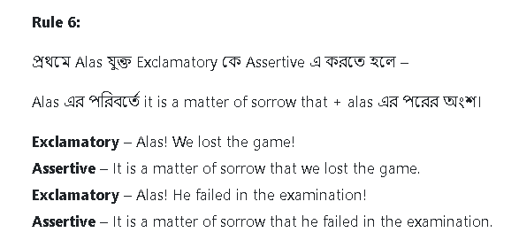
5

Slide 9
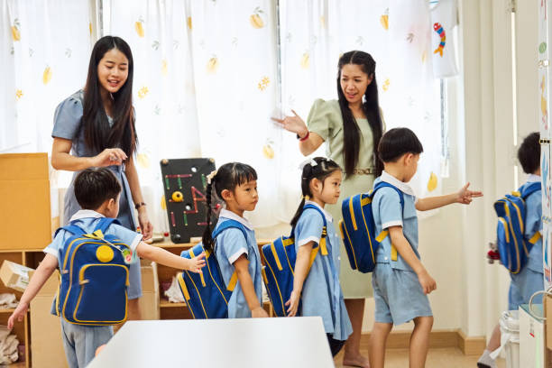
See you next.

