Slide 1
Dear students,
Welcome our
English First Paper Class

Slide 2
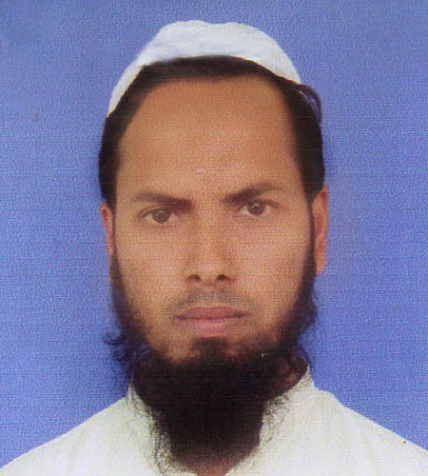
Teacher’s Identity
Md Nizam uddin ( Assistant Teacher)
Ranigonj High School
Ranigonj Bazar, Jagannathpur
Sunamgonj.

Slide 3
Class test – 04
Unit -05
Lesson- 05
Let’s Become Skilled Workforce
Questions no- 02,03
Marks – 12
Time : 50minutes

Slide 4
2. Answer the following questions.
How can we learn English?
Which has made communication easier ?
How can a man get best chance ?
Why is English needed all the more in Bangladesh ?
Do you think, English language become a skilled workforce ?

Slide 5
3. Fill in the gaps with suitable words.
English is an ……..a)…..language. It is ……b)….all over the…….c)…….English is a ………d)…..language. We are learning English mainly for our………e)…….

Slide 6
Matching with answer
international
spoken
world
common
exams

Slide 7
Thank you
For joining our
English First Paper Class

