Slide 1



Slide 2


Slide 3

Introduction to the Lesson
Unit-14
Activity-1.2,1.3
Lesson Title-The Champion Girl
Class-Five
Sub-English

Slide 4

Learning Outcomes
Students will be able to-
3.4.1 Ask simple questions on familiar topics.
3.4.2 Answer simple questions appropriately and confidently.
4.2.1 Read aloud texts with proper stress,intonation.

Slide 5
Review of the prior knowledge
*Have you ever played a game with your eyes closed?
*How do you feel when you close your eyes?
*Can you do your daily activities with your eyes closed?

Slide 6


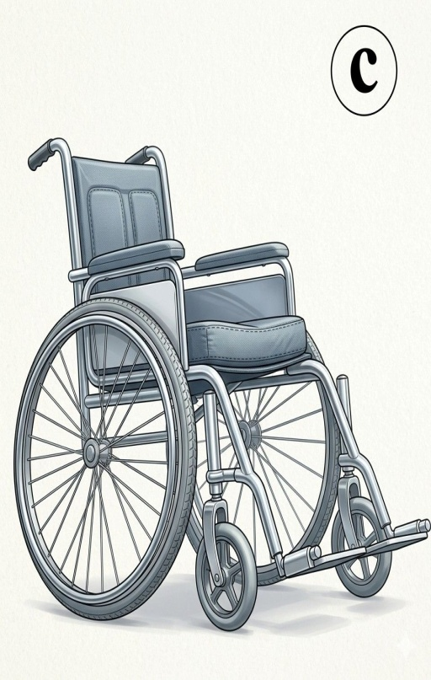
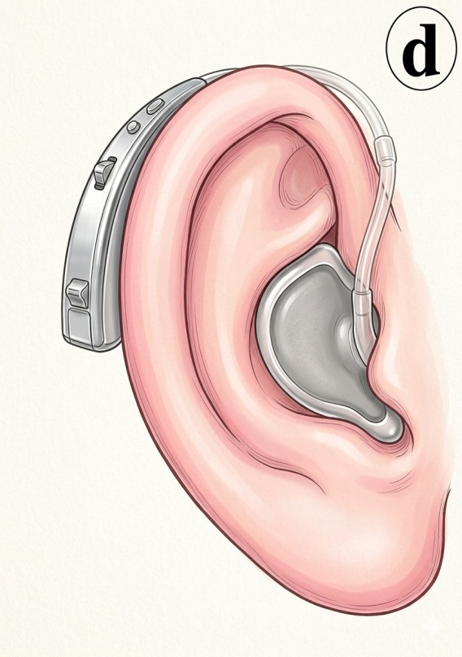
Look at the pictures
a.Have you seen these things before?
b.Do you know anyone who uses any of them?
c.Why do people use these things?

Slide 7
Today we are going to read a text about a girl with special needs.

Slide 8
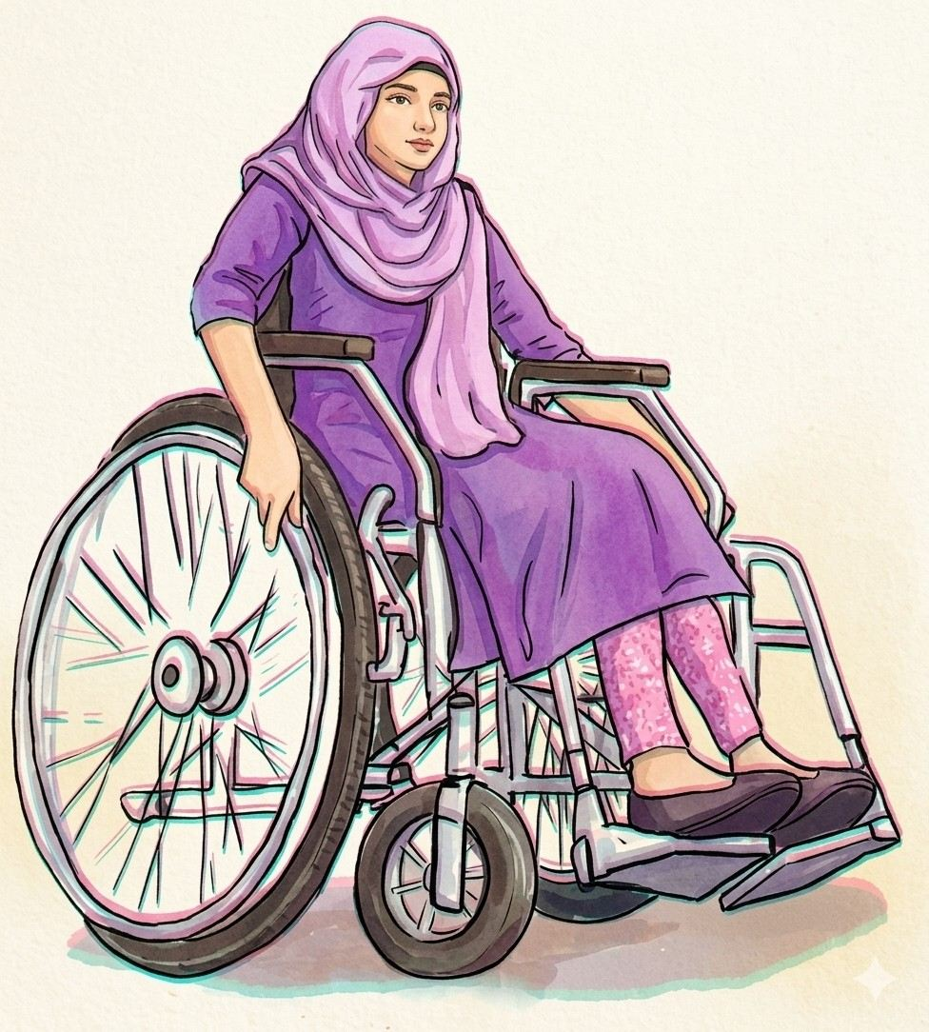
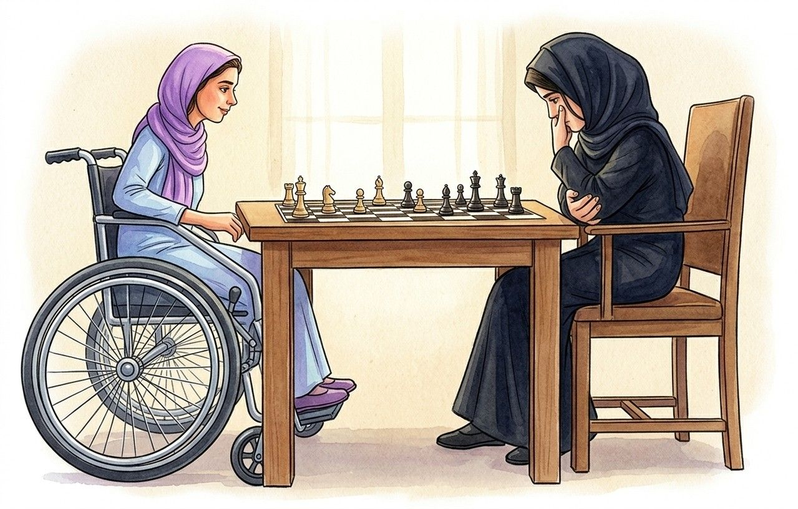
Can you guess what may be our today’s Lesson?

Slide 9


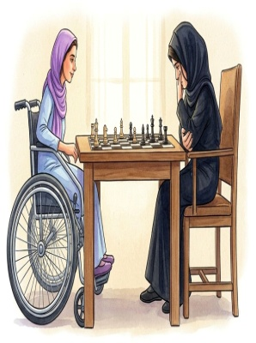
Our Today’s Lesson
The Champion Girl

Slide 10

New words
Champion
Winner

Slide 11
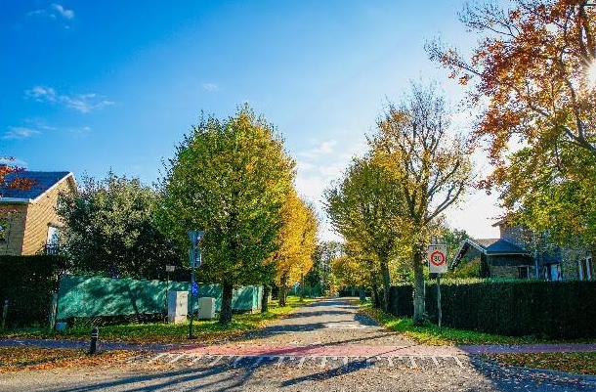
Neighbourhood
Vicinity

Slide 12
Opponent
Rival

Slide 13

Inspiration
Motivation

Slide 14

Congratulate
Felicitate

Slide 15
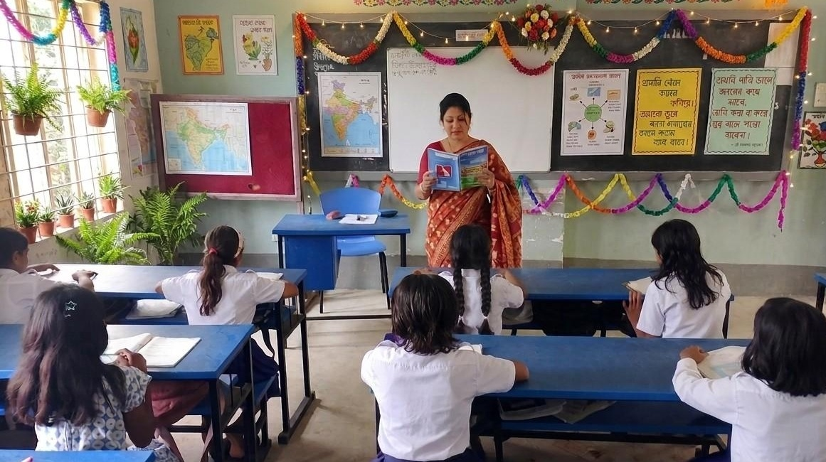
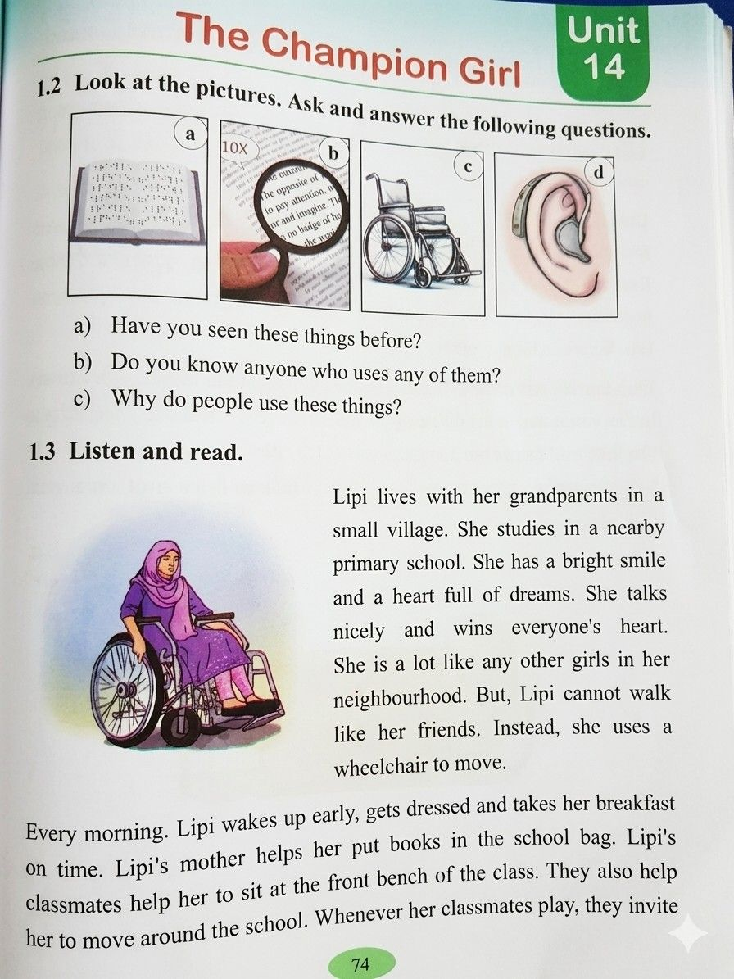
Teacher’s Model Reading

Slide 16
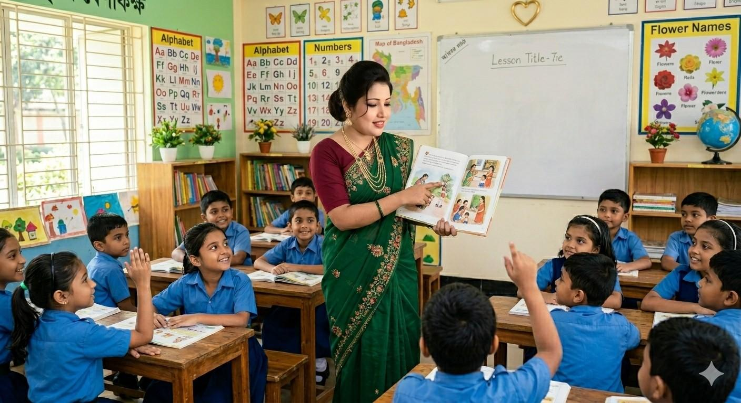
Choral Reading

Slide 17
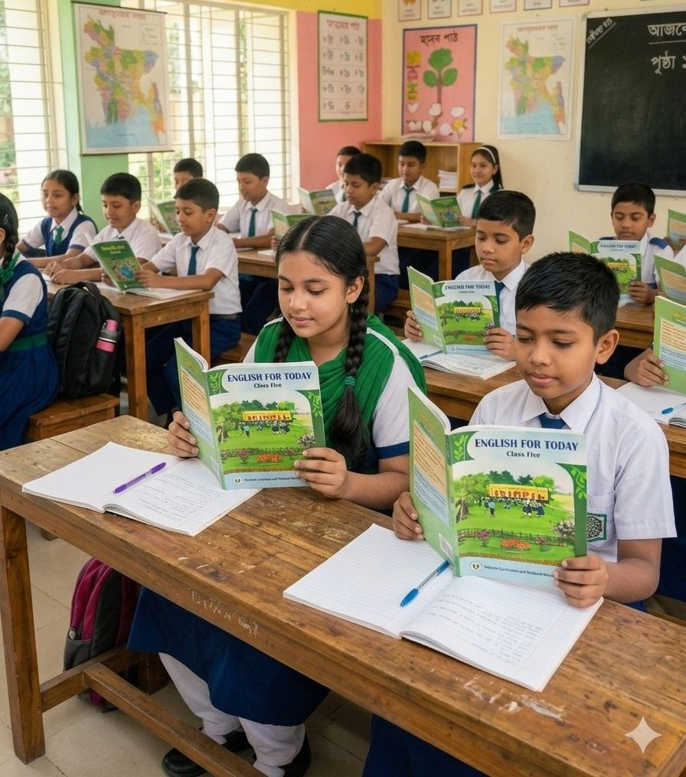
Student’s Reading

Slide 18
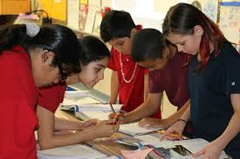
Group Work
Group-1
Group-2
Group-3

Slide 19
Read the text in groups and answer the following questions.
1.Where does Lipi live?
2.How does Lipi get ready for school every morning?
3.What competition has Lipi won at school?

Slide 20

Pair Work
Read the text in pairs.One will read the text aloud first,and the other partner will check the reading.Change your roles in turns.

Slide 21
One day one word
Dream
স্বপ্ন
My dream is to be a doctor.

Slide 22
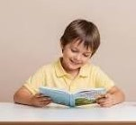

Assessment
Read the text with proper stress and intonation individually.
Answer the following questions.
1)Which is Lipi’s favourite place?
2)How does Lipi’s teacher help her in the class?
3)Why does Lipi want to set up a school?

Slide 23
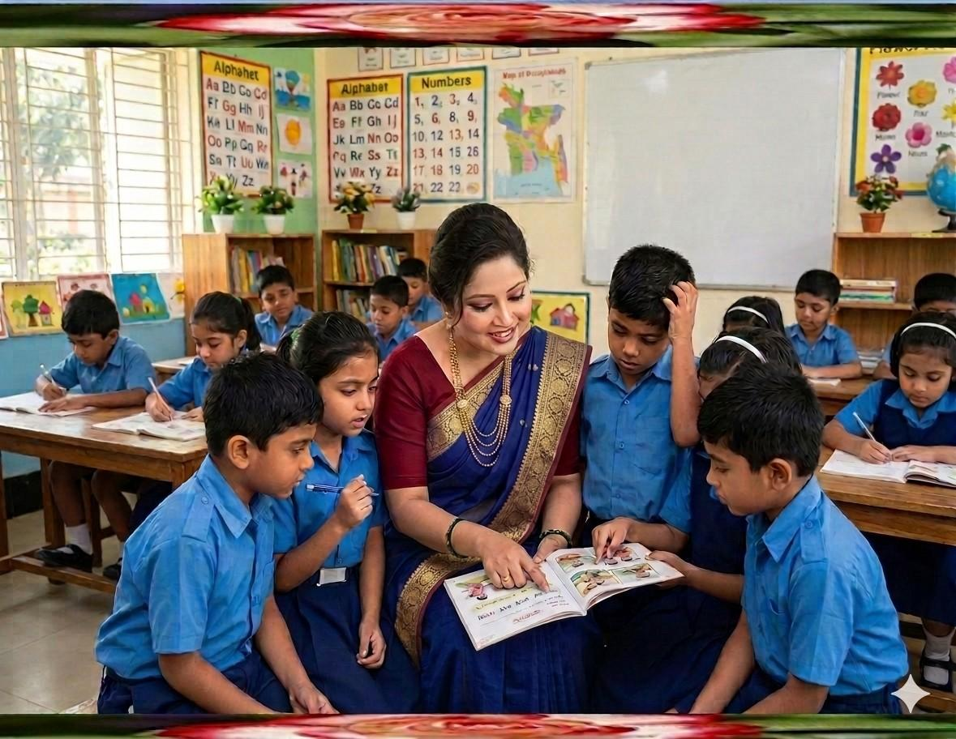
Feedback
Support the students during the class
who cannot read aloud the text properly.

Slide 24
Summary of the session
“What have you learnt today?”
“We have learnt some new words and read the text aloud properly.”

Slide 25
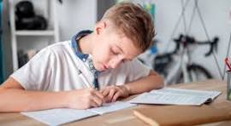
Home Work
Suppose you have a friend with special needs.Write five sentences about your friend.

Slide 26


