Slide 1
Dear students,
Welcome today our
English First Paper Class

Slide 2
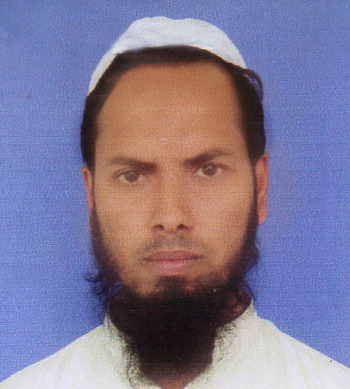
Teacher’s Identity
Md Nizam uddin ( Assistant Teacher)
Ranigonj High School
Ranigonj Bazar, Jagannathpur
Sunamgonj.

Slide 3
Class test – 06
Unit -07
Lesson- 05
Love for Humanity
Questions no- 02,03
Marks – 12

Slide 4
2. Answer the following questions.
Who is Mother Teresa?
Where did she was born ?
What does ‘Nirmal Hriday’ stand for?
What did she teach us?
Do you think, Mother Teresa is a humanist ?

Slide 5
3. Fill in the gaps with suitable words.
Mother Teresa is a ………a)…woman. She was born in… b)……. She is an Albanian great…….c)…… The world…..d)……her for her love and compassion for……e)……..

Slide 6
Matching with answer
great
Albania
Lady /woman
salutes
humanity

Slide 7
Thank you
For joining our
English First Paper Class

