Slide 1

Nasrin Jahan

Slide 2

Nasrin Jahan

Slide 3

Nasrin Jahan

Slide 4

Nasrin Jahan

Slide 5

Nasrin Jahan

Slide 6

Nasrin Jahan

Slide 7

Nasrin Jahan

Slide 8

Nasrin Jahan

Slide 9
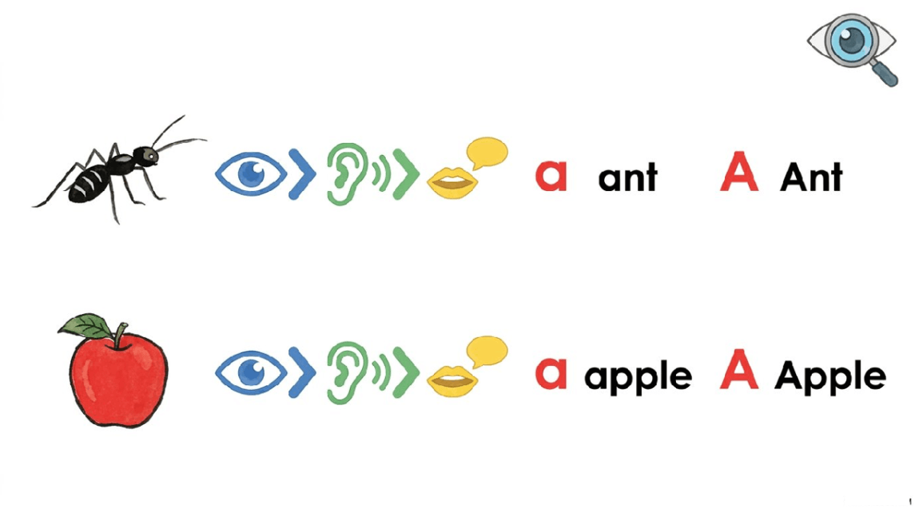
Nasrin Jahan

Slide 10
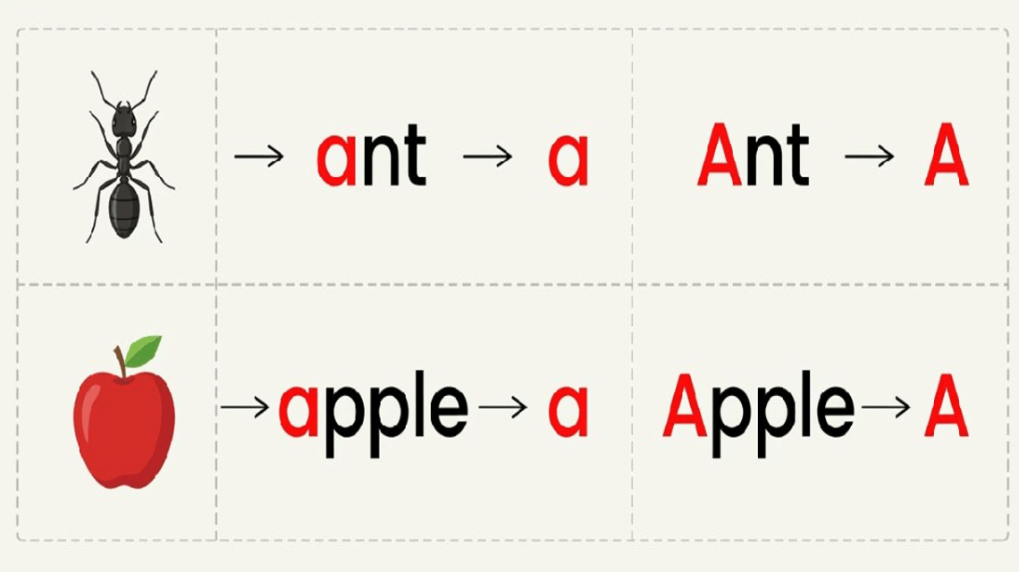
Nasrin Jahan

Slide 11
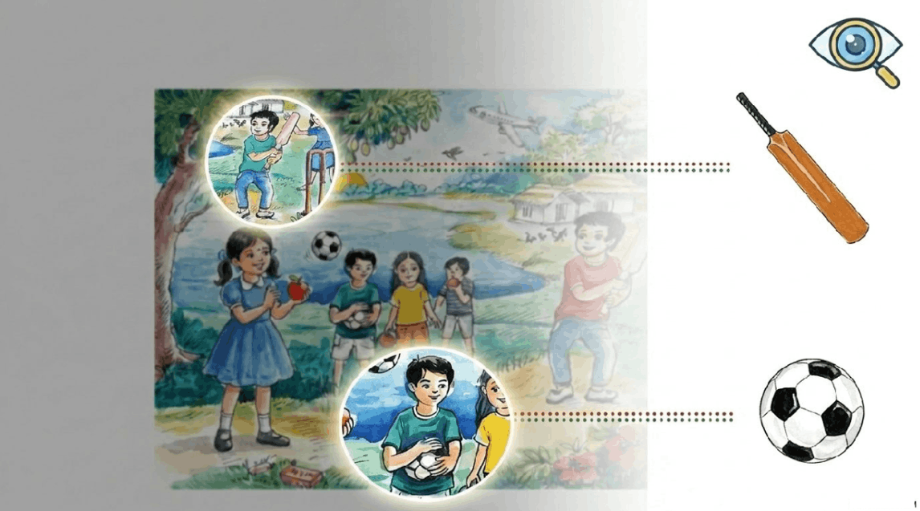
Nasrin Jahan

Slide 12

Nasrin Jahan

Slide 13
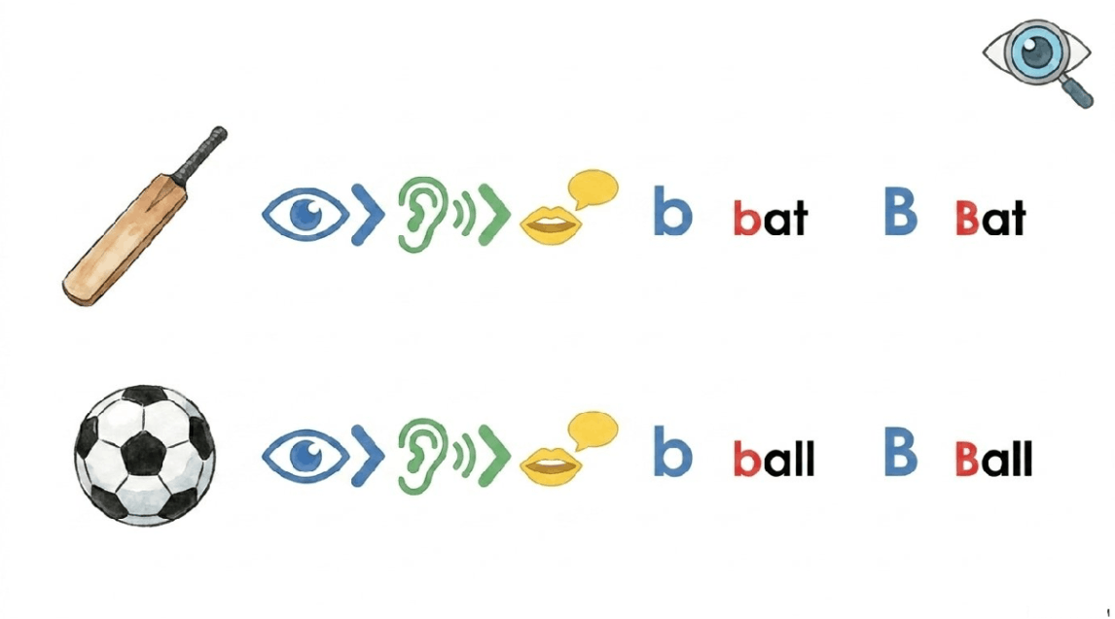
Nasrin Jahan

Slide 14
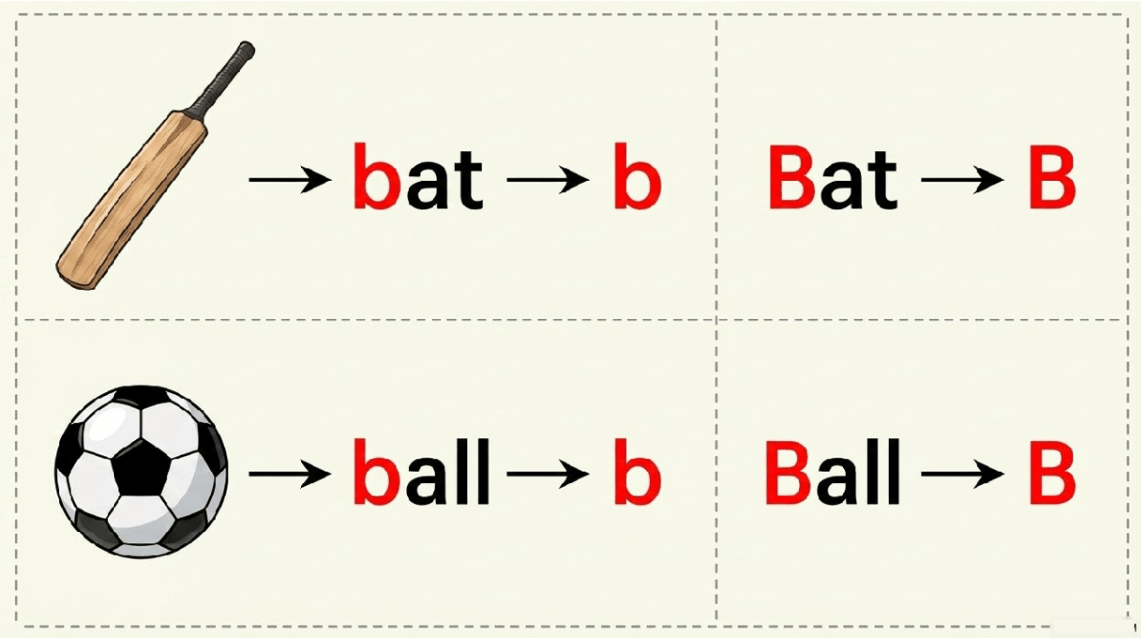
Nasrin Jahan

Slide 15
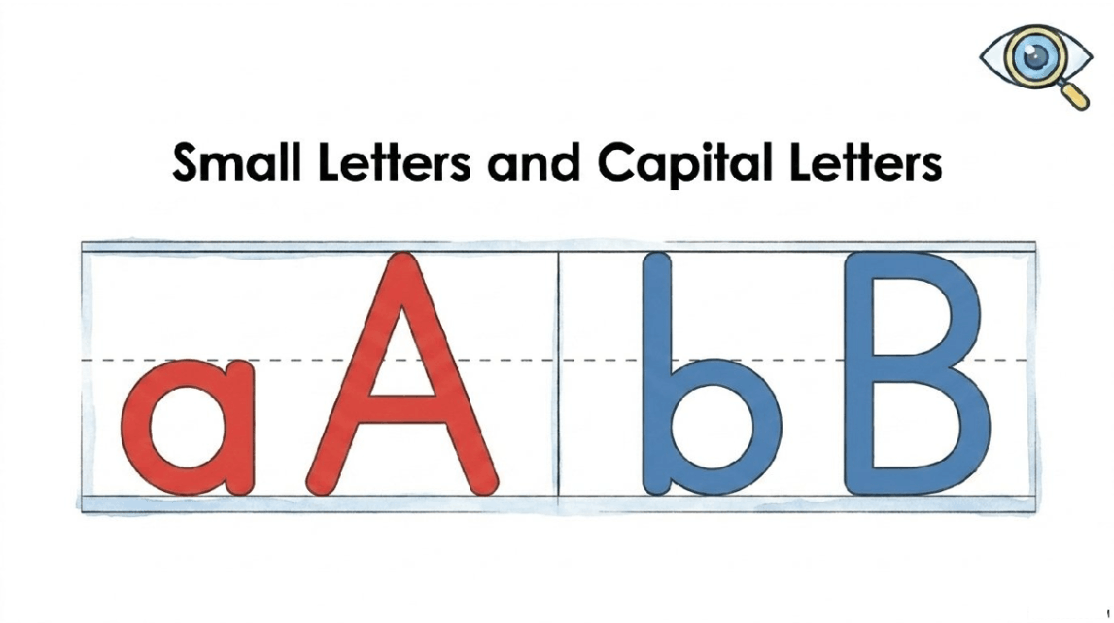
Nasrin Jahan

Slide 16

Nasrin Jahan

Slide 17

Nasrin Jahan

Slide 18
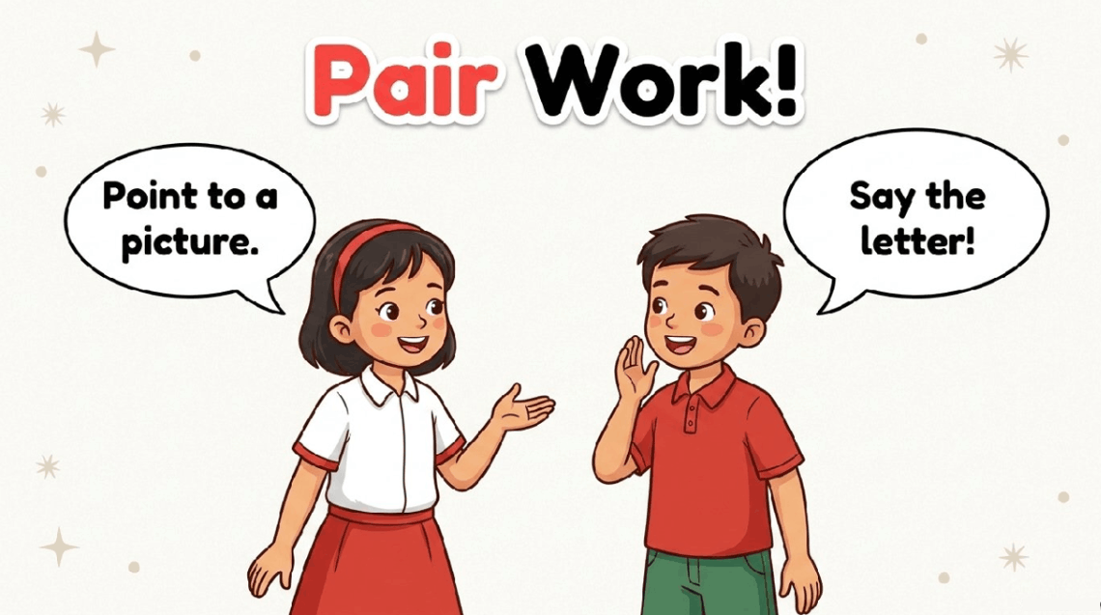
Nasrin Jahan

Slide 19
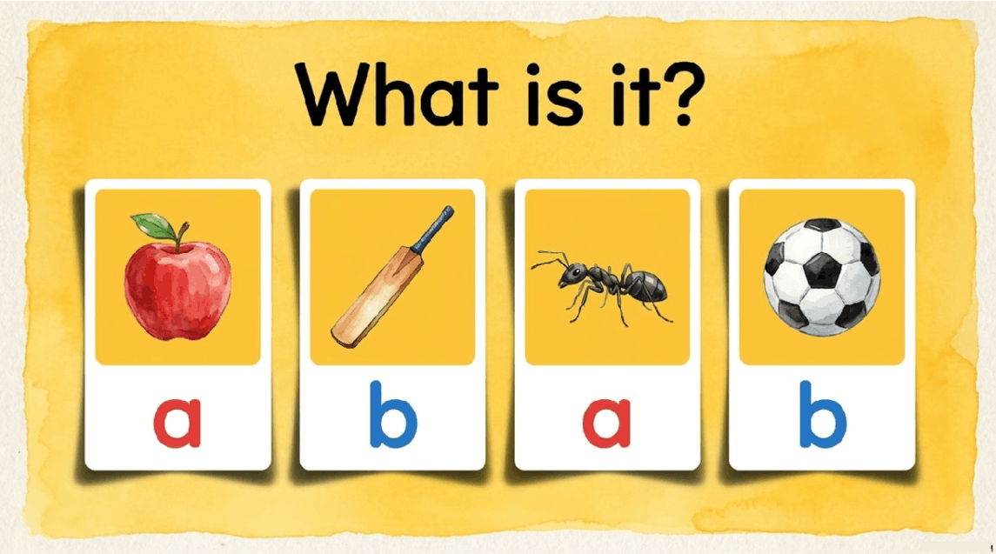
Nasrin Jahan

Slide 20
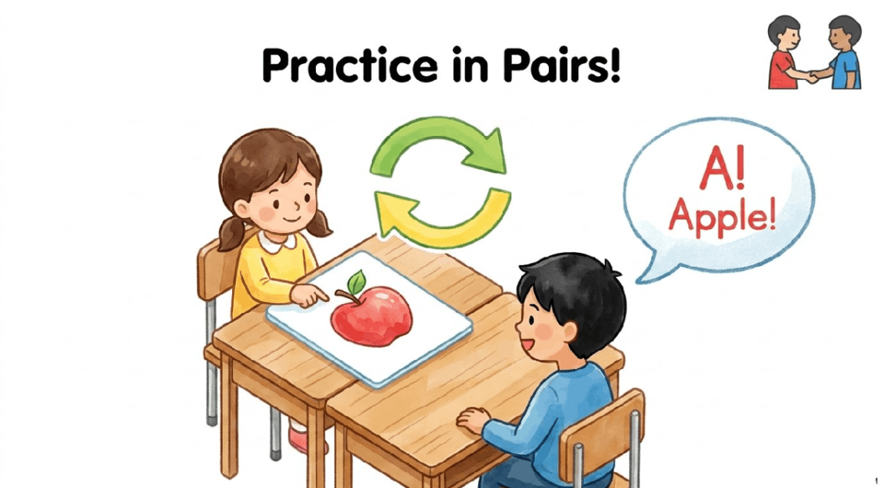
Nasrin Jahan

Slide 21
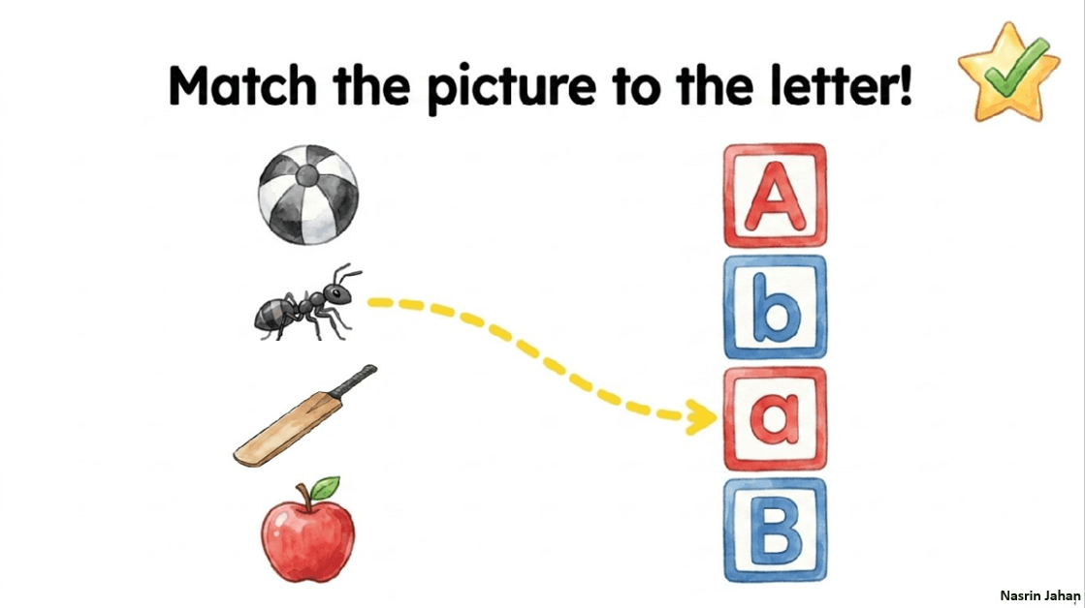
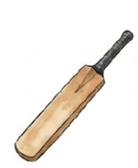

Slide 22


