Slide 1
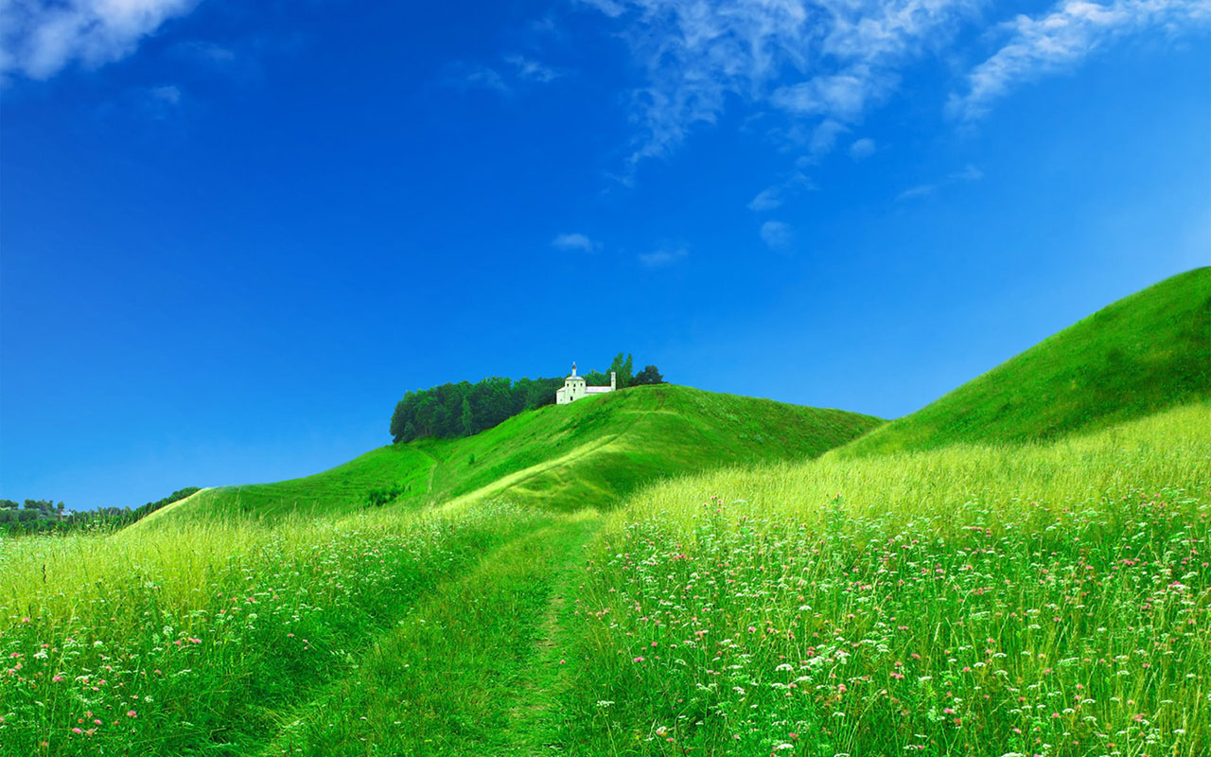

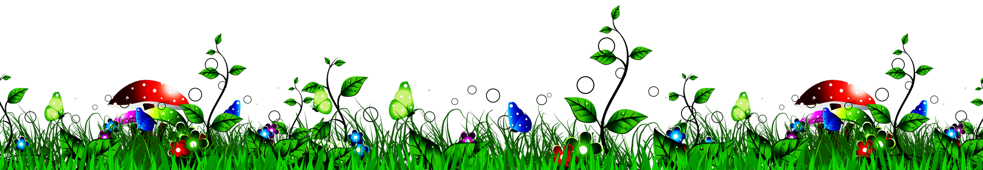

WELCOME TO ALL IN TODAY’S
ENGLISH LESSON

Slide 2




Presented By
Rajib Dutta
Assistant teacher
Bhingrol Govt.Primary School
Anowara, Chottogram
Email: rajibduttaat@gmail.com

Slide 3
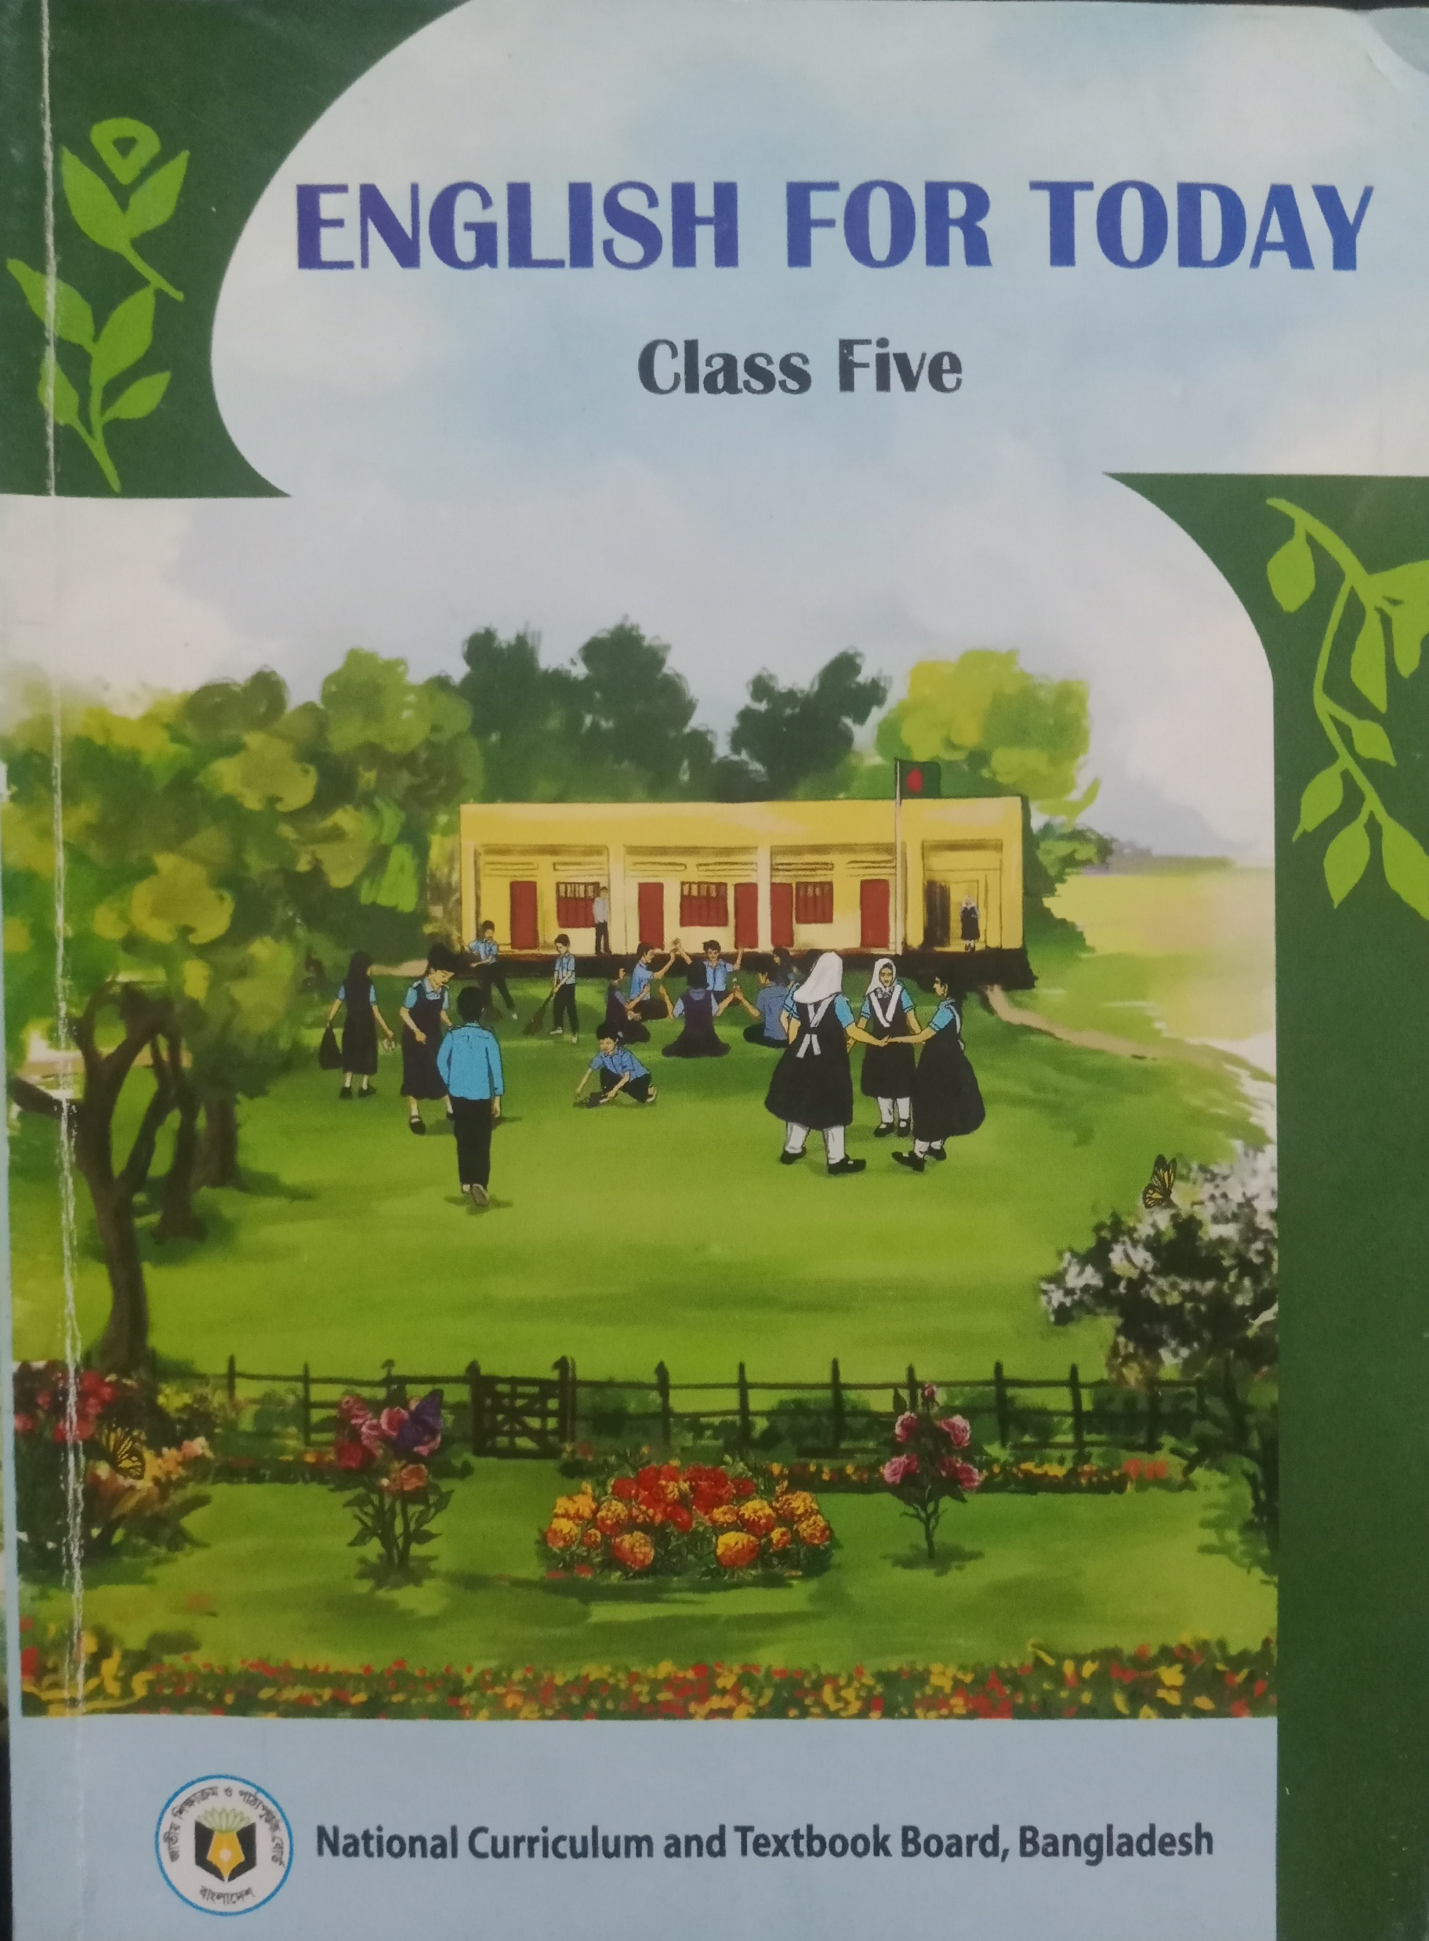
Introduction of the lesson
Class : FIVE
Subject : English
Unit : 16
Lesson : 1 (Page- 83)
Lesson Title : the giving tree
TIME :

Slide 4
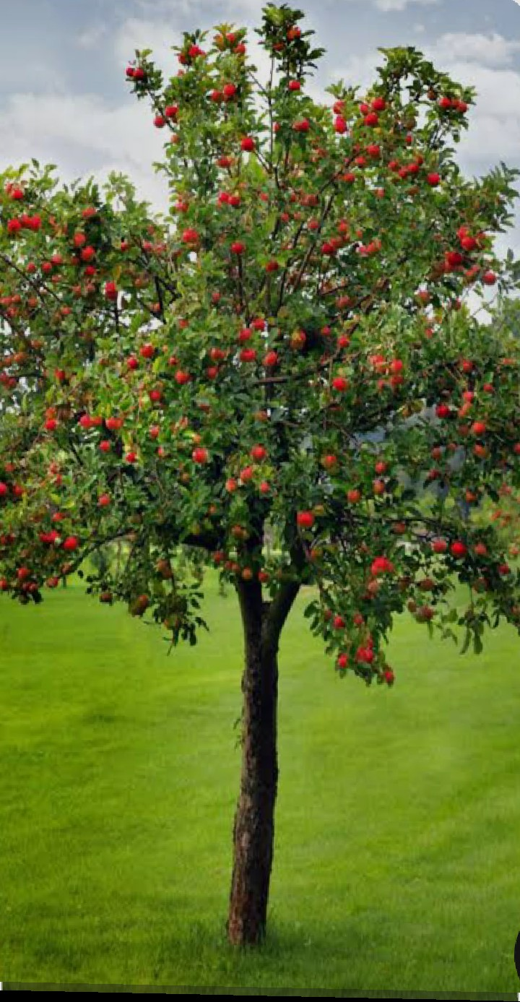
Today’s lesson
The
Giving
Tree

Slide 5
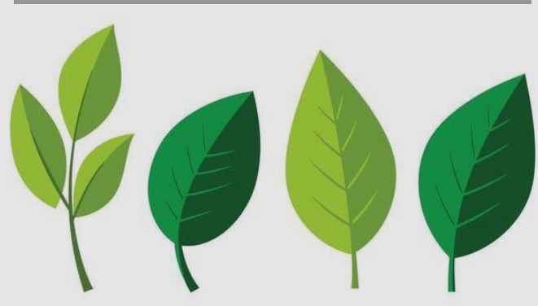
Leaves
A flat, green plant organ attached to a stem.

Slide 6
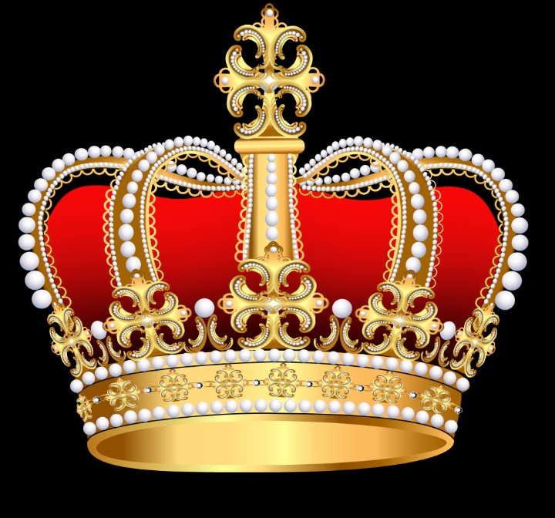
Crown
A traditional ornamental headpiece worn by a monarch

Slide 7
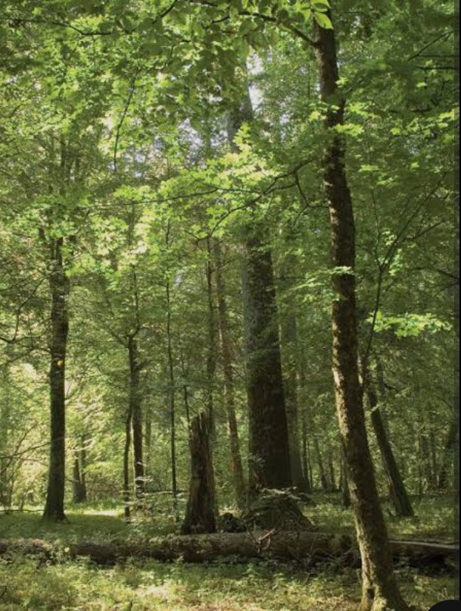
Forest
A large area of land covered with trees.

Slide 8
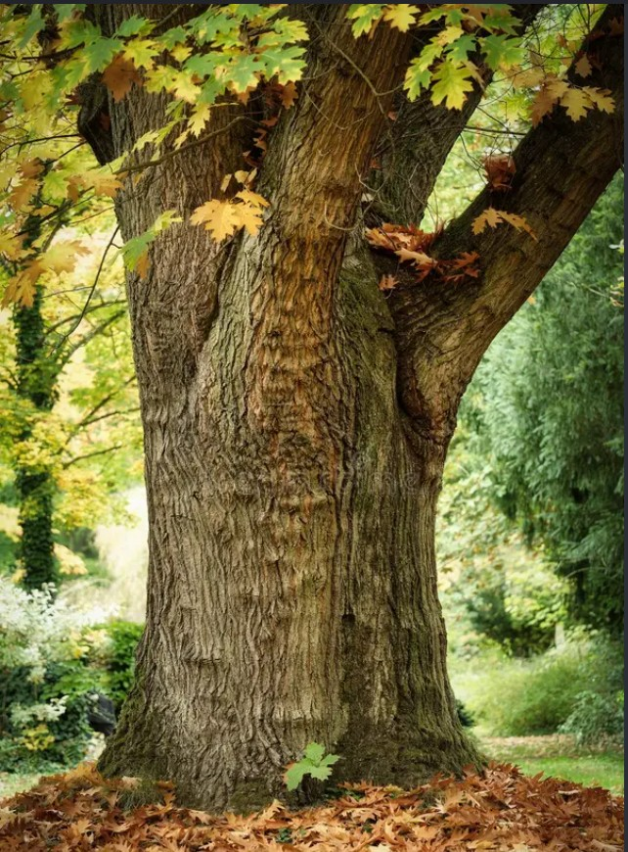
Trunk
The main structural steam of a tree.

Slide 9
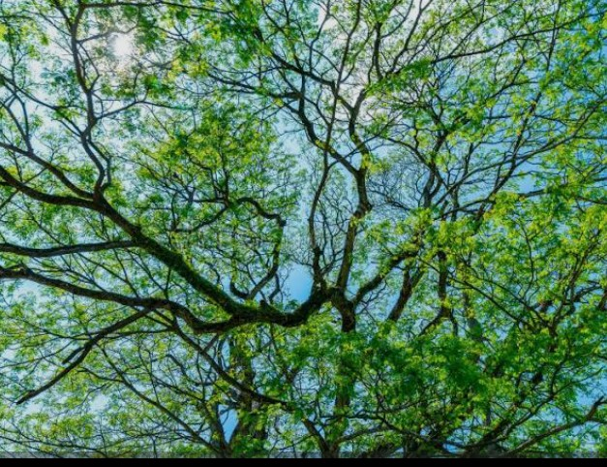
Branches
The natural subdivision of a plant stem.

Slide 10
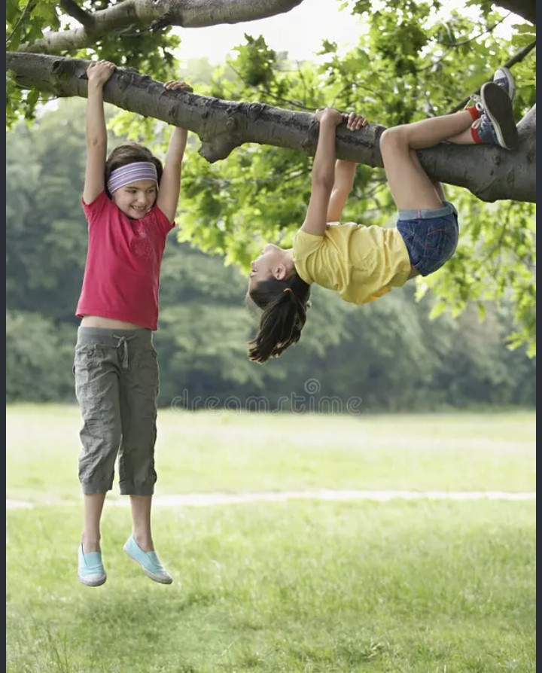
Swing
A hanging position that moves back and forth.

Slide 11
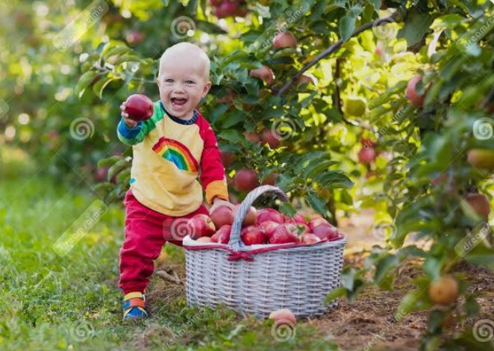
Gather
To bring or come together into a group.

Slide 12
Teacher read text with proper pronounciation two times
Once there was a tree and she loved a little boy. Every day the boy would gather leaves and make them into crowns. He would play king of the forest wearing the crown. He would climb up her trunk and swing from her branches. When he was tired, he would sleep in her shade. The boy loved the tree very much. And the tree was happy.
But time went by. The boy grew older. He stopped playing with the tree. And the tree was often alone.
Then one day the boy came to the tree. The tree said, ‘Come, Boy, come and climb up my trunk. Swing from my branches and eat apples. Play in my shade and be happy.’ ‘I am too big to climb and play,’ said the boy. ‘I want to buy things. I want SOME MONEY. Can you give me some money?
‘I’m sorry,’ said the tree. ‘I have no money. I have only leaves and apples. Take my apples, Boys, and sell them in the city.” And so, the boy climbed up the tree and gathered her apples. And the tree was happy.

Slide 13
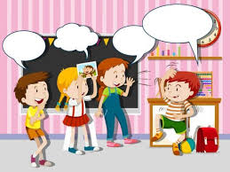
Students activities
1.Students will read the text with pair proper pronounciation.
2Students read the text alone with proper pronounciation.
3.Advanced students help to weaker students.

Slide 14
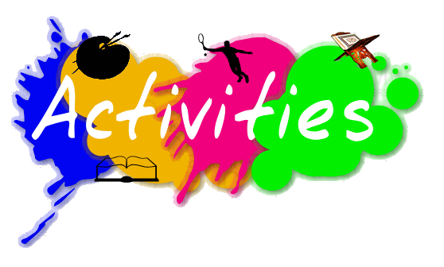
Match the words with their meaning
1. crown to bring together into a group.
2. forest hanging position.
3. trunk a traditional ornamental headpiece.
4. gather a large land area covered with trees.
5. swing the main structural stem of a tree.

Slide 15
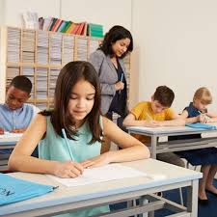
Answers the following questions
1. Who loved the boy?
Ans: A tree loved the little boy.
2. What did the boy do to gather leaves?
Ans: The boy gather leaves and make them into crowns.
3. When the boy tired what did he do?
Ans: The boy would sleep in the tree’s shade when he was tired.
4. What things does the tree have?
Ans: The tree has only leaves and apples.
5. How did the boy get money?
Ans: The boy got money to sell the apples in the city.

Slide 16
Students activities
Students will read the text proper pronunciation with missingwords
Then one day the boy to the tree. The tree said, ‘Come, Boy, come and up my . Swing from my and eat apples. Play in my and be happy.’ ‘I am too big to climb and .’ said the boy. ‘I want to buy . I want some . Can you give me some money?’
‘I’m ,’ said the tree. ‘I have no money. I have only leaves and . Take my apples, Boy, and sell them in the .’ And so, the boy climbed up the tree and gathered her apples. And the tree was happy.
came
climb
trunk
branches
shade
play
things
money
sorry
apples
city

Slide 17
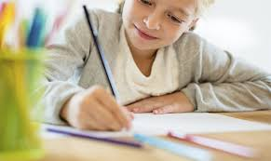
Home work
Write five sentences about ‘importance of the trees’.

Slide 18

