Slide 1

WELCOME

Slide 2


Teacher’s Identity
Uday Kumar Shil
Assistant Teacher
Isladigor Uttar Para Government Primary School
Raiganj, Sirajganj

Slide 3

Class : Four
Subject : English
Unit : 15
Lessons :
Page No. : 67 - 68
Topic : Environment Pollution
Nusair and Samin are…..… peaceful for everyone.

Slide 4
Learning Outcomes
By the end of this lesson learners will be able to learn about environment pollution

Slide 5
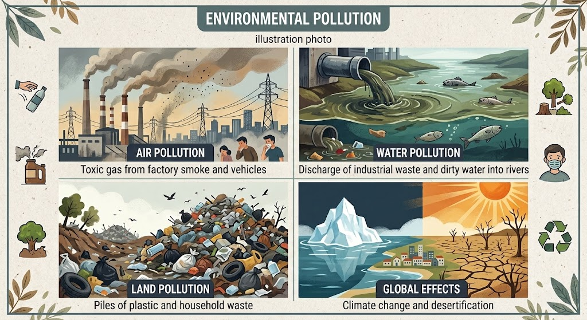

Slide 6
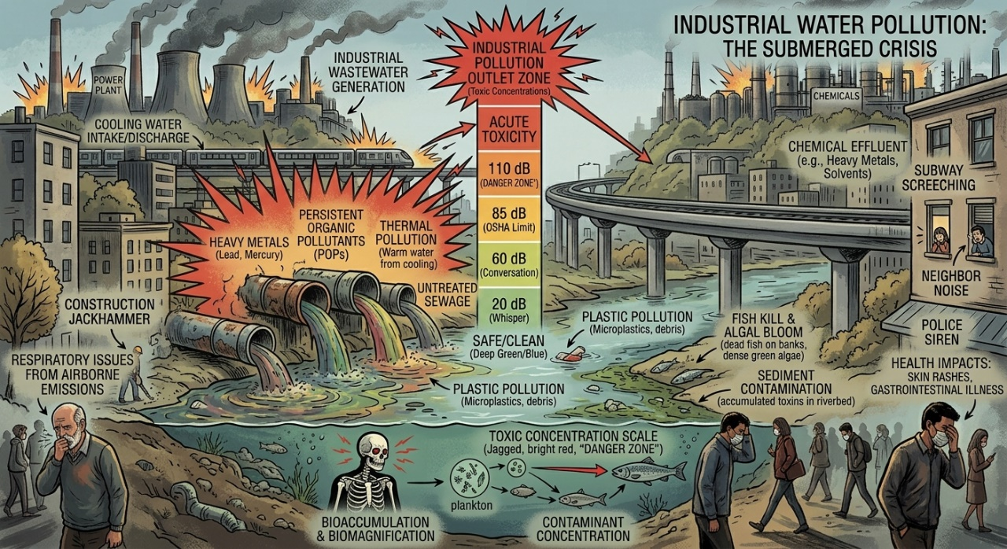
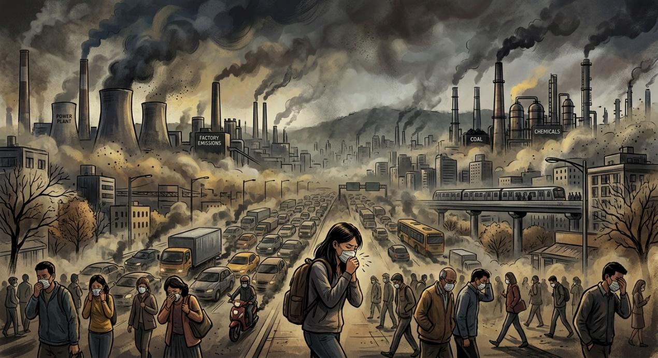
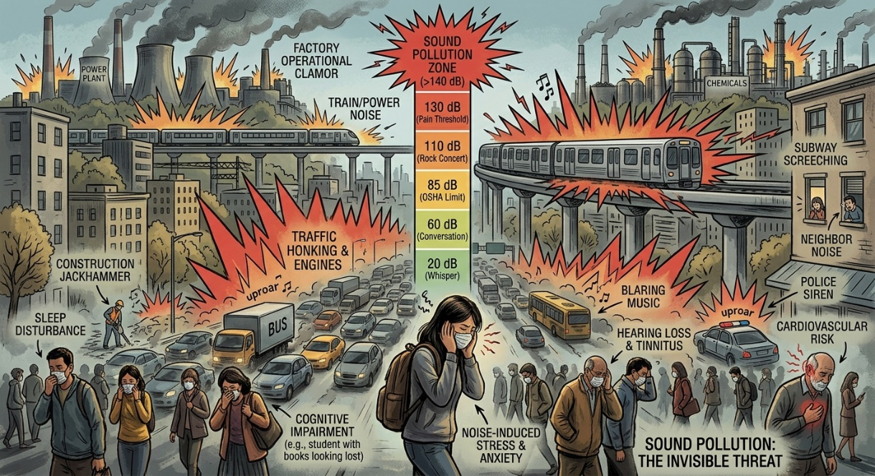
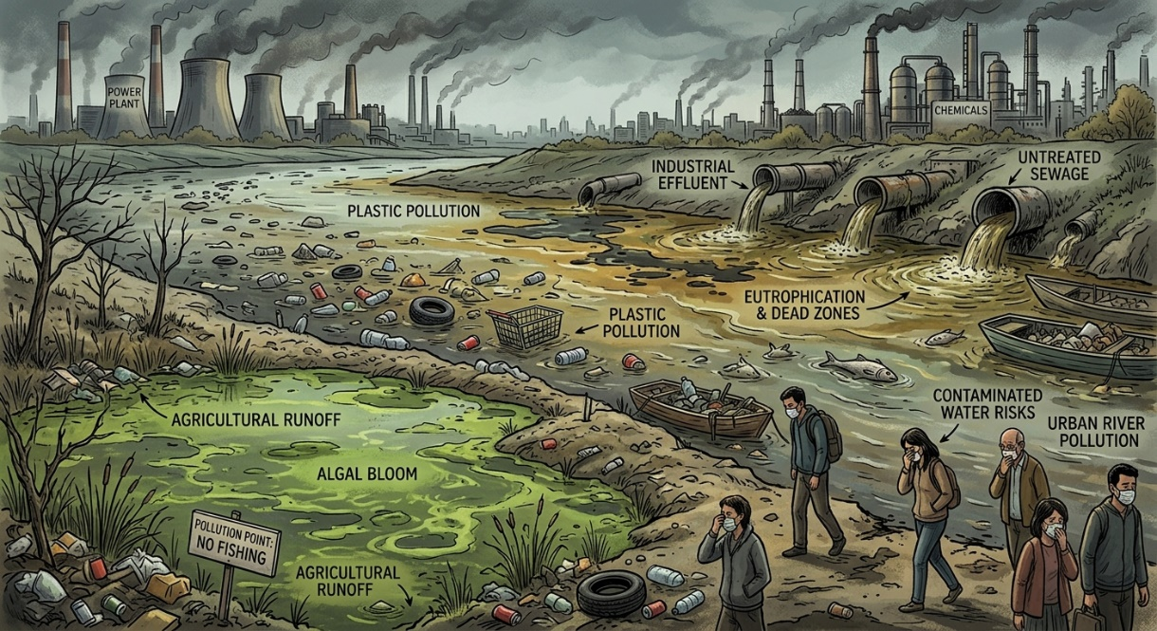

Slide 7
Let's watch a video about environmental pollution.
1. https://www.youtube.com/watch?v=J3Df0-ZJ_WA
2. https://www.youtube.com/watch?v=7qkaz8ChelI

Slide 8
Now take your English book
and open at page no. 67

Slide 9
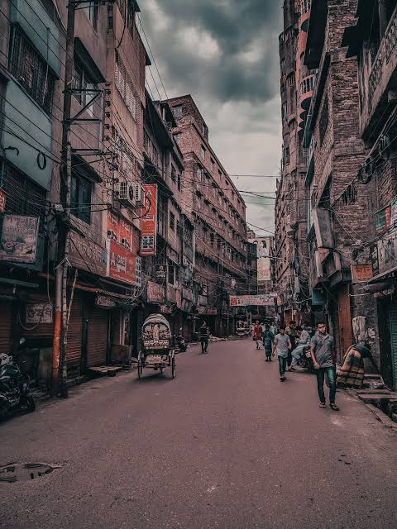
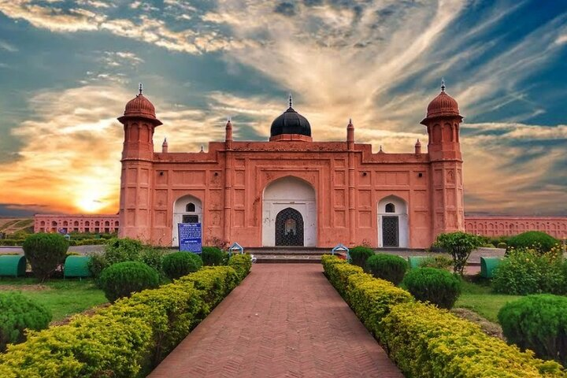
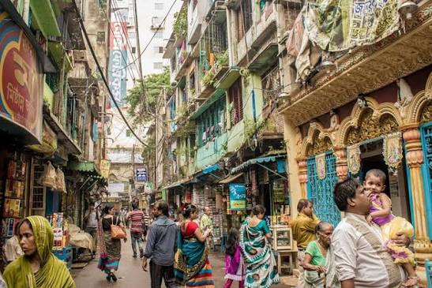
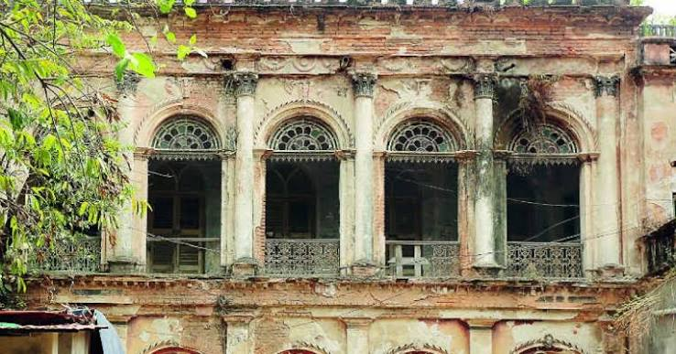
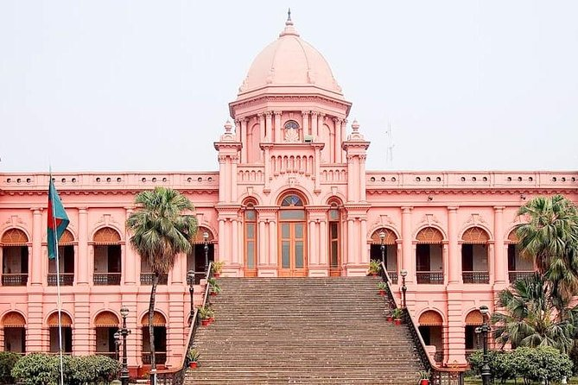
Old Dhaka

Slide 10
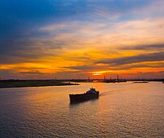
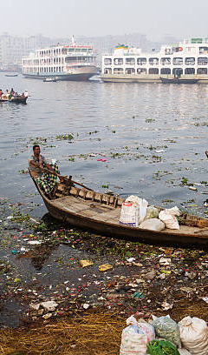
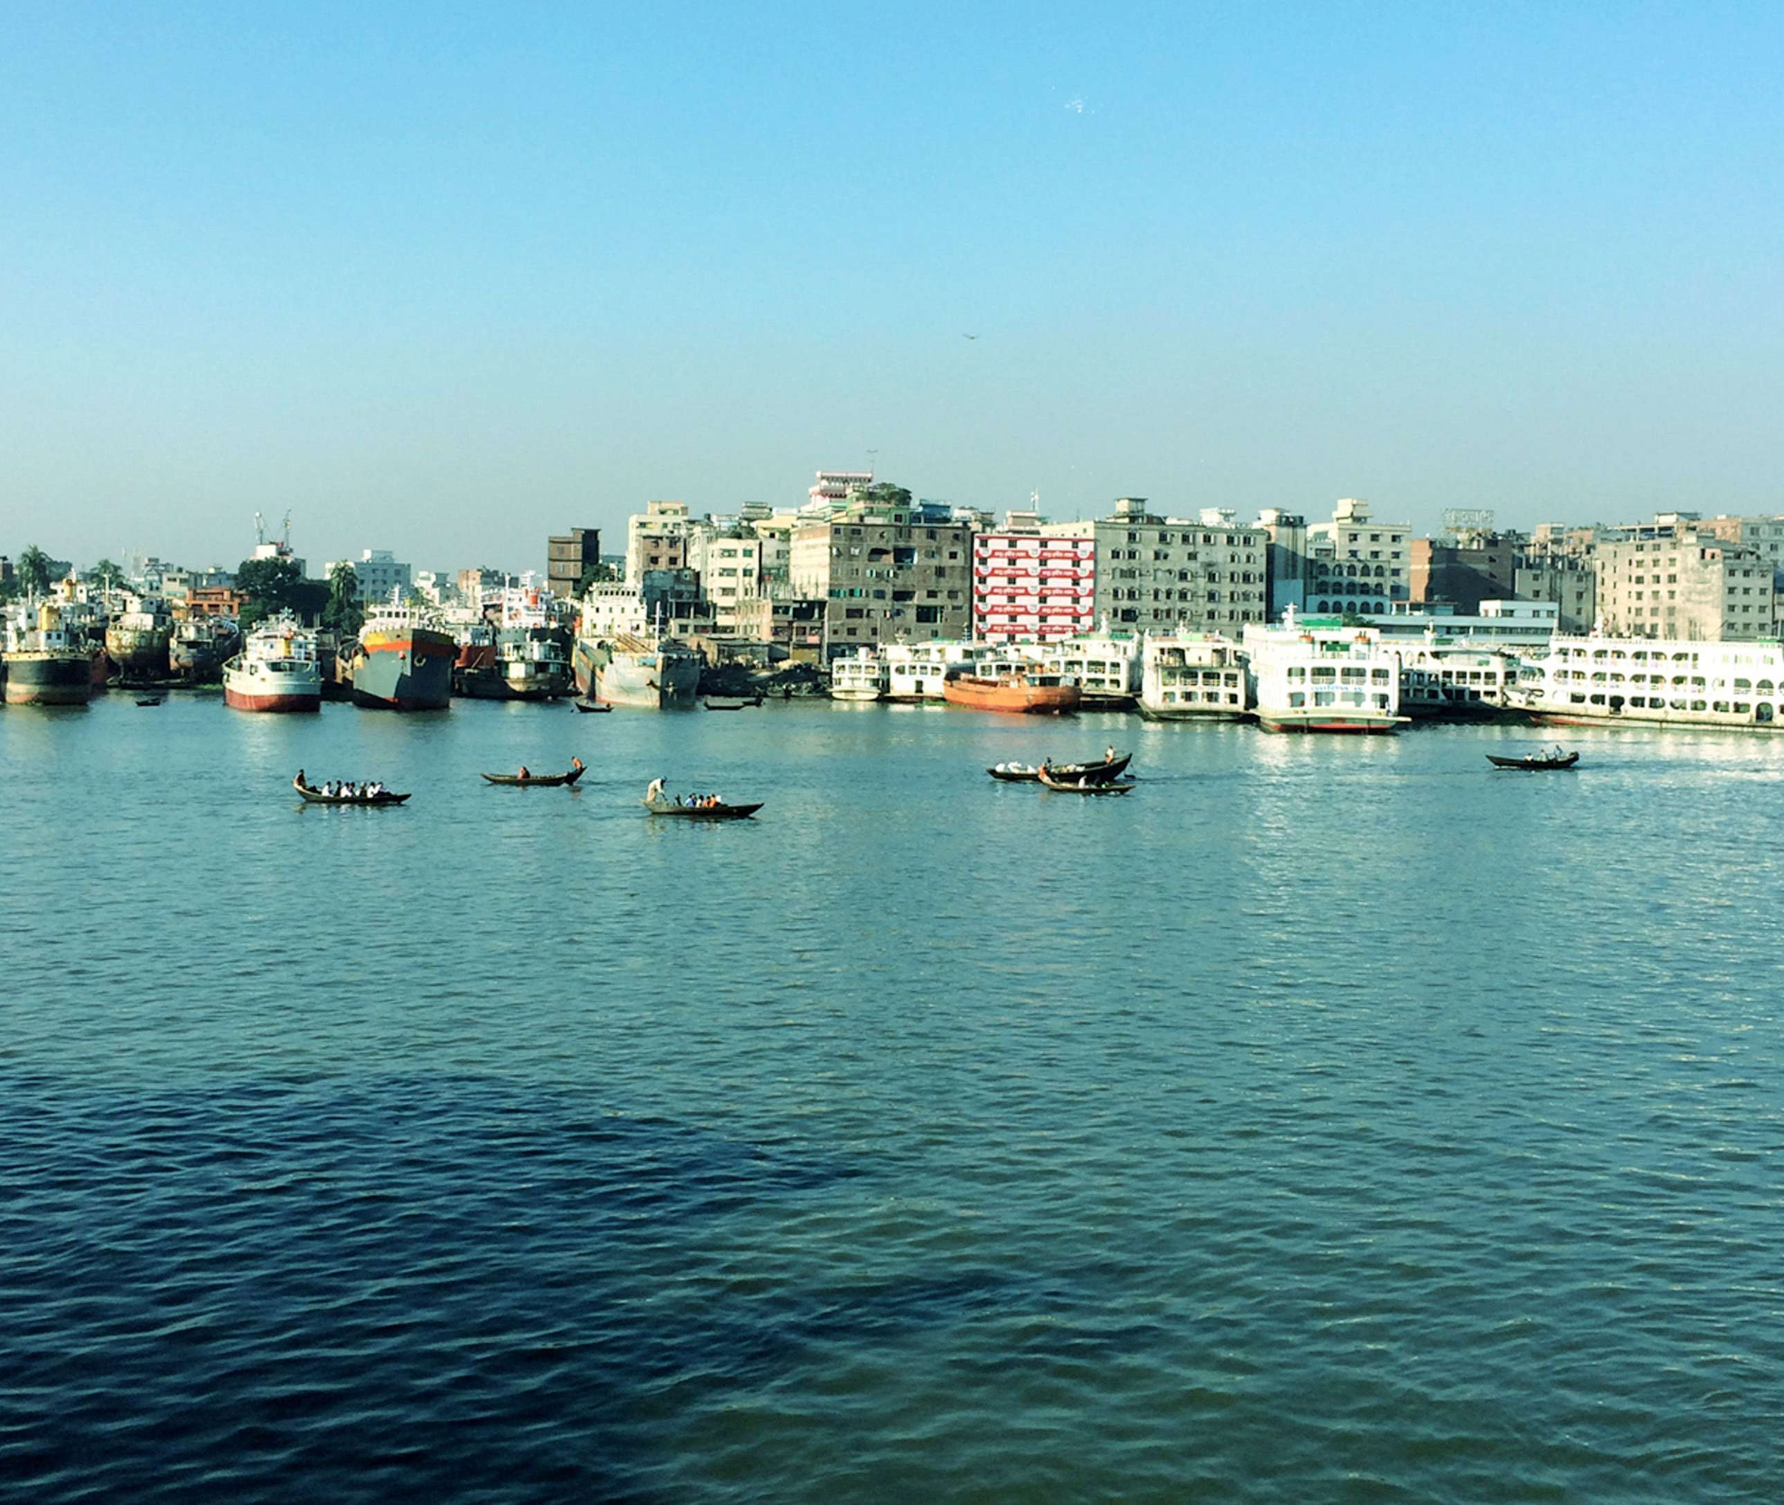
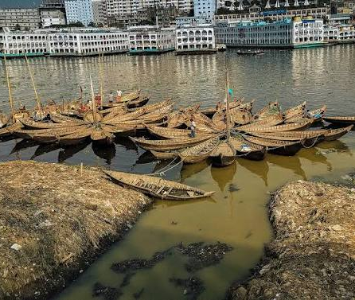
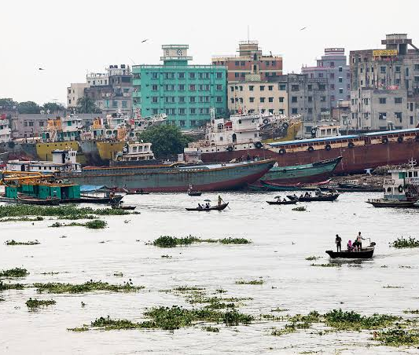
Buriganga River

Slide 11
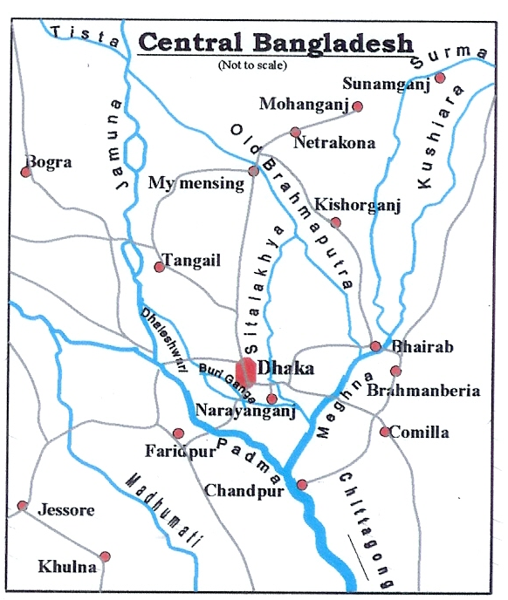
Nusair and Samin are two friends. They go to Armanitola Government Primary School located in old Dhaka. Every morning, they walk to school along the river Buriganga.

Slide 12
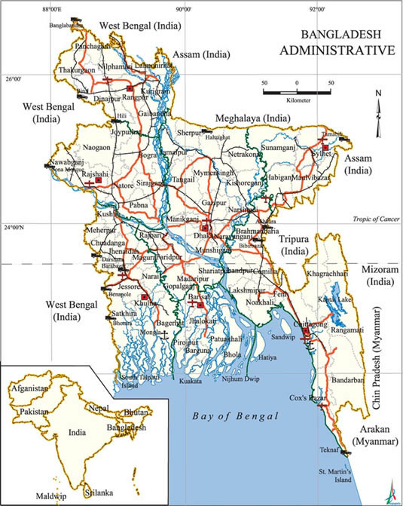
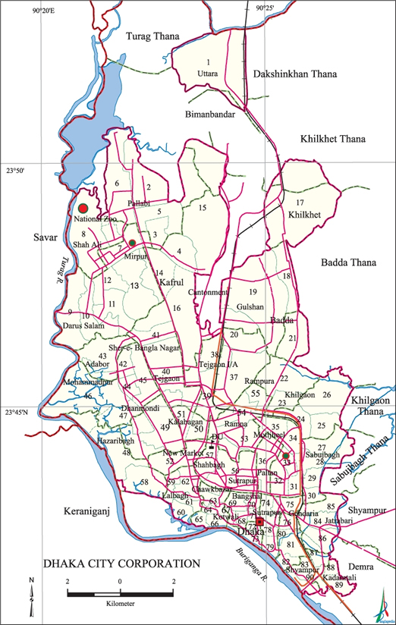
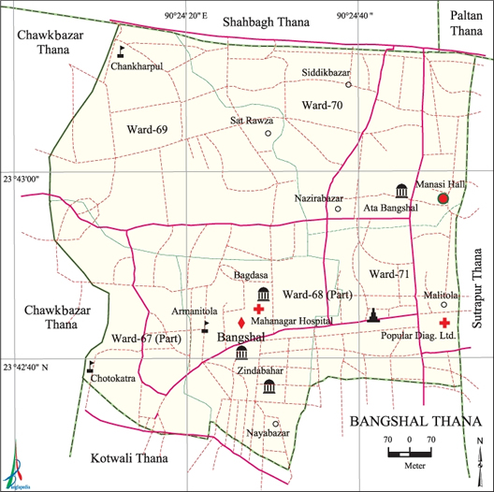
Map of Bangladesh
Map of Dhaka City
Map of Bongshal Thana (Armanitola)

Slide 13
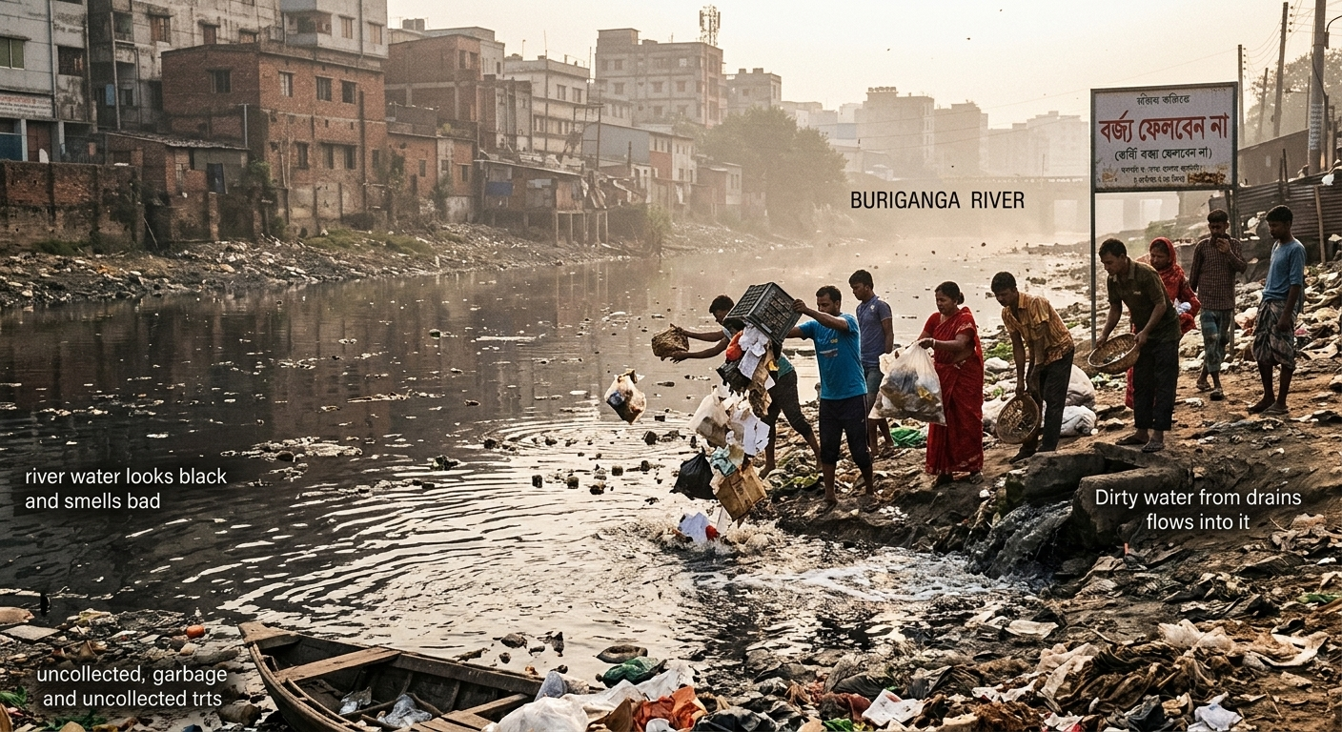
On their way, they see people throwing trash and waste into the river. Dirty water from drains also flows into it. The river water looks black and smells bad. They know this water is polluted. It is not safe for the fish, the plants or for people. Nusair and Samin feel sad and wonder, "Why do people make the river so dirty?"

Slide 14
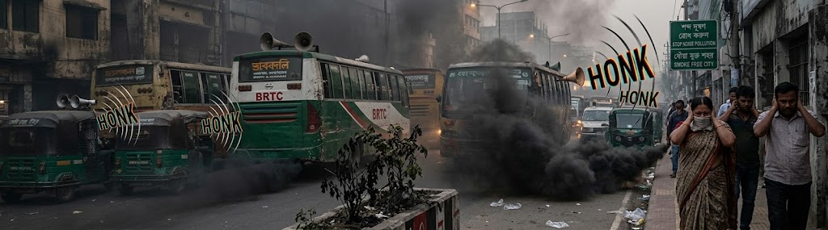
As they walk, many cars and buses pass by. They see black smoke coming from the vehicles. This smoke pollutes the air. Breathing this polluted air can make people sick. The vehicles also honk their horns very loudly. It hurts their ears. Very often, they cover their ears with their hands. They feel uneasy for this sound pollution. They ask each other, "Why are the vehicles so loud?"

Slide 15
Nusair and Samin know that the world around us is very important. Clean air and water help us stay healthy. However, living a healthy life becomes impossible when people pollute the air, water, and make too much noise.
They make a promise to each other. They will do their best to keep their environment clean and peaceful for everyone.

Slide 16
Vocabulary

Slide 17
Word | Meaning
Government | সরকার
Old Dhaka | পুরান ঢাকা
River | নদী
Walk | হাঁটা
Along | বরাবর / পাশ দিয়ে
Throwing | নিক্ষেপ করা / ছুঁড়ে মারা
Word | Meaning
Trash | ময়লা / আবর্জনা
Waste | বর্জ্য / অপচয়
Dirty | নোংরা / অপরিষ্কার
Drain | নালা / ড্রেন
Flow | প্রবাহিত হওয়া / গড়িয়ে চলা
Smell | গন্ধ পাওয়া / দুর্গন্ধ বা সুবাস
Feel | অনুভব করা / অনুভূত হওয়া

Slide 18
Word | Meaning
Sad | দুঃখিত / বিষণ্ণ
Wonder | বিস্মিত হওয়া / ভাবা
Make | তৈরি করা
Smoke | ধোঁয়া
Vehicle | যানবাহন
Breathing | শ্বাস-প্রশ্বাস
Word | Meaning
People | মানুষজন / জনগণ)
Sick | অসুস্থ / পীড়িত
Promise | প্রতিশ্রুতি / কথা দেওয়া)
Impossible | অসম্ভব
Important | গুরুত্বপূর্ণ
Healthy | স্বাস্থ্যকর / সুস্থ
Peaceful | শান্তিপূর্ণ / শান্ত

Slide 19
Write True or False for each statement.
True
a) Loud horn causes sound pollution. ...........
b) People should throw waste in the water. ...........
c) Breathing polluted air can make us sick. ...........
d) Car and bus horns cause air pollution. ...........
e) People are responsible for environment pollution. ...........
False
True
False
True

Slide 20


(A) Write four reason about environmental pollution?

Slide 21


