Slide 1


Slide 2


Slide 3

TOPIC
Mr. Moti By-Rahad Abir
A comprehensive Class 9–10 study guide for Mr. Moti by Rahad Abir — covering character analysis, literary devices, themes, vocabulary, and assessment materials.

Slide 4


Learning Objectives
1
2
Characters & Relationships
Literary Devices
Understand character motivations and the emotional bonds driving the story forward
Analyze symbolism, imagery, and narrative perspective across key scenes
3
4
Themes
Vocabulary & Culture
Explore loss, identity, and the human-animal bond as lenses for the story
Expand contextual vocabulary and discuss cultural significance of rural Bangladeshi life
students connect the text to personal and social identity.

Slide 5
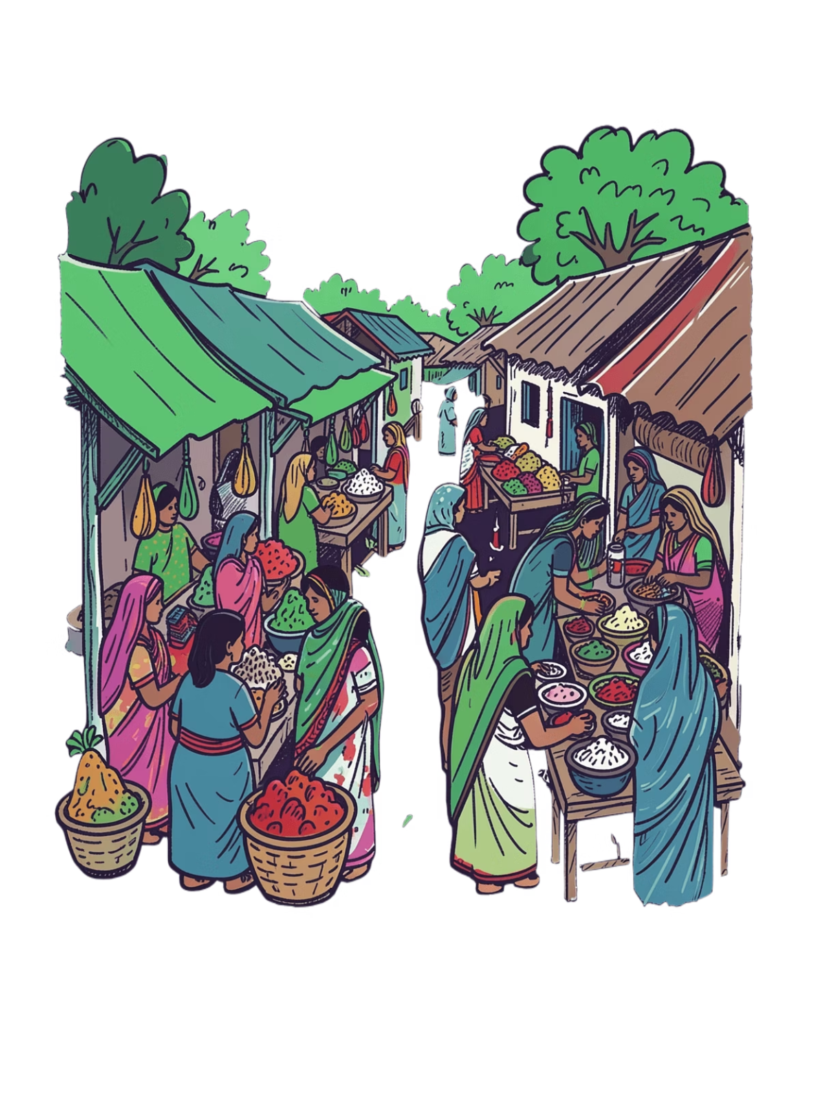
Story Context: Setting & Background
⏱ Time
📍 Place
During wartime in Bangladesh — reflects the spirit and trauma of the 1971 Liberation War era
A rural village with an agricultural economy; the haat bar (market day) culture shapes daily social life
🏘 Social Class
A working-class family — Sonabhan and Ameen depend on farming and market sales to survive

Slide 6
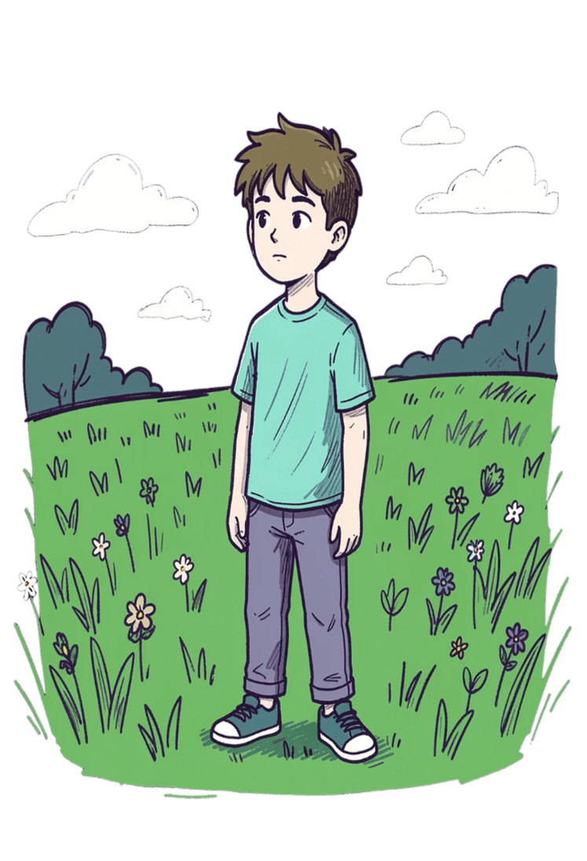

CHARACTER ANALYSIS
Ameen
Age & Transformation
Motivation
Bond with Moti
Drawn to fighting — bullfighting, cockfighting, boat racing — an inherited stubbornness that defines his choices
His rooster is more than a pet — Moti represents his childhood and fading innocence before war changes everything
A 17-year-old on the edge of manhood; physically mirrors his dead father — carrying both his legacy and his fate

Slide 7
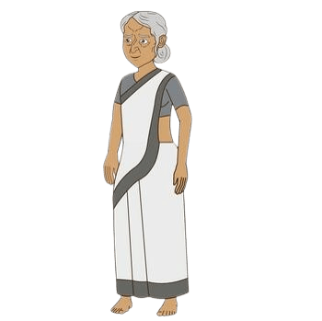

CHARACTER ANALYSIS
Sonabhan
Role
Internal Conflict
Connection to Moti
A widowed mother — emotionally vulnerable yet resilient in the face of repeated loss
Torn between letting Ameen follow his path into war and the consuming fear of losing him as she lost his father
After Ameen departs, Moti becomes her emotional anchor — a living symbol of family and absent love

Slide 8
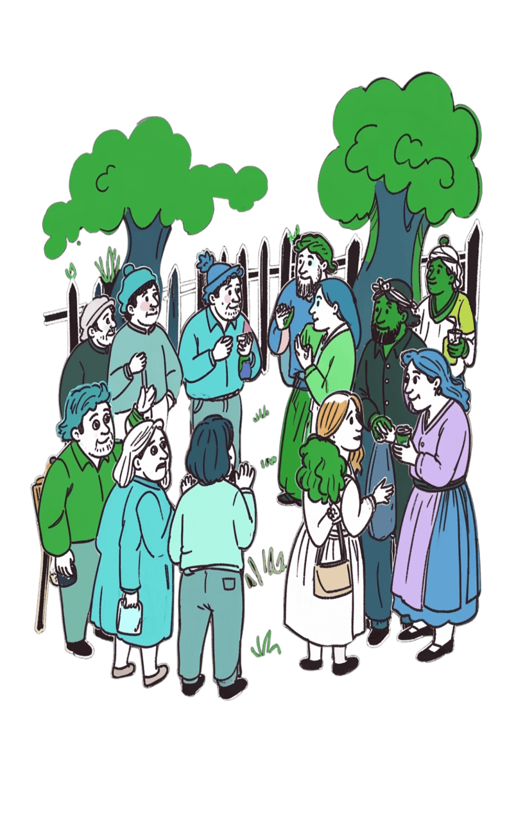
The Warning Scene: Social Conflict
The Chowkidar's Wife
Why This Scene Matters
Her warning is not an act of kindness — it is village gossip dressed as concern. She embodies the class-based judgment that surrounds Sonabhan and Ameen at every turn.
Villagers perceive this family as outsiders or lesser — a perception reinforced through social interactions and economic standing.
This moment is a microcosm of the story's central tension — how economic vulnerability and social status create invisible but powerful divisions within a community.
For students, this connects directly to the Sense of Self unit: how does society's view of us shape how we see ourselves?

Slide 9


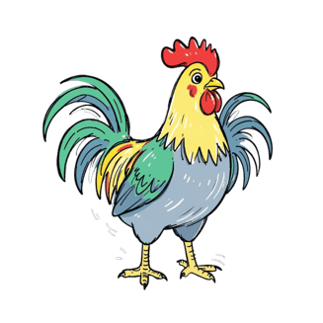
Symbolism: Moti the Rooster
Innocence & Childhood
Family Bond
Vulnerability
Moti embodies Ameen's youth — the life he leads before war strips away everything familiar and pure
The rooster is a living thread connecting Ameen, Sonabhan, and the idea of home — even when they are apart
A young creature entirely dependent on care — mirroring Ameen's own emotional fragility beneath his stubborn exterior

Slide 10

Literary Devices
Imagery & Narrative Technique
Sensory Details
Emotional Subtext
Objects like the "cloudy mirror," "floral shirt," and "rattan basket" ground the reader in vivid rural Bangladeshi life
Sonabhan's "puffy eyes" and telling silences communicate grief without a single direct statement — show, don't tell
Narrative Perspective
Third-person narration reveals inner thoughts, creating intimacy and allowing readers to inhabit multiple characters at once

Slide 11
Key Vocabulary & Expressions
Word / Phrase | Meaning | Significance in Story
Haat bar | Weekly market day for commerce and community | Establishes the social and economic rhythm of rural life
Lungi | Traditional lower garment worn by men in South Asia | Signals Ameen's cultural identity and working-class background
Cockerel | A young rooster not yet fully grown | Directly mirrors Ameen — youth, vitality, not yet forged by experience
Stubbornness | Inflexible determination; resistance to change | An inherited trait that propels Ameen toward both glory and danger

Slide 12
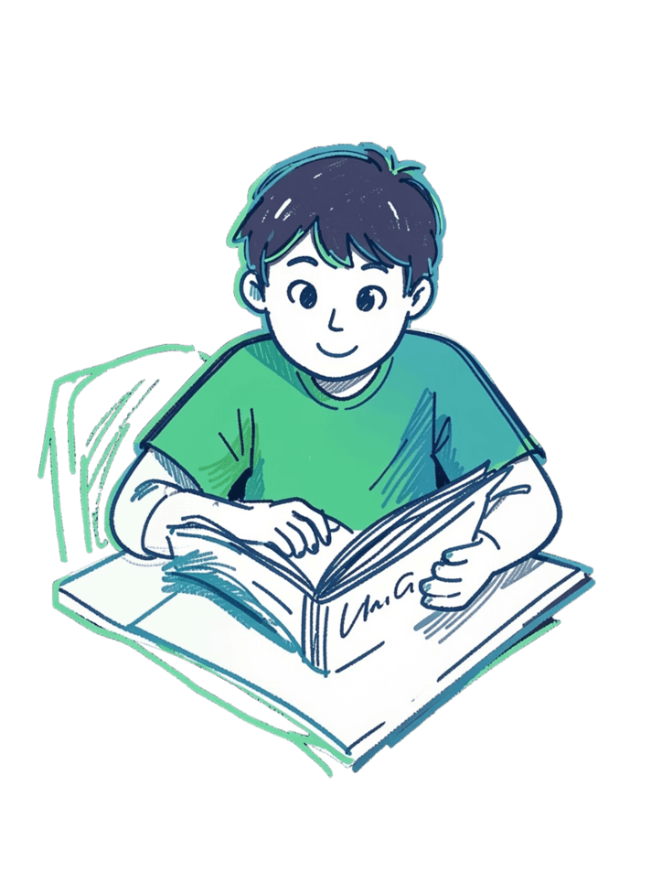



Comprehension Questions
RECALL &UNDERSTANDING
1
2
Sonabhan's Puffy Eyes
Ameen at Breakfast
Why does Sonabhan have "puffy eyes" the morning after Ameen announces his departure? What does this reveal about her emotional state?
What does Ameen's behavior at breakfast reveal about his awareness — or lack thereof — of his mother's feelings?
3
Father's Shadow
How does the description of Ameen's physical appearance connect him symbolically and emotionally to his dead father?
Teacher's Note: These questions test recall and literal comprehension — suitable for class discussion, short written responses, or oral assessment.

Slide 13



Analysis Questions
CRITICAL THINKING
Social Class & The Warning Scene
Moti as Symbol
What does Moti represent in Sonabhan's life after Ameen leaves for war? How does the rooster's fate mirror Sonabhan's own emotional journey?
How does Chowkidar's wife's warning reflect the story's broatheder theme of social class divisions? What does her intervention reveal about community power dynamics?
Fascination with Fighting
Why does the author emphasize Ameen's fascination with fighting contests rather than depicting the war directly? What does this narrative choice achieve?
Higher-Order Thinking: These questions require students to interpret, infer, and connect textual evidence to themes.

