Slide 1
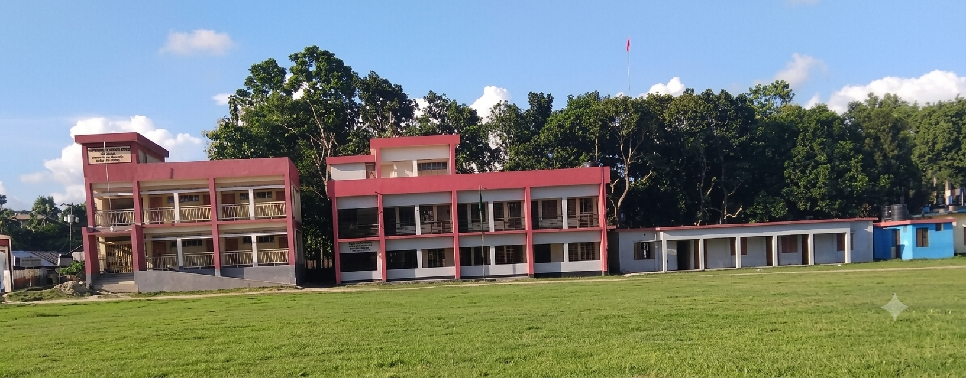

Slide 2

Teacher
Md. Iqbal Hossain
Assistant Teacher
Parshuram Model Government Primary School

Slide 3

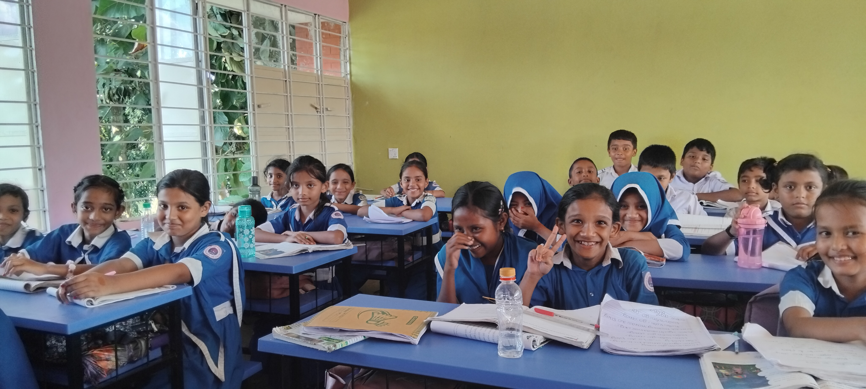
Unit 6: Cleanliness
Lesson 2: Steps of Washing Hands

Slide 4
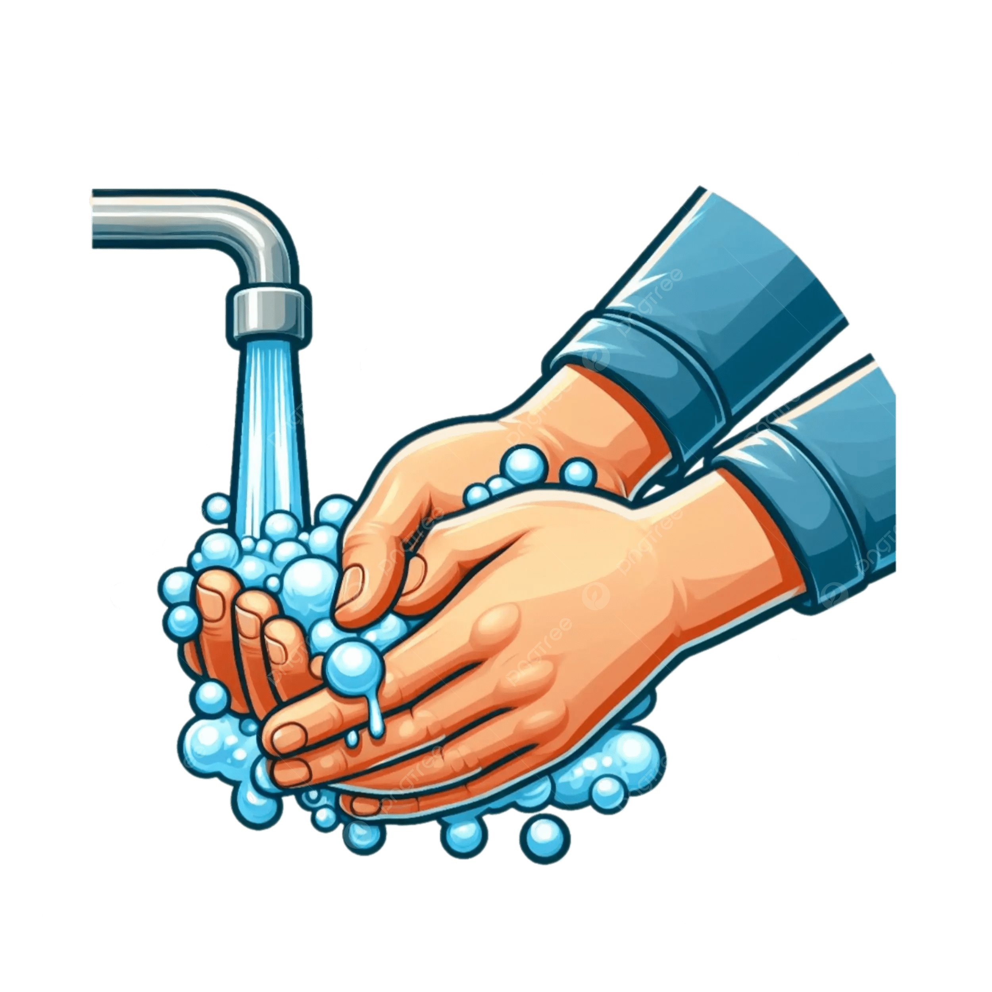
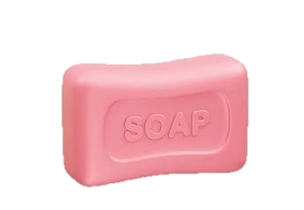

Look and Say
• Water
• Soap
• Tap
• Towel

Slide 5
Why Is Washing Hands Important?
Dirty hands can spread germs.
Washing hands is important.
It is the best way to prevent germs.

Slide 6
Steps of Washing Hands — 1 to 4
1. Open the tap. Wet your hands with clean water.
2. Turn the tap off.
3. Apply soap on your hands.
4. Rub your hands for at least 20 seconds.

Slide 7
Steps of Washing Hands — 5 to 8
5. Clean the back of your hands, fingers and under the nails.
6. Open the tap. Rinse your hands well with clean water.
7. Turn the tap off again.
8. Wipe your hands with a clean towel.

Slide 8
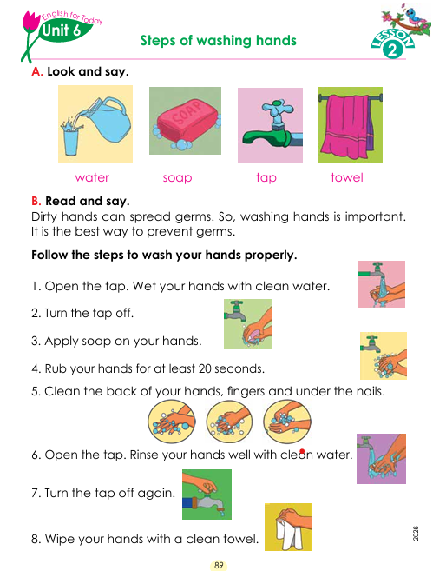
Open at page 89

Slide 9
Let’s Practise!
• Say the steps in order.
• Demonstrate the steps of washing hands.
• Remember: Wash your hands properly.

Slide 10
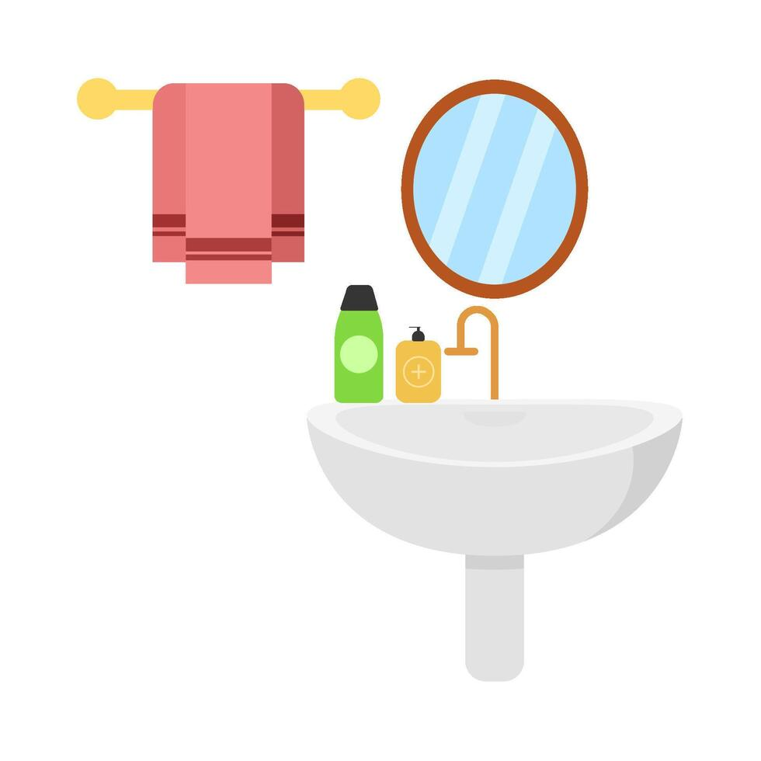
THANK YOU

