Slide 1
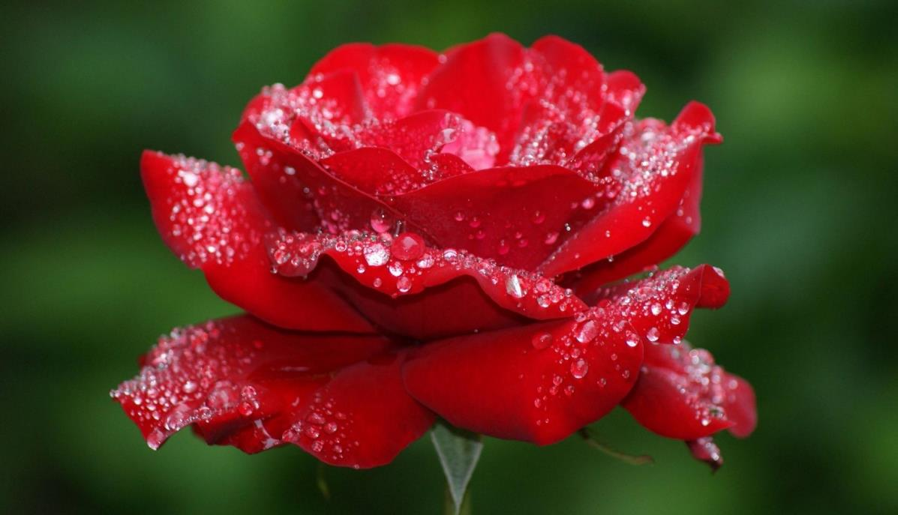
Welcome dear students….

Slide 2
Teacher’s Introduction
Md.Laltu Mia (M.A,B.ed, M.ed) Assistan Teacher (English)
Bhatai Secondary School, Shailokupa ,jheanidah
E-mail: mlaltumia81@gmail.com
Phone: 01912394162

Slide 3
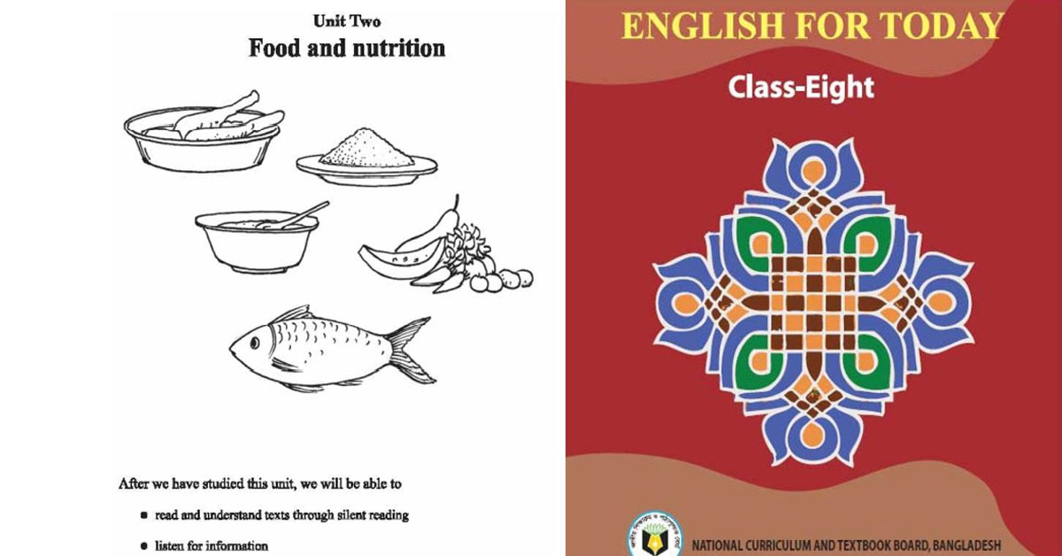
English First paper
Class –Eight
Unit –2
Lesson – One
21/06/2026

Slide 4
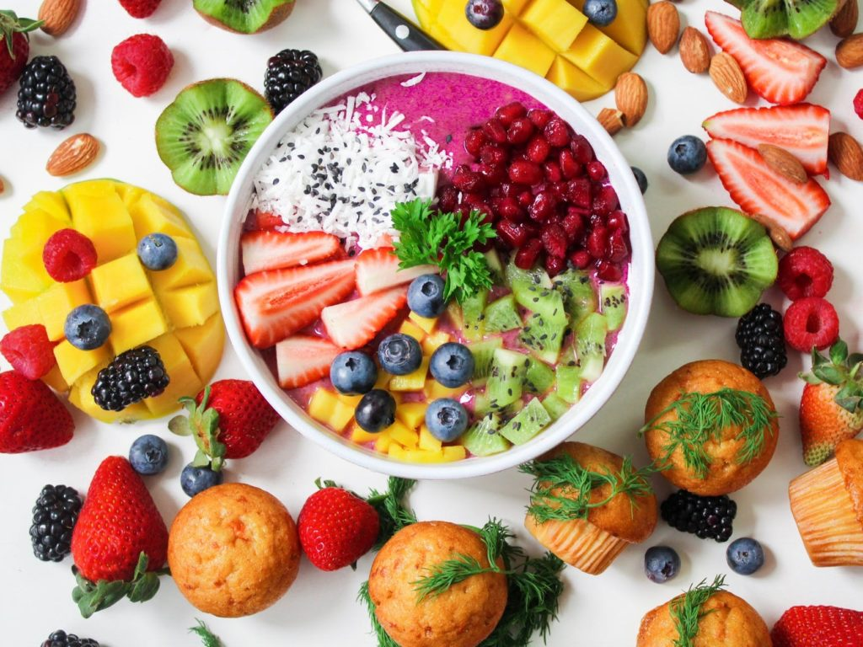
Look at the picture

Slide 5
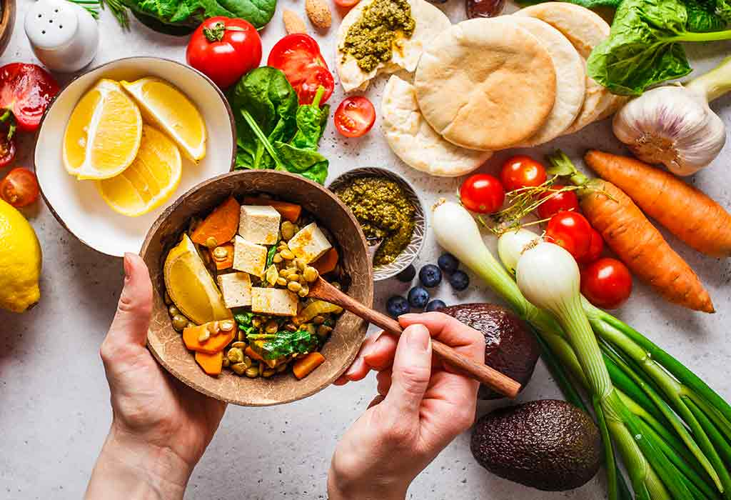
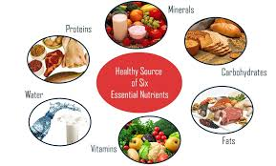

Slide 6
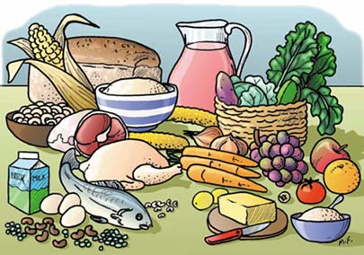
To day our lesson
Good Food

Slide 7
Learning outcomes:
By the end of the lesson, the learners will be able to -------
Tell the meaning of some words
read and understand texts through silent reading
write answers to questions
Complete the sentences.

Slide 8
Vocabulary,Pronunciation , meaning,tell parts of speech and make sentences.Five minutes
Nutritious
Wholesome
We should eat nutritious food.
Adjective
Substances
Elements
There are two substances of water.
Noun
Physical
Bodily health
Physical exercise needs for fit .
adjective
Structure
Framework
Write a structure for voice change
Noun

Slide 9
Ms Rehana, the English teacher, is talking to the class
about food. “Food is very important for our body,” she says. “We can’t live without it. So you must always have good food.”
“What’s good food, teacher?” asks a student.
“Good food means the right kind of food for good health,” says Ms Rehana. “It is nutritious. It must contain natural substances that our body needs to grow properly and stay healthy. But remember, you must not eat too much though the food is good. Eating too much is bad for health. You have to eat only a certain amount of food that your body needs. So we do not need the same kind of food in the same quantity. It depends on your growth and physical structure”.

Slide 10
Group Work (08-minutes)
Answer the following questions.
a)What is Ms Rehana talking about?
b)Why do we eat food?
c)What is meant by ‘nutritious food’?
d)How much food does a person need to eat a day?
e)Does everyone need the same amount of food? Why?

Slide 11
Answer
a) Ms Rehana is talking about food.
b) We eat food so that we can live.
c) ‘Nutritious food’ means the kind of food which contains natural substances for our body to grow properly and stay healthy.
d. A person needs to eat only a certain amount of food daily that his body needs.
e. Everyone does not need the same amount of food because it depends on their growth and physical structure.

Slide 12
Pair work
Complete these sentences.
1. We should eat good food to_____
2. We should not eat more than_____
3. Eating too much food is not _____
4. Good food means_________________
grow properly and stay healthy
what our body needs
good for health
the right kind of food for good health

Slide 13
Application
5 minutes
Find out five verbs from the Section –A
and make these past form and make sentences with past form of these verbs.
is
ask
remember
Mean
eat
Answer: a) was b) asked c) remembered d) meant e) ate

Slide 14

Homework
Write a paragraph about the food you and your family eat .

Slide 15
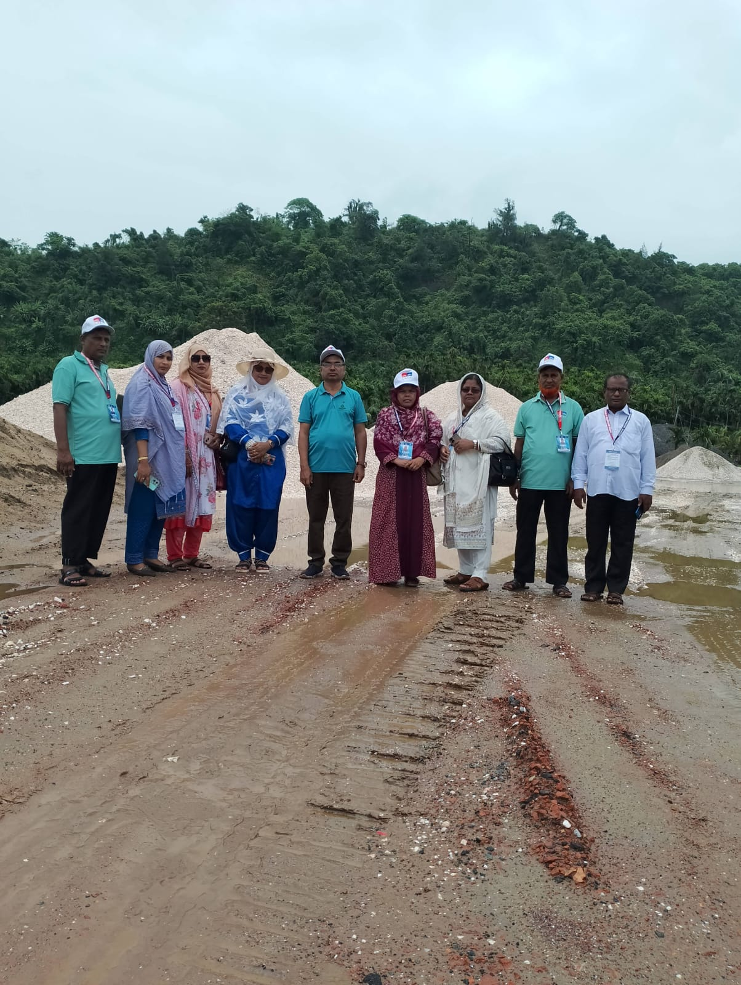
Goog Bye

