Slide 1


Slide 2
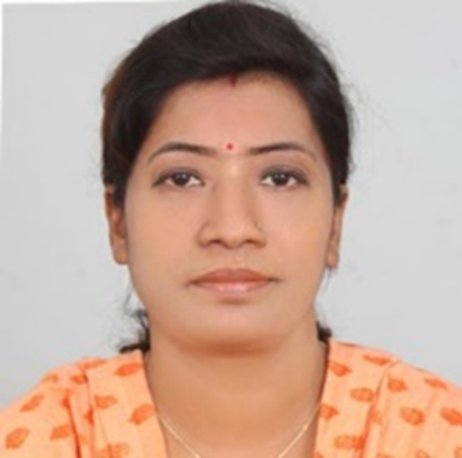
Teachers’ Identity
SUMI DAS
Assistant Teacher
Purba ziri Amania Lokman Hakim Model Govt. Primary School.
Patiya , Chattogram.

Slide 3
Lesson Introduction
Class :5
Unit :16
Title : The Giving Tree (1.1, 1.2)
Page : 82, 83

Slide 4
Learning Outcome
3.4.2- Answer simple questions appropriately and confidently.
4.2.1- Read aloud texts with proper stress and intonation.

Slide 5
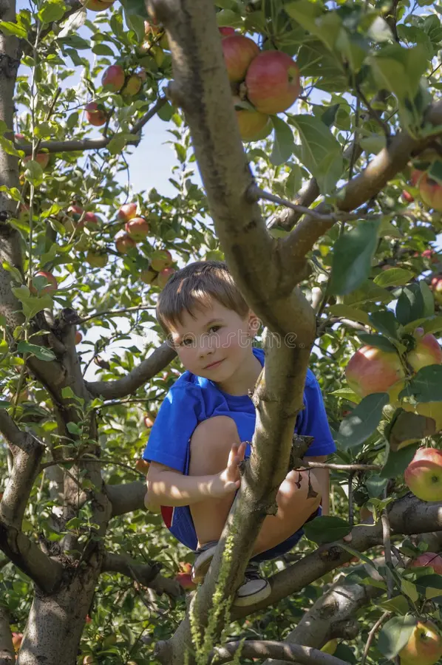
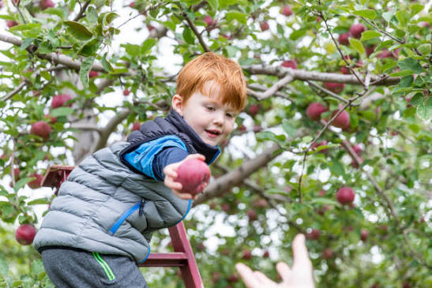
What is your favourite tree? Why do you like it?
How do trees help us?

Slide 6
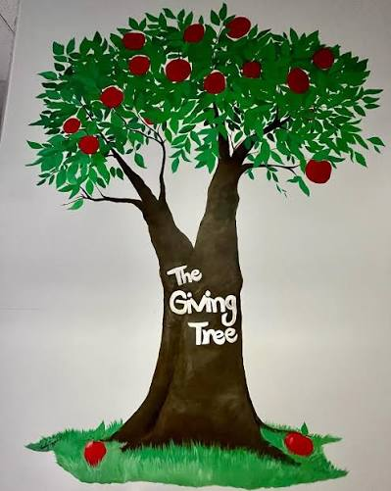

Slide 7
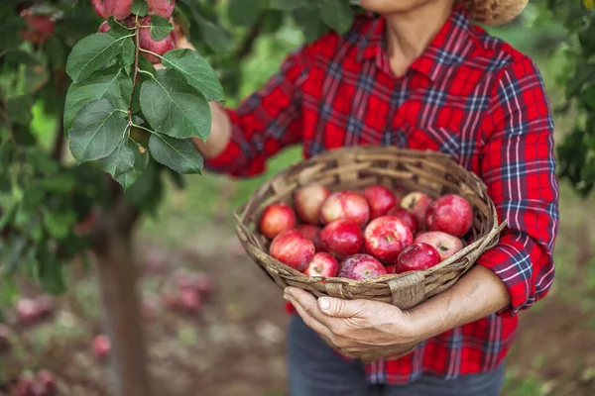

Gather- bring together
Crown - A circular ornamental headdress

Slide 8
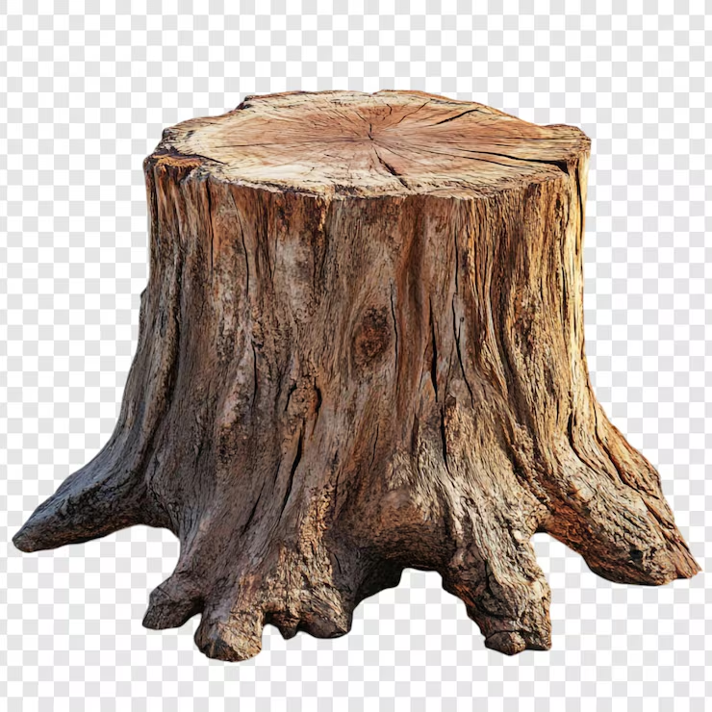
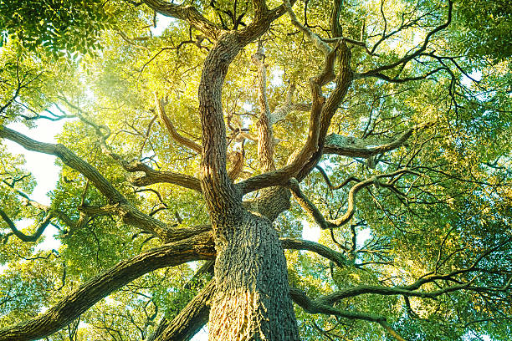
Trunk-the main woody stem of a tree.
Brance- a part of a tree which grows out from the trunk.

Slide 9
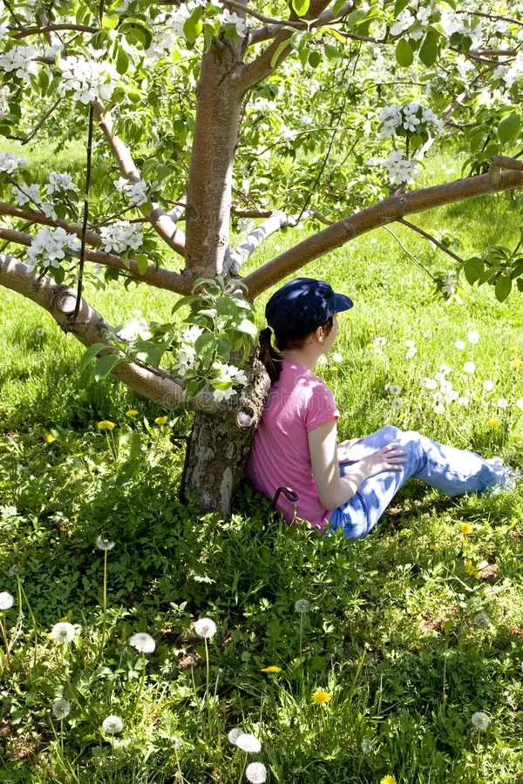
Shade – shelter from direct sunlight.

Slide 10
The Giving Tree
Once there was a tree and she loved a little boy. Every day the boy would gather leaves and make them into crowns. He would play king of the forest wearing the crown . He would climb up her trunk and swing from her branches. When he was tired, he would sleep In her shade . The boy loved the tree very much. And the tree was happy.
But time went by. The boy grew older. He stopped playing with the tree. And the tree was often alone.
Then one day the boy came to the tree. The tree said, ‘Come, Boy, come and climb up my trunk. Swing from my branches and eat apples. Play in my shade and be happy.’ ‘I am too big to climb and play,’ said the boy. ‘I want to buy things. I want some money. Can you give me some money ?’
“I m sorry,” said the tree. “ I have no money. I have only leaves and apples. Take my apples , Boy, and sell them in the city.” And so, the boy climbed up the tree and gathered her apples. And the tree was happy.

Slide 11
Simple Comprehension questions a)What did the boy do with the leaves?
b)Why did the boy stop playing with the tree?

Slide 12
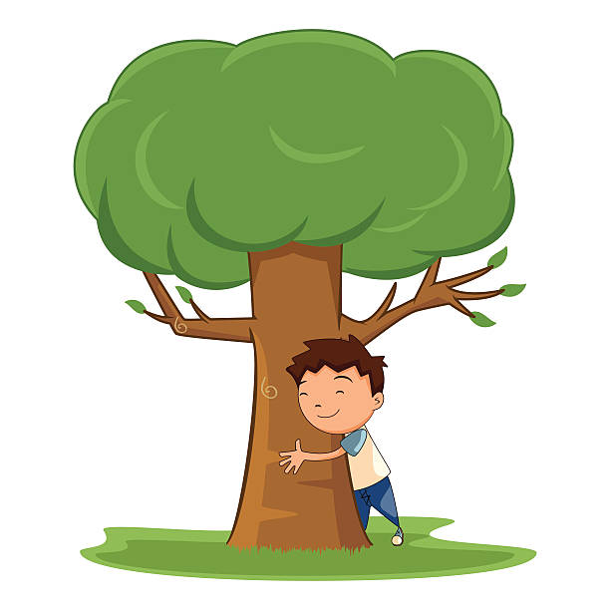

Slide 13
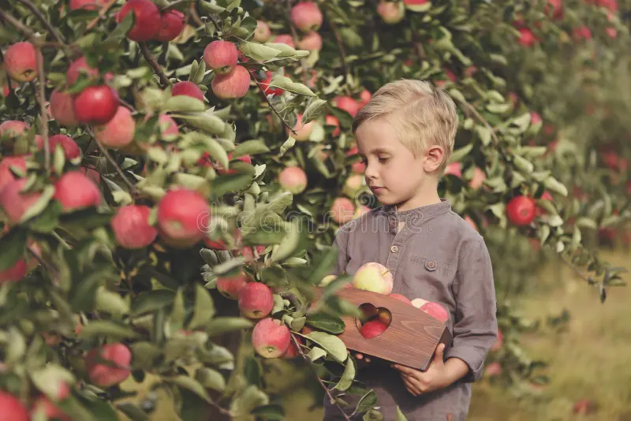

Slide 14


