Slide 1
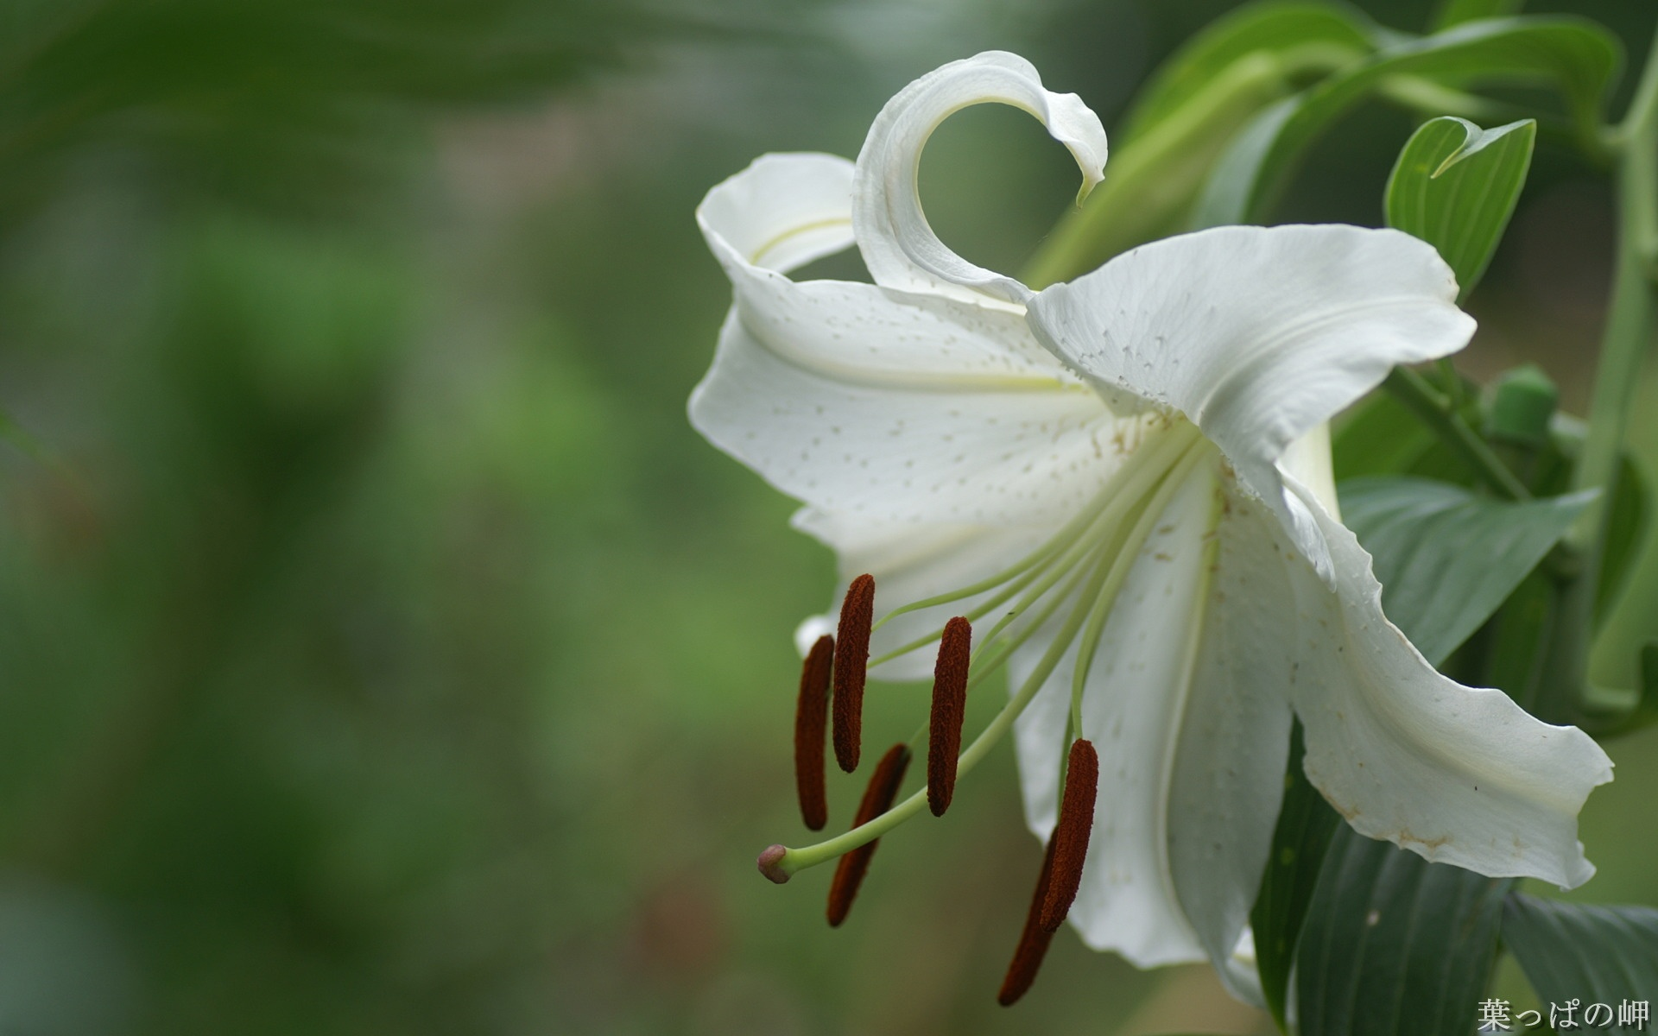
Welcome

Slide 2
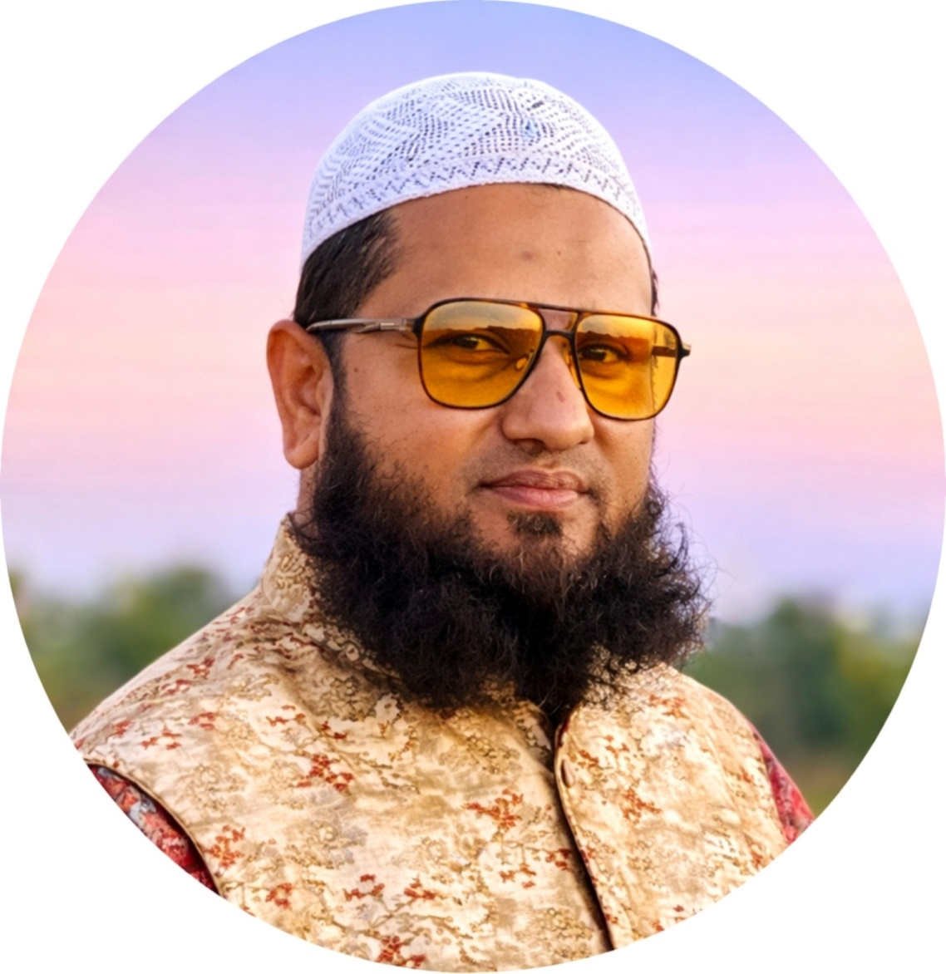
Right form of verb
Prepared by
Mohammad Sohel Rana
Lecturer in English
Abeda Khanam Girls’ High School & College
Karatia, Tangail.

Slide 3
Subject 3rd person singular হলে verb + s/es হয়।Subject prural হলে verb (base form) হয়।
Example: It ____ (entertain) us with politeness and discipline.
2. Verb এ র কাজ subject না করলে passive verb হয় ।সে ক্ষেত্রে to be+ verb(past participle)লাগে।
Example: cricket _____(call) the gentlemen’s game.
3. অনেক দীর্ঘ subject থাকলে এর শুরুর শব্দ বা Head word অনুসারে verb নির্নয় হয় ।
A sense of brotherhood and fraternity _____(create) among the playing nations through it.

Slide 4
4. বাক্যে last, last night, yesterday , ago , long since, since, previously, past অতীতের কোন ঘটনা থাকলে verb (past) হয়।
Example: The English ____ (play) cricket here in this subcontinent and since then it____(become) an internal part of our entertainment.
5. বাক্যে just, just now, already , yet , ever, lately, recently থাকলে have/has+verb (past participle ) হয়।
Example: They already ____ (show) their performance in serial matches

Slide 5
Practice test

Slide 6
Cricket is a popular game. Both the young and the old (a) —- (get) pleasure from this game. In fact, cricket (b)—- (call) the gentlemen’s game. It (c) —- (entertain) us with politeness and discipline. A sense of brotherhood and fraternity (d) —- (create) among the playing nations through it. At present cricket is the most popular game in Bangladesh. The English (e) — (play) it here in this subcontinent and since then it (f) —– (become) an internal part of our entertainment. Our team (g) —– (consist) of skilled players. They already (h) —- (show) their performance in serial matches. But it is a matter of sorrow that sometimes our players (i) — (play) so poorly that our countrymen (j) —- (become) astonish.

Slide 7
Recap

Slide 8
1.Subject 3rd person singular হলে verb + s/es হয়।Subject prural হলে verb (base form) হয়।
2. Verb এ র কাজ subject না করলে passive verb হয় ।সে ক্ষেত্রে to be+ verb(past participle)লাগে।
3. অনেক দীর্ঘ subject থাকলে এর শুরুর শব্দ বা Head word অনুসারে verb নির্নয় হয় ।
4. বাক্যে last, last night, yesterday , ago , long since, since, previously, past অতীতের কোন ঘটনা থাকলে verb (past) হয়।
5. বাক্যে just, just now, already , yet , ever, lately, recently থাকলে have/has+verb (past participle ) হয়।

Slide 9
A poor man was once (a) — (put) in jail, although he (b) — (do) no wrong. After a long time, the king of the state (c) – (visit) the jail and the man told him that he was innocent but a case (d) – (file) against him by some of his enemies. The king (e) — (inquire) privately and (f) – (find) that it was true. He (g)--- (give) the man some money and set him free. He went straight to the market. In a shop there, wild birds (h) — (keep) in cages for sale. He said to the shopkeeper, I wish to buy all the birds of your shop. These birds unjustly (i) —(imprison) and I like to (j) — (set) them free.

Slide 10
Rules of Right form of verbs
6. Simple sentence a দুটি verb থাকলে পরের টি verb+ing হয়।
I hate ………. (sleep) alone.
7. Verb দিয়ে বাক্য শুরু হলে verb+ing - হয়।
---- (teach) is a noble profession
8. সকল preposition পর verb+ing - হয়।
By ---- (get) the light of education,
9. বাক্য now, at present ,at this moment থাকলে am/is/are+verb(ing) হয় ।

Slide 11
Rules of right form of verbs
10. With a view to,look forward to, get used to, be used to ইত্যাদির পর verb+ing হয়।
A teacher teaches his students with a view to --- (give) the light of education.
11.present+ as if/ as though + past
Past+asif/as though+ past perfect
The students nowadays act as though they (h)--- (know) everything
12. Lest এর পর should+verb(base)/ verb-(past) হয়।

Slide 12
(a)--- (teach) is a noble profession. A teacher (b)---(teach) his students from the core of his heart. He teaches his students with a view to (C)--- (give) the light of education. By (d)--- (get) the light of education, students can (e)--- (enlighten) their inside. The students (f)--- (learn) their lessons now as their teachers (g)--- (instruct) them. But the students nowadays act as though they (h)--- (know) everything. They are not (i)--- (pay) heed to their teachers’ advice. But the students must be careful in their studies lest they (j)--- (fail) to secure good marks.

Slide 13


